Slide 1
ASSCA2022, Feb. 14, 2023
Progress of heavy-ion accelerator(RAON) including Linac commissioning
Yeonsei Chung on behalf of Rare Isotope Science Project

Slide 2
001. Project Overview & Status
002. Accelerator Systems
003. RI & Experimental Systems
004. Beam Instrumentation & commissioning
005. Summary and Outlook

Slide 3
Part 1.
Project Overview

Slide 4
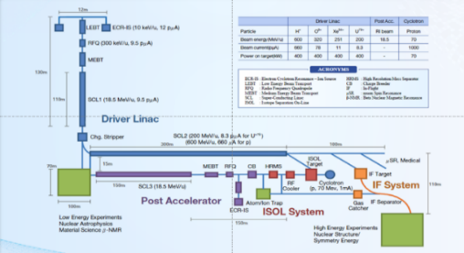
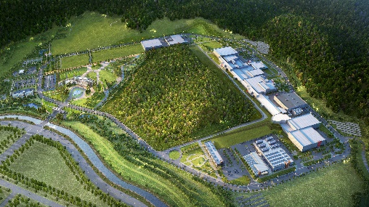
Rare Isotope Science Project (RISP)
Goal: To build a heavy ion accelerator complex RAON,
for rare isotope science research in Korea.
* RAON - Rare isotope Accelerator complex for ON-line experiments
Budget: KRW 1,518 billion (US$ 1.32 billion, 1$=1,146krw)
- accelerators and experimental apparatus : 522.8 billion won
- civil engineering & conventional facilities : 996 billion won (incl. site 357 billion won)
Period: 2011.12 ~ 2022.12(1st Phase)
2023.01 ~ (2nd Phase)
System Installation Project
Providing high intensity RI beams by ISOL and IF
ISOL: direct fission of ²³⁸U by 70 MeV proton
IF: 200 MeV/u ²³⁸U (intensity: 8.3 pμA)
Providing high quality neutron-rich beams
e.g., ¹³²Sn with up to 250 MeV/u,
up to 10⁹ particles per second
Providing More exotic RI beam
production by combination of ISOL and IF
Development, installation, and commissioning of the accelerator systems that provides high-energy (200MeV/u) and high-power (400kW) heavy-ion beam
Facility Construction Project
Construction of research and support facility to ensure the stable operation of the heavy-ion accelerator, experiment systems, and to establish a comfortable research environment
※ Accelerator and experiment buildings, support facility, administrative buildings, and guest house, etc.

Slide 5
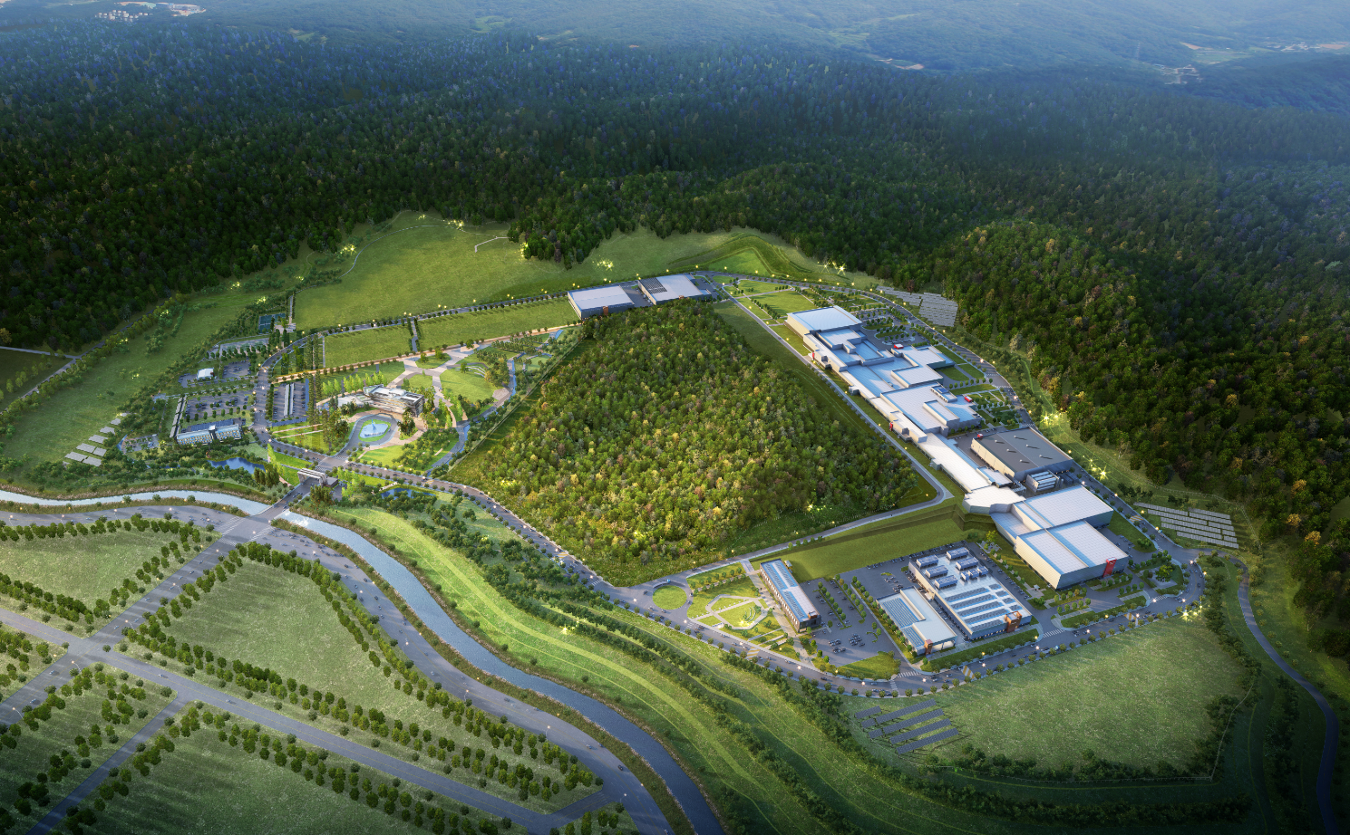
Campus Layout
Campus Area : 952,066㎡ (including the reservation area of 144,640㎡)
Period : 2014 ~ 2021(8 years)
Cost : 996 billion won (incl. 357 billion won for land)
Building Area : 76,259㎡(11 Bds)
Total Bd. Area : 116,252㎡
Constructor : POSCO Consortium(11 companies)
Assembly Bd.
SRF Test Bd.
High Energy B
IF Separator / High Energy A
Waste Strorage
Cryogenics Bd.
HQ Office
Reservation
ISOL
SCL
Info. Center
Guest House
Low Energy A,B
Control Center
Utility Bd.
Electricity Bd.

Slide 6
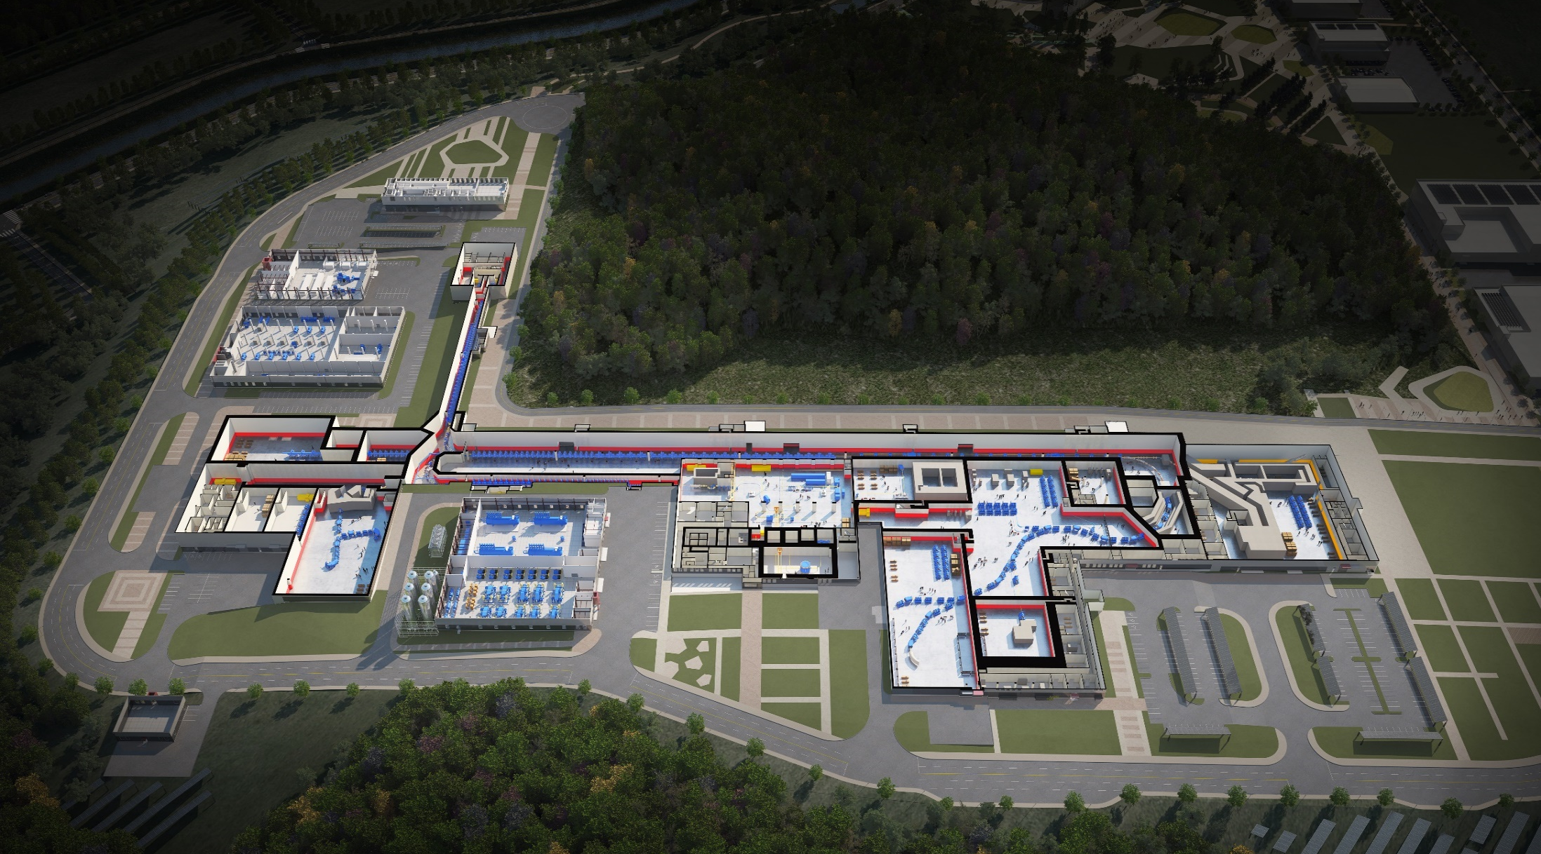

RAON Layout
Control
Center
Utility
SCL1
ISOL System
HPMMS/
CLS
IF System
SCL3
SCL2
BIS
ECR IS
μSR
NDPS
KOBRA
Cyclotron
HRS
LAMPS
● SCL1 has been decided to postpone
: SCL3 is going to be taking a role of SCL1 in the early operation

Slide 7
RIBs at RAON
IF
ISOL
KOBRA
ISOL+IF
RAON will provide access to unexplored regions of the nuclear chart

Slide 8

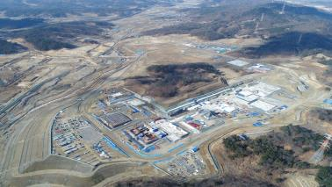
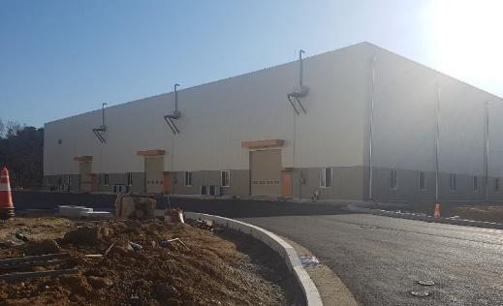
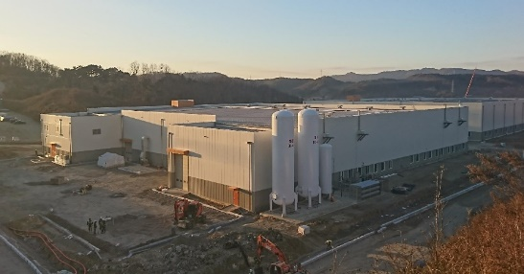
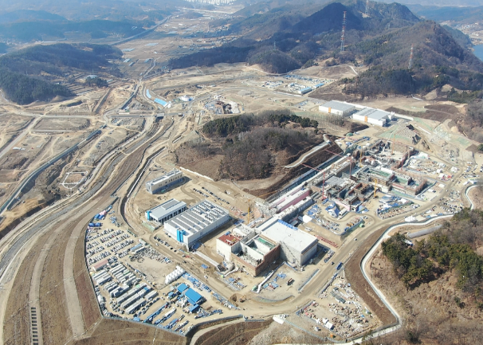
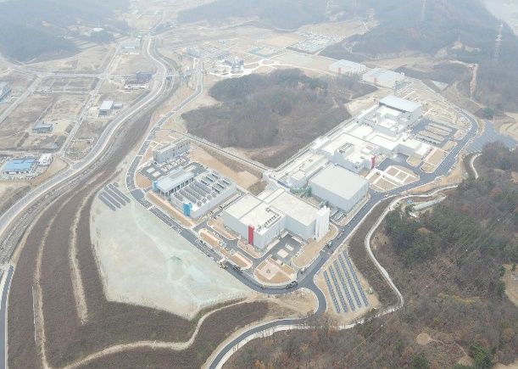
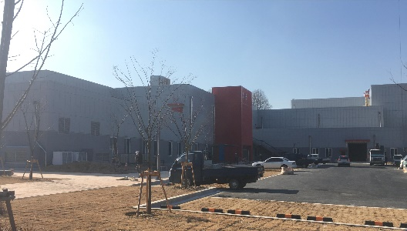
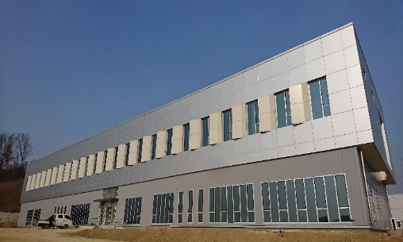
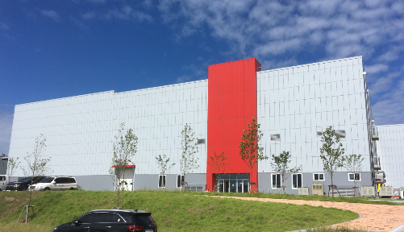
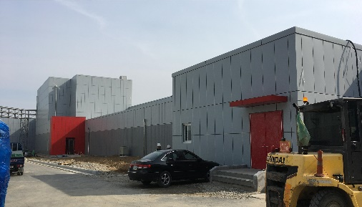
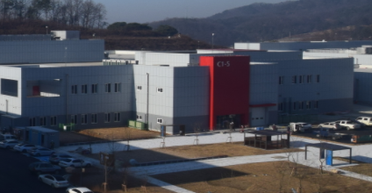
View of Construction Site
● View of Construction Place (`20.10)
<Assembly Bd.>
<`17.01>
<`18.01>
<SRF Test Bd.>
<`19.01>
<`20.10>
<High Energy Exps.>
<Control Center>
<Low Energy Exps.>
<SCL3>
<ISOL>

Slide 9
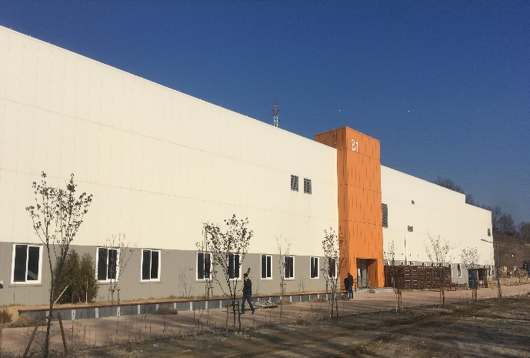
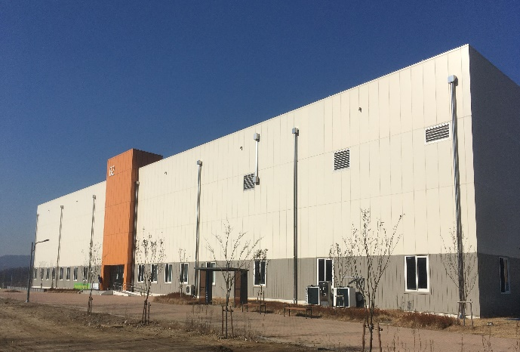

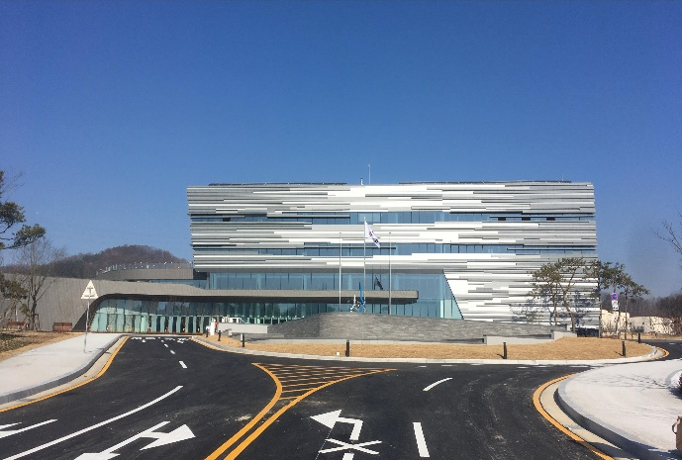
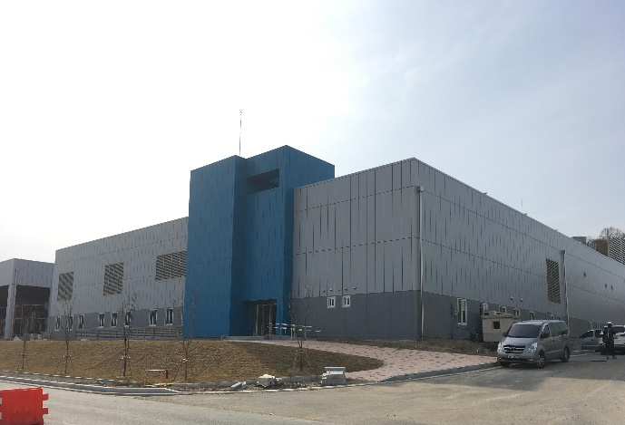
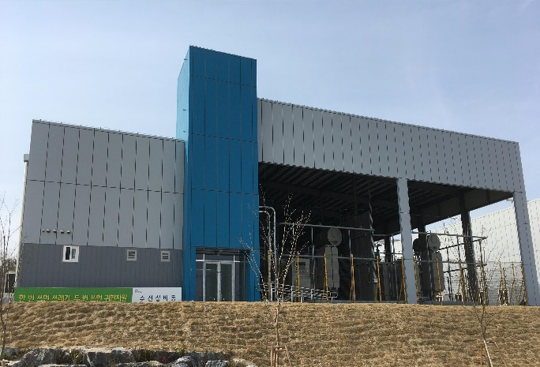
Conventional Facilities
SRF Test Bd.
Assembly Bd.
Control Center
HQ Office Bd.
Utility Bd.
Electricity Bd.

Slide 10
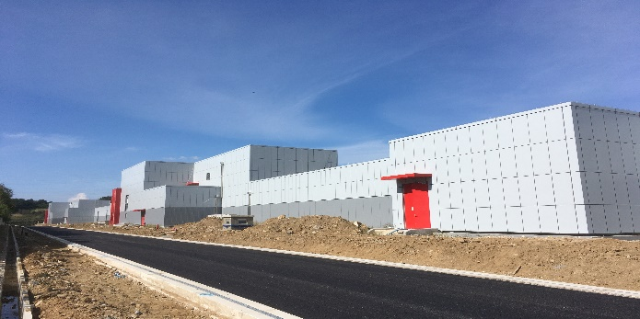
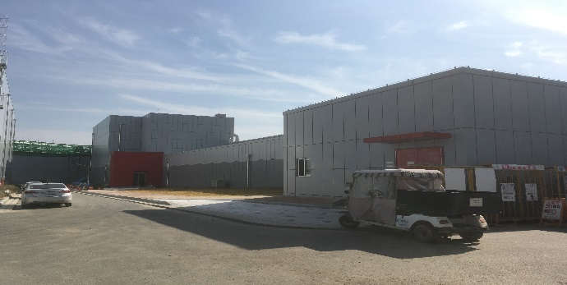
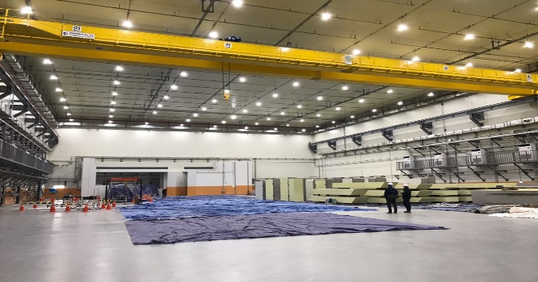
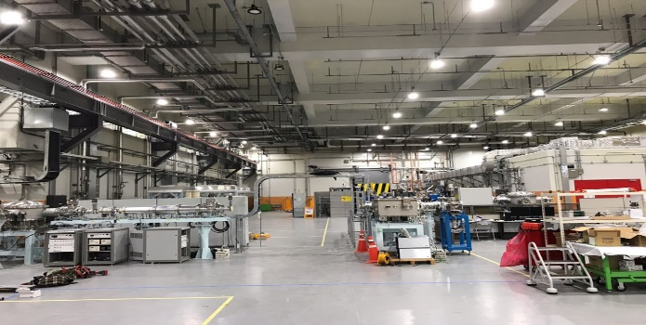
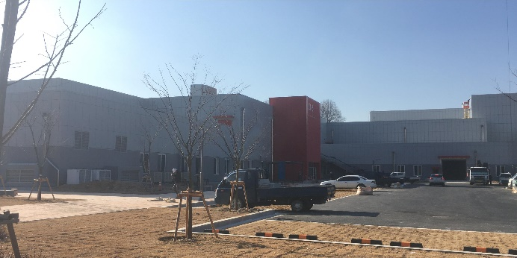
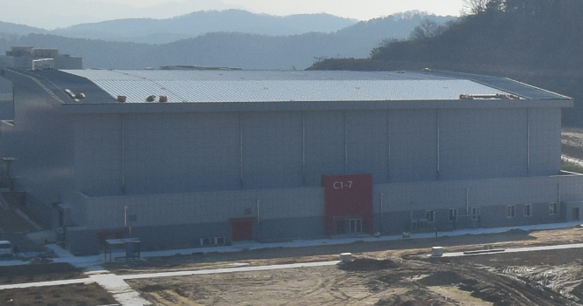
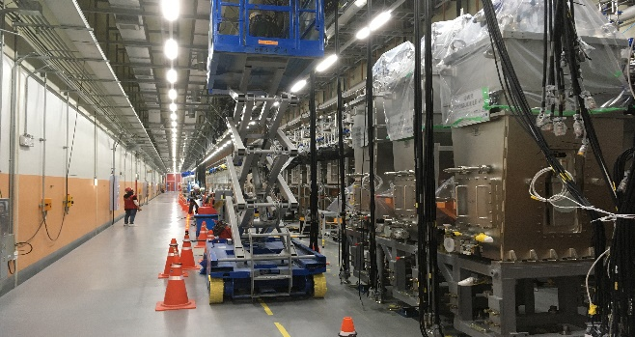
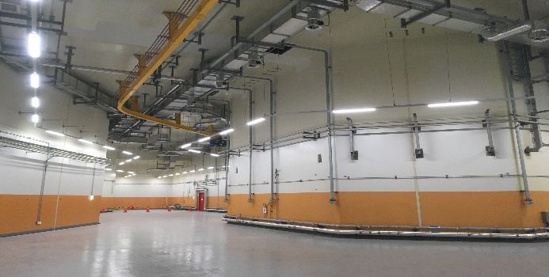
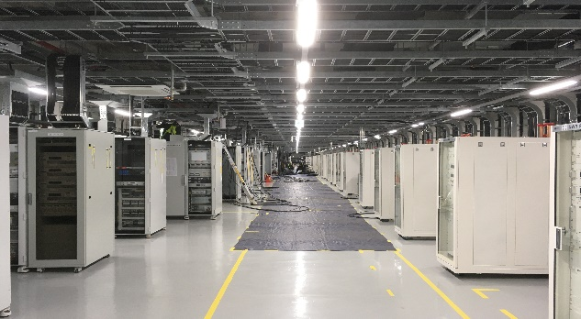
Accelerator Building, Experimental Halls
SCL2
SCL3
Low Energy A/B
ISOL
IF/ High Energy A
High Energy B
SCL3
Bending Section
SCL3-gallery
10

Slide 11
Part 2.
Accelerator Systems

Slide 12
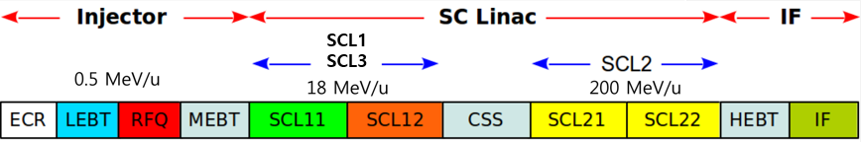
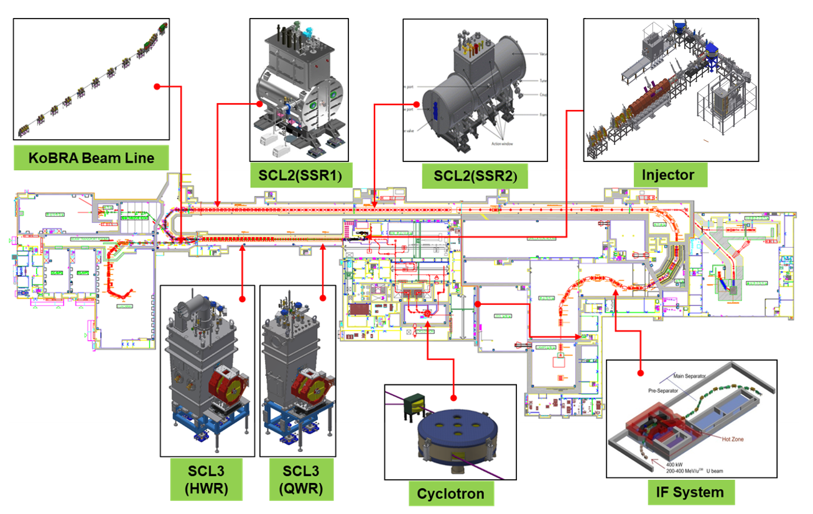
Accelerator Systems

Slide 13
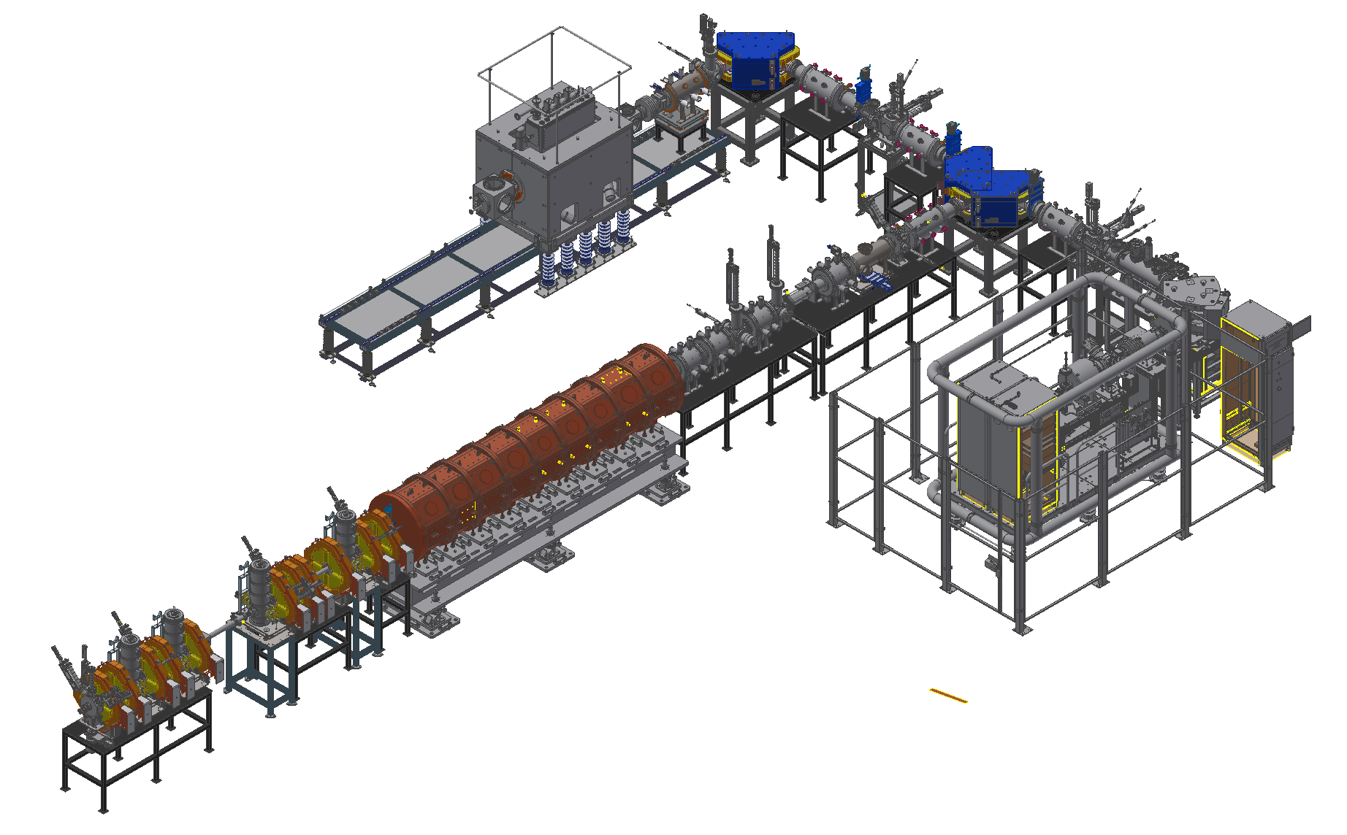
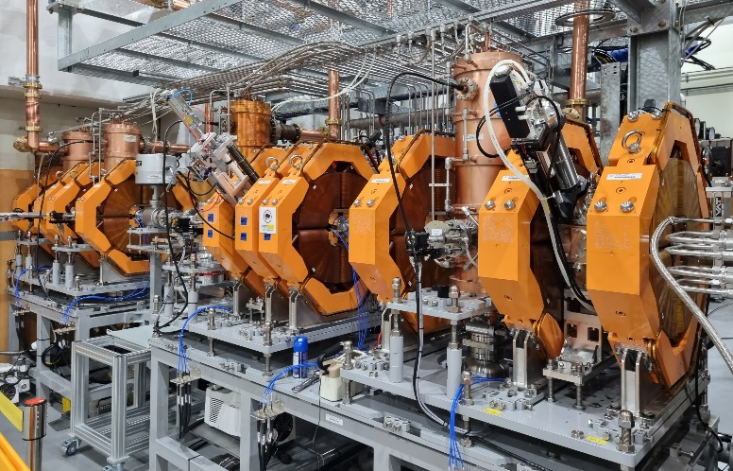
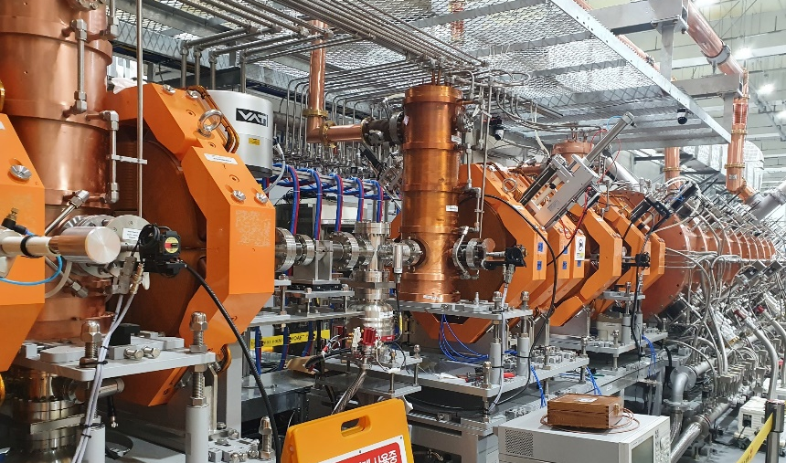
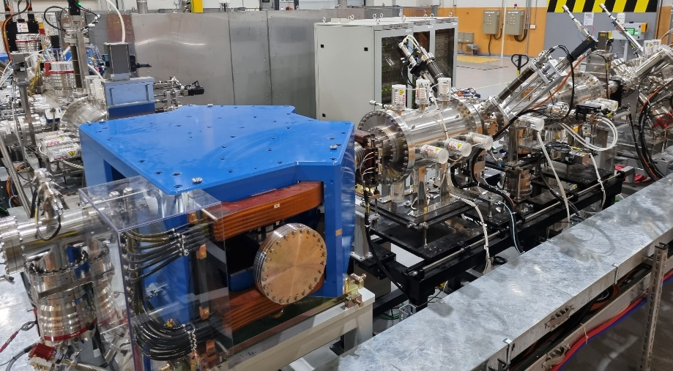
Injector System
Two ECR-IS on high voltage platforms
14.5 GHz ECR ion source
28 GHz superconducting ECR ion source
LEBT (E = 10 keV/u)
10 keV/u, Dual bending magnet
Chopper & Electrostatic quads, Instrumentation
RFQ (E = 500 keV/u)
81.25 MHz, Transmission Eff. ~98%
CW RF Power 94 kW (SSPA: 150 kW)
MEBT (E = 500 keV/u)
Four RF bunchers (SSPA: 20, 15, 2×4 kW)
Simple quadrupole magnets, Instrumentation
SC ECRIS
LEBT
ECRIS
MEBT
RFQ
Installation completed and beam commissioning from October, 2020

Slide 14

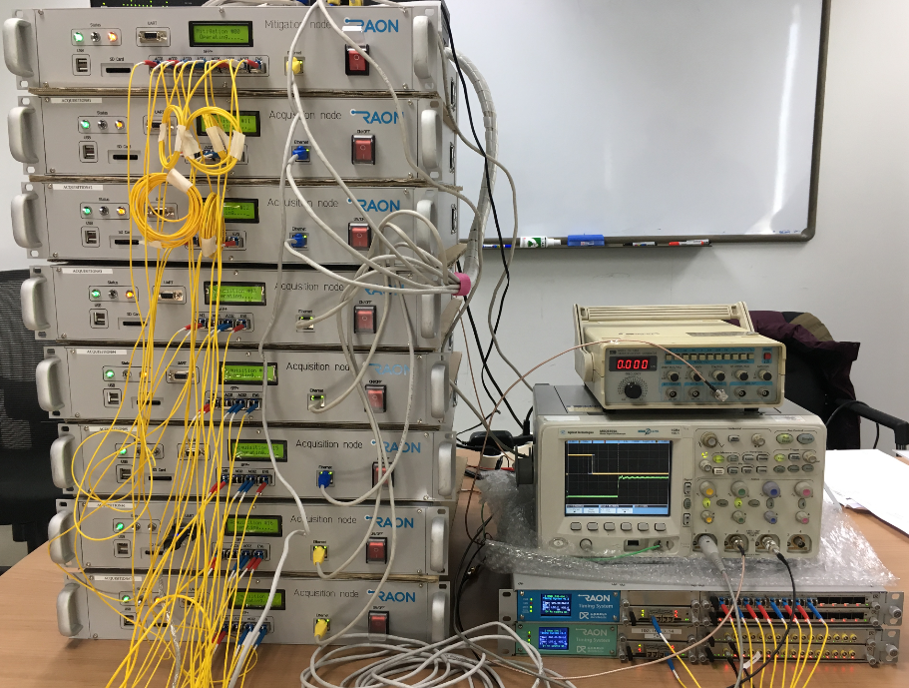

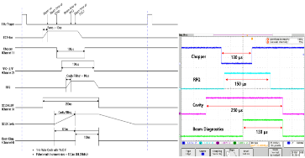
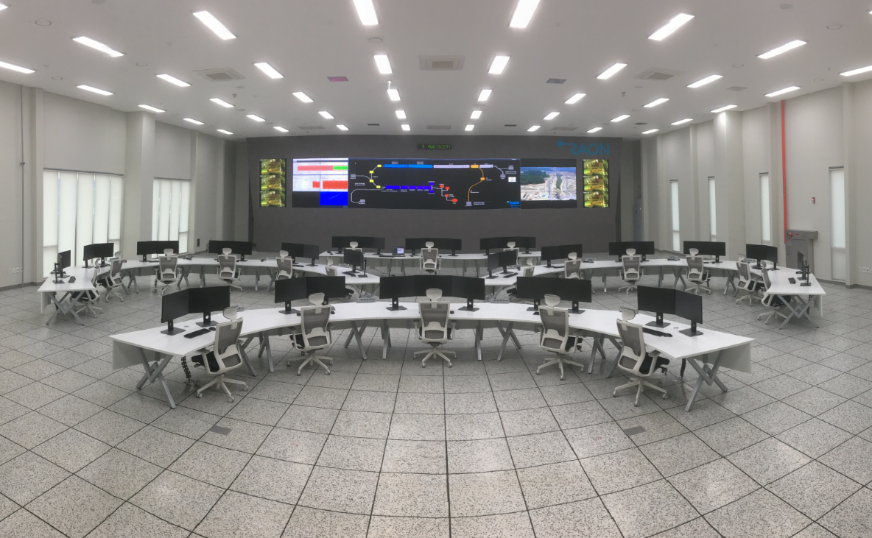
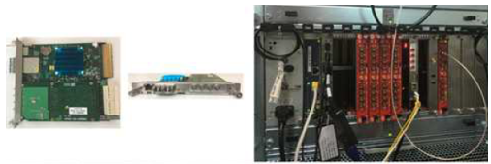
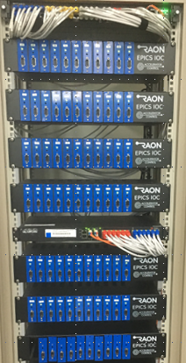
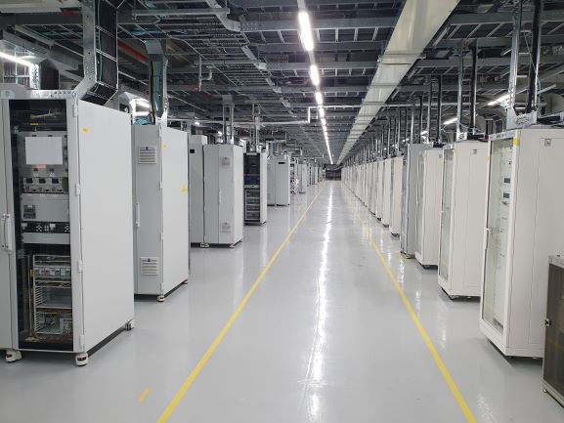
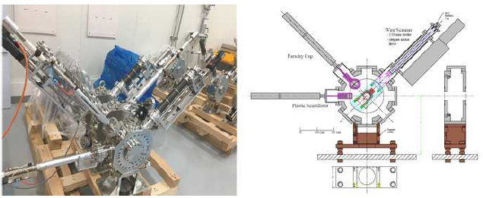
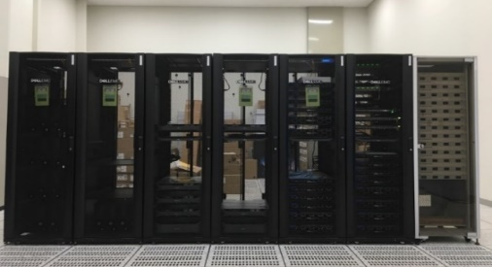
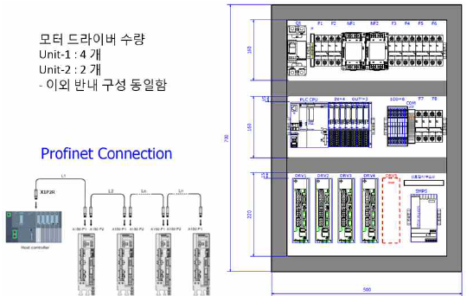
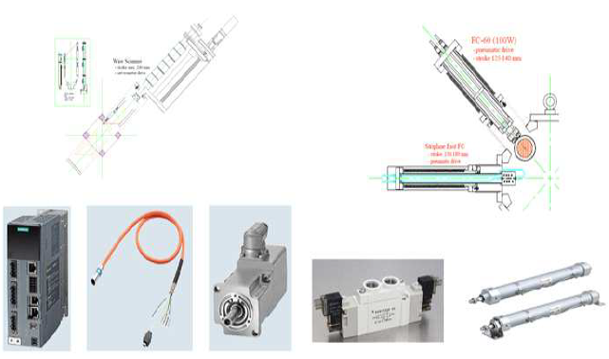
Control System
Control Center
Integrated Control System
Timing System
Fast Protection System
Local Control System
Main Control Room
Data Storage System
EPICS IOC
Controllers
SCL3 Control System(43)
Beam Diagnostics Control System

Slide 15
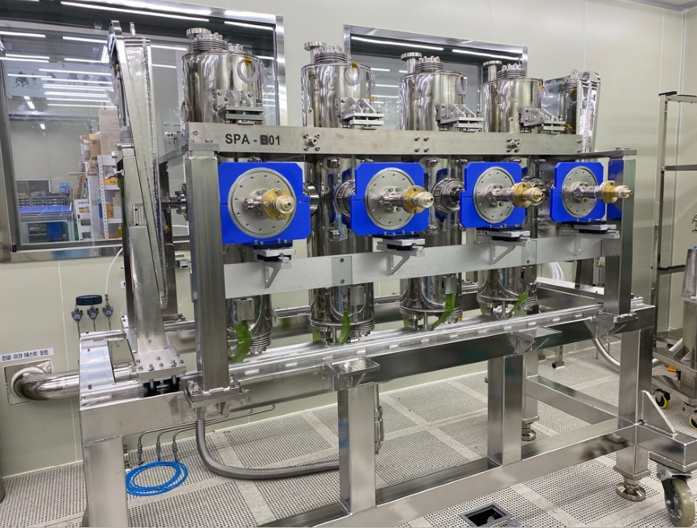
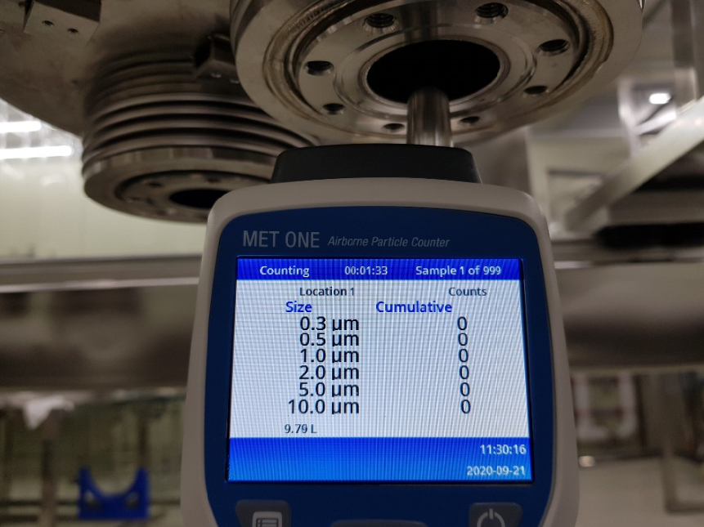
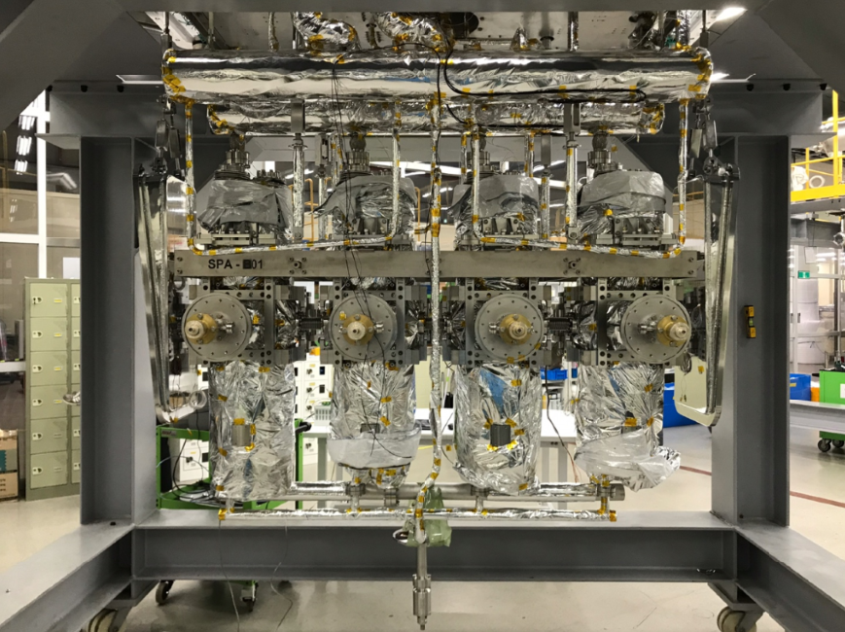
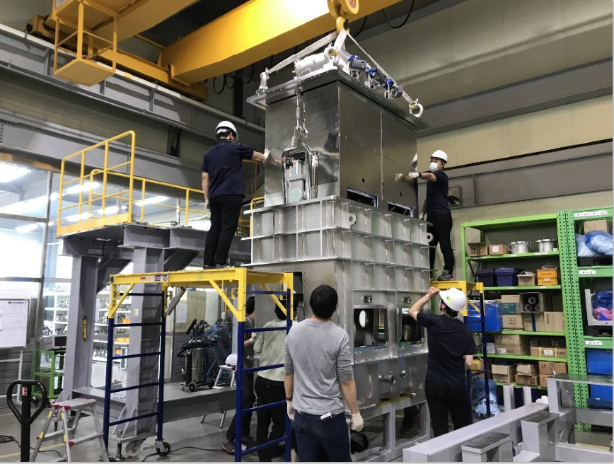
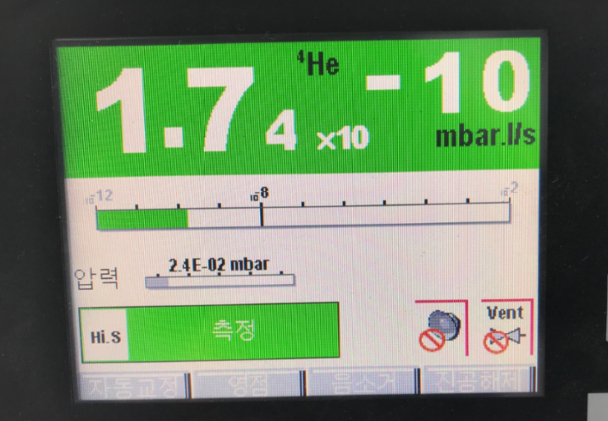
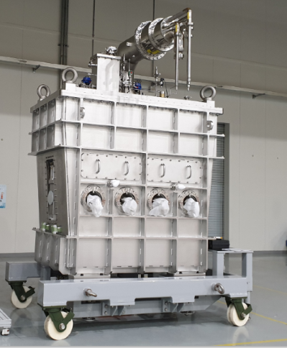
HWR Cryomodule Assembly
Particle count inside cavity “0”
Cavity String
With cryogenic piping
Vacuum leak rate
Top loading to cryostat
HWR B type

Slide 16




Clean Assembly @ Accelerator Tunnel
(Cryomodule + Warm section) + (Cryomodule + Warm section)
Cryomodule & Warm section is clean assembled in the clean booth@tunnel
Total Particle counts(size=0.5um above/10 mins) were less than 30 counts

Slide 17



Superconducting Linac, SCL3 Tunnel and Gallery
QWR & HWR Cryomodule
Cryogenic Distribution to Cryomodule
Clean beam line assembly
CM/Cryogenic Control Rack and SSPA
Installation completion and ready for beam commissioning in 2021

Slide 18







Accelerator Systems – SCL2
SCL21(SSR1)
∙ 1st prototype was performed by TRIUMF(2019.6)
Balloon type(less multipacting, better mechanical characteristics)
Accelerating gradient over 8.7MV/m, Multipacting below 2MV/m
∙ 2nd prototype with domestic vendor
RF System
∙ SSPA (8, 20 kW): 2020.01~2022.12
Requirement for RF power rating
∙ HPRF transmission line
3-1/8”, 4-1/16” rigid coaxial
∙ LLRF control system (2020.04~2023.12)
∙ RF reference line (81.25MHz) : 2022.12
1st prototype by TRIUMF
2nd prototype by domestic vendor
SCL22(SSR2)
∙ 1st prototype of cavity
Designed by RISP, fabricated by domestic vendor
Balloon type, Deep drawing (depth ~280mm)
∙ 2nd prototype with IHEP
Cylindrical type
RISP design(balloon type)
SSR1
SSPA Prototype

Slide 19


SRF Test facility
On-site SRF
test facility
3 pits for VT; up to 3 cavities per pit
3 HT bunkers
To cover all RAON cavities - QWR (82.125 MHz), HWR (162.5 MHz) and SSR1 & 2 (325 MHz)

Slide 20

QWR Cavity VT test results
Frequency (MHz) | Optimum 𝛽 | Eacc (MV/m) | Vacc (MV) | Q0 | # of cavity | # of module | Op. temp (K)
81.25 | 0.047 | 6.1 | 1.06 | 1.3e+8 | 22 | 22 | 4.5
Target

Slide 21

HWR Cavity VT test results
Frequency (MHz) | Optimum 𝛽 | Eacc (MV/m) | Vacc (MV) | Q0 | # of cavity | # of module | Op. temp (K)
162.5 | 0.12 | 6.6 | 1.46 | 1.5e+9 | 106 | A/B = 14/19 | 2.05
# of fabrication (@10/12/2020) |  |  |  |  | 53 | A : 8, B : 1
Target
1.5e+9 @6.6 MV/m
The cavities below the target include bare cavities as R&D phase and all were re-processed after 1st VT

Slide 22







LLRF System
81.15 MHz (SEL)
81.25 MHz (SEL)
162.4 MHz (SEL)
162.5 MHz (SEL)
E_{acc}=6.11 MV/m (±0.49%),
Phase=50º (±0.14º)
LLRF Latency Test
QWR Cavity Control Test@SRF
CSS OPI
Test and confirmation with SEL(Self-Excited Loop) mode(±100 kHz) & GDL(Generator Driven Resonator) mode; GDR mode@nominal operation
Realized, LLRF and control system via EPICS

Slide 23

RF Control Test of HWR#26
RF Control Test(Amplitude/Phase feedback with Tuner control)
RF Amplitude, Phase Control
Target RF amplitude, 6.6 MV/m(±0.13%) < 1%, Phase=100º (±0.63º) < 1 deg
Tuner operation threshold : +/- 5deg
Control bandwidth: 90~160 Hz

Slide 24

Cryo-plant

Slide 25








Cryogenic Distribution Systems
Layout of cryogenic distribution system @ SCL3 and SCL2
SSR1(23)
SSR2(23) + Extension (2)
SCL2
SCL2
SCL3
SCL3
HWRB(19)
HWRA
(13 +2)
QWR(11)
LTS(13)

Slide 26




The First Cool-Down Curve of SCL3
Cooling down cryogenic distribution system, thermal shields of all CM with SCL3 cryo-plant, simultaneously.
End
Oct. 26th
QWR CM1, 2
HWR B CM19
4.5 K reached
Cavities : QWR Cool-down
Cavities : HWR Cool-down
From Sep. 7th
Cavities : Cool-down

Slide 27
Part 3.
RI & Experimental Systems

Slide 28











RI & Experimental System
Bio-medical facility
Neutron Facility
HPMMS
CLS
mSR
Low Energy Exp. Bldg
Ultra-low Exp. Bldg
High Energy Exp. Bldg
ISOL
KOBRA
IF
LAMPS

Slide 29



ISOL System
ISOL Target Room
ISOL Beam Line
EBIS Charge Breeder
MMS/MR-TOF
TIS, EBIS, RFQ-CB, beam line were tested with SI(Cs) beam, completed in 2021

Slide 30



ISOL System
• Driver beam : proton 35<K<70 MeV, up to 70 kW
• Target : UCx, MgO, BN, CaO, BeO, SiC, etc
• Ion Source : Surface, RILIS, Plasma
• RIB : 6< A < 250, 10<K< 80 keV, 10^8 pps(Sn), >90% purity @Exp. • incident to RFQ of Post accelerator 10 keV/u
• full remote maintenance system with TIS modularization
- ISOL beam lines including sub-systems
are commissioned with Cs beam in 2021
- RI beam commissioning using SiC target (Q1 2023)

Slide 31

ISOL Beam Test in 2021
Magnetic current (A)

Slide 32






KoBRA Spectrometer commissioning in 2021
F1 PPAC
2021.10.15
Alpha source (²⁴¹Am)
2021.10.19
2021.10.18

Slide 33







Other Experimental Systems
(IF Separator)
(Cyclotron)
(NDPS)
(muSR)
(MMS)
(LAMPS)
(BIS)
All exp. systems are installed and machine-commissioned by 2022

Slide 34
Part 4.
Beam Instrumentation & Commissioning

Slide 35
Beam Diagnostics Functions
Initial commissioning & Component tuning
FC, WS, BV, ACCT, BPMs(position, phase, TOF)
Beam specification : Ar(9+), ~30eμA, 100μs, 1Hz
During operation(On-line)
Monitor beam transport and acceleration function
BPM : Beam position and phase
BCM : Beam current and transmission(RFQ, SCL3, P2DT, SCL2)
BLM : Beam Loss and link to Machine Protection
Beam current is 1mA ~ 1μA
Commissioning and during operation(On-demand)
1-D, 2-D profile distribution (WS, EM)
Bunch length (Stripline FFC)
Beam Attenuator @LEBT

Slide 36





4.
Injector Instrumentation
LEBT
Wire scanner - 5 sets (4 installed)
Beam Viewer – 3 sets (2 installed)
Bergoz ACCT – 1 set
Faraday Cup – 5 sets (4 installed)
beam Attenuator – 2 sets (1/100)
2-D Allison Scanner – 2sets (1 installed)
MEBT (Installed)
Wire scanner - 4 sets
Beam Viewer – 1 set
Bergoz ACCT – 2 sets
Faraday Cup – 2 sets
Stripline FFC – 1 set
BPM – 6 sets

Slide 37

Layout of RAON Beam Diagnostics

Slide 38

Beam Position Monitor(BPM)
Measurements : Beam Position, Phase, relative Intensity
SCL3(Installed) : Button-type BPM, Curved type 20mmx30mm
P2DT(Installed) : Large button-type BPM(Bending section), Button-type BPM
SCL2(Fabricated) : Stripline BPM, Curved type 25mmx150mm

Slide 39



Beam Diagnostics at SCL3-Warm Section
Cryomodule
Beam
Diagnostic
Chamber
BPM
Quadrupole
Magnet
BPM and BDC inside of Magnetic Quadrupole Doublet
Installation (& alignment) procedure of BDC/BPM/Beam Pipe assembly (particle-free with pure N₂ purging) in between two cryomodules is well defined & followed
Ring Type(ID=36 mm, Nb) BLC inside BDC
- Directly collect halo/stray beam
BPM

Slide 40

Beam Loss Monitor(BLM)
ACCT
ACCT
ACCT
ACCT
Superconducting Linac : 1 BLM(BLC, PD)/Warm section
Bending Section(P2DT) : Plastic Scintillator, Ion Chamber
DBCM(ACCT networks) for Primary MPS
PC or IC
ACCT
ACCT
ACCT
ACCT
ACCT
ACCT
 | PC(IC) | PD | BLC | DBCM(ACCT)
QWR | - | - | ongoing | ongoing
HWR1 | - |  | ongoing | ongoing
HWR2 | - |  | ongoing | ongoing
P2DT | X | X | X | X
SSR1 |  | X | X | X
SSR2 |  | X | X | X

Slide 41



Diagnostics DAQ System
AMC-pico8
Control board
cRIO for ACCT
BPM
153 modules fabricated; SCL3(60), P2DT(28), SCL2(65)
supports timing, trigger, interlock, postmortem, EPICS of RAON
Current (WS, FC, BLM, BLC) - μTCA system
CAENels AMC-pico: 42 boards, 8 ch/20 bit/pA range
Modified firmware for RAON trigger, interlock and EPICS
ACCT – Standalone 1u chassis
100 MS/sec, 14-bit 4 ADC channels
Upgrade from cRIO System(1MS/sec)
supports timing, trigger, interlock, postmortem, EPICS of RAON
BPM electronics
Electronics for SCL3 are fully tested/calibrated

Slide 42






Beam Physics
Start-to-end simulation: uranium (²³⁸U^{33+,34+→77+,78+,79+,80+,81+})
Physics application tools
SCL3
SCL2
SCL2 extension
Transverse beam size
Longitudinal beam size
On-line orbit correction
BIPAM (Beam Input Parameter And Matching)
CAPS (Cavity Amplitude and Phase Scan)

Slide 43



Beam commissioning (LEBT)
Beam parameter measurements (Allison scanners, wirescanners)
measuring initial beam parameters (fitting beam sizes of wirescanners)
controlling optics when needed
do matching to RFQ
Emittance measurement (Allison scanner, quad scan)
Beams: Ar9+ (~30μA), Ar8+ (~47μA)
Beam emittance
(Allison scanner)
LEBT beam parameters
Beam emittance
(quad scan)
emittance comparison
 | X | Y
Allison | 0.048 | 0.067
Quad Scan | 0.041 | 0.038

Slide 44


Beam commissioning (LEBT)
- modelling of initial beam using wire scanner and Allison data
* Comparing WS data with TRACK simulation
* First wire scanner is located before Allison scanner
TRACK (blue)
Measured(red)
[ Ar8+ ]
[ Ar9+ ]

Slide 45



LEBT Orbit Correction
- orbit correction
- beam tracking (TRACK, DYNAC codes)
LEBT orbit correction
TRACK (beam dynamics code)

Slide 46



RFQ Beam Transmission
RFQ RF set-point (Ar9+, Ar8+):
beam transmission measured using MEBT ACCT2
Fitting against model
* Measured transmission = 94 % (simulation = 98%)
Cavity RF power: 51.5 kW (Design ~39.1 kW (20% margin))
RFQ RF set-point
(error bar: 3σ)
measurement
model
MEBT
RFQ

Slide 47


Medium Energy Beam Transport (MEBT)
MEBT beam parameter measurements
using beam sizes from wirescanners
measure initial beam emittances & parameters
can do matching to SCL3
ε_{x}=0.052
ε_{y}=0.059
MEBT buncher RF set-point
using phase scan technique
determines RF amplitude & phase
RF set-points of 4 bunchers obtained
Beam Energy is 507 keV/u
(TOF, 1st and 2nd BPMs in MEBT)

Slide 48




Injector Transmission
- 10% beam duty operation: 96 minutes, 10Hz, 10msec (2021.12.07.)
* Injector transmission > 94%
- MEBT beam emittance measurement based on quad scan
TRACK (blue)
Measured(red)
MEBT quad scan
emittance measurement
ε_{x} = 0.064 mm-mrad
ε_{y} = 0.049 mm-mrad
Injector beam transmission

Slide 49







Bunch Length Measurement, Fast-FC
Fabrication of Stripline type Fast Faraday Cup
PEEK
Ta plate
Oscilloscope (4 GHz, 25 GSPS)
Frequency component < 3 GHz
With 0.13 ns bunch length
Semi-rigid SMA cable in vacuum
PEEK insulator
Ta plate in front of FFC
Bolting at irregular position
Ar 8+, 50 uA, at the end of MEBT (4 bunchers)
$100 μs$ macro pulse commissioning beam
Expected peak amplitude was ~ 4 mV
RF amplifier and oscilloscope prepared, considering frequency component
Amplifier ( 43 dB Gain )
Bandwidth 300 kHz ~ 14 GHz

Slide 50








Bunch Length Measurement
Measured bunch Length at MEBT
Phase scan of Buncher 4
bunching
debunching
Measured single bunch length was $0.297 ns \left(1σ\right)$ with Gaussian fit.
Shows good signal repeatability for measuring bunch trains.
Overlapped signal of 325 bunches in 4 us is shown.
Bunching and debunching was observed by rebuncher in MEBT.

Slide 51
Linac(SCL3) Commissioning
Measurements to perform
QWR/HWR RF set-point (phase scan, BPM)
Beam energy (phase scan, TOF with BPMs)
Beam current, transmission (ACCT, FC)
Orbit correction (BPM & dipole steerer)
Beam transverse profile (wirescanner)
Transverse matching (wirescanner)
Beam emittance (X and Y) : beam size fitting, quad scan
Physics applications for commissioning
BIPAM (Beam Input Parameters And Matching)
CAPS (Cavity Amplitude and Phase Scan)
Orbit correction application
Emittance data analysis & wirescanner data analysis

Slide 52



The 1st SCL3 Beam Commissioning (Oct. 7, 2022)
Beam Energy 0.701 MeV/u
  Ar⁹⁺ beams accelerated by QWR #1~#5 on the 7th of Oct, 2022

Slide 53



CAPS (Cavity Amplitude and Phase Scan)
Phase scan with BPMs (Time of Flight measurement)

Slide 54



The 2nd SCL3 Beam Commissioning (Dec. 16, 2022)
Beam Energy 2.472 MeV/u
  Ar⁹⁺ beams accelerated by QWR #1~#22 on the 16th of Dec, 2022
Final Results :
2.457 MeV/u (Measured)
2.444 MeV/u (TRACK)
QWR#3, #20 excluded

Slide 55

SCL3 Beam Commissioning Plan
Finished 2 K cool-down of SCL3 on Jan. 11, 2023.
Commissioning of SCL3 to be finished until March 2023
From March 2023, beams on KoBRA spectrometer

Slide 56
Part 5.
Summary & Outlook

Slide 57
Summary & Outlook
Injector beam commissioning was carried out, achieving machine setting and key measurements :
measured beam parameters (energy, emittance, Twiss parameters, beam sizes etc)
capable of controlling LEBT and MEBT beam optics freely as needed
achieved beam transmission of 95% max (routinely > 90%)
machine verification including diagnostics devices
RAON is preparing for Linac(SCL3) beam commissioning
1st/2nd beam commissioning using 22 QWR CMs in SCL3 were successfully done.
ECR → SCL3 → KoBRA using Ar-40(9+) in Q1/Q2 of 2023
Cyclotron → ISOL for RI beam extraction is expected in Q1 of 2023
Plan for SIB/RIB experiments
RIBs from ISOL to be injected into SCL3 in Q4 of 2023
SIB experiments(ECR→SCL3 → KoBRA/NDPS) will be carried out in Q4 of 2023
RIB experiments in ISOL beamline using Al isotope beams

Slide 58

감사합니다.
Thank you

