Slide 1
A SRF Cavity for Light Sources
Younguk Sohn
Pohang Accelerator Laboratory, POSTECH
The 4th Asian School on Superconductivity and Cryogenics for Accelerators (ASSCA2022),
13-19 February 2023, Korea University, Sejong, Korea

Slide 2
Topics
Radio-Frequency Cavity for Light Sources
Characteristics of Synchrotron Accelerators
Coupled-bunch Instabilities
4th Generation Synchrotron Radiation using SRF Cavities
Introduction of Multi-Purpose, Korean 4GSR

Slide 3
A RF Cavity

Slide 4
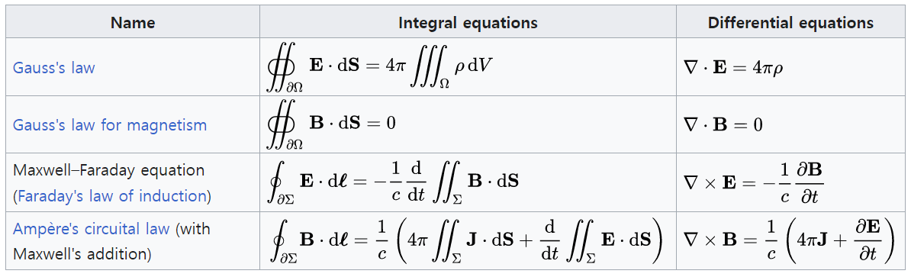
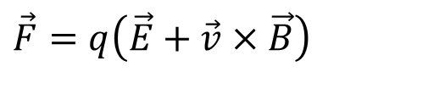

Basic Equations of Accelerators
Newton’s Law’s of Motion
$$\vec{F}=m\vec{a}$$
Lorentz Force – Force on a charged particle traveling with velocity, v, in the presence of an electric, E, or magnetic, B, field
$$\vec{F}=q\left(\vec{E}+\vec{v}×\vec{B}\right)$$
Maxwell’s Equations: RF cavities - To determine the particle motion one needs to know the electric and magnetic fields

Slide 5
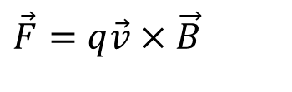
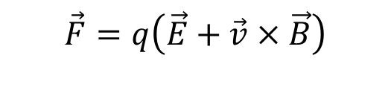


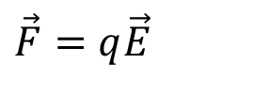
Lortentz Force
$$\vec{F}=q\left(\vec{E}+\vec{v}×\vec{B}\right)$$
Transverse beam dynamics by magnets
Longitudinal beam dynamics by RF cavities
$$\vec{E}=0$$
$$\vec{B}=0$$
$$\vec{F}=q\vec{v}×\vec{B}$$
$$\vec{F}=q\vec{E}$$

Slide 6
Optics for Accelerators
The optics are the distribution of elements (typically magnetic) that guide and focus the beam - sometimes referred to as the lattice
Focusing Elements
Bend Element
y (B-field)
s (particle motion, v)
X (Force)

Slide 7
A RF Cavity - Interaction between RF fields and beam
Power by electromagnetism
“0” by vector operation
$$F{⋅}v{ } = −qE{⋅}v{−}q(v{×}B{)}⋅v{ }= −qE{⋅}v{}$$
A RF cavity should provide electromagnetic power, as much as E to increase beam energy, only by electric field, (i.e, RF cavity, not by magnets) can provide accelerator energy !!
Energy ramping by increase magnetic field in a synchrotron accelerator consumes RF power through RF cavities !!

Slide 8
A RF Cavity - Functions
To transfer RF power (~energy) to the charged particles(bunches)
In LINACs, to ramp up particles energy, resulted to speed up of bunches in longitudinal direction
In synchrotron accelerators, to compensate loss power of particles to produce radiation in circular orbit and narrow band heating in vacuum chambers/beam tubes
to maintain bunches motion steadily even with producing synchrotron radiation
to confirm orbit stability through synchronous motion
to support beam lifetime

Slide 9
A RF Cavity - Functions
Required voltage in cavity in synchrotron accelerators
P_{b} : beam power
I_{b} : beam DC current
α_{c} : momentum compaction factor
h : harmonic number
σ_{E} : energy spread
e: electric charge of electron
E₀ : beam energy
ω_{RF} : angular frequency of RF cavity
σ_{l} : bunch length
V_{b} : beam voltage
V_{c} : cavity voltage
φ_{s} : synchronous phase
Voltage seen in beam
Synchrotron particle
confirming orbit stability through synchronous motion
RF Voltage
RF Phase

Slide 10
A RF Cavity – Choice of cavity material
The consideration to choose cavity material
cavity performance, such as accel. E, required power, HOM impedance, …: beam quality
easiness of fabrication and integrating construction: cost
utility such as electricity and cooling station: cost
operation & maintenance (failure probability, required man power and time): cost
mean time between repairs (MTBF): reliability
initial available budget for project: policy
Target: require accelerator performance
technical constricts
available budget
capital efficiency
social consensus

Slide 11
A RF Cavity – Material characteristics: normal conducting
Copper and aluminum, but the former is dominant.
Mature technology and wide usage in LINACs and synchrotrons (PLS-II, PAL-XFEL, …)
Easy fabrication and less initial cost for system construction, but similar or higher operation/maintenance cost, compared to a superconducting cavity
More installation spaces for integrated RF system (with HPRF, LLRF, cooling system, and so on)

Slide 12
A RF Cavity – Material characteristics: superconducting
Niobium (Nb), Nb coated copper, thin film with HTC (high-temperature superconductor) material
Dominant for the large-scale accelerators (LHC, KEKB, XFEL, RAON, ESS, ILC & FCC …)
Still under technology evolution
Fastidious fabrication procedures and higher initial cost for system construction, but similar operation/maintenance cost. Considering the initial cost of total electric power, the SRF cavity would be only solution for ultra large-scale accelerators such as ILC and FCC !!
Expensive cryogenic system including He refrigerator

Slide 13
A RF Cavity – SC Cavity’s advantages over NC cavity
CW operation at higher gradients (<≈10 MV/m) → fewer cavities → save space
Higher power conversion efficiency, from electric power plant to beam: lower total capital cost
Higher RF power transfer rate to beam, resulted to simple cavity shape
larger beam aperture → low impedance for high bunch-charge beams
easier HOM damping → higher bunched beam instability thresholds
Superconducting HOM-absorbed, single-cell cavities are ideal for storage rings

Slide 14
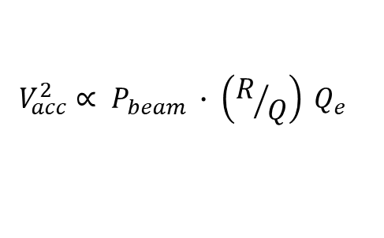
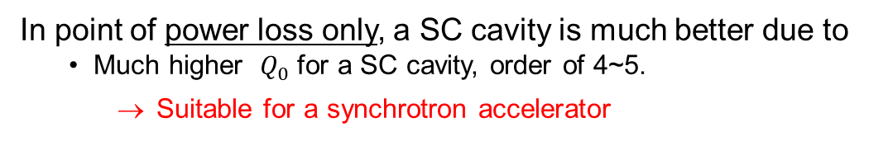
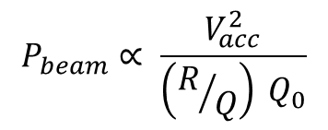
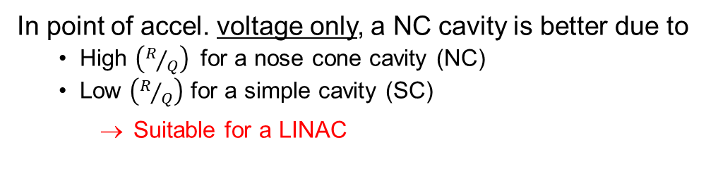
A RF Cavity – SC Cavity’s advantages over NC cavity
S. Belomestnykh, Cornell University, “ Superconducting RF in Storage-Ring-Based Light Sources”,
13th International Workshop on RF Superconductivity, Peking University, October 15, 2007
$$V_{acc}^{2}∝ P_{beam} ∙ \left(R/Q\right) Q_{e}$$
In point of accel. voltage only, a NC cavity is better due to
High $\left(R/Q\right)$ for a nose cone cavity (NC)
Low $\left(R/Q\right)$ for a simple cavity (SC)
Suitable for a LINAC
$$P_{beam}∝ \frac{V_{acc}^{2}}{\left(R/Q\right) Q_{0}}$$
In point of power loss only, a SC cavity is much better due to
Much higher ${ Q}_{0}$ for a SC cavity, order of 4~5.
Suitable for a synchrotron accelerator

Slide 15
A RF Cavity – Cavity performance in synchrotron accel.
High quality beam
High beam current for synchrotron light sources
High luminosities for colliders
Small emittance (beam size)
← By high damping rate of higher order mode (HOM) from a cavity
Avoiding coupled multi-bunch or beam break-up instabilities depending on the machine and beam parameters that will set the acceptable cavity impedance thresholds
to be comprised by all beam-induced cavity Eigenmodes,
to absorb wakefields, by cavity HOM dampers/absorbers
to remove upto beam-dynamically safe levels
to reduce the heat load at cryogenic temperature in SC and proper water temp. in NC.

Slide 16
A RF Cavity – Cavity performance in synchrotron accel.
Strong HOM damping
based on coaxial and waveguide HOM couplers in cavity itself
beam line absorbers
Combination of two

Slide 17
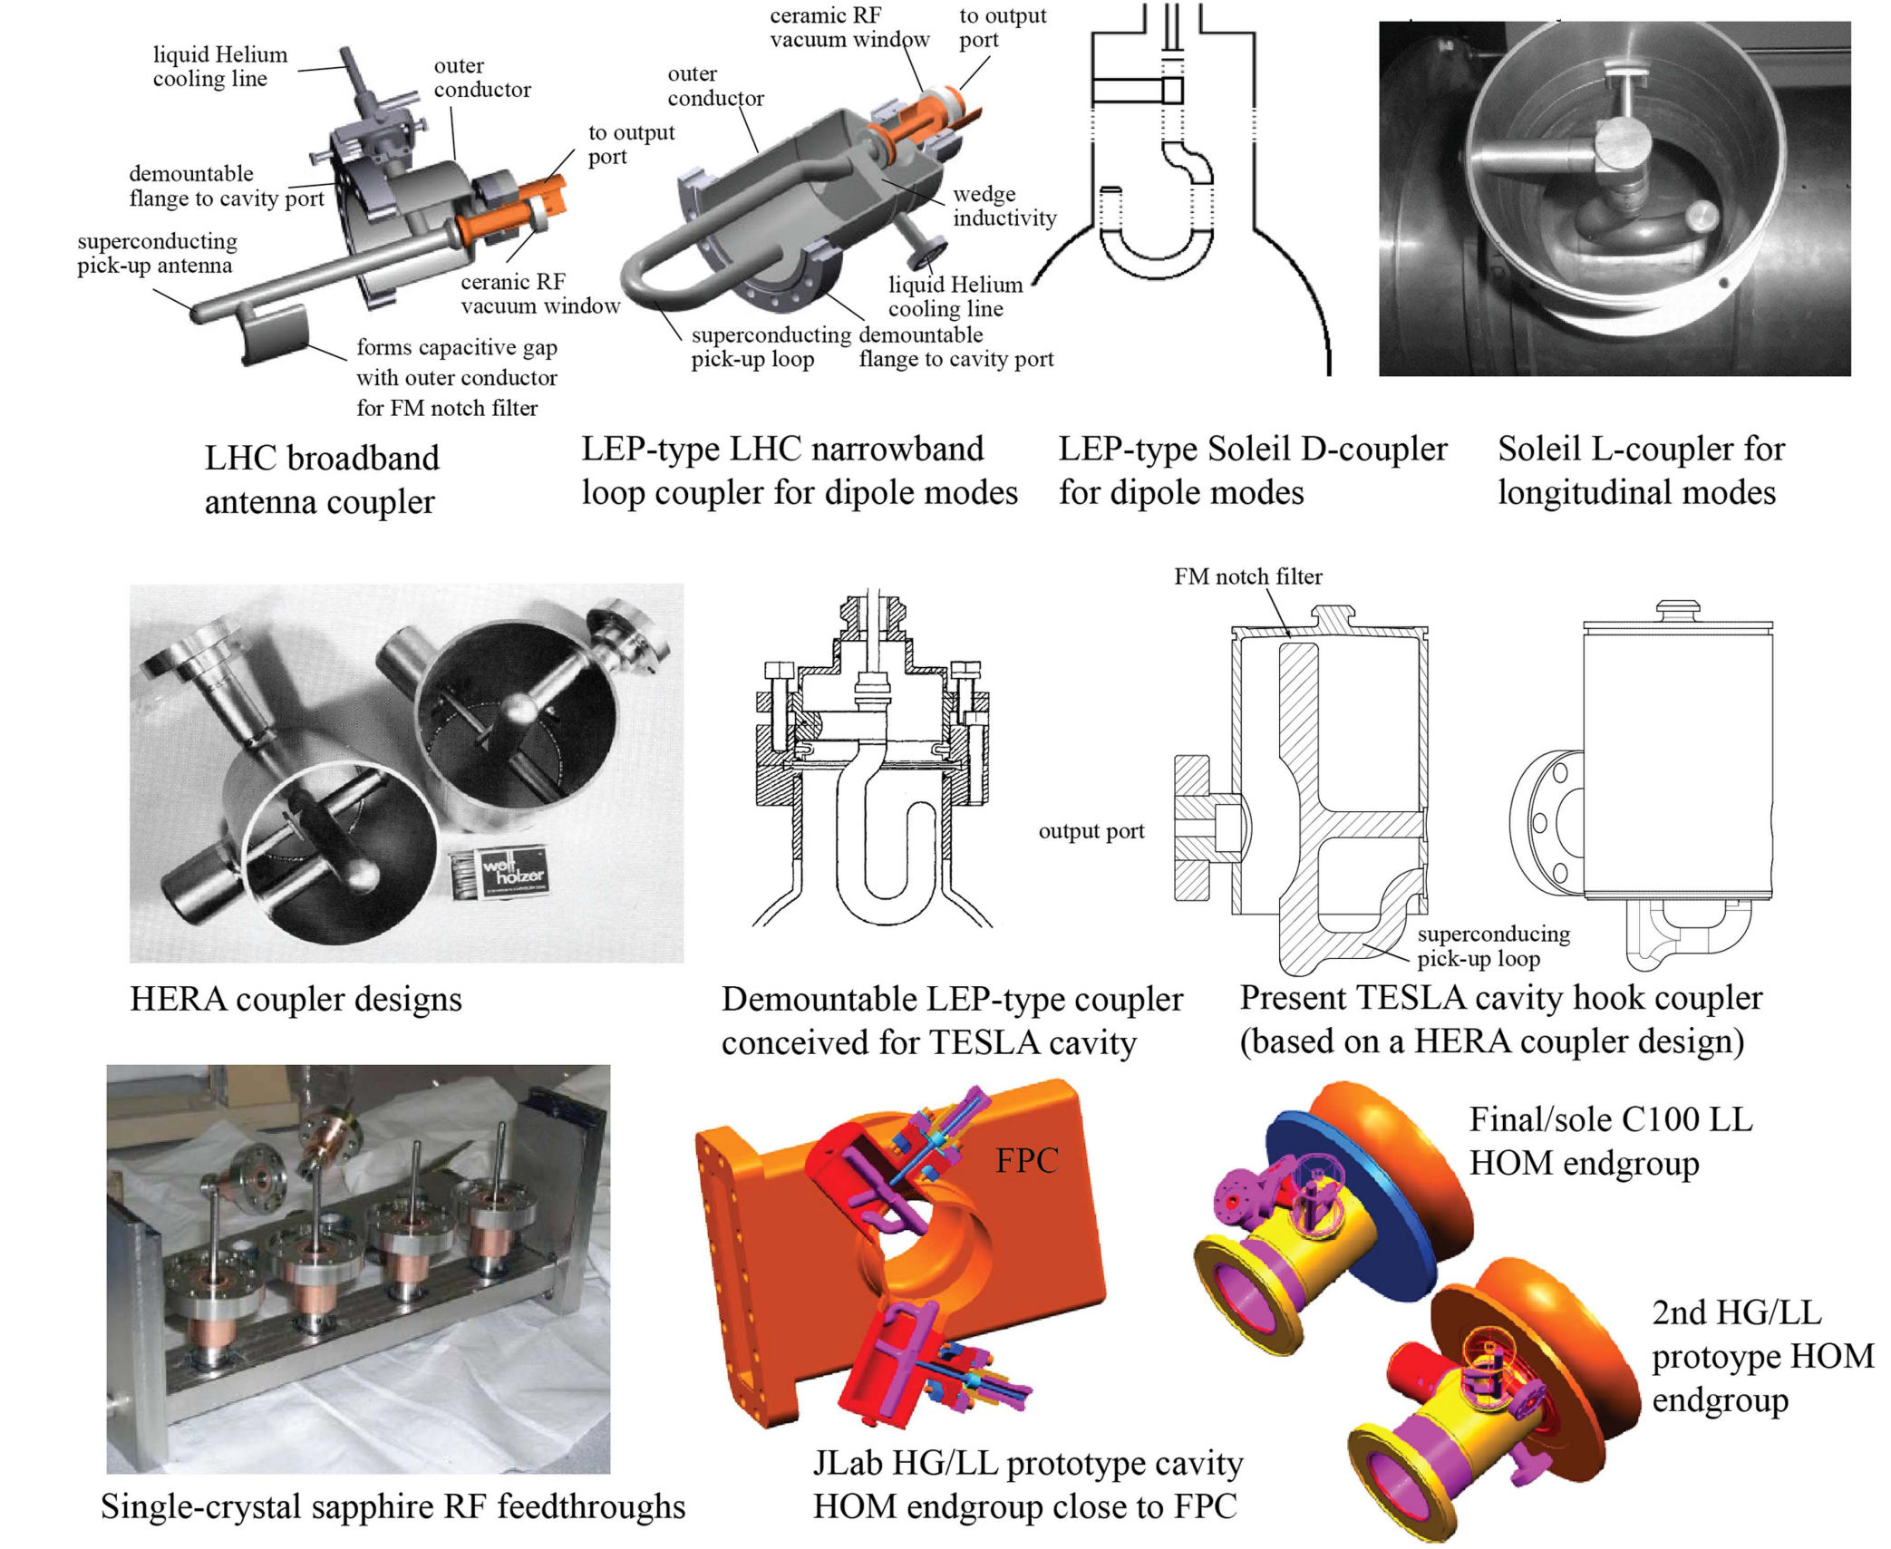
Coaxial and Waveguide Dampers (Couplers) in a Cavity
Frank Marhauser, Next generation HOM-damping, 2017 Supercond. Sci. Technol. 30 063002

Slide 18
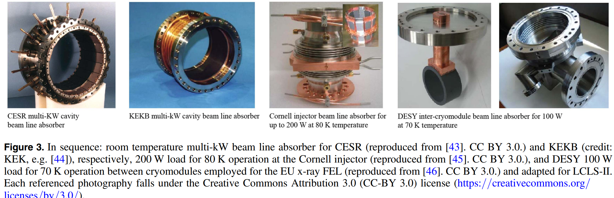
Beam Line / Tube Absorbers
Frank Marhauser, Next generation HOM-damping, 2017 Supercond. Sci. Technol. 30 063002

Slide 19
Characteristics of
Synchrotron Accelerators

Slide 20
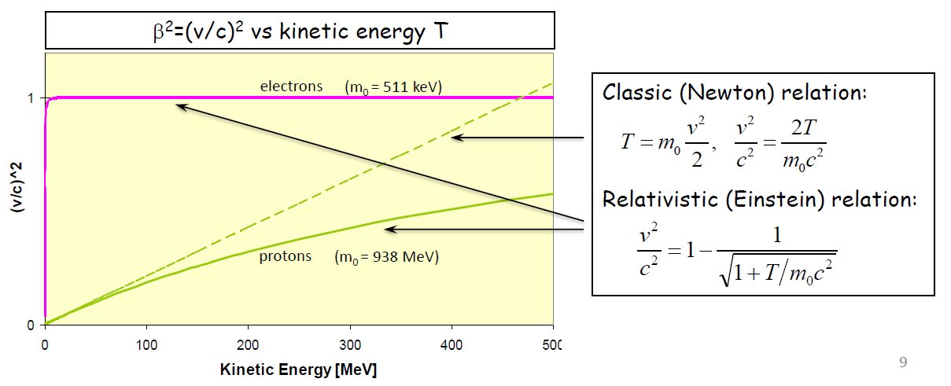
Comparison, between Linear and Circular Accelerators
In linear accelerators (LINAC), the beam crosses the accelerating structures only once, from one end to the other
In circular accelerators (synchrotron), the beam repeatedly crosses the same accelerating structure
Linear accelerators are the only ones that can be used in the domain where the particle velocity is increasing
Different behaviors for electrons and protons in LINACs

Slide 21
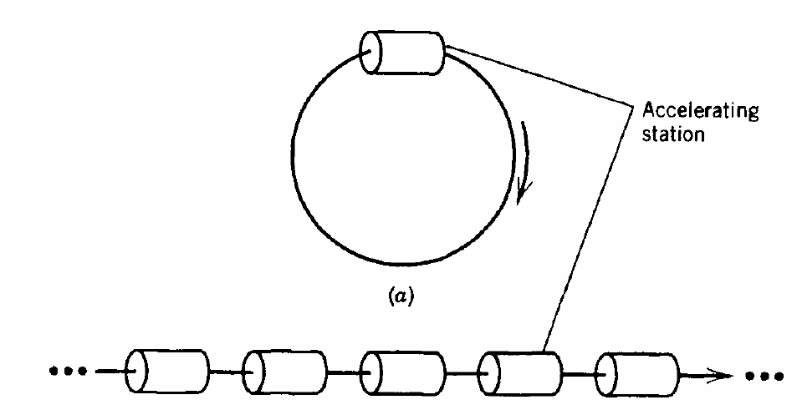
Linear (LINAC) and Circular Accelerators (Synchrotron)
Both LINAC and synchrotron use electromagnetic fields oscillating in resonant cavities to apply the accelerating force.
LINAC – particles follow straight path through series of cavities
Synchrotron – particles follow circular path in B-field and particles return to same accelerating cavity each time around
Synchrotron
Linac

Slide 22
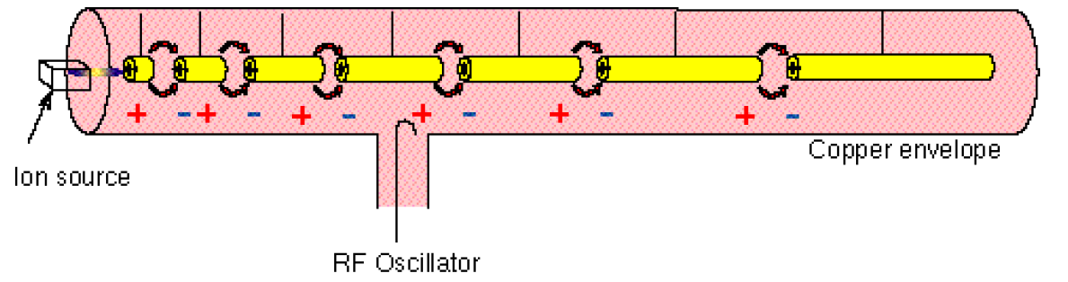
A LINAC
Particle gains energy at each gap
Lengths of drift tubes follow increasing velocity
Spacing becomes regular as v approaches c

Slide 23
A LINAC
Low-Energy acceleration
Use for injectors to synchrotrons or stand-alone
For electron, protons and ions, linacs can be synchronous with the RF fields in the range where velocity increases with energy.
Protons: β = v/c =0.51 at 150 MeV, 0.95 at 2 GeV.
High-Energy acceleration
Production of high-intensity proton beams
High energy linear colliders for leptons, where the main advantage is the absence of synchrotron radiation.

Slide 24
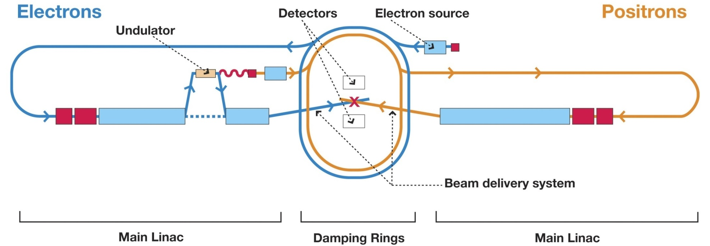
A LINAC – Linear collider
International Linear Collider (ILC)
  - Superconducting cavities
  - 31.5 MV/m gradient
  - 500 GeV, with 35 km total length
  - Upgrade to 1000 GeV possible

Slide 25
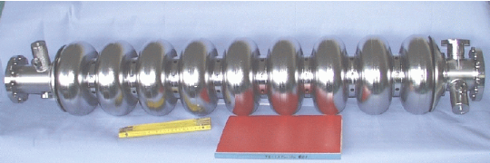
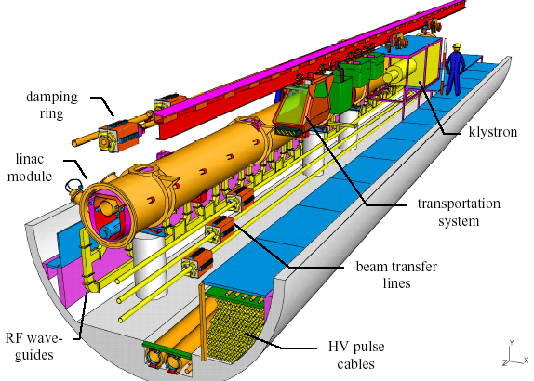
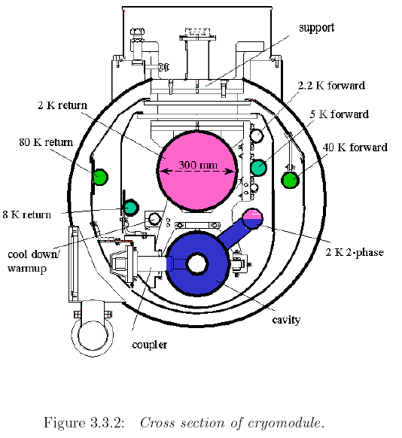
ILC Super-conducting Technology
1.3 GHz 9-cell cavity
1680 modules, with 10 9-cell cavities each

Slide 26
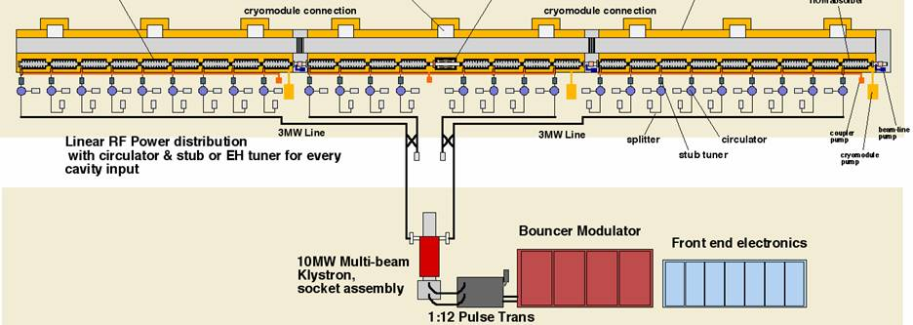
ILC Main Linac RF Unit

Slide 27
A Synchrotron (Circular Accelerators)
Beam from a booster ring or
a LINAC
Use same accelerating structure many times over
Guide charged particles around closed path (“circle”) with magnetic fields
Provide magnetic focusing to keep beam small
Schematic modern synchrotron or storage ring

Slide 28
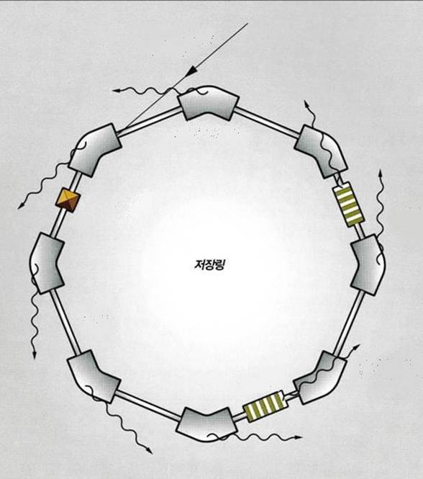
A Usual Synchrotron Radiation (Light Source)
Accelerated
electron bunch
RF Gun
Synchrotron radiation
Klystron
Microwave
Bending magnet
Modulator
RF cavity
Full-energy Linac or Booster ring
Storage Ring
Vacuum chamber
Insertion device
Beamline

Slide 29
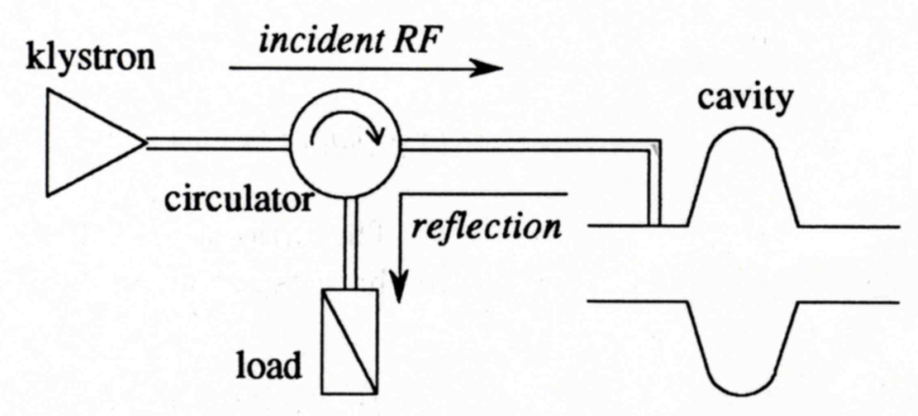
Configuration of RF system for the Synchrotrons
High power RF
Charged particles and/or bunches
LLRF
(Control System)

Slide 30
Characteristics of Synchrotron Light Sources
Characteristics of photon beams
high brilliance and flux,
wavelength tunability & selection-ability,
beam size tunability & selection-ability,
(partially) coherent radiation,
polarization,
time structure
Stability factor by
energy,
intensity,
position,
size

Slide 31
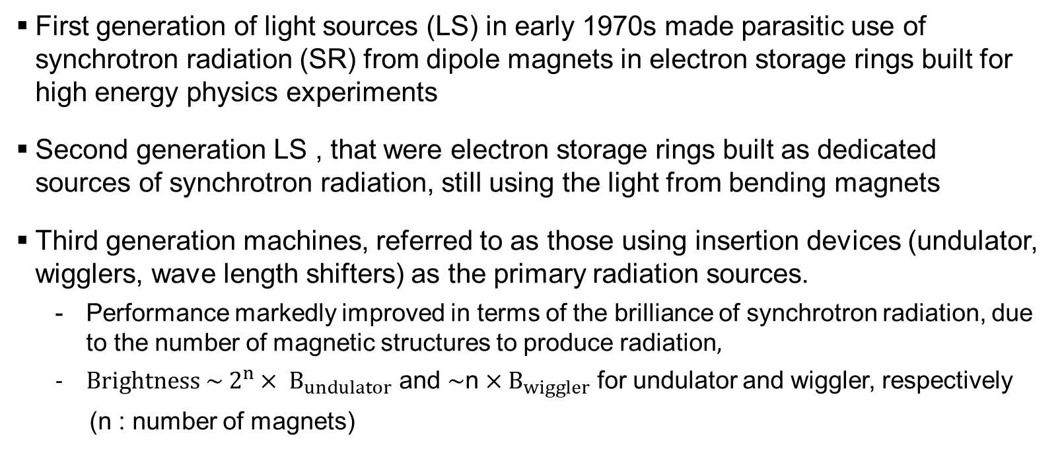
Evolution of Synchrotron Light Sources
First generation of light sources (LS) in early 1970s made parasitic use of synchrotron radiation (SR) from dipole magnets in electron storage rings built for high energy physics experiments
Second generation LS , that were electron storage rings built as dedicated sources of synchrotron radiation, still using the light from bending magnets
Third generation machines, referred to as those using insertion devices (undulator, wigglers, wave length shifters) as the primary radiation sources.
Performance markedly improved in terms of the brilliance of synchrotron radiation, due to the number of magnetic structures to produce radiation$,$
${Brightness \sim 2}^{n}× B_{undulator}$ and $\sim$n$×B_{wiggler}$ for undulator and wiggler, respectively
(n : number of magnets)

Slide 32
Evolution of Synchrotron Light Sources
Forth generation LS (4GSR), characterized as "ultra-low emittance” less than 100 pm⋅ rad with state-of art insertion devices. Another prominent brilliance compared to 3rd LS.
The brilliance, scales inversely proportional to two transverse emittances of electron beam and linearly proportional to electron beam intensity.
Low emittance by magnetic lattice design with larger number of bending magnet, compared 3rd LSs

Slide 33
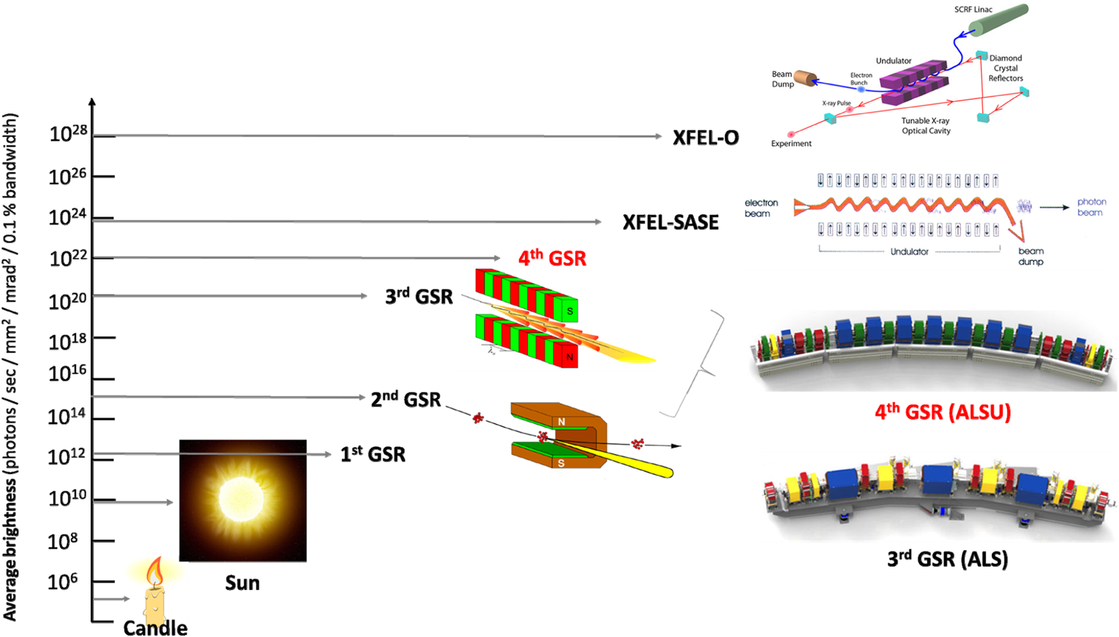
Development of Radiation Sources & Brightness
X-ray free electron laser oscillator
Shin, S. New era of synchrotron radiation: fourth-generation storage ring. AAPPS Bull. 31, 21 (2021). https://doi.org/10.1007/s43673-021-00021-4

Slide 34
Coupled-bunch Instabilities
(≈ beam break-up instabilities)
The key issue in a synchrotron accelerator is

Slide 35
Coupled (multi)-bunch Instabilities
High quality beam (high intensity, ultra-low emittance beam)
High beam current for synchrotron light sources
High luminosities for colliders
Performance degradation (collective effects)
Beam instabilities: coupled-bunch instabilities by HOM
Intensity-dependent effects : beam-induced machine heating, Touschek scattering, IBS (Intra Beam Scattering), tune shifts
The beam intensity, where up above a certain current the beam becomes collectively unstable due to its self EM field, called a wake field, acting back on itself !!
Means to mitigate collective effects
Bunch lengthening with harmonic cavities
Bunch by bunch longitudinal/transverse feedback
The collective effects have significant impacts on the beam performances of synchrotron light sources and also colliders for high-energy experiments

Slide 36
Coupled-bunch Instabilities
The effect of bunches perturbation by the wakefield of the preceding bunches through the coupling impedances of rf cavities and/or beam chamber. For coupled bunch oscillation modes, if the bunches are equally spaced and equally charged.
Same oscillation amplitudes of all the bunches
Phase difference of each successive bunch is Δφ = 2π μ/Β
(B is the number of bunches and μ, coupled bunch mode number is ( 1 < μ < B-1 )
Different several higher modes of oscillation as dipole mode, quadrupole mode, sextupole mode. Usually dipole mode (rigid bunch mode) has much influence on the beam,

Slide 37
Coupled-bunch Instabilities
The time-average (majority) experiments of synchrotron radiation researches request a high average photon flux, by a high average electron beam current: multi-bunch mode
A high intensity multi bunch beam is subject to long-lasting wakes excited by the ensemble of bunches and induce coupled-bunch instabilities.
The time-resolved experiments utilize the strict timing of electron bunches circulating in a ring, by increasing the bunch charge intensity: single bunch mode
Sensitive to short-range wake fields that are excited by the bunch itself and drive , resulted to single bunch instabilities

Slide 38
Coupled-bunch Instabilities
The fundamental mode of a cavity is loaded by an external RF amplifier and has a high quality factor so it makes compensate the loss power of beam
While the higher mode (HOM) of a cavity is loaded by the beam itself and has a some value of quality factor so that its fields have a significant effect on the beam. In this way, the HOM can produce a long- / short-ranges wakefields that has a significant static or dynamic effect depending on oscillation of the bunches within their rf buckets
The HOM spectrum cannot be fully suppressed, in principal
Static loading refers to cases where the centroid and form of the charged particle bunches are stationary relative to their rf bucket and the wakefield is excited at an exact harmonic of the machine revolution frequency.
Dynamic loading is where there is oscillation of the bunches within their rf buckets and so the wakefield is excited at a revolution harmonic plus or minus the oscillation frequency depending on the sign of the phase advance from one bunch to the next.

Slide 39
Growth Rate of Longitudinal Coupled Bunch Instability
The growth/damping rate of the longitudinal coupled bunch oscillation for the dipole mode is given by
e: electron charge,
α: Momentum compaction factor,
I: average beam current,
E: beam energy,
f_{r}: revolution frequency,
f_{s}: synchrotron oscillation frequency,
B: number of bunches,
μ: longitudinal coupling mode number ( μ = 1, 2,,, , B-1 ),
ν_{s} : synchrotron oscillation tune (ν_{s} = f_{s} / f_{r}),
τ_{s} : bunch length in seconds
form factor G(Δφ) ≈ 1 for Δφ << 1,
angular frequency is determined by bunch structure and equals to (nB+ μ + ν_{s} )
Re[Z//(ω)] is positive, so the first and the second terms of equation (1) contribute to the growth and the damping, respectively.
Radiation damping effect is always competing with this growth rate. If growth rate exceeds the damping rate for a given current, then the instability arise !!

Slide 40
Growth Rate of Longitudinal Coupled Bunch Instability
The longitudinal coupling impedance of a cavity is generally given
R_{sh} : shunt impedance,
Q_{c} : unloaded Q-factor
Q_{L} : loaded Q-factor,
R_{sh} : shunt impedance,
ω_{a} : resonant angular frequency of the cavity
Z∥ is key factor for CBI !!
when ω_{a} = 2π f_{r} (nB+ μ + ν_{s} ) the growth rate reaches maximum, as expressed by

Slide 41
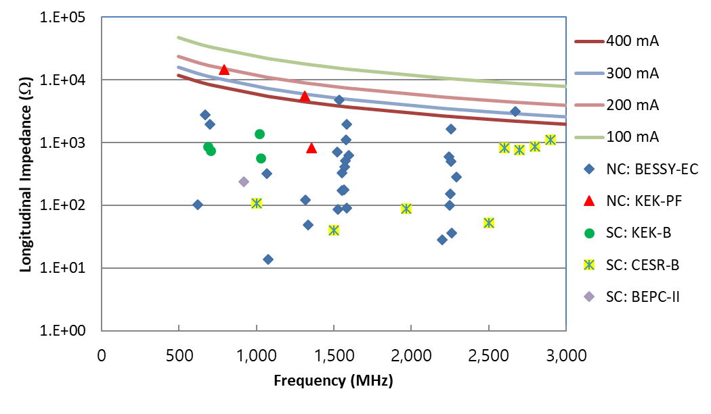
Growth Rate of Longitudinal Coupled Bunch Instability
The equilibrium of radiation damping and growth rate gives the threshold current, expressed by,
α_{ε} : radiation damping rate,
U₀ : radiation loss energy per turn,
T_{r} : revolution time
Example for PLS-II, 3 GeV and 400 mA (lines for calculation and symbols for cavities’ HOM impedances

Slide 42
Growth Rate of Transverse Coupled Bunch Instability
The growth rate of the transverse coupled bunch oscillation for dipole mode is given
δ νβ : tractional part of betatron oscillation tune νβ
β : betatron function at cavity
F: form factor defined by Sacherer [4]
e: electron charge,
I: average beam current,
E: beam energy,
f_{r}: revolution frequency,

Slide 43
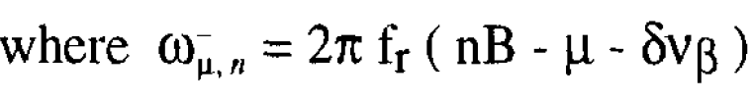
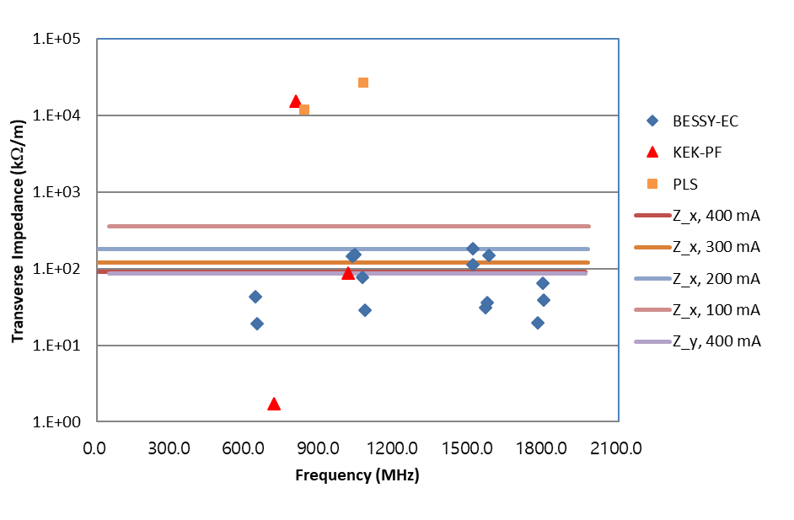
Growth Rate of Transverse Coupled Bunch Instability
The growth competes with the radiation damping also. If the growth rate exceeds the damping rate, instability arise. The threshold current is given by
α⊥ : radiation damping rate,
U₀ : radiation loss energy per turn,
T_{r} : revolution time
Example for PLS-II, 3 GeV and 400 mA (lines for calculation and symbols for cavities’ HOM impedances

Slide 44
4th Generation Synchrotron Radiation
(4GSR)

Slide 45
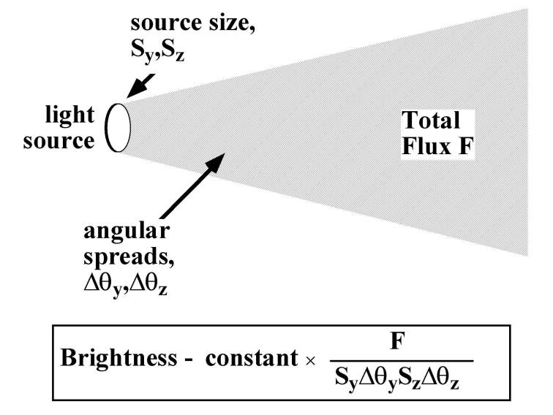
Characteristics of 4GSR
Higher brightness of photons, ~10² order higher than 3GSR
Smaller beam emittance (especially transverse emittance), ~10⁻² order smaller than 3GSR, by magnetic lattice design, with small and more number of magnets
High beam current
Brightness ~ number of photons per angular divergence, the cross-sectional area, and a bandwidth of 0.1% of photon beam
as a figure of merit for storage ring
S_{y} : transverse beam size (~ ε_{y} : beam emittance)
F : emitted flux, related to beam characteristics, F ~ F(I_{beam})

Slide 46
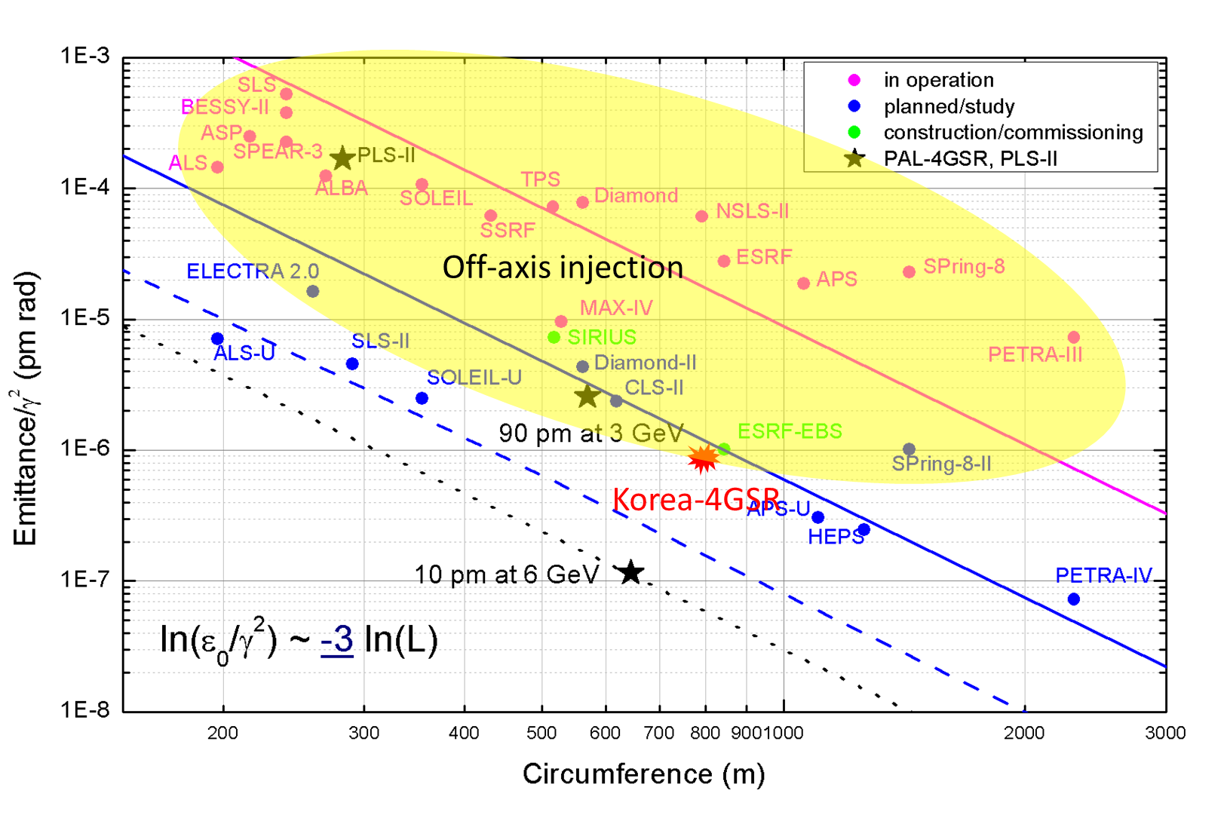
Worldwide Synchrotron Radiation Machines
(Circumference and beam emittance)

Slide 47
Cavity Selection by Synchrotron Facilities for 3GSR
Emitance > 1 nm*rad

Slide 48
Family of SRF cavities for Synchrotron Radiation
352 MHz
PLS-II
SIRIUS
500 MHz
Not realized
500 MHz
S. Belomestnykh: SRF in SR Light Sources - SRF2007, Beijing

Slide 49
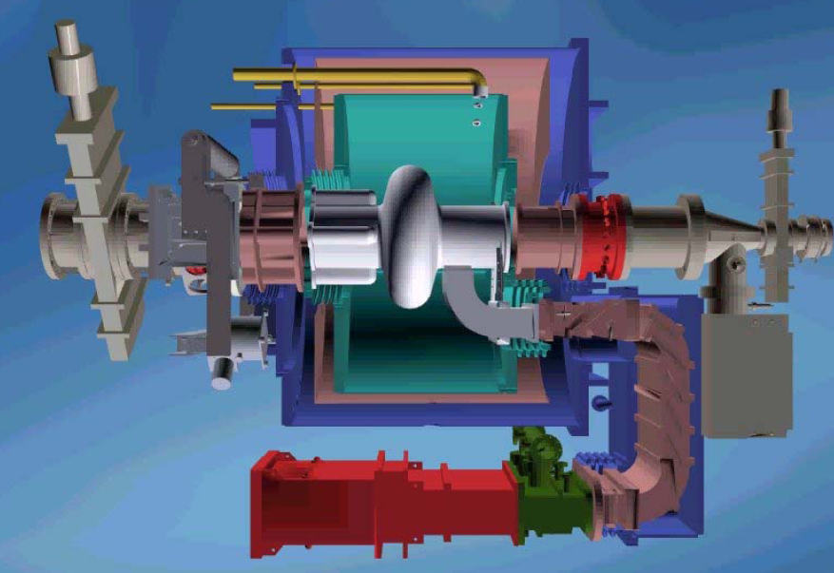
SRF CESR-B cryomodule
CESR-B Cryomodule (Cornell Electron Storage Ring-B)
Commercial manufacture @ RI Instruments with technology transfer
Operation at PLS-II (4), TLS (2), CLS (3), DIAMOND (4), SSRF(3) CESR-II (4), NLSL-II (3), SIRIUS (2)
Resonant frequency [MHz] | 499.765
R/Q per cavity [Ω] | 89
Q₀ | > 7×10⁸
R_{shunt} /cavity [MΩ] | 4500
Operating Temperature [K] | 4.5
Accelerating Voltage /cavity [MV] | >2.5
RF Power to Beam /cavity [kW] | >300
Heat leak/cryomodule at 4.5K [W] | 100
Surface preparation | BCP & HPR
Single-cell cavity
Waveguide type main power coupler
Ferrite HOM absorber
LHe volume: 550 liters
Static cryogenic heat loads: 30 W
Cryomodule length: ~2.86 m

Slide 50
SRF CESR-B cryomodule

Slide 51
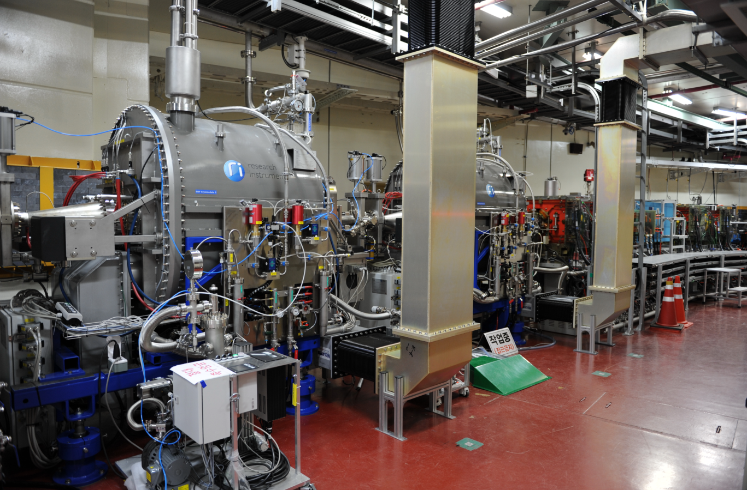
SRF CESR-B cryomodule in PLS-II
Parameters | PLS-II
Current [mA] | 400
RF frequency [MHz] | 499.973
Beam loss power [kW] | 498
Accelerating Voltage [MV] | 3.3
Cavity number | 3
SRF module 2
SRF module 3

Slide 52
SRF KEK-B cryomodule
Modified KEK-B Cryomodule
Adopted cavity from 508 MHz in KEK-B to 500 MHz
Available through collaboration with KEK
Operation at BEPC-II (2), TPS (3)
Big power capacity
Resonant frequency | 499.8 MHz
R/Q | 95.3 Ω
Q₀ | 10⁹
Q_{ext} | 7x10⁴
Operating Temperature | 4.5 K
Accelerating Voltage / Cavity | >2 MV
RF Power to Beam / Cavity | > 350 kW
HOM Removal | Absorber
BEPC-II Version
Single-cell cavity
Coaxial type main power coupler
Ferrite HOM absorber
Wide beam tube
Cryomodule length: ~3.2 m

Slide 53
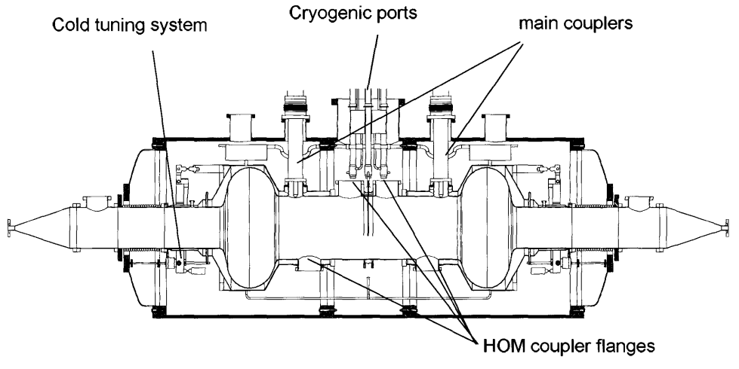
SRF SOLEIL cryomodule
352 MHz, 2-cell HOM damped cavity per cryomodule
Nb/Cu single-cell HOM damped cavities
Operation at SOLEL (2 cryomodules)
Nb sputter copper cavity
Coaxial type main power coupler
HOM coupler
Cryomodule length: < 7 m

Slide 54
Cavity Selection by Synchrotron Facilities for 4GSR
Why a normal conducting RF cavity is dominant for 4GSR, even with disadvantage of HOM impedance ?
Lower availability of SRF cryomodule than a NC cavity (longer repair time against several critical failures)
Proper-low HOM impedance from design from a NC cavity
Well design of HOM damper in a NC cavity
Well developed feedback system of beam orbit such as LFS and TFS

Slide 55
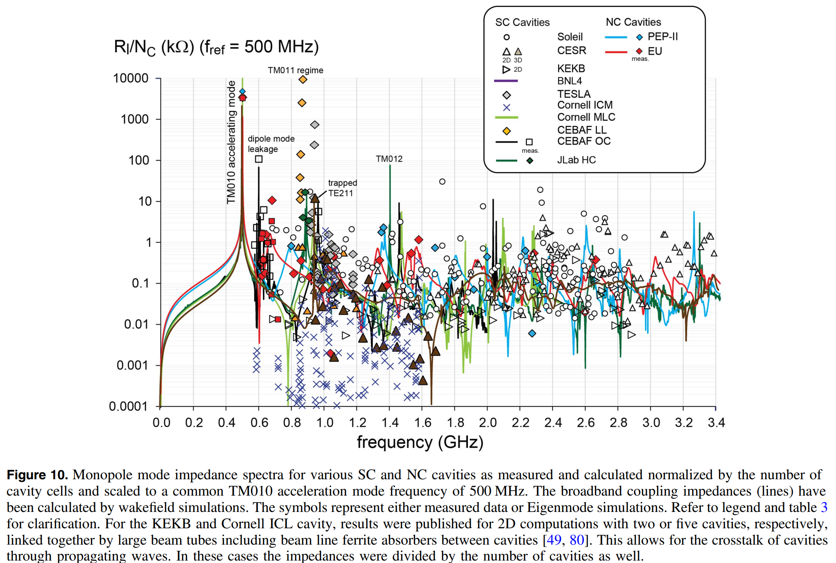
Impedances of Several Cavities’ HOMs: Longitudianl
To damp down HOMs in a SC cavity is much easier than NC, due to bigger beam tube aperture !!
for NC synchrotron accel.
for SC synchrotron accel.
Frank Marhauser, Next generation HOM-damping, 2017 Supercond. Sci. Technol. 30 063002

Slide 56
Impedances of Several Cavities’ HOMs: transverse
for NC synchrotron accel.
for SC synchrotron accel.
Frank Marhauser, Next generation HOM-damping, 2017 Supercond. Sci. Technol. 30 063002

Slide 57
Introduction of Multi-Purpose,
4th Generation Synchrotron Radiation
(Korean 4GSR)

Slide 58




4GSR International Advisory Committee Meeting (Oct. 13, 2022)
Overview of 4GSR
Multipurpose Synchrotron Radiation Construction Project
Oct. 13, 2022

Slide 59

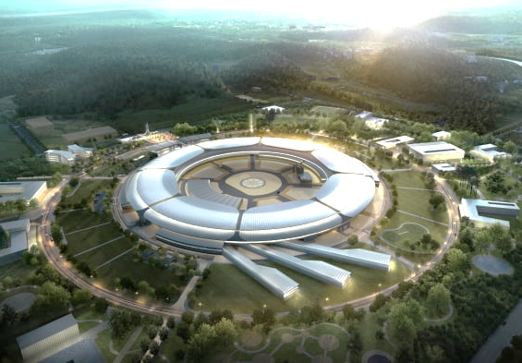


1st 4GSR International Advisory Committee Meeting (Oct. 13, 2022)
4GSR Outline
Multipurpose Synchrotron Radiation Construction Project
- Period: 2021 July to 2027 June (6yrs)
- Budget: 1.0454 Trillion KRW (≈ USD 750M)
- Land: 540,000 ㎡ / Building: 69,400 ㎡
- Location: Ochang, Chungcheongbuk-do
<4GSR Project Budget Plan>
(Million USD)
Years | 2021 | 2022 | 2023 | 2024 | 2025 | 2026 | 2027 | Sum
Machine | 8 | 44 | 77 | 172 | 180 | 97 | 28 | 606
Site | 72 | 72 | - | - | - | - | - | 144
Sum | 80 | 116 | 77 | 172 | 180 | 97 | 28 | 750
Specifications
- Beam Energy: 4 GeV
- Beam Emittance: less than 100 pm·rad (CDR: 58 pm·rad)
- Circumference: 800m
- Beamlines : more than 40
- Accelerator: Gun, Injector LINAC, 4 GeV Booster
- Lattice: MBA-7 Bend Achromat

Slide 60
1st 4GSR International Advisory Committee Meeting (Oct. 13, 2022)
Project Timeline
2021 | 2022 | 2023 | 2024 | 2025 | 2026 | 2027 | 2028
Multipurpose Synchrotron Radiation Construction Project
CDR
TDR
Accelerator & Beamlines
Site Construction
Building & Facility Construction
Test Run
Operation

Slide 61
1st 4GSR International Advisory Committee Meeting (Oct. 13, 2022)
Project Governance
Ministry of Science and ICT
Chungchengbuk-do/Cheongju-si
Project Structure
Project Council
Director
Project Evaluation Council
Construction Advisory Committee
International Advisory Committee
Korea Basic Science Institute
Multipurpose Synchrotron Radiation Construction Project
Deputy Director
Accelerator Systems Division
Infrastructure & Facility Construction Division
Project Management Division
Accelerator
(PAL)
Beamlines
(PAL)
Facility Construction
(KBSI)
Site Construction

Slide 62
1st 4GSR International Advisory Committee Meeting (Oct. 13, 2022)
Manpower
 |  | 2022 | 2023 | 2024 | 2025 | 2026 | 2027
Director |  | 1 | 1 | 1 | 1 | 1 | 1
KBSI | Vice Director | 1 | 1 | 1 | 1 | 1 | 1
 | Accelerator System | 4 | 6 | 11 | 14 | 26 | 37
 | Infrastructure & Facility | 9 | 15 | 15 | 15 | 15 | 15
 | Project Management | 10 | 18 | 19 | 19 | 19 | 19
 |  | 24 | 40 | 46 | 49 | 61 | 72
PAL | Accelerator | 85 | 92 | 105 | 109 | 117 | 117
 | Beamlines | 67 | 72 | 79 | 85 | 87 | 87
 | Project Management | 23 | 25 | 26 | 26 | 25 | 23
 |  | 175 | 189 | 210 | 220 | 229 | 227
Total |  | 200 | 230 | 257 | 270 | 291 | 300

Slide 63
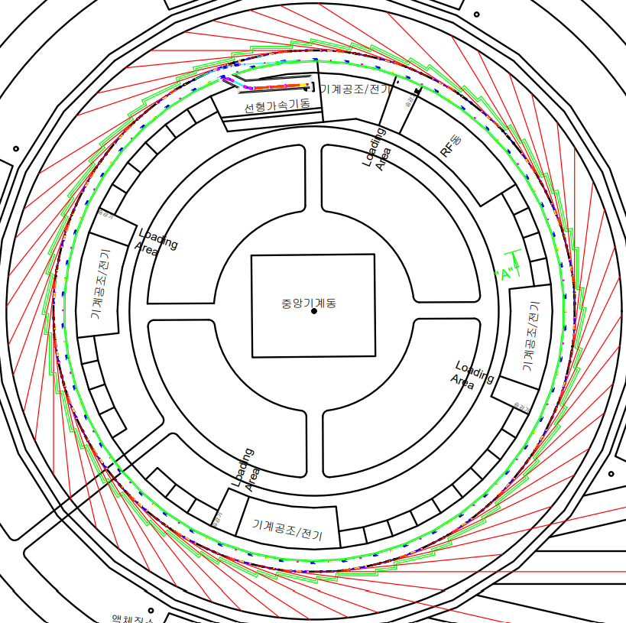
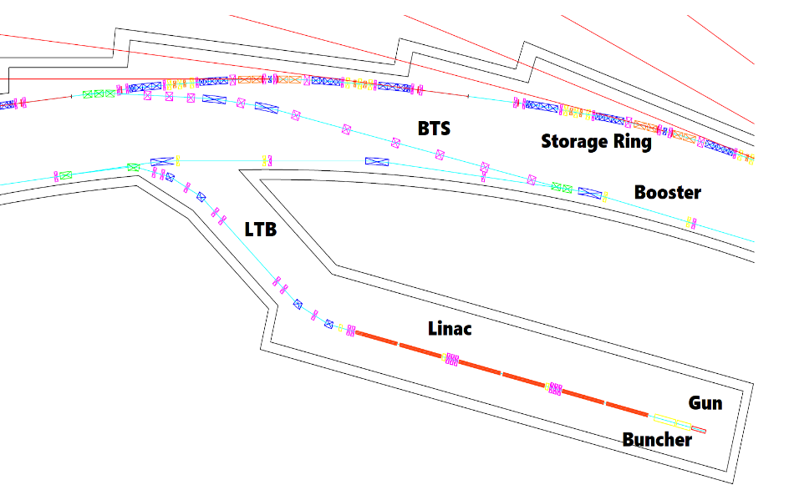
1st 4GSR International Advisory Committee Meeting (Oct. 13, 2022)
Main Parameter
General Parameter
Energy / GeV | 4.0
Symmetry / Sub-Symmetry | 28
Straight Sections: No & Length / m | 28 / 6.5
Ring Circumference / m | 798.8
# Dipole Magnets | 28 * 7 = 196
Nat. Emittance / prad m | 58
regular hor/ver @ coupling | 55 / 6 @ 10 %
Diffraction limited source for | l > 1.7 / 0.365 nm
Energy spread | 1.20E-3
Bunch Length s_{t} / ps | 10.68 (without HC) / 53.40 (with HC)
RF Parameter & Others
RF frequency / MHz | 499.877
# cavities / total Voltage | 10 x nc / 3.5 MV
# buckets: total / gap | 1332 / 267
Harmonic RF system | 3rd, active,NC, 800 kV
Average current / mA | 400
Lifetime / h | 4.54 (flat) / 8.81 (round)
Top up operation | yes
Injection scheme | 4 Kicker bump
Beam pipe (in achrom.) / mm² | D: 24(H)*20(V) @ Straight Section
Magnets:
max. bending magnet field / T | 1.7
max. quadrupole grad. T/m | 56
max. sextupole strength T/m² | 1844

Slide 64
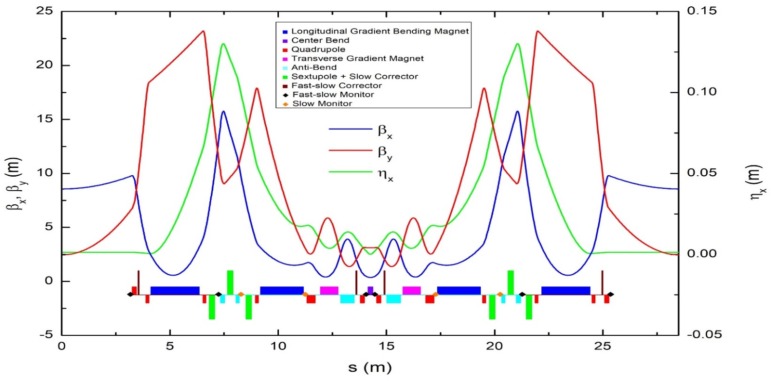
1st 4GSR International Advisory Committee Meeting (Oct. 13, 2022)
Hybrid multi-bend achromat
“Linear lattice design”
“Layout of an arc section”
Center Bend (1.96 T)
Reverse Bends (RB)
Longitudinal Gradient
Bends (LGB1/LGB2)
Reverse Bends (RB)

Slide 65
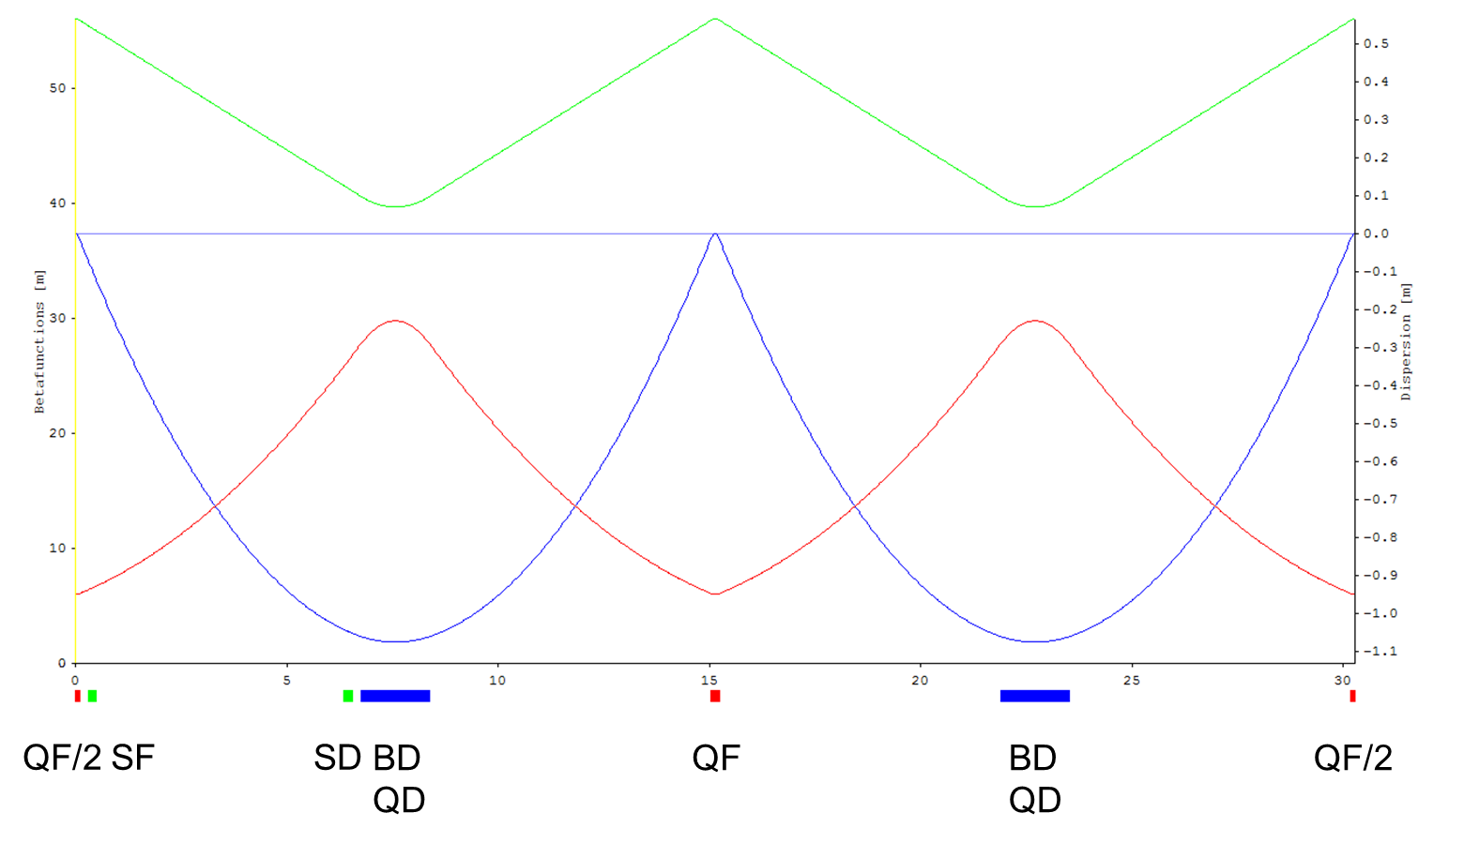
1st 4GSR International Advisory Committee Meeting (Oct. 13, 2022)
Injector
Booster
Same tunnel with SR.
Enough dynamic aperture: (Ax: -27 ~ 27 mm, Ay: ~ 14 mm).
Two normal cavities in one straight section.
Linac
Thermionic DC gun (Y-845).
500 MHz sub-harmonic pre-buncher for multi-bunch.
2.997 GHz (Pre) buncher and 6 accelerator tanks
4GSR Linac | Multi-bunch | Single-bunch
Energy | 200 | 200 | MeV
Frequency (e-gun and SHB) | 499.546 | 499.546 | MHz
Frequency (Accelerator) | 2997.28 | 2997.28 | MHz
Emittance (at 200 MeV) | ≤ 200 | ≤ 200 | nm
Relative energy spread (rms) | ≤ 1 | ≤ 0.5 | %
Pulse to pulse energy variation | ≤ 0.25 | ≤ 0.25 | %
Pulse to pulse beam position | ≤ 0.20 | ≤ 0.20 | mm
Pulse to pulse jitter | ≤ 100 | ≤ 100 | ps
Pulse charge | 3 to 10 | 0.01 to 2.5 | nC
Pulse duration | 100 to 400 | ≤ 1 | ns
Repetition rate | 2 | 2 | Hz
4GSR Booster |  | Value | Unit
Design Parameters | Cell Number | 50 | -
 | Length | 756.86 | [m]
 | Electron Energy | 0.2 - 4 | [GeV]
 | Natural Emittance | 6906 | [pm rad]
Tune and Chromaticiy | Horizontal Tune | 19.208 | -
 | Vertical Tune | 9.268 | -
 | Natural Horizontal Chromaticity | -35.146 | -
 | Natural Vertical Chromaticity | -14.617 | -
 | Horizontal Chromaticity | -2 | (target)
 | Vertical Chromaticity | -2 | (target)

Slide 66
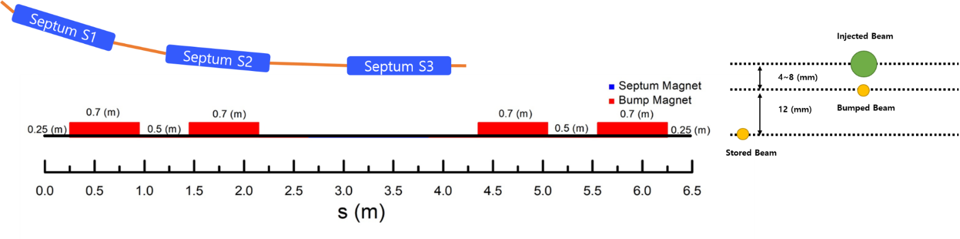
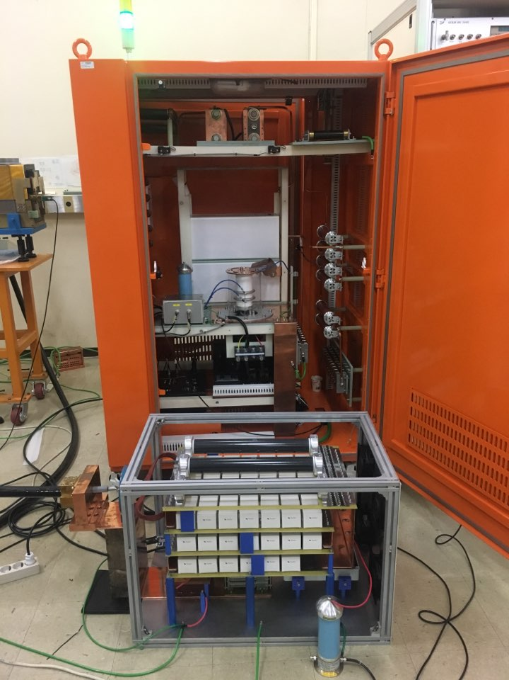
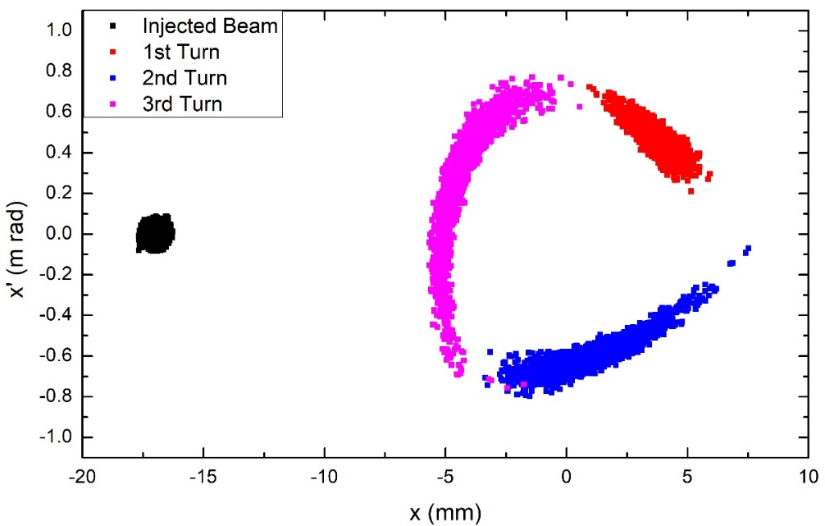
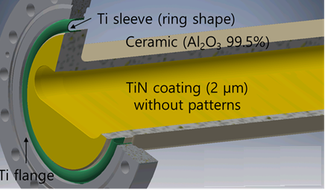
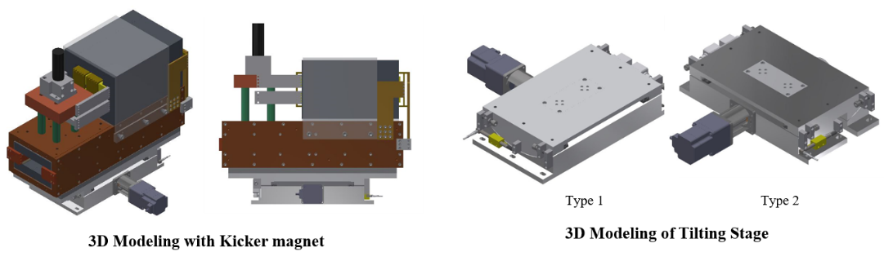
1st 4GSR International Advisory Committee Meeting (Oct. 13, 2022)
Beam Injection
Well demonstrated scheme will be used.
Baseline: conventional four kickers injection.
- Dynamic aperture: (Ax: -10 ~ 10 mm).
Including advanced scheme: NLK.
No beam loss in injection simulation with RF
Solid-state switch test in PLS-II

Slide 67
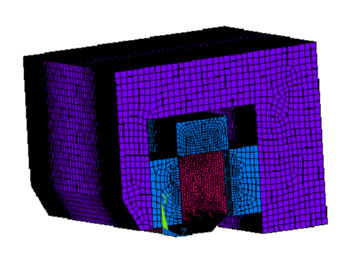
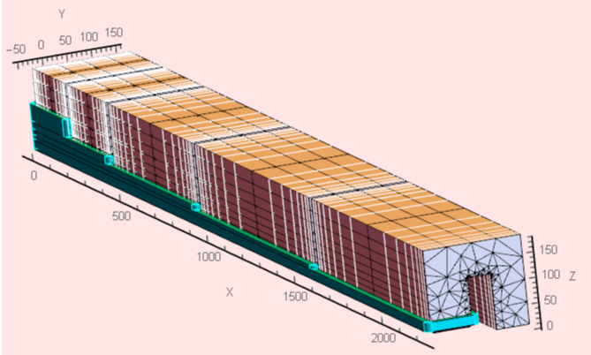
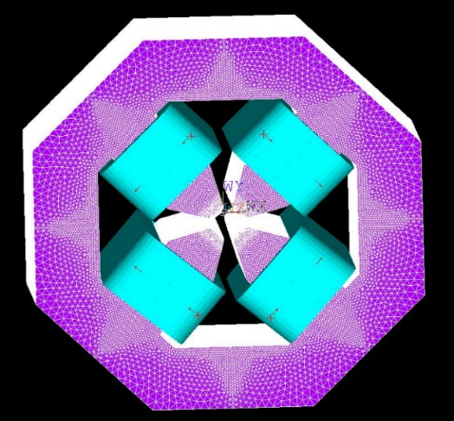
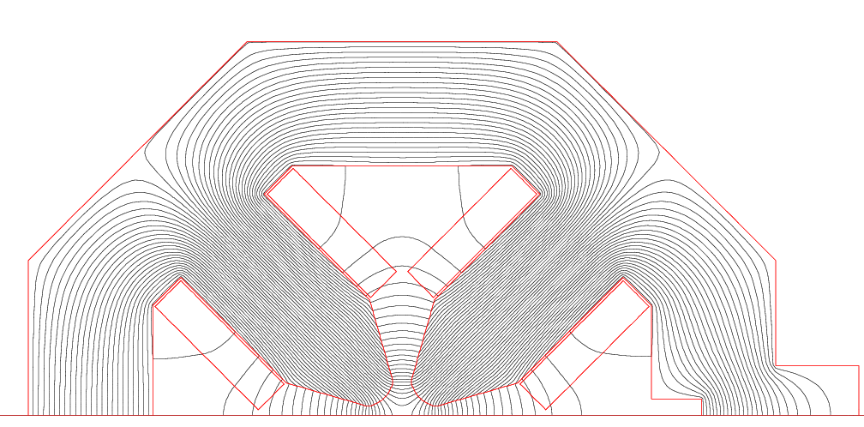
1st 4GSR International Advisory Committee Meeting – 2022 Oct 13
Magnet System
1. Korea-4GSR needs 980 demanding magnets.
2. Center bend features 2T field, and Permendur is
adopted for the pole.
3. Longitudinal Dipole used staggered independent coils,
and reluctance gap in the return yoke to follow the
design field.
4. Quadrupole, Dipole Quad magnet achieved 60 T/m
gradient using tapered pole, without using expensive
Permendur.
5. Sextupole is not so demanding but requires non-
interfering H/V/SQ windings.
Magnet | Required Number | Remark
Central BM | 28 | 1*28
Long. BM | 112 | 4*28
Reverse Bend | 336 | 2*3*28 (should have B, B’)
Quad Bend | 56 | 2*28 (should have B, B’)
Quadrupoles | 336 | 6*2*28
Sextupoles | 168 | 6*28 (should have B”, H/V Corr, Skew Quad)
Fast Corr. | 112 | 4*28 (H/V combined corrector)
Magnets/Sec | 35 | 31+4 (fast Corr.)
Total | 980 | Total number of magnets

Slide 68
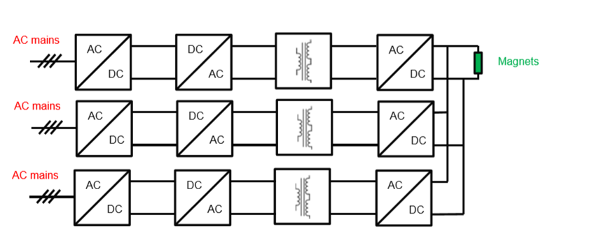
1st 4GSR International Advisory Committee Meeting (Oct. 13, 2022)
Magnet Power Supply
PS configuration with modular structure for easy and fast recovery from fault.
PS connection option: Individual or grouping (series) for high power unipolar PS.
Modular structure
Quantity | 1,228
MPS Type | Unipolar
Input Voltage | 380VAC 3phase
Max. Current | 120 A
Max. Voltage | 40 V
Max. Power | 4.8 kW
Accuracy | TBD
Repeatability | 10 ppm
Reproducibility | 100 ppm
Ripple and Noise | 10 ppm
Long-term Stability (8h) | 10 ppm
Temperature Stability | 5ppm / K
Line Regulation | ±10 ppm
Load Regulation | ±10 ppm
Setting Resolution | >18 bit
Readback Resolution | >18 bit
Parallel Operation up to | 4
Quantity | 840
MPS Type | Bipolar
Input Voltage | 220VAC 1phase
Max. Current | 15 A
Max. Voltage | 5 V
Max. Power | 75 W
Accuracy | TBD
Repeatability | 10 ppm
Reproducibility | 100 ppm
Ripple and Noise | 50 ppm
Long-term Stability (8h) | 100 ppm
Temperature Stability | 5ppm / K
Line Regulation | ±10 ppm
Load Regulation | ±10 ppm
Setting Resolution | 18 bit
Readback Resolution | 18 bit
Quantity | 112
MPS Type | Bipolar
Input Voltage | 220VAC 1phase
Max. Current | 5 A
Max. Voltage | 20 V
Max. Power | 100 W
Accuracy | TBD
Repeatability | 10 ppm
Reproducibility | 100 ppm
Ripple and Noise | 50 ppm
Short-term Stability (30min) | 10 ppm
Temperature Stability | 5ppm / K
Line Regulation | ±10 ppm
Load Regulation | ±10 ppm
Setting Resolution | 20 bit
Readback Resolution | 24 bit
Small Signal Bandwidth | 10 kHz
Specification of Power Module for High Power MPS
Specification of Slow MPS
Specification of Fast MPS

Slide 69

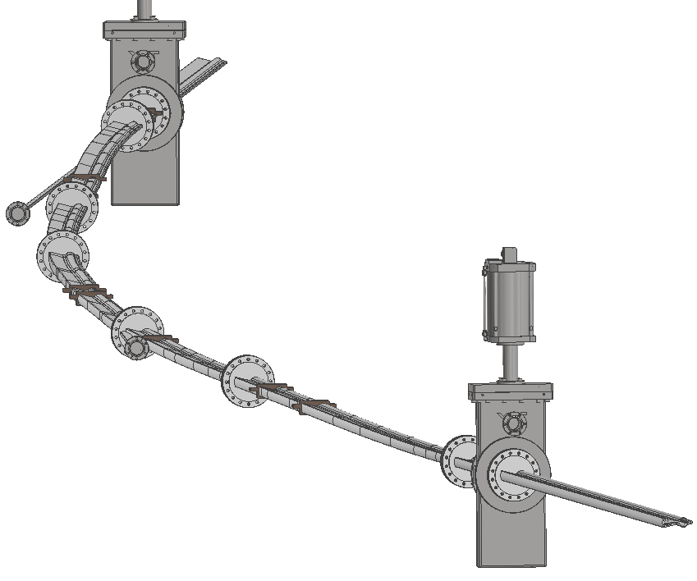
1st 4GSR International Advisory Committee Meeting (Oct. 13, 2022)
SR Vacuum Chamber
  Beam chamber cross section is octagon shape (24 mm (H) x 18 mm (V)) except for center bend.
  Vertical aperture of the center bend chamber is 10 mm.
  Eight RF-bellows are used for installation and to reduce stress.
  Two gate valves are located at the end of the arc section.
  Seven sputter ion pumps are installed for noble gas pumping.
  The clearance between the vacuum chamber and the magnets is larger than 0.6 mm.
Clearance
Vacuum chambers of an arc-section
ID beam port
Bending magnet beam port

Slide 70
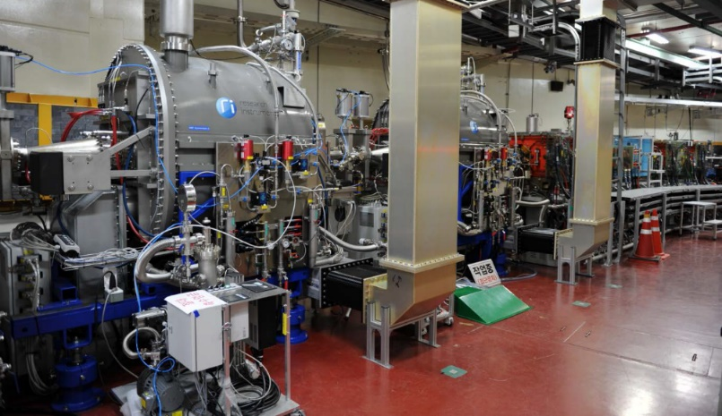

1st 4GSR International Advisory Committee Meeting (Oct. 13, 2022)
Two Major Changes from CDR
Electron Gun at Linac
Thermionic DC Gun
Photocathode RF Gun
Subject | Single bunch mode | Multi-bunch mode
Beam energy | 100 kV | 100 kV
Charge | 0.01∼2.5 nC | 3∼5 nC
Pulse length | ≤1 ns | 100∼400 ns
Repetition rate | 2 Hz | 2 Hz
Photocathode RF gun (PAL-XFEL)
Subject | Single bunch mode | Multi-bunch mode
Beam energy | 4 MeV | 4 MeV
Charge | 0.01∼1 nC | 1∼3 nC
Pulse length | <20 ps | 200 ns (100 pulses)
Repetition rate | 2 Hz | 2 Hz
* PAL-XFEL has sufficient experience with Photocathode RF Gun
RF System for SR
SRF Cavity
NRF Cavity from RI

Slide 71
1st 4GSR International Advisory Committee Meeting (Oct. 13, 2022)
Two Major Changes from CDR
Comparison
Cavity Type | SRF (CDR) | Normal RF* (Euro Design) | Remarks
Required RF voltage [MV] | 3.5 | 3.5
Required beam power [kW] | 720 | 720
Shunt impedance [M-Ω] | 89,000.0 | 3.4
Required power / coupler[kW] | 240.0 | 90
Wall loss power / cavity [kW] | 0.008 | 18
Beam Loading Power / cavity | 240 | 72
Required gap voltage/cavity [kV] | 1,166.7 | 350
# of cavity | 3 | 10
# of Klystron | 3 | 10
Total klystron output power [kW] | 864.0 | 1,080.2 | Applied 20% operational margin
AC power for klystron [kW] | 1,885.2 | 2,700.4 | RF conversion rate: 40%
Unit Klystron power (kW) | 288.0 | 108
Total cavity cooling load | 700 W @4.5K | 180 kW | SRF: He Refrigerator / NRF: LCW
Compressor cooling load, SC [kW] | 300.0 | -
HPRF cooling power [kW] | 754.1 | 3,240.5 | Total loss + 20% operational margin

Slide 72
1st 4GSR International Advisory Committee Meeting (Oct. 13, 2022)
Beamlines
【 Industry oriented 】
① BioPharma BioSAXS
② Material Structure Analysis
③ Soft X-ray Nano probe
【 Research oriented 】
④ Nanoscale Angle resolved Photoemission
⑤ Coherent X ray Diffraction
⑥ Coherent Small angle X ray Scattering
⑦ Real time X ray Absorption Fine Structure
⑧ Bio Nano crystallography
⑨ High Energy Microscopy
⑩ Nano-probe

Slide 73


1st 4GSR International Advisory Committee Meeting (Oct. 13, 2022)
Beamlines

Slide 74


1st 4GSR International Advisory Committee Meeting (Oct. 13, 2022)
Construction Site
방사광
가속기
부지

Slide 75

1st 4GSR International Advisory Committee Meeting (Oct. 13, 2022)
4GSR Design – Building Design Company (Haenglim*)
* Designed PAL-XFEL

Slide 76

1st 4GSR International Advisory Committee Meeting (Oct. 13, 2022)
4GSR Design – Building Cross-session

Slide 77

1st 4GSR International Advisory Committee Meeting (Oct. 13, 2022)
4GSR Design – Special Facilities & Utilities

Slide 78

1st 4GSR International Advisory Committee Meeting (Oct. 13, 2022)
4GSR Design – Floor Plan

Slide 79
1st 4GSR International Advisory Committee Meeting (Oct. 13, 2022)
Summary
Multipurpose Synchrotron Radiation Project
- The project aims to build 4 GeV storage ring with an emittance less than 100 pm
- Its circumference will be 800m
- It can host more than 40 beamlines. Initially, 10 beamlines will be ready.
2 Institutions working together
- KBSI: Leading institution in charge of Building and Facility
- PAL: Partner institution in charge of Accelerator and Beamlines
Construction will be completed by 2027
- Building design began in September, 2022 and will be completed by 2023
- TDR will be finished by 2023
- Construction will be started in spring, 2024

Slide 80

1st 4GSR International Advisory Committee Meeting (Oct. 13, 2022)
Thank You

