Slide 1
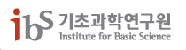
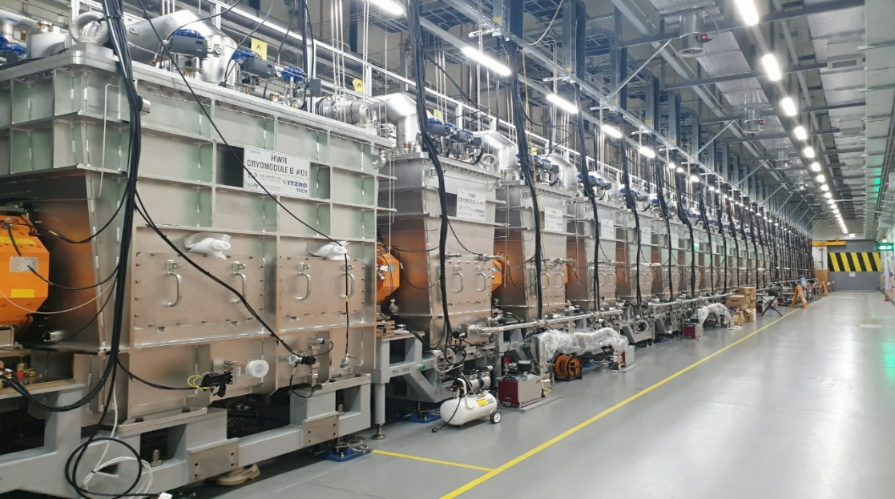
QWR and HWR Cryomodules for Heavy Ion Accelerator in RAON/RISP
Heavy-Ion Accelerator Research Institute, IBS
Youngkwon Kim
2023. 2. 16

Slide 2

Contents
Introduction
  Overview
  RAON layout
  Project milestone
  Introduction of SCL3
Introduction on cryomodule
Design issue of cryomdoule
Mass production of SCL3 cryomodules
Installation and commissioning
1
2
3
4
5

Slide 3
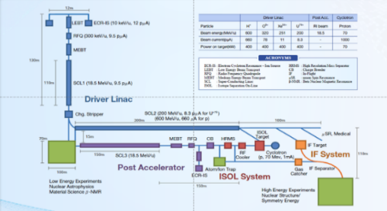
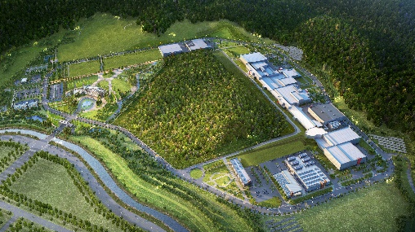
Overview
Goal: To build a heavy ion accelerator complex RAON,
for rare isotope science research in Korea.
* RAON - Rare isotope Accelerator complex for ON-line experiments
Budget: KRW 1,432 billion (US$ 1.26 billion, 1$=1,135krw)
- accelerators and experimental apparatus : 460.2 billion won
- civil engineering & conventional facilities : 972 billion won (incl. site 357 billion won)
Period: 2011.12 ~ 2021.12
System Installation Project
Development, installation, and commissioning of the accelerator systems that provides high-energy (200MeV/u) and high-power (400kW) heavy-ion beam
Providing high intensity RI beams by ISOL and IF
ISOL: direct fission of ²³⁸U by 70 MeV proton
IF: 200 MeV/u ²³⁸U (intensity: 8.3 pμA)
Providing high quality neutron-rich beams
e.g., ¹³²Sn with up to 250 MeV/u,
up to 10⁹ particles per second
Providing More exotic RI beam
production by combination of ISOL and IF
Facility Construction Project
Construction of research and support facility to ensure the stable operation of the heavy-ion accelerator, experiment systems, and to establish a comfortable research environment
※ Accelerator and experiment buildings, support facility, administrative buildings, and guest house, etc.

Slide 4
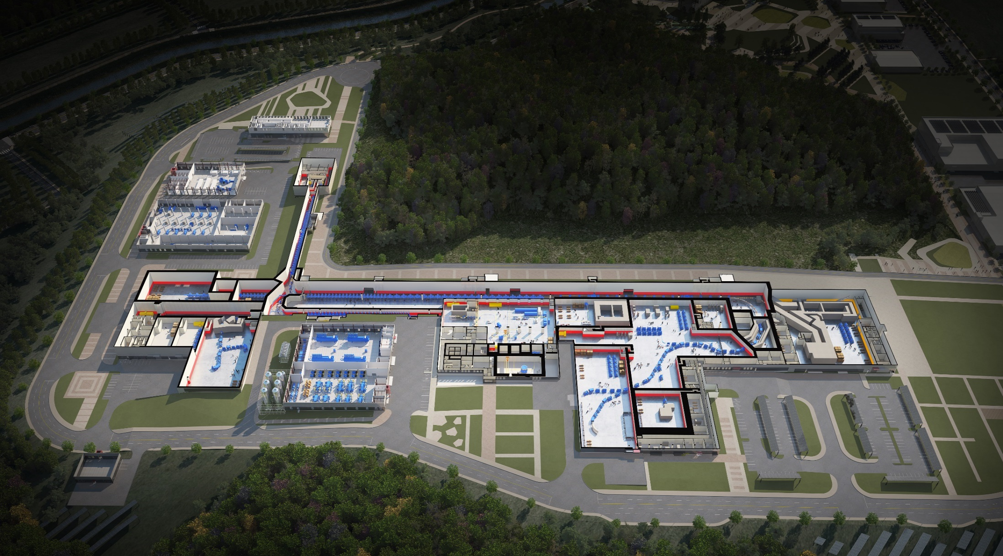

RAON layout
Control
Center
Utility
ECR IS
SCL1
ISOL System
HPMMS/
CLS
IF System
SCL3
SCL2
BIS
μSR
NDPS
KOBRA
Cyclotron
HRS
LAMPS
SCL1 has been decided to be postponed
: SCL3 is going to be taking a role of SCL1 in the early operation

Slide 5
Project milestone
Project milestone of RAON were modified 3 times as in 2015, 2018, and 2021 due to;
  Too optimistic and aggressive plan at planning phase of RAON
  RAON project launched with absolutely nothing prepared for the project: no people, no facility, no technology
  A lot of trial & errors from lacks of technology and experience during implementation
Current status
  To separate installation of low energy linac(SCL3) and high energy linac(SCL2) as phase 1 and phase 2, respectively
  Beam commissioning of SCL3 is on-going and planned to finish in April 2023.
  The 1st step of phase 2, R&D of SCL2 cryomdoules will go during coming 3 years, 2023~2025

Slide 6
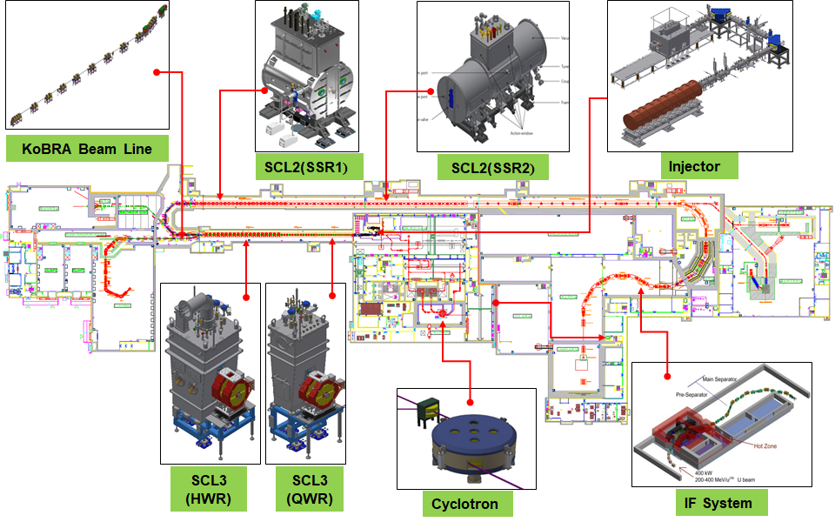
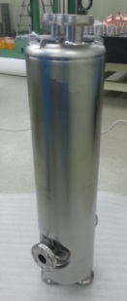
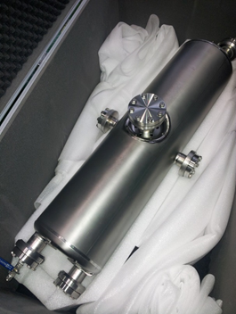
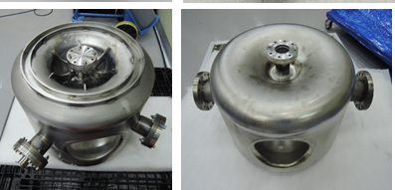
Introduction on SCL3
Layout of RAON
RF Parameter of QWR and HWR
 | QWR | HWR
β_{opt} | 0.047 | 0.12
f [MHz] | 81.25 | 162.5
L_{eff} | 173.5 | 221.5
R/Q [Ω] | 469 | 295
E_{p}/E_{acc} | 5.7 | 5.2
B_{p}/E_{acc} [mT/(MV/m)²] | 10.4 | 9
E_{acc} [MV/m] | 6.1 | 6.6
V_{acc} [MV] | 1.06 | 1.46
QR_{s} | 18.1 | 36.8
 | Cavity | # of cav. | # of CM | Cav. Op. T (K)
SCL1,3 | QWR | 1 | 22 | 4.5
 | HWR | 2 | 13+2 | 2.05
 |  | 4 | 19 | 2.05
SCL2 | SSR1 | 3 | 23 | 2.05
 | SSR2 | 6 | 23+2 | 2.05

Slide 7
Contents
Introduction
Introduction on cryomodule
  Role of cryomodule
  Requirements for RAON cryomodule
  Configuration of RAON cryomdoule
Design issue of cryomdoule
Mass production of SCL3 cryomodules
Installation and commissioning
1
2
3
4
5

Slide 8
Role of cryomodule
Integration of cavities, power couplers, tuners, cryogenic pipelines, etc.
Cryomodule maintains operating condition of superconducting cavities
  Thermal insulation for cryogenic operation
  Vacuum insulation
  Shielding of earth’s magnetic field (500 mG → ~10 mG)
  Alignment of cavity
Interface between the components of accelerators and utilities
  Warm section (vacuum chamber, quadruple magnets, beam pipes, etc.)
  Valve box of CDS (cryogenic distribution system)
  Pressurized air for actuator(cryogenic valve, gate valves, etc.) or cooling system(inner conductor, etc.)
  Signal lines (temperature and pressure sensors, valves, actuators, etc.)
  RF transmission lines, and so on…

Slide 9
Requirements for RAON Cryomodules
 |  | QWR | HWR CMA | HWR CMB
Size | Width | Less than 1.6 m
 | Length, mm | 610 | 1130 | 2010
 | Height | Less than 3.5 m
Operating Temp. | THS | 40 K
 | Pipe lines | 4.5 K or 2.05 K
 | Cavity | 4.5 K | 2.05 K
Alignment | x, y | ± 1 mm
 | z (beam direction) | ± 1 mm
 | tilt | ± 0.28 °
Pressure ratings | Helium jacket / reservoir | Room temp.: 2 bar(a) internal Cold temp.: 4 bar(a) internal
 | THS cooling line | 20 bar(a) internal
 | Vacuum vessel | 1 bar (a) external
Magnetic shield |  | 15 mG
Vacuum | Cavity | Less than 10⁻⁹ mbar at cold
 | Vacuum vessel | Less than 10⁻⁵ mbar at cold

Slide 10
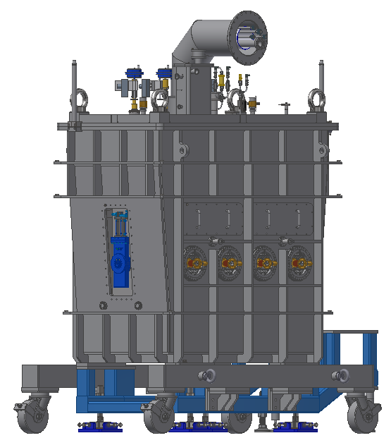
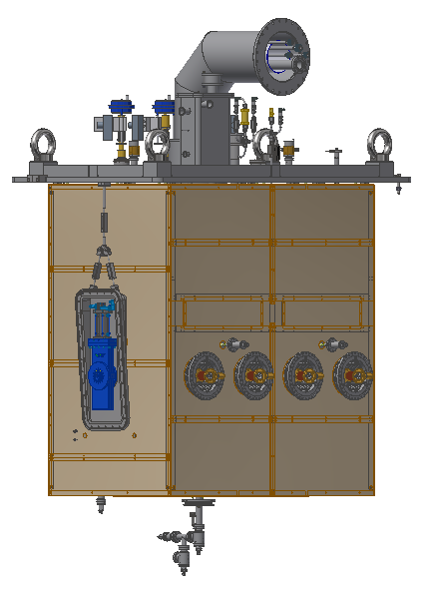
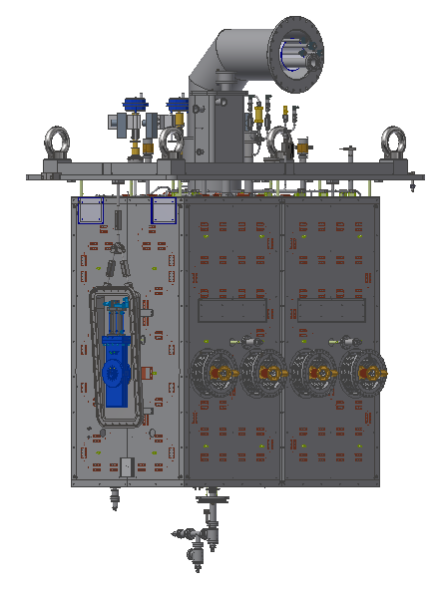
Configuration of RAON SCL3 Cryomodule
View port for open target
Magnetic shield
(mu-metal)
Thermal shield
(Al plate + Cu pipe)
Cryomodule assembly

Slide 11
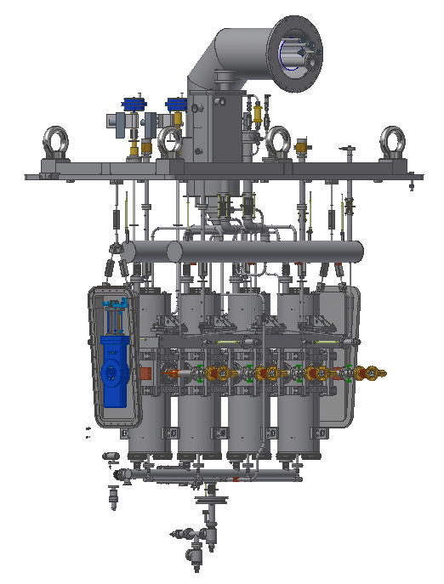
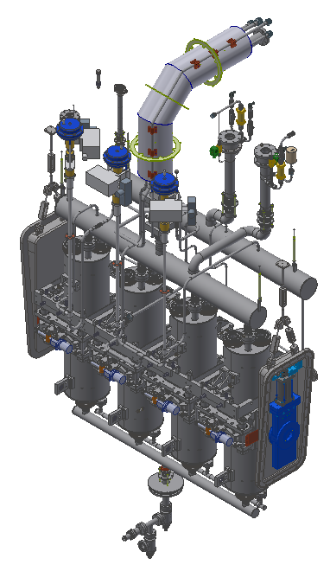
Rupture disk for helium guard
Helium guard for 2 K pressure safety
Cryogenic pipe lines to valve box
Pressure safety system
(rupture disk, relief valve, solenoid valve)
Cryogenic valve
4 K reservoir
Strong-back
2 K reservoir
Cavity vacuum manifold
Beamline gate valve
Power coupler
Tuner
All-metal angle valves

Slide 12
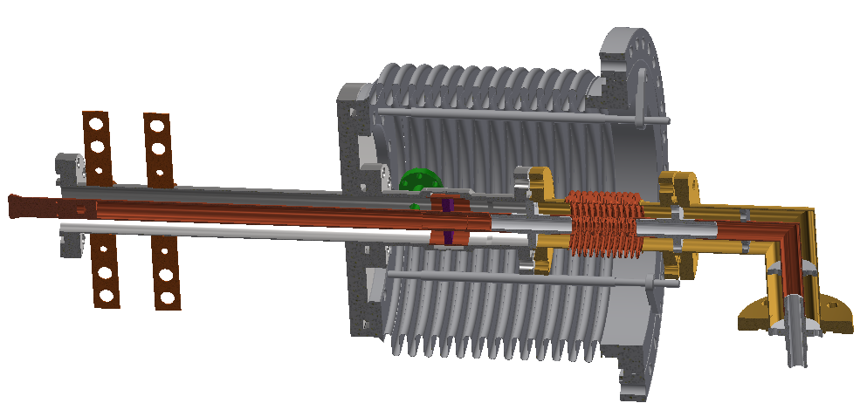
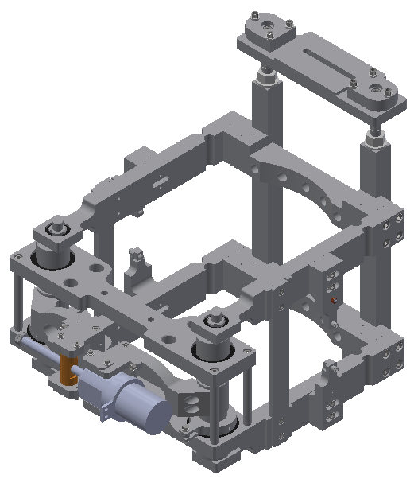
Inner conductor
Outer conductor
Thermal intercept
Power coupler
Contact with cavity beam port flange
Cryogenic motor
Tuner

Slide 13
Contents
Introduction
Introduction on cryomodule
Design issue of cryomdoule
  Thermal design
  Sizing for HeII heat transfer
  Alignment of cavity
Mass production of SCL3 cryomodules
Installation and commissioning
1
2
3
4
5

Slide 14
Thermal design
Thermal design
Minimizing heat ingress from the ambient
Estimation of thermal load at each temperature level (2 K, 4.5 K, 40 K , etc.)
➔ Determine the size of cryogenic system
Convection
  No convection in cryomodule by vacuum pumping below 10⁻⁵ mbar
Conduction
  Reducing cross-sectional area and increasing heat transfer path
  Thermal intercepts connected with intermediate temperature (40 K and 4.5 K)
Radiation
  Thermal shield cooled by GHe (tunnel) or LN2 (test facility)
  Multilayer insulation (MLI)

Slide 15
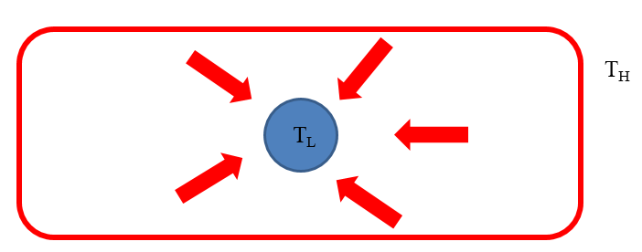
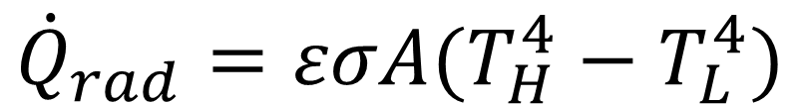
Thermal design
Radiation heat load
$${\dot{Q}}_{rad}=εσA(T_{H}^{4}−T_{L}^{4})$$
Using material with shine surface(small ε) or MLI(multilayer insulation)
Reducing temperature difference
σ – Boltzmann constant = 5.67 *10⁻⁸ W/m²
A – emitter area
ε – emissivity

Slide 16
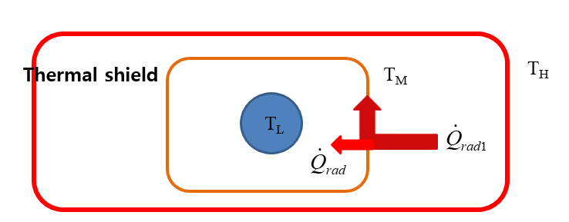

Thermal design
Thermal shield: reducing the temperature difference
$${\dot{Q}}_{rad}=εσA(T_{H}^{4}−T_{L}^{4})$$
Using material with shine surface(small ε) or MLI(multilayer insulation)
Reducing temperature difference
$$({300}^{4}−2^{4})/({40}^{4}−2^{4})=3164.1$$

Slide 17
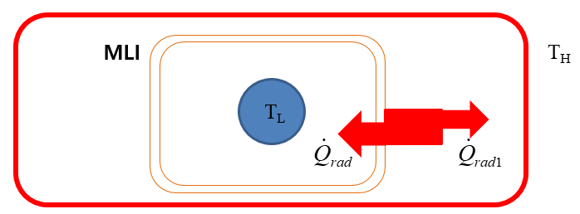
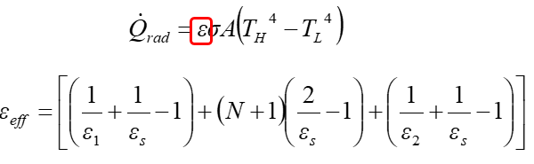
Thermal design
MLI: reducing effective emissivity
$${\dot{Q}}_{rad}=εσA(T_{H}^{4}−T_{L}^{4})$$
Using material with shine surface(small ε) or MLI(multilayer insulation)
Reducing temperature difference

Slide 18
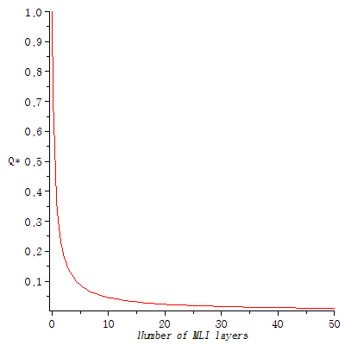
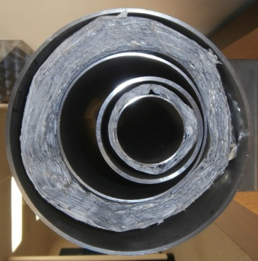
Thermal design
MLI: reducing effective emissivity
Vacuum Jacket
MLI
LN₂
LHe
Analytical calculation!!!
➔ How many layers? Actual heat ingress through MLI??

Slide 19
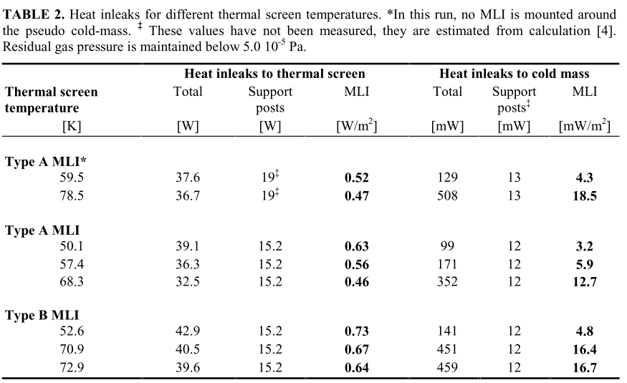
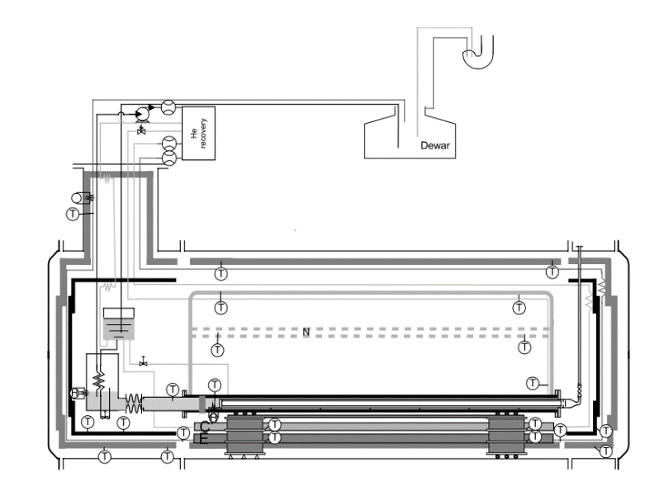
Thermal design
Actual heat flux with THS and MLI
Worst case scenario calculation [1]
  10⁻⁴ Torr, e=0.2, keff=0.15 W/m-K: 2.5 W/m² at 50 K (four 15 layers MLI)
  10⁻⁴ Torr, e=0.06, keff=0.15 W/m-K: 0.094 W/m² (two 12 layers MLI)
Experiment with LHC magnet [2]
  0.8 W/m² at 50 K (30 layers MLI)
  0.05 W/m² at 1.9K (10 layers MLI)
[1] E.F. Daly et al., Spallation neutron source cryomodule heat loads and thermal design, Adv. Cryog. Eng, vol. 47A, p531-539
[2] L. Dufay et al., A large-scale test facility for heat load measurements down to 1.9 K, CEC/ICMC2001, p16-20, July 2011, Madison, Wisconsin, USA

Slide 20
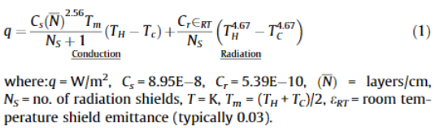
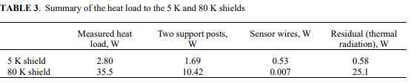
Thermal design
Actual heat flux with THS and MLI
Empirical formula [3]
Experiment with ILC cryomodule in KEK [4]
  1.51 W/m² at 80 K (30 layers MLI)
  0.041 W/m² at 5K (10 layers MLI)
[3] T.C. Nast et al., Multilayer insulation considerations for large propellant tanks, Cryogenics, 64, p105-111, 2014
[4] N. Ohuchi et al., Study of thermal radiation shields for ILC cryomdule, Adv. Cryog. Eng., p929-936, 2012

Slide 21
Thermal design
Actual heat flux with THS and MLI
Thermal load through MLI for RAON cryomodule thermal load estimation
  300 K to 40 K with 30 layers of MLI: 1.5 W/m²
  40 K to 2 K with 10 layers of MLI: 0.05 W/m²

Slide 22
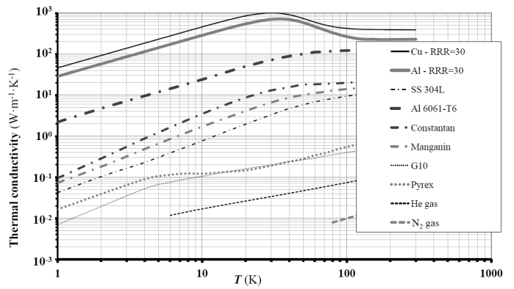
Thermal design
Conduction heat load
Increasing heat transfer path
Using low conductivity materials such as GFRP, STS, etc.
Reducing cross-sectional area
  P. Duthil, Material properties at low temperature

Slide 23
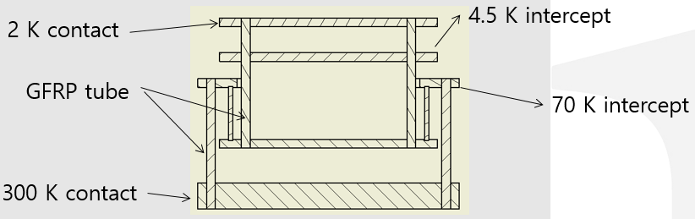
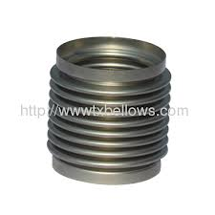
Thermal design
Conduction heat load
Support post
  T. Nicol, “Design and analysis of the SSC dipole magnet suspension system.”, 1989, IISC
Bellows: reducing area and increasing length
Warm-to-cold transition beam pipe

Slide 24


Thermal design
Thermal intercepts
Cross-sectional area: A
Thermal conductivity: k
Length: L
4 K
$$\dot{Q_{4K}}$$
L
300 K
T (K)
$$\dot{Q_{4K}}=−kA\frac{∆T}{L}$$
x

Slide 25

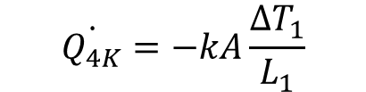
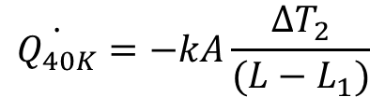
Thermal intercepts
Cross-sectional area: A
Thermal conductivity: k
Length: L
4 K
$$\dot{Q_{4K}}$$
L₁
L-L₁
300 K
T (K)
$$\dot{Q_{40K}}$$
Thermally connected with
thermal shield
$$\dot{Q_{4K}}=−kA\frac{{∆T}_{1}}{L_{1}}$$
$$\dot{Q_{40K}}=−kA\frac{{∆T}_{2}}{{(L−L}_{1})}$$
x₁
x
Reduced 4 K thermal load but NEW 40 K thermal load !!!!
➔ How to determine the intercept position??

Slide 26



Thermal intercepts
How to determine the intercept position? or How to optimize the thermal load ?
Coefficient of Performance:
$$COP=\frac{Q_{L}}{W}$$
$${COP}^{−1}=\frac{W}{Q_{L}}$$
: Work required for 1 W cooling at low temperature (T_{L})
T_{H}
 | Ref. 1 |  | Ref. 2 |  | Ref. 3
 | COP⁻¹ | COP ratio | COP⁻¹ | COP ratio | COP ratio
2 K | 800 | 3.2 | 714 | 3.66 | 3
4.5 K | 250 | 1 | 200 | 1 | 1
40 K | 25 | 0.1 |  |  | 0.1
77 K | 14 | 0.056 | 16 | 0.08
Q_{H}
Ref.
W
Q_{L}
T_{L}
COP ratio = (COP⁻¹_{at T}) / (COP⁻¹_{4.5K})
$$Q_{eq}=3Q_{2K}+Q_{4.5K}+{0.1Q}_{40K}$$
Position minimizing equivalent thermal load!
C. Pagani et al., Cryomodule design, assembly and alignment, SRF 2003
E. Chojnacki et al., Cryogenic heat load of the Cornel ERL main cryomodules, SRF 2009
F. Casagrande et al., Integrated thermal analysis of the FRIB cryomodule design, IPAC2012

Slide 27

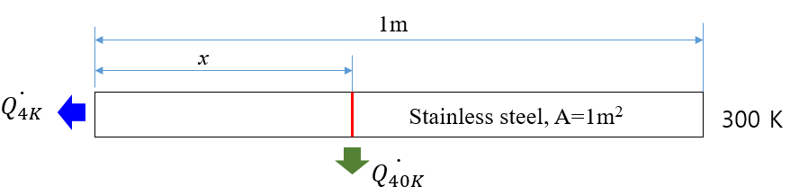
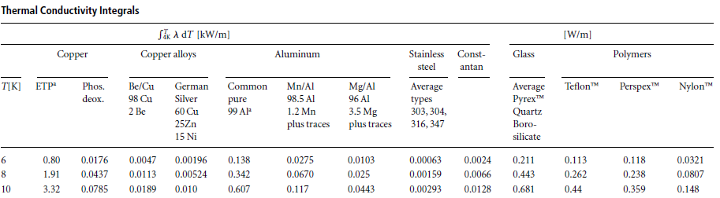
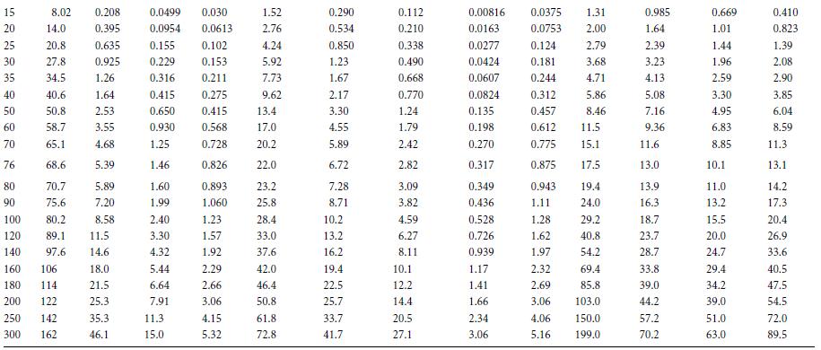

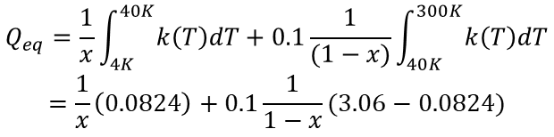


Simple example
4 K
$$Q_{eq}=Q_{4.5K}+{0.1Q}_{40K}$$
$$Q_{eq}=\frac{1}{x}\int_{4K}^{40K}{k\left(T\right)dT}+0.1\frac{1}{(1−x)}\int_{40K}^{300K}{k\left(T\right)dT}$$
$$=\frac{1}{x}\left(0.0824\right)+0.1\frac{1}{1−x}(3.06−0.0824)$$
$$\frac{dQ_{ea}}{dx}=0$$
$$∴x≈0.35 m$$
J. W. Ekin, Experimental techniques for low temperature measurements

Slide 28
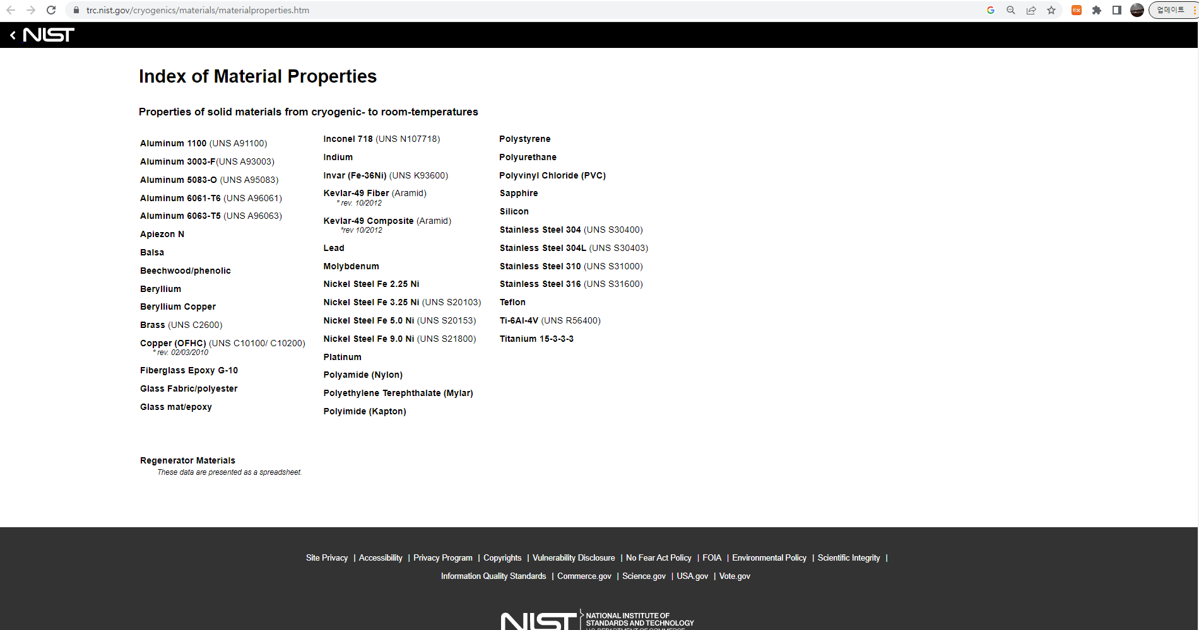
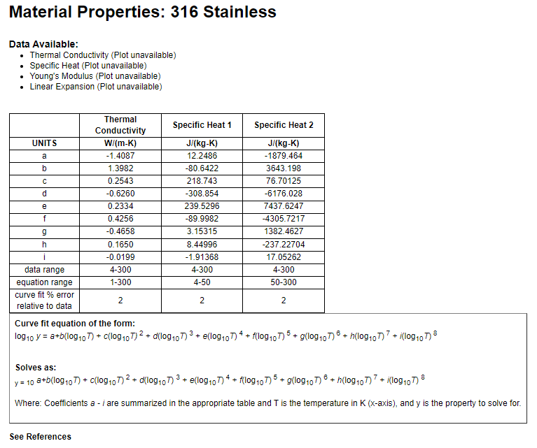
NIST cryogenic material properties
https://trc.nist.gov/cryogenics/materials/materialproperties.htm

Slide 29
Margin of thermal load estimation
Qtotal = F0 X (Qd X Fd + Qs X Fs)
  F0: Redundancy and degradation HRS (1.15)
  Fd: beam loss, uncertainty of dynamic load (1.3 ~ 1.1)
  Fs: Uncertainty of static load (1.3~1.1)
50 % margin for estimated thermal load
Estimated and measured static thermal load for cryomodules
Heat load |  | QWR (22 EA) |  |  | HWR CMA (13+1 EA) |  |  | HWR CMB (19 EA)
 |  | 2.05 K | 4.5 K | 35 – 55 K | 2.05 K | 4.5 K | 35 – 55 K | 2.05 K | 4.5 K | 35 – 55 K
Estimated without margin | Static | - | 5.0 | 55.5 | 3.0 | 3.0 | 78.6 | 4.5 | 5.0 | 121.0
Estimated with 50% margin | Static | - | 7.5 | 83.3 | 4.5 | 4.5 | 117.9 | 6.8 | 7.5 | 181.5
Measured in tunnel (average)* | Static | - | 4.5 |  | 4.3 | 5.1 |  | 6.1 | 6.8
*: measurement result shown in later slide for static thermal load

Slide 30
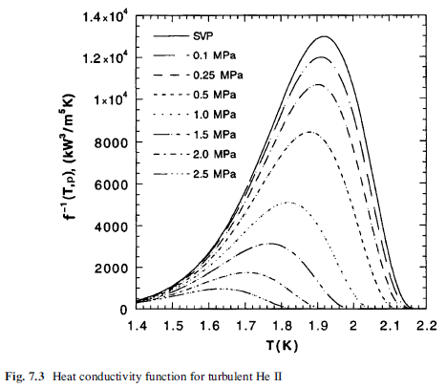
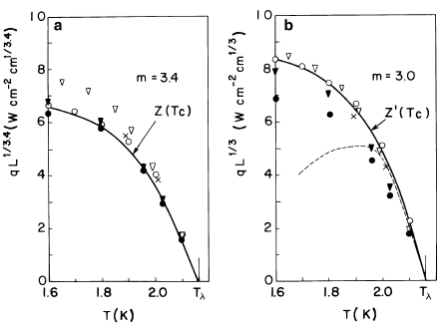

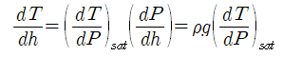


Sizing for HeII heat transfer
He II heat transfer
Generalized steady-state limiting heat flux
Thermal conductivity function at 2.05K: 6500 kW³/m⁵〮K
Depth of HeII in helium jacket: ~1 m
Peak heat flux:
, where
Peak heat flux=0.969 W/cm² ∼1W/cm²
V. Sciver, Helium cryogenics 2nd ed.
T. Peterson, Notes about the limits of heat transport from a TESLA helium vessel with a nearly saturated bath of HeII

Slide 31
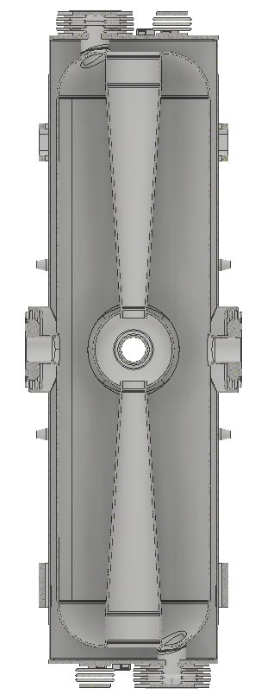
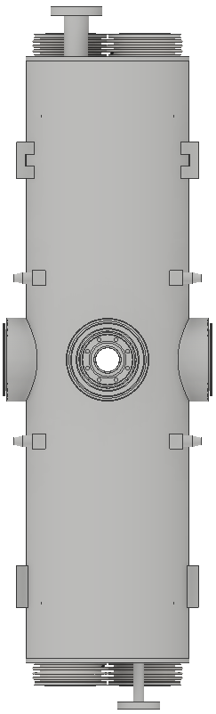

Sizing for HeII heat transfer
He II heat transfer: sizing of helium jacket and chimney
He vessel design: 2 K LHe heat transport
  Maximum heat flux: 1 W/cm², no surface boiling
  Gap b/w cavity and he vessel, diameter of vertical tube
 | gap (cm)
HWR | 0.013
SSR1 | 0.038
SSR2 | 0.058
d
d
h
g
h
1 cm gap between cavity and helium jacket
cavity
 | HWR CMA | HWR CMB | SSR1 | SSR2
Total thermal load (W) | 14.0 | 26.1 | 29.6 | 112.7
Thermal load per cavity (W) | 7.0 | 6.5 | 9.9 | 18.8
Diameter of vertical tube (mm) | 37 |  | 44.7 | 60
Allowable thermal load (W) | 10.8 |  | 15.7 | 28.3

Slide 32
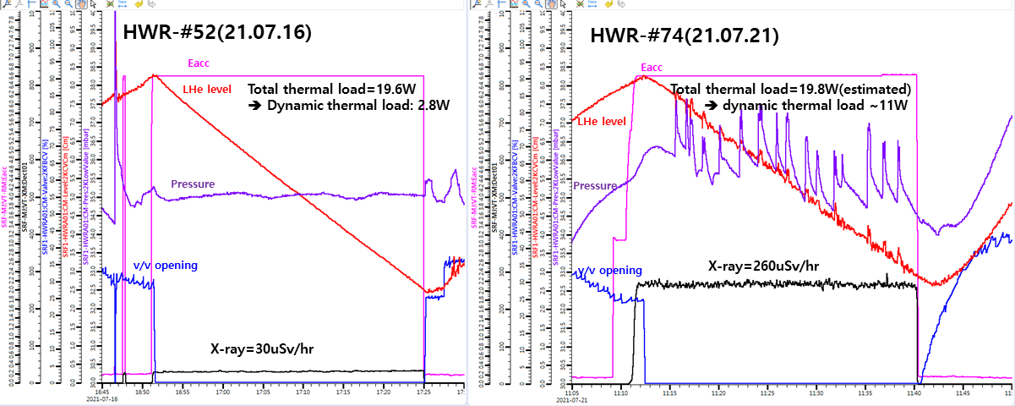
Sizing for HeII heat transfer
Abnormal pressure fluctuation due to insufficient heat transfer area in superfluid helium
HWR CMB-#08
Q_{s} per cavity ≒ 4.2 W
Q_{t} of HWR-#52 ≒ 6 W
Q_{s} per cavity ≒ 2.2 W
Q_{t} of HWR-#74 ≒ 13.2 W while allowable thermal load is 10 W
➔ Fluctuation of pressure and liquid level

Slide 33
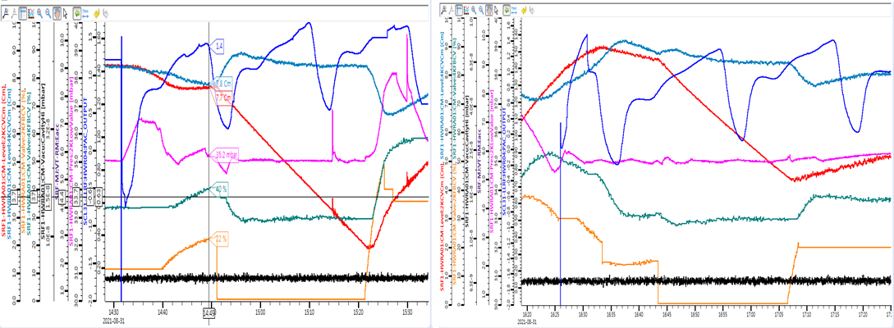
Sizing for HeII heat transfer
Abnormal pressure fluctuation
HWR-#99 of HWR CMB-#18
Pressure
Pressure
E_{acc} = 6.6 MV/m, Q_{d}= 9.6 W, Q_{t} of #99 = 12.6 W
E_{acc} = 6.4 MV/m, Q_{d}= 8.6 W, Q_{t} of #99 = 11.6 W
Limiting heat flux is between 11.6 W and 12.6 W while the estimated one is 10.8 W

Slide 34
Alignment of cavity
Requirement of cavity alignment
  x, y, z: ± 1mm (peak-to-peak), tilt: ± 0.28°
Cavities should be assembled precisely in the cryomodule
Position of cavity can be change by;
  Vacuum pumping: deformation of vacuum chamber
  Thermal contraction by cool-down: deformation of cavity, supporting system, etc.
  ➔ Position of cavity should be monitored or measured during vacuum pumping and cool-down

Slide 35
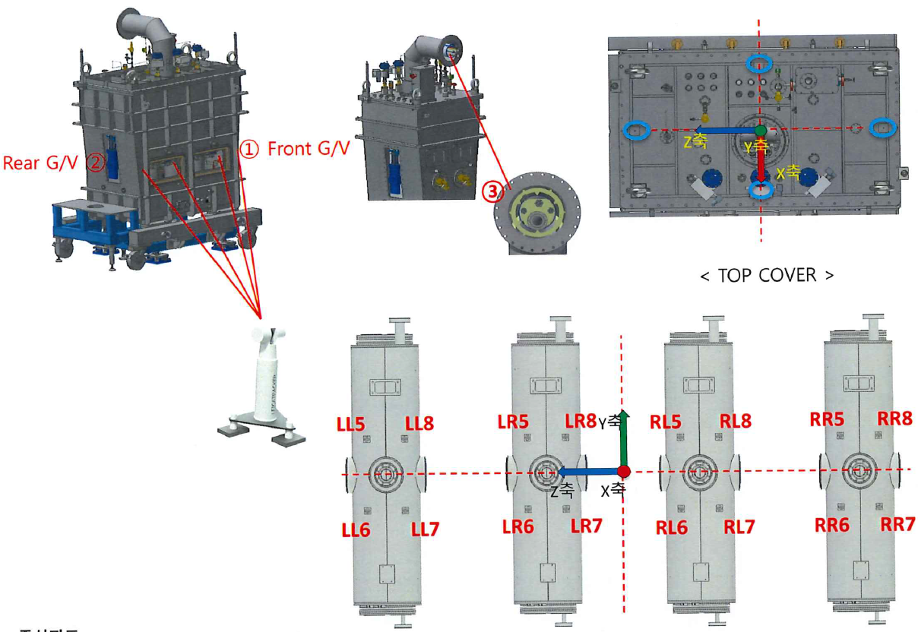
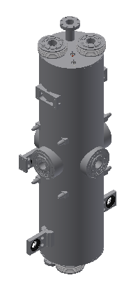
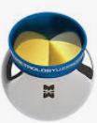
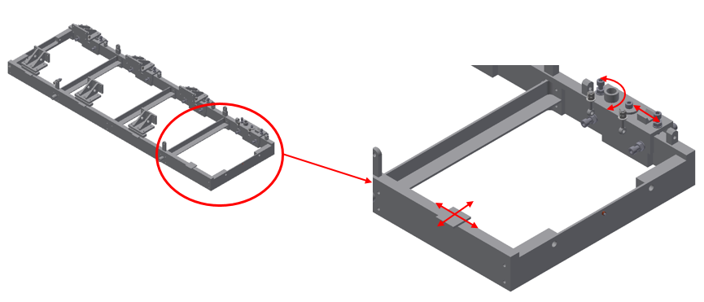
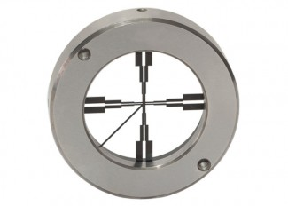
Alignment of cavity
Precision assembly in cyromodule
Fiducial post for laser tracker
Connection to strong back
Lase tracker
Beam port
Cavity position measurement during assembly
Open target for cavity displacement measurement
Dressed cavity
Strong-back for cavity support

Slide 36


Alignment of cavity
Displacement measurement by optical method
Reference
Measurement of open target position before and after cool-down
Micro Alignment Telescope (MAT)
Measurement of cavity’s displacement before and after vacuum pumping and cool-down
Location of the beam port can be estimated by the displacement of the open targets

Slide 37

Alignment of cavity
Prototype test of displace measurement in the prototype cryomodule with LN2
Open targets on the beam ports to know the actual position of beam ports
To check the repeatability and to know the amount of vertical calibration

Slide 38


Alignment of cavity
Repeatability of cavity position: QWR CM

Slide 39

Alignment of cavity
Repeatability of cavity position: HWR CMB
Horizontal position of beam line can be estimated as the center line of left and right open target position
Vertical position of beam line can be estimated by the center line of left and right open target position and thermal contraction of cavity
Comparison of displacement of 1st and 3rd cool-down

Slide 40


Alignment of cavity
Calibration of cavity’s vertical position for warm assembly
Calibration value should include the displacement by the vacuum pumping and thermal contraction of supporting rod and cavity
Fixed position for the cavity’s thermal contraction

Slide 41


Alignment of cavity
Calibration of cavity’s vertical position for warm assembly
Calibration: 1.2 mm lower the beam port from the beam line (center line of gate valve)
In the 1st trial, error of beam port vertical position is less than 0.4 mm
In mass production, calibration value was changed considering the change of open target position based on the cool-down test results of cryomdoules.

Slide 42



Results for mass production cryomodules
HWR CMA
QWR CM
Calibration value for each cryomdoule
 | QCM | HCMA | HCMB
Vertical (mm) | -2.7 | -2.5 | -3.0
Horizontal (mm) | - | +1.0 | +1.0 (#1,#4) +1.8 (#2, #3)
HWR CMB

Slide 43
Contents
Introduction
Introduction on cryomodule
Design issue of cryomdoule
Mass production of SCL3 cryomodules
  Contract
  Schedule
  Changes in mass production
  Cavity fabrication
  Performance test
Installation and commissioning
1
2
3
4
5

Slide 44
Mass production of SCL3 cryomdoule
Contracts
 | SCL31 |  | SCL32
 | Products | Quantity | Products | Quantity
Final deliverables | QWR cryomodule | 22 | HWR cryomodule A | 15
 |  |  | HWR cryomodule B | 19
Subcomponents to be fabricated | Superconducting cavities | 18 | Superconducting cavities | 104
 | Power couplers | 20 | Power couplers | 104
 | Tuners | 22 | Tuners | 104
 | Cryostat | 21 | Cryostat A | 14
 |  |  | Cryostat B | 18
Contract amount | $ 9,065,128 |  | $ 25,457,148
Period | 2017. 12 ~ 2020. 07 |  | 2018. 05 ~ 2022. 01
Domestic vendor: VitzroTech
(cavity: RI as subcontractor)

Slide 45
Mass production of SCL3 cryomdoule
Items supplied by IBS
 | QWR | HWR
Superconducting cavities | 4 ea | 2 ea
Power couplers | 2 ea | 2 ea
Tuner | - | 2 ea
Cryomodules | 1 set | 1 each sets
Nb materials | 120 % of required quantity
Cryogenic motors for tuner | 22 ea | 105 ea
Pick-up | 22 ea | 106 ea
Beam line gate valve | 40 ea | 68 ea
Cavity vacuum valve | 44 ea | 34 ea
Cryogenic valves | 42 ea | 96 ea
Temperature sensors | 210 ea | 820 ea

Slide 46
Mass production of SCL3 cryomdoule
Acceptance test for final deliverable
 | QWR cryomodules | HWR cryomodules
Performance requirements | Total thermal load at 4.2 K below 20 W | Total thermal load at 2.05 K below 14.1 W (module A) below 26 W (module B)
Test conditions | E_{acc}: 6.1 MV/m Frequency: 82.15 MHz Cavity vacuum<5e-8 mbar Insulation vacuum<1e-5 mbar Resolution of frequency tuning< 5 Hz | E_{acc}: 6.6 MV/m Frequency: 162.5 MHz Cavity vacuum<5e-8 mbar Insulation vacuum<1e-5 mbar Resolution of frequency tuning< 5 Hz
Function test | Coupler: RF power supply more than 8 hours at room temperature Tuner: tuning range over 50 kHz Cavity alignment Operation of sensors, valves, and so on.
※ Vertical test must be done for all cavities before cryomodule assembly

Slide 47
Schedule for mass production
 | 2017 | 2018 |  |  |  | 2019 |  |  |  | 2020 |  |  |  | 2021
QWR
HWR
Contract(‘17.12)
cavity fabrication (’18.03 ~ ‘20.06)
module & tuner fabrication (‘18.03~’19.03)
coupler fabrication (‘18.03 ~ ‘20.01)
vertical test (‘18.08 ~ ‘20.07)
module assembly (‘19.07 ~ ‘20. 08)
Helium jacket issue based on the KGS (Korea Gas Safety)
horizontal test (‘19.08 ~ ‘20. 09)
Contract(‘18.05)
cavity fabrication (‘18.09~’21.06)
module fabrication (‘18.12 ~ ‘20. 06)
tuner fabrication (‘19.01 ~ ‘20. 04)
coupler fabrication (‘19.03 ~ 21.04)
vertical test (‘20.02 ~ ‘21. 07)
module assembly (‘20.09 ~ ‘21.10)
Fabrication delay due to COVID-19 issue in subcontractor (RI, Germany)
Design change of beam sphere and beam port
horizontal test (‘20.10 ~ ‘21. 11)

Slide 48

Changes in mass production
Reduction of df/dp of QWR cavity
 | Estimated (Hz/mbar) | Measured (Hz/mbar)
Prototype (bare) Beam port free | -37.9 | -33.4^{#2-1}, -37^{#3-1} -31^{#3-2}
Prototype (jacketed) Beam port free | 36.7 | 33.6^{#1-1}, 36.5^{#2-1}
Pre-production (jacketed) Beam port free | 12.7 | 13.97
Pre-production (jacketed) Beam port fixed | -4.6 | 5.2
F
 | A | B
Prototype | 115.7 | 148
Pre-production | 96.7 | 120
Force balance b/w cavity and helium jacket of cavity beam port
  Beam port-to-beam port length of the dressed cavity increases due to the helium pressure
  Reduction of outward force by reducing beam port flange size

Slide 49


Changes in mass production
Uniform LFD of QWR cavity
 | Calculated [Hz/(MV/m)²] | Measured [Hz/(MV/m)²]
Prototype (bare) Beam port free | -16.4 | -20^{#1-1}, -32.7^{#2-1} -17.4^{#2-2}, -44.6^{#3-1} -14.7^{#3-2}
QWR-#03(pre-production)
Before modification
(Cracks in welding point)
After modification
(Cracks in welding point)
LFD variation due to the welding of disk and rib on the top of the cavity
  Change the welding method from tack welding to line welding

Slide 50


Changes in mass production
Beam port and beam sphere design change of HWR cavity
Parameter | Original | Modified
Rounding of Beam tube | 5mm | 10mm
H of Beamport cup | 52.5mm | 49.5mm
Diameter of Ring | 120mm | 130mm
Width of Ring | 65mm | 67mm
Rounding of Ring | 30mm | 33mm
E_{peak}/E_{acc} | 5.54 | 5.05
Improvement EM performance of cavity
  FE starts around 6 MV/m while operating E_{acc} is 6.6 MV/m
  Decreasing E_{peak}/E_{acc} by 9.8 %
  Location of welding lines are moved away from the high E_{acc} region

Slide 51



Changes in mass production
Round top for HWR cavity (during prototyping)
Flat top
2nd prototype
1st prototype
1st prototype
2nd prototype
Multipacting suppression: MP band below 2 MV/m
Structural stability of cavity w/o stiffener
  Deformation and stress reduced by half
  - Max. deformation: 1.9 mm → 0.86 mm
  - Max. stress: 1.69 Gpa → 679 MPa

Slide 52


Cavity fabrication

Slide 53


Cavity fabrication
Outer conductor
Inner conductor

Slide 54








Cavity fabrication
Material
Material inspection
Visual inspection, Soaking test
Structural characteristics
Cutting of materials
Pressing & machining for parts

Slide 55

Cavity fabrication
Bare cavity

Slide 56






Cavity fabrication
Clamp-up test
Frequency adjustment before final welding
E-beam welding
Ultrasonic cleaning (USC)
BCP
HPR
High temperature heat treatment

Slide 57
Cavity fabrication
Full and light BCP procedure in detail
1st BCP
2nd BCP
3rd BCP
Clean room assembly
Light BCP
(dressed cavity)
Visual inspection
Visual inspection
Visual inspection
Cleaning
Visual inspection
Freq.,weight check
Freq.,weight check
Freq.,weight check
Ports & valve
assembly
Freq.,weight check
USC
(Liqinox, DI)
BCP
(Upper, ~50um)
BCP
(Lower, ~50um)
Leak test
BCP
(Lower, ~20um)
BCP
(Lower, ~50um)
USC
(DI water)
USC
(DI water)
Ar charging
USC
(DI water)
Freq.,weight check
Vertical test
Freq.,weight check
USC
(DI water)
Drying
(10 class cleanroom)
HPR
He jacketing
HPR
Drying
(10 class cleanroom)
Drying
(10 class cleanroom)
Drying
(10 class cleanroom)
* Weight check: estimation of etching depth

Slide 58



Cavity fabrication
BCP system
Closed-loop chemical circulation type
49%HF+69%HNO₃+85%H₃PO₄ (1:1:2)
Keeping Nb concentration in acid below 15g/L
Acid flow rate : 2~10LPM
Etch rate : 0.7~1㎛/min
Target removal : 120~150㎛(Bulk BCP) + 15~20㎛(light BCP, bare) + 15~20㎛(light BCP, jacketed)
Temperature control (23kW chiller) : below 15℃ during the process
  The acid is pre-cooled down to 5~9℃ in the acid storage tank. (cooling water temp. is just above freezing level of chiller)

Slide 59
Cavity fabrication
HPR procedure in detail
Visual inspection
USC
HPR
Drying
Clean assembly
Scratch, dent, oil
DI water, 50°C, 20 min.
Fixture installation
10 class cleanroom
HPR ports
DI water quality check (18MΩ)
Beam port
(5cm/min, 20rpm)
2ⅹHPR port
(5cm/min, 20rpm)
10 ~ 12 hours
2ⅹHPR port
(5cm/min, 20rpm)

Slide 60



Cavity fabrication
HPR system
Water pressure: 100 bar
Nozzle rotating speed : 20rpm
Nozzle/Cavity moving speed : 5cm/min
High pressure filter : 0.5㎛

Slide 61


Cavity fabrication
USC (Ultrasonic cleaning) system
Class1000 (ISO6) cleanroom
Double bath type
  1st bath(degreasing) : 1% liquinox
  2nd bath(rinsing) : DI water
Ultrasonic Power : 1.5kW
Ultrasonic Frequency : 40kHz
Heating up to 60℃

Slide 62



Cavity fabrication
He jacketing procedure
Thermal shock test
(LN2)

Slide 63
Cavity fabrication
Frequency Control during the whole fabrication
Target: 81.14 MHz ±10kHz before assembly in cryomodule

Slide 64




Cavity fabrication
Clean assembly
USC & HPR
Parts using USC | Parts not using USC
Less than 1 particle (≤ 0.3μm) /5s | Less than 1 particle (≥ 1.0 μm) /1s
Particle counting
Reference: TTC topical workshop on clean room assembly, 2014

Slide 65



Performance Test
Vertical Test
Vertical Test
Vacuum Chamber
Ion Pump
2K Reservoir
4K Reservoir
Vacuum Line
Cryostat
Top flange

Slide 66



Performance Test
Vertical Test
Vertical Test
Cryogenic valve
Ion pump
Vacuum pumping lines
& vacuum gauges
GHe supply & return
VLP return
Feedthroughs
LN2 supply & return
Vacuum pump
for cavity
Assembly area(clean room) for vertical test
Top flange in the vertical test pit

Slide 67





Vertical Test
Inner conductor
Outer conductor and bellows
Variable coupler
Motor

Slide 68


QWR VT results
$$Q_{0}=\frac{ωU}{P_{d}}$$
E_{acc}: 6.1 MV/m, Q₀=2.4e+8@4.2K, Number of cavity: 22 ea

Slide 69


QWR VT results
Baking of cavity and variable coupler
Acceptance rate: 56 % (18 pass / 32 test, 4 prototype cavity)
  Failure for multipacting conditioning due to insufficient baking of variable coupler
  Field emission due to contamination

Slide 70

HWR VT results
E_{acc}: 6.6 MV/m, Q₀=2.3e+9@2.05K, Number of cavity: 106 ea

Slide 71

HWR VT results
Acceptance rate: 76 %
  FE: 28 cases, MP failure: 3 cases, Vacuum failure: 3 cases, Malfunction of V/C: 2 cases

Slide 72

Performance vs. processing
① Hand HPR and baking for variable coupler (’19.12) ➔ overcoming MP failure
② N2 purging before the vacuum line connection (‘20.04)
③ 100 bar HPR for variable coupler bellows to prevent contamination of cavity(‘20.05)
④ Cleanroom management: cleaning tools, clothes, etc. (‘20.06)

Slide 73


Horizontal Test
Horizontal Test
Test Procedure
Installation in the bunker
Cavity frequency check & tuner operation test
Leak test and vacuum pumping for cavity
Leak test and Purging cryogenic pipes
Connecting cryogenic lines, signal cables, DC bias,
RF transmission lines, etc
Cool-down
Thermal shield cool-down by LN2
Cavity cool-down through cool-down line
4K Test
MP conditioning
Cable calibration
Static and total thermal load measurement
Field emission conditioning with pulsed RF power,
if necessary
2K Test
2 K pump-down: df/dp measurement (~3MV/m)
Q_{ext} measurement with VNA
Static and total thermal load measurement
LFD & tuner operation test
Alignment measurement
Tuner test at room temp. (~0.2 Hz/pulse, ~30 kHz span)

Slide 74


Horizontal test facility
Horizontal test bunkers
RF transmission line
Helium distribution lines
SSPA
Valve box for HT

Slide 75

Performance Test
Horizontal Test
Test setup

Slide 76




Performance Test
Horizontal Test
P&ID for cryomodule and cryogenic system
Recovery compressor and gas bag
Liquefier (280L/h) and dewar(3,000L)
Thermal shield cooled by LN2
Thermal intercepts
- 4 K intercepts: loop thermosiphon connected with 4 K reservoir
- 40 K intercepts: copper braid wire connected with thermal shield
3 cryogenic valves: 1 for cool-down and 2 for JT expansion
Heat exchanger to precool the LHe before 2 K expansion
Vacuum pumping system to maintain 35 mbar
Pump-down system(vacuum pumps): 1.5g/s each

Slide 77


Cool-down of cryomodule
Initial LHe cooling through a cool-down line
Cool-down history of HWR cryomodule

Slide 78


Multipacting conditioning (HWR cavity)
MP in low field (<1MV/m)
- P_{f} below 40 W
- Vacuum level fluctuation
Vaccum
P_{t}
P_{f}
E_{acc}
P_{f}
P_{r}
P_{t}
E_{acc}

Slide 79


Multipacting conditioning (HWR cavity)
Vaccum
MP in high field (<2MV/m)
P_{t}
E_{acc}
P_{f}
P_{t}
P_{f}
P_{r}
P_{f} increases in stepwise but P_{r} decreases

Slide 80

Conditioning effect during E_{acc} increase
X-ray: amount of field emission
➔ quick view of cavity’s performance
Conditioning of cavity (Burning of field emitter)
E_{acc} (Mv/m) | 3.5 | 4.0 | 4.5 | 5.0 | 5.5 | 6.0 | 6.6 | Remarks
HWR#13 (uSv/hr) | 8.5 | 48 | 352 | 800 | 3450 |  |  | Trip on 5.6
 | After trip → |  | 0.7 | 8 | 56 | 300 | 1250
HWR#32 (uSv/hr) | 4 | 89 | 223 | 400 |  |  |  | Trip on 5
 | After trip → |  |  | 65 | 300 | 430 | 1800

Slide 81


2K pump-down
Pressure
4.2 K @ 1bar
Phase transition around λ-point
Cavity temperature
LHe level
2.05 K @ 35mbar
2K pump-down
df/dp measurement during 2K pump-down (E_{acc} < 3MV/m)

Slide 82





Q_{ext} measurement with VNA
CM number | HWR #B07
CAV | HWR #51 | HWR #77 | HWR #80 | HWR #81
Freq [MHz] | 162.5 | 162.5 | 162.5 | 162.5
S₂₁ (dB) | -52.22 | -52.05 | -51.19 | -50.91
S₂₁ | 2.45E-03 | 2.50E-03 | 2.76E-03 | 2.85E-03
Q_{L} | 1.07E+06 | 8.01E+05 | 9.98E+05 | 1.13E+06
S₁₁ (dB) | -6.00E-02 | -8.00E-02 | -7.00E-02 | -6.00E-02
S₁₁ | 9.93E-01 | 9.91E-01 | 9.92E-01 | 9.93E-01
S₂₂ (dB) | -4.70E-01 | -3.80E-01 | -3.90E-01 | -4.40E-01
S₂₂ | 9.47E-01 | 9.57E-01 | 9.56E-01 | 9.51E-01
Q_{t} | 7.13E+11 | 5.14E+11 | 5.25E+11 | 5.58E+11
S₂₁’ (dB) | -51.96 | -51.82 | -50.96 | -50.66
S₂₁’ | 2.52E-03 | 2.56E-03 | 2.83E-03 | 2.93E-03
Q_{t}’ | 6.71E+11 | 4.87E+11 | 4.98E+11 | 5.27E+11
$$S_{21}^{′}=S_{21}−\frac{\left(S_{11}+S_{22}\right)}{2}$$
$$Q_{t}=\frac{1}{Q_{c}}{\left(\frac{2Q_{L}}{S_{21}}\right)}^{2}$$
$$Q_{c}≈Q_{L}$$
, since
$$Q_{0}\sim O\left({10}^{9}\right), Q_{c}\sim O({10}^{6})$$
H. Hahn et al., Calibration of the ERL cavity FPC and PU couplers, 2010

Slide 83


Q_{ext} measurement of QWR and HWR cavities
QWR
HWR
Requirement for Pickup Q_{ext}(Q_{t}) from LLRF system: two orders higher than Q₀
Power coupler Q_{ext} (Q_{c}): control bandwidth and required RF power
- Average control bandwidth: QWR (149 Hz), HWR (143 Hz)

Slide 84





Thermal load measurement
Measurement of thermal loads
Thermal load measured by boil-off calorimetry
Dynamic thermal load of each cavity
$$Q=\dot{m}h_{fg}=ρ_{l}\frac{dV}{dt}h_{fg}$$
Frequency [Hz]
$$Q_{dynamic}=Q_{t1}−Q_{static}$$
$$Q_{t1}$$
E_{acc}² [(MV/m)²]
, where is thermal load when only one cavity is in its operating E_{acc}
LFD measurement

Slide 85


df/dp and LFD measurement
Prototype cavity
df/dp and LFD measurement results
Comparison of VT and HT
Relatively larger df/dp of HWR cavities but lower pressure fluctuation at 2.05 K
- Pressure fluctuation: ~ ±1 mbar at 4.5 K, ~ ±0.3mbar at 2.05 K
Enhancement of cavity’s stiffness by tuner in cryomodule: 45 % lower df/dp and LFD

Slide 86

Thermal load measurement results
Dynamic thermal load of each cryomodule is sum of the dynamic thermal load of cavities in the cryomdoules

Slide 87


Static thermal load
Static thermal load change w.r.t. time during HT
Static thermal load of HT vs. tunnel
Wrong measurement
Main reason: Large mass (~40 Kg) of tuner
Static thermal load that we had measured were 5.6 W and 8.3 W for HWR CMA and HWR CMB, respectively while the average static thermal load measured during the experiments were 8.0 W and 10.7 W, respectively.
Average static thermal load
- HT: QWR (10.4 W), HCMA (9.6 W), HCMB (9.5 W)
➔ NOT THERMALIZED!!!
- Tunnel: QWR (4.5 W), HCMA (4.3 W), HCMB (6.1 W)

Slide 88

Dynamic thermal load of each cavity

Slide 89

Thermal load measurement of QWR cryomdoule in tunnel
E_{acc} of QCM #01~#06 (ramp-up section): 4 MV/m (Q_{t} < 1 W @ 4 MV/m)
Malfunction of level meter of QCM#14, QCM#21
Severe degradation of cavities in QCM #13, #14

Slide 90


Tuner test
Wide range test (±100 Hz span)
- 20 pulse/step * 50 steps * 3 times up and down
- Control bandwidth ~ 130 Hz
- Tuning resolution: 0.2~0.25 Hz/pulse

Slide 91

Tuner test
Narrow range test
- 20 pulse/step * 3 steps * 20 times up and down
- Small backlash (~a few Hz)

Slide 92






Tuner test
df Measurement
FRQ-DOWN
FRQ-UP
df Measurement
FRQ-DOWN
FRQ-UP
Noise during the operation of tuner (df of cavity ~ 300 Hz)
- Noise removed by reducing the motor speed to 1/32

Slide 93

Phase and amplitude locking test of cryomdoule

Slide 94


Slide 95
Contents
Introduction
Introduction on cryomodule
Design issue of cryomdoule
Mass production of SCL3 cryomodules
Installation and commissioning
  Installation
  Beam commissioning
1
2
3
4
5

Slide 96


Installation

Slide 97




Installation
Cryomodule and warm section is clean assembled in the portable clean booth in tunnel
Particle counts (size=0.5um above/10min.) were less than 30 counts

Slide 98






Installation
Cryogenic systems
SCL3 plant: 4.2 KW at 4.5 K, SCL2 plant: 13.5 kW at 4.5 K
Cold box
Warm compressors
LHe distribution box
Welding VBx to CM
VBx connection
QWR CMs, VBx in rear side

Slide 99



Beam commissioning
SCL31 section: Ar beam (2.47 MeV/u, 34 uA)
Injector
SCL31: 22 QWR cryomodules
(‘22.12.16) SCL31 beam commissioning
14.5GHz ECR-IS
LEBT
RFQ
MEBT
(‘22.10.07) 5 QWR cryomodules
Beam commissioning of whole SCL3 is on-going
  MP conditioning of 76 HWR cavities were finished.
  Beam commissioning for SCL3: ‘23. 3. 24
  SCL3-KoBRa beam commissioning: ‘23. 4. 14
  Warm-up and maintenance: ~ ‘23. 8. 31
  - QWR#20, HWR CMA-#1, HWR CMB-#11
  - VLP return cryogenic valves in VBxs
  Experiment in KoBRA: ’23. 12. 01 ~

Slide 100


Thank you

Slide 101

Sizing for HeII heat transfer
Abnormal pressure fluctuation: other reason??
Increase of JT valve opening
Sudden stop of pumping

Slide 102


Pulse conditioning
X-ray
High E_{acc} without quench
(Max. P_{out} of SSPA = 4 kW)
Monitoring X-ray value
P_{t} signal in oscilloscope
P_{f}
Quench
P_{r}
P_{t}

