Slide 1
Fabrication Technology of QCS magnets for Super-KEKB
Asian School on Superconductivity and Cryogenics for Accelerators
February 13-19, 2023
TAEHYUN KIM

Slide 2
Contents
0
What is MITSUBISHI ELECTRIC?
Superconducting magnets and coils
3-1. Introduction of QCS magnets for Super-KEKB
3-2. Fabrication of QCS magnets
3-3. Accurate assembly of cryostat
3-4. High voltage testing
4. Wiring
5. QCSR in factory
6. Conclusion

Slide 3
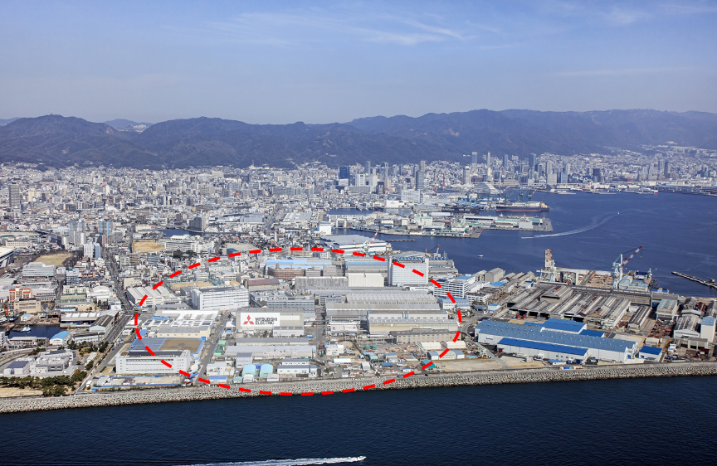
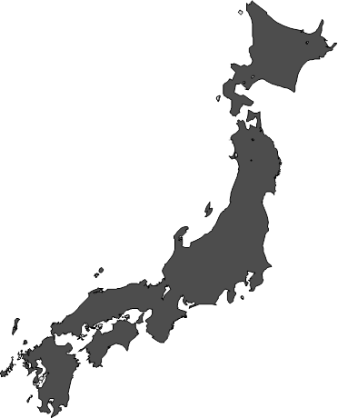
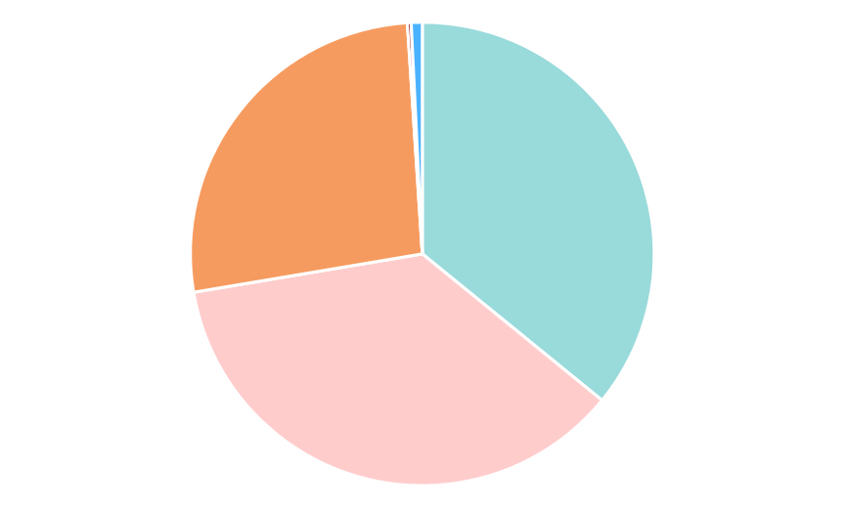

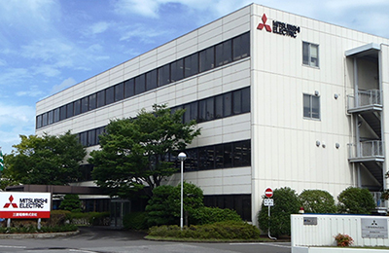

What is MITSUBISHI ELECTRIC?
1
Energy Systems Center(ESC)
KOBE
Sales ratio by business field
Accelerator/
Superconductor
application systems
Energy
(hydroelectric)
Energy
(nuclear)
Power
system
solution
Energy
(thermal)
Nagasaki
Yokohama
Power information
& communication system
Electrical Motor
Kobe
ESC
Plant Engineering
Generator
(Thermal, Hydro, Nuclear)
Instrument & Control System
Electrical grid control & monitoring system
Accelerator/Superconductor application
What is MITSUBISHI ELECTRIC?
3

Slide 4
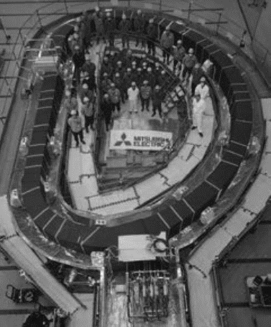
Superconducting magnets and coils
2
・Mitsubishi Electric manufactures SC-magnets and SC-coils from 1980’s
For example,
SC-Combined Function magnets for Neutrino Beam Line at J-PARC
Final Focus SC-magnets, QCS-R/L, for SuperKEKB
Pion Capture Solenoid for COMET (just going)
Poloidal Field SC-coils, EF and CS, for JT-60SA
Winding Pack of Toroidal Field coils for ITER
・Mitsubishi Electric have developed Continuous
automatic winding cable-in-conduit conductor (CICC) techniques
If you interest, check the following.
“https://www.giho.mitsubishielectric.co.jp/giho/pdf/2019/1911113.pdf”
It is used to manufacture large scale SC magnets for experimental fusion reactor.
First Winding Pack of TF coil for ITER in JAPAN
Source: Abstracts of CSSJ conference Vol.97 P125

Slide 5
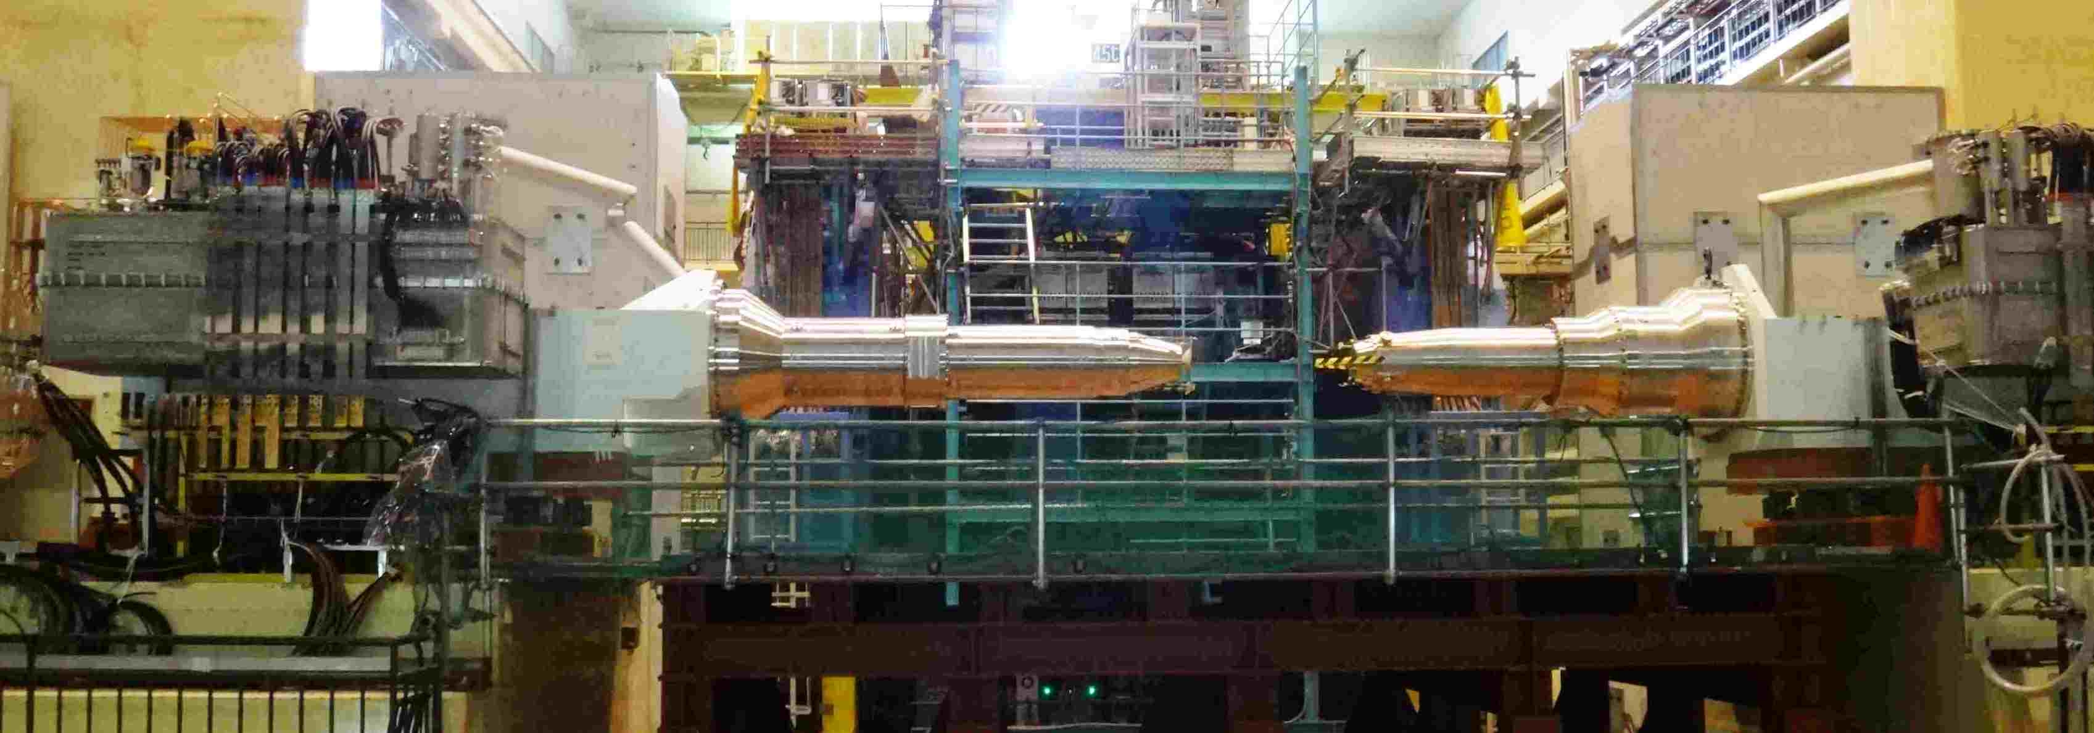
Introduction of QCS magnets for Super-KEKB
3-1
Belle-Ⅱ Particle Detector
QCS-R
QCS-L
Interaction Point
QCS is final focus system of SuperKEKB
（Target luminosity is 40 times as KEKB）
Squeezing to extremely small beam at interaction point
（1/20 as KEKB，10μm×0.05μm）
⇒Many superconducting magnets are installed in cryostats
for beam focusing.
（Requirement of accurate winding and assembly）

Slide 6
Introduction of QCS magnets for Super-KEKB
3-1
Horizontally flipped previous photo

Slide 7
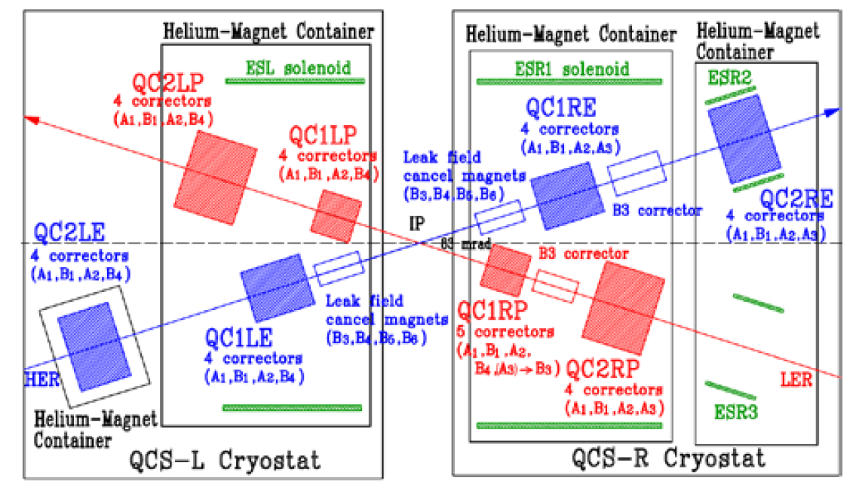
Introduction of QCS magnets for Super-KEKB
3-1
Layout of magnets
Horizontally flipped previous photo
Superconducting quadrupole magnets
for beam focusing
Electron（7GeV）
Positron（4GeV）
Superconducting solenoid magnets
for compensating of Belle Ⅱ detector field

Slide 8

Introduction of QCS magnets for Super-KEKB
3-1
Front region of QCS-R
Electron
（7GeV）
Positron（4GeV）

Slide 9
Introduction of QCS magnets for Super-KEKB
3-1
QCS-R
QCS-L
Service cryostat
3287 mm
2724 mm
Including
30 magnets
Including
25 magnets
Magnet cryostats
Superconducting magnets in Magnet cryostats
 | QCS-R | QCS-L
Quadrupole magnets | 4 | 4
Solenoid magnets | 3 | 1
Corrector magnets | 23 | 20
Fabrication
at MELCO
Assembly of magnet and service cryostats in MELCO

Slide 10
Fabrication of QCS magnets
3-2
Beam line with quadrupole of QCS-R
Electron
（7GeV）
Positron（4GeV）
Quadrupole magnet
Solenoid magnet

Slide 11
Fabrication of QCS magnets
3-2
Electron
（7GeV）
Positron（4GeV）
Quadrupole magnet

Slide 12
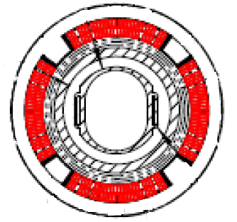
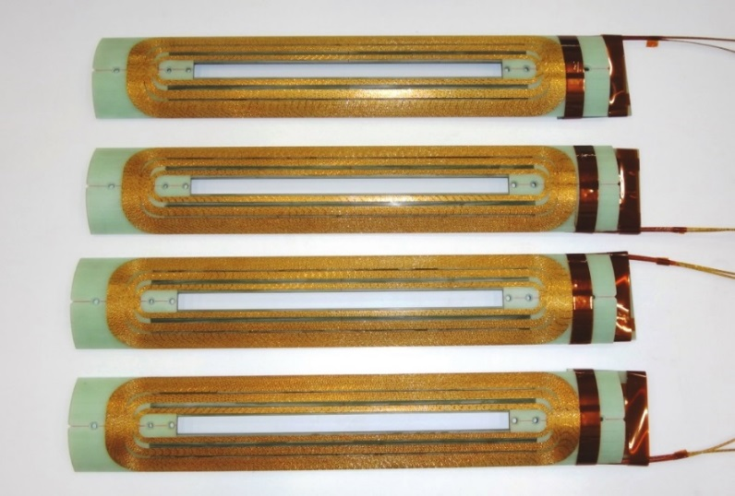
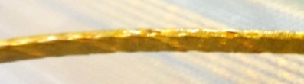
Fabrication of quadrupole magnet
3-2
Accurate fabrication
Cable winding
Rutherford type NbTi cable
Width 2.5 x Thickness 0.93 mm
Cross section
of QC1P
Coil length and thickness measured after curing
 | QC1LP | QC1RP | QC1LE | QC1RE
Design （mm) | 384 |  | 430
Average length（mm） | 384.00 | 383.98 | 429.98 | 429.92
1 σ | 0.044 | 0.006 | 0.041 | 0.010
Design （mm) | 5.425
Average thickness（mm） | 5.418 | 5.423 | 5.425 | 5.418
1 σ | 0.006 | 0.002 | 0.003 | 0.002

Slide 13
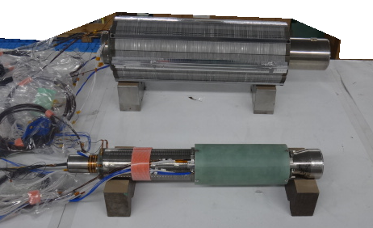
Fabrication of quadrupole magnet
3-2

Slide 14
Assembly of beam line with quadrupole
3-2
Beam line with quadrupole of QCS-R
Electron
（7GeV）
Positron（4GeV）

Slide 15
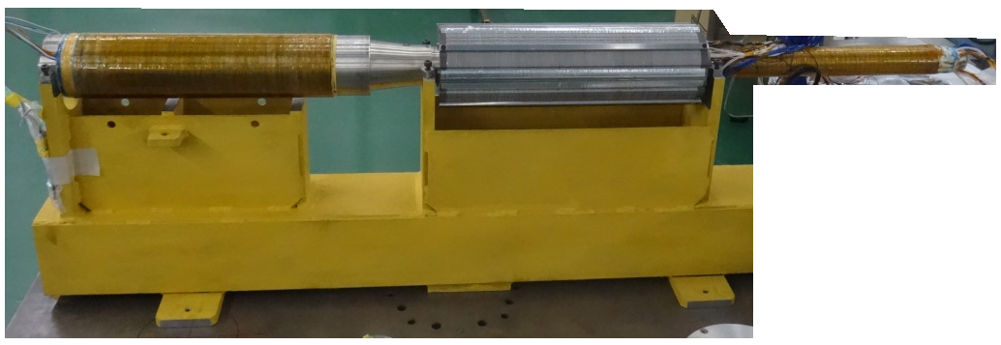
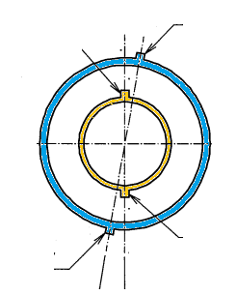
Fabrication of quadrupole magnet
3-2
Key of quadrupole
magnet
Key of compensating
magnet
Key of compensating
magnet
Key of quadrupole
magnet
Quadrupole
magnetic field

Slide 16
Fabrication of solenoid magnet
3-2
Electron
（7GeV）
Positron（4GeV）
Solenoid magnet

Slide 17
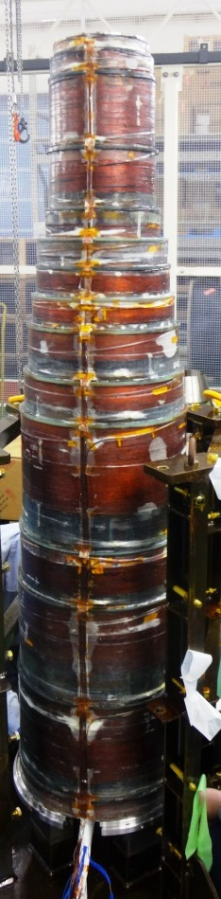
Fabrication of solenoid magnet
3-2
Solenoid is placed in narrow space between
outer Belle II, and, inner beam line magnets
IP side
1575 mm
Constraints:
For outer shape, Belle Ⅱ bore, and radiation shield.
For Inner shape, beam line magnets.
For magnetic field, Belle Ⅱ solenoid field compensation.

Slide 18
Fabrication of solenoid magnet
3-2
Constraints lead to very thin structure, and divided windings.
Design minimum gap of 2mm between winding and radiation shield.
Assembly was completed successfully.
IP side
Winding frame（White area，minimum thickness of 5mm）
Winding（Red area, total 6237 turns, 15 divisions）
Radiation shield
1575 mm

Slide 19
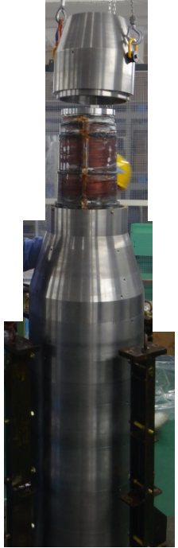
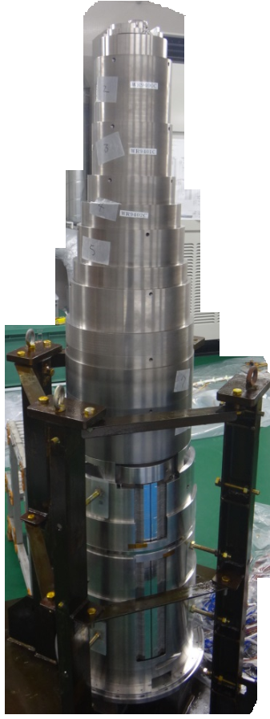
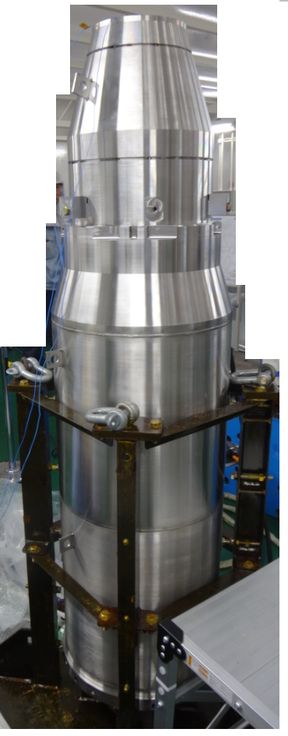
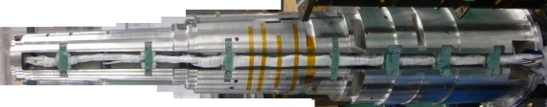
Fabrication of solenoid magnet
3-2

Slide 20
Accurate assembly of cryostat
3-3
Electron
（7GeV）
Positron（4GeV）
Front region of cryostat

Slide 21
Accurate assembly of cryostat
3-3
Rod
Vacuum
He vessel
Liquid He filling
Vacuum vessel
Alignment of magnets
Tolerance of± 0.2 mm from beam axis at room temperature
Different configuration of inner and outer area of He vessel leads to different approach of alignment.
→ Inner area of He vessel: No constraint for heat transfer by liquid He filling.
Use alignment key provided by machining
Densely packed components

Slide 22
Accurate assembly of cryostat
3-3
Rod
Vacuum
He vessel
Liquid He filling
Vacuum vessel
Alignment of magnets
Tolerance of± 0.2 mm from beam axis at room temperature
Different configuration of inner and outer area of He vessel leads to different approach of alignment.
→ Outer area of He vessel: Preventing heat transfer, vacuum insulation.
Using rod
Influence of thermal expansion coefficient, electromagnetic force.
EM force of 36 kN act on Solenoid compensating Belle Ⅱ field.

Slide 23
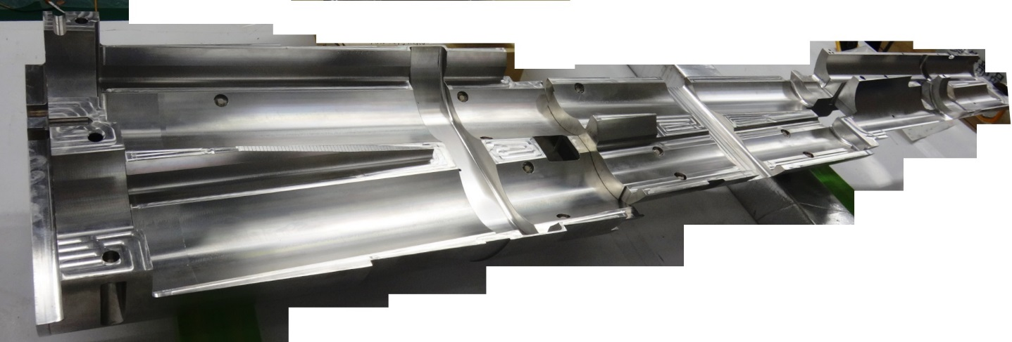
Alignment structure inner side of He vessel
3-3
83mrad
Magnet fixing support was manufactured
Holding of quadrupole magnets
Two beam lines
Tolerance: Displacement of ± 0.1 mm
Rotating angle of ± 2 mrad

Slide 24
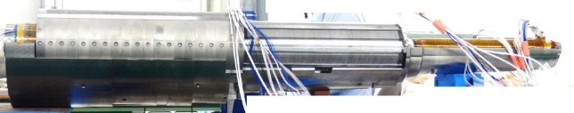
Alignment structure inner side of He vessel
3-3
Quadrupole magnets on the support
QC2RP，4 corrector
Corrector, magnetic shield yoke
QC1RP，5 corrector
4 leak field cancel magnet
QC1RE，4 corrector
Corrector, magnetic shield yoke

Slide 25
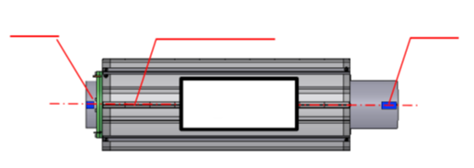
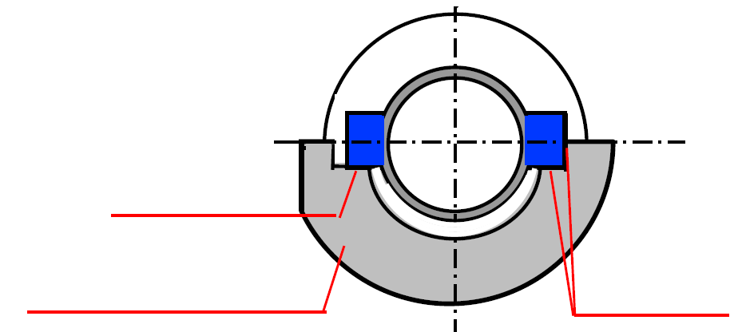
Alignment structure inner side of He vessel
3-3
Alignment structure for quadrupole magnets
Alignment
key
Alignment
key
Axis of magnet
Alignment
surface
magnet
Alignment
surface
Support
High precision machining provided the accurate alignment surfaces on the support.
⇒Displacement error of less than 0.2 mm between axis of magnet and beam line

Slide 26
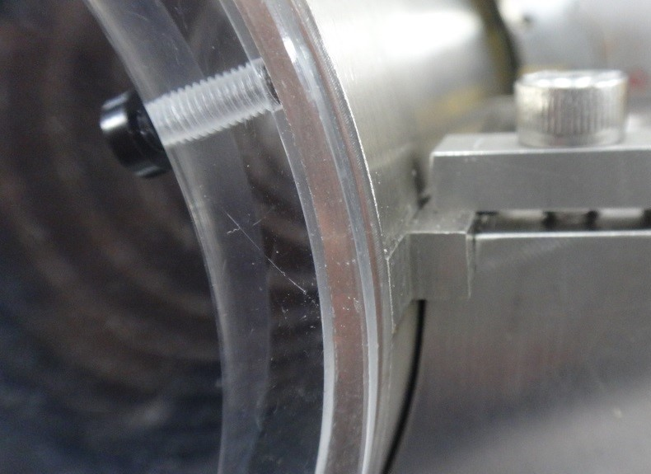
Alignment structure inner side of He vessel
3-3
Alignment
surface
Alignment
surface
Support
High precision machining provided the accurate alignment surfaces on the support.
⇒Displacement error of less than 0.2 mm between axis of magnet and beam line

Slide 27
Alignment structure outer side of He vessel
3-3
He vessel must be aligned
to vacuum vessel of cryostat accurately.
・Supported from Eight rods
・Accurate alignment mark on vacuum vessel
He vessel
Vacuum
vessel
Rod
He vessel
Vacuum vessel
Requirement for alignment
Preload is applied to rods, in order to withstand EM force to He vessel induced by operation.

Slide 28
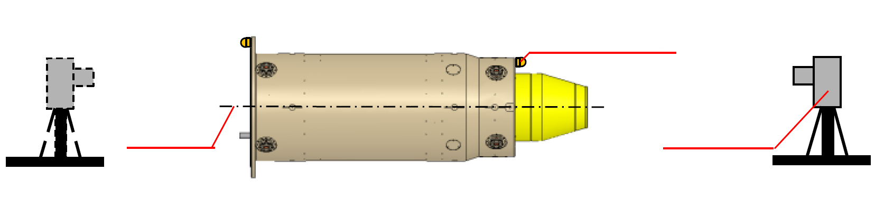
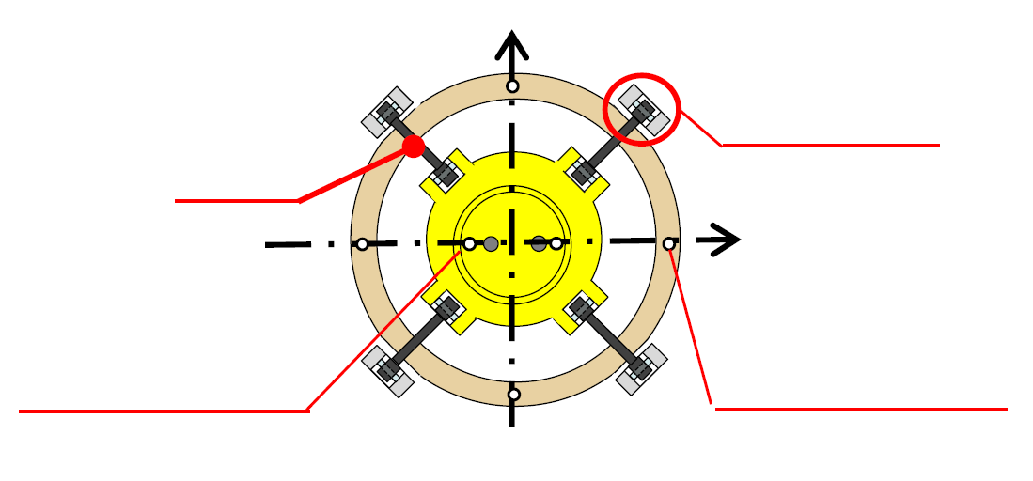
Alignment structure outer side of He vessel
3-3
Axis of vacuum vessel was evaluated
with Laser tracker using alignment holes
Vacuum vessel
Alignment hole
of vacuum vessel
Reflector
Axis
of vacuum vessel
Laser tracker
Alignment mechanism
Alignment mechanism
Rod
Vacuum vessel
He vessel
Alignment hole
of He vessel
Alignment hole
of vacuum vessel

Slide 29
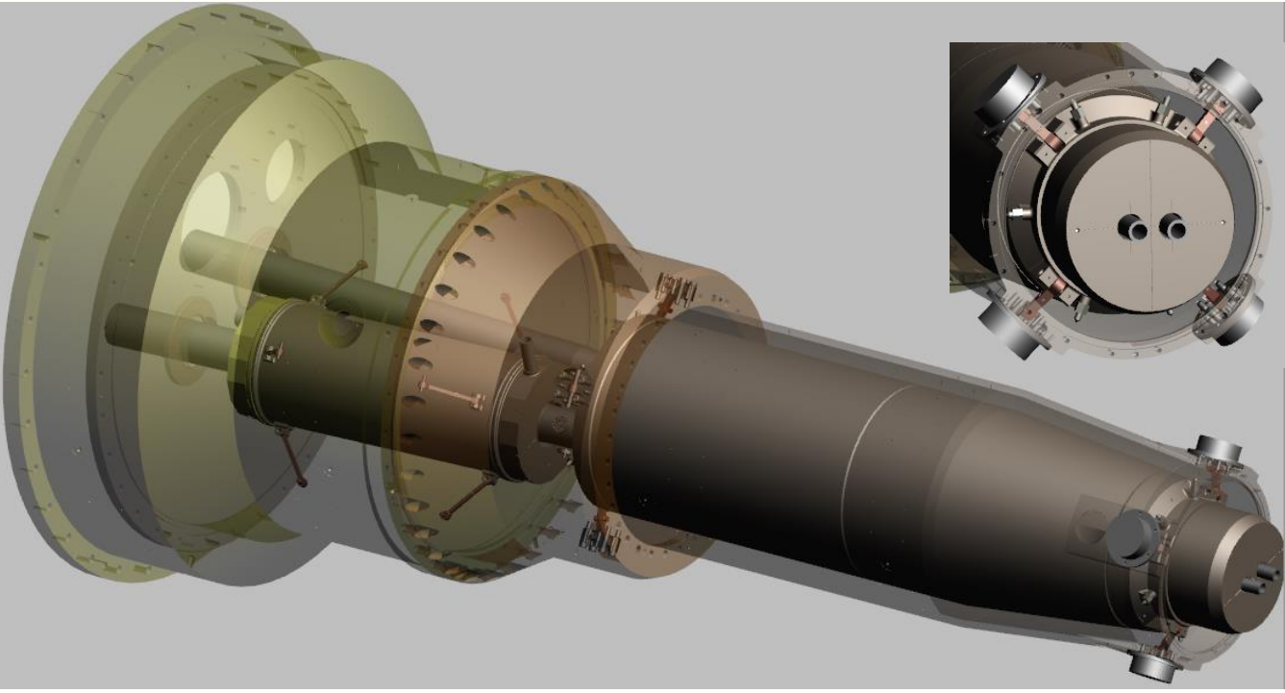
Alignment structure outer side of He vessel
3-3
Source: AFAD2018
Alignment mechanism
Rod
Vacuum vessel
He vessel
Alignment hole
of He vessel
Alignment hole
of vacuum vessel

Slide 30
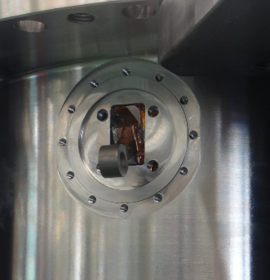
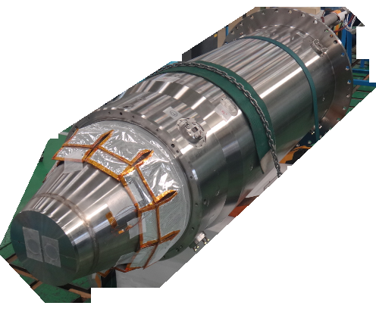
Alignment structure outer side of He vessel
3-3
Alignment mechanism
Rod
Vacuum vessel
He vessel
Alignment hole
of He vessel
Alignment hole
of vacuum vessel

Slide 31
Alignment structure outer side of He vessel
3-3
He vessel was aligned to axis of vacuum vessel.
・Alignment holes of He vessel were used as measurement reference.
・Alignment holes were measured with laser tracker.
・Position of alignment holes were adjusted with alignment mechanism
⇒ Coaxiality less than 0.2 mm, which is target position displacement,
were achieved for two beam line at room temperature.
Preload requirements of rods were satisfied.
⇒Assembly for front region of QCS-R cryostat was completed.
Alignment mechanism
Rod
Vacuum vessel
He vessel
Alignment hole
of He vessel
Alignment hole
of vacuum vessel

Slide 32
High voltage testing
3-4
One of requirement of High voltage testing is He ambient.
Withstand voltage of He gas is as 1/10 times or less as Air.
Gap filled with gas He is easy to breakdown.
Therefore, insulation of winding is important.
The results is acceptable
Radiation shield
Winding（Red area）

Slide 33
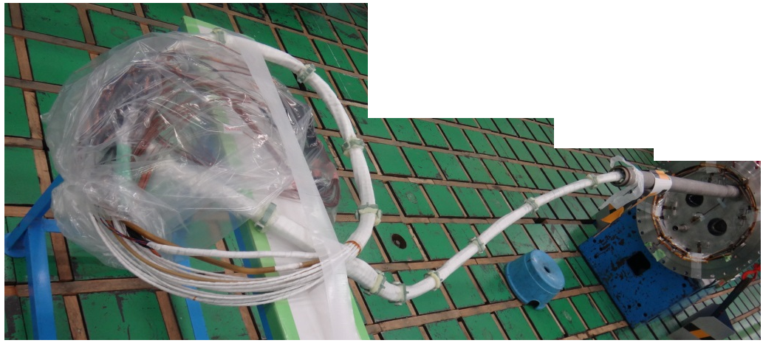
Wiring
4

Slide 34
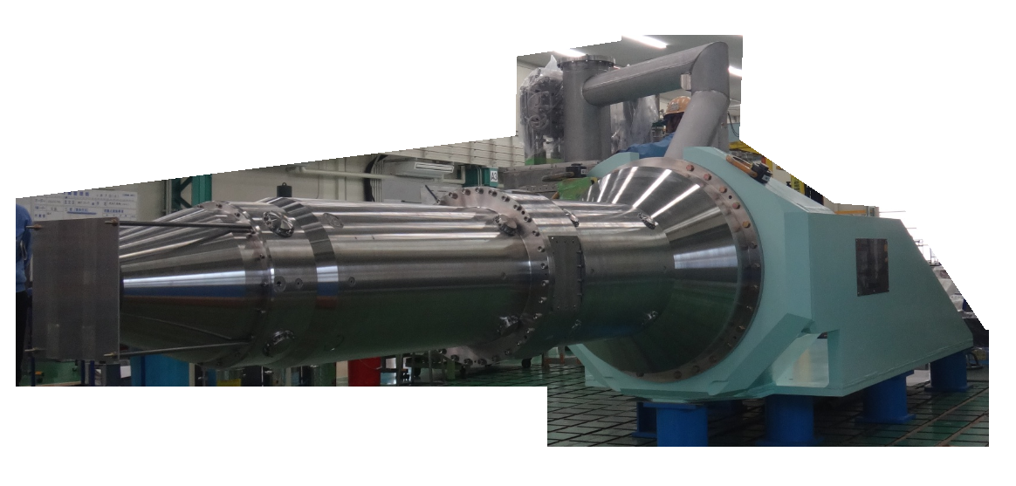
QCSR in factory
5

Slide 35
Conclusion
6
QCS-R
QCS-L
・Fabrication of QCS-R and QCS-L were completed.
・QCS-R and QCS-L provided steady operating in SuperKEKB
We would like to show our deep appreciation to KEK members for continuously supporting to fabrication.

