Slide 1
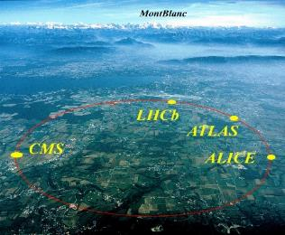
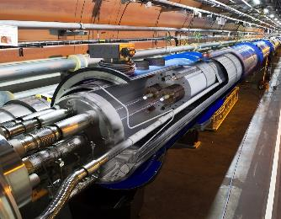
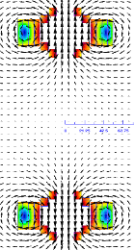
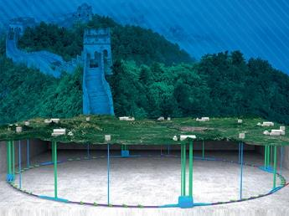
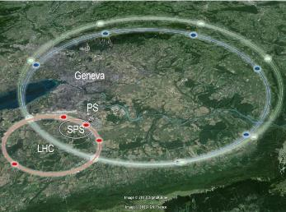
Fundamentals and Advances in
Superconducting Accelerator Magnets
超导加速器磁体基础及前沿进展
徐庆金 Qingjin Xu
中国科学院高能物理研究所
Institute of High Energy Physics,
Chinese Academy of Sciences
The 4th Asian School on Superconductivity Cryogenics for Accelerators (ASSCA2022)，
Korea University，Sejong Korea, Feb 13-19 2023

Slide 2
Outline
Fundamental Principles of the Superconducting Accelerator Magnets
PRINCIPLES of Superconductivity and Particle Accelerators
CHARACTERISTICS and MAIN CHALLENGES of the Superconducting Accelerator Magnets
Case Study
Progress of the High Field Magnet R&D at IHEP
Progress of the HL-LHC CCT Magnets

Slide 3
Outline
Fundamental Principles of the Superconducting Accelerator Magnets
PRINCIPLES of Superconductivity and Particle Accelerators
CHARACTERISTICS and MAIN CHALLENGES of the Superconducting Accelerator Magnets
Case Study
Progress of the High Field Magnet R&D at IHEP
Progress of the HL-LHC CCT Magnets

Slide 4
Acknowledgement
The materials of this section are based on the following references
“Superconducting Accelerator Magnets” by Steve Gourlay and Soren Prestemon (LBNL), June 2018
“Superconducting Accelerator Magnets” by Soren Prestemon (LBNL), Paolo Ferracin and Ezio Todesco (CERN), June 2015
“Applied Electromagnetism: Magnet and RF-Cavity Design” by Mau Lopes and Jeremiah Holzbauer (FNAL), January 2016
USPAS website: http://uspas.fnal.gov/materials/materials-table.shtml
And talks from Lucio Rossi, Steve Gourlay et al, and the textbooks:
  Martin N. Wilson, "Superconducting Magnets", 1983.
  K.-H. Mess, P. Schmuser, S. Wolff, “Superconducting accelerator magnets”, Singapore: World Scientific, 1996.
  Fred M. Asner, "High Field Superconducting Magnets", 1999.

Slide 5
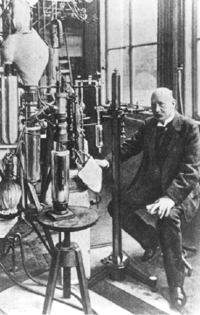
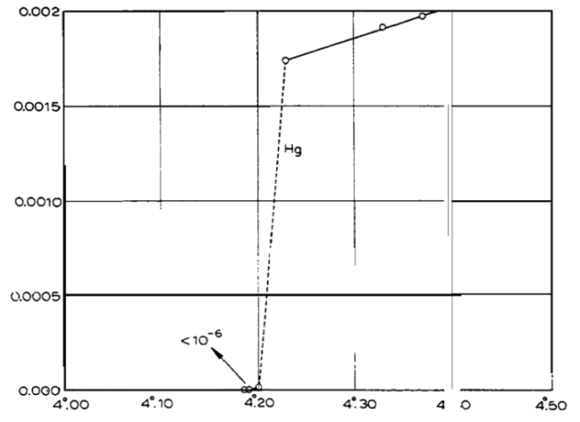

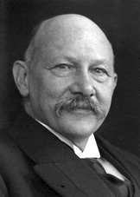
The Discovery of Superconductivity
Successfully liquefied He gas
in 1908
Discovery of Superconductivity in 1911
Resistance
Temperature (K)
The Nobel Prize in
Physics 1913
"for his investigations on the
properties of matter at low
temperatures which led, inter alia,
to the production of liquid helium”
Heike Kamerlingh Onnes
Dutch Physisist
(1853-1926)
Heike Kamerlingh Onnes
Fundamentals & advances in superconducting magnets, QXU，Feb 2023
5

Slide 6
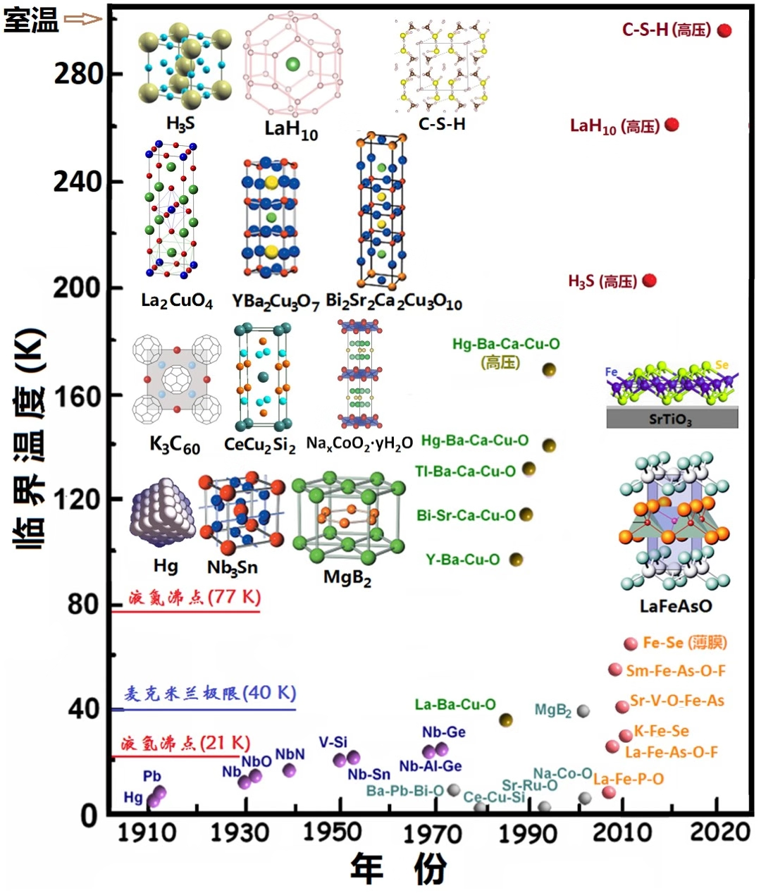
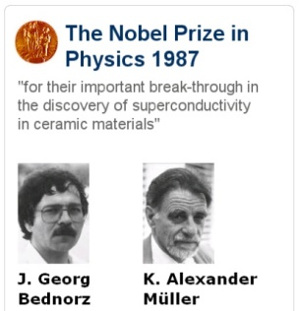
The History of Superconductors
传统超导体
(Tc < 40K)
Before 1986
铜氧化合物
高温超导体
(Tc 达160K)
1986/1987
铁基
高温超导体
(Tc 达55K)
2008
Huiqian Luo
Fundamentals & advances in superconducting magnets, QXU，Feb 2023
6

Slide 7
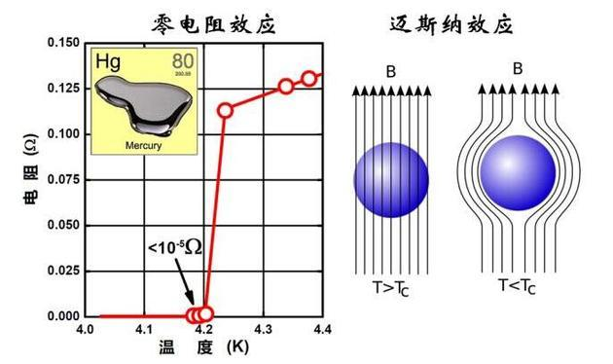
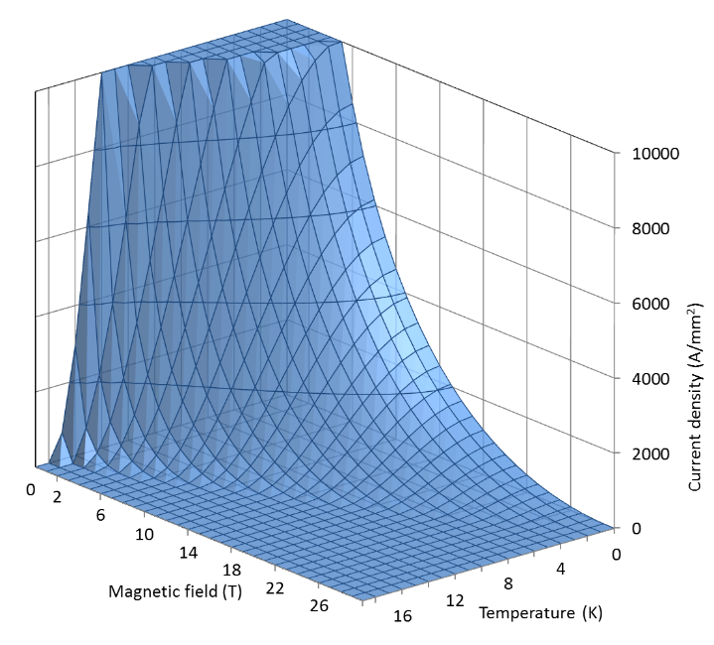
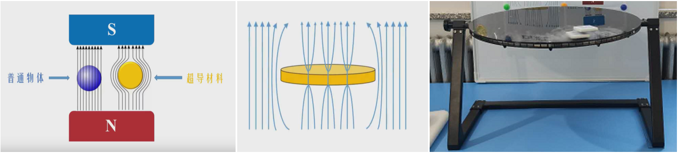
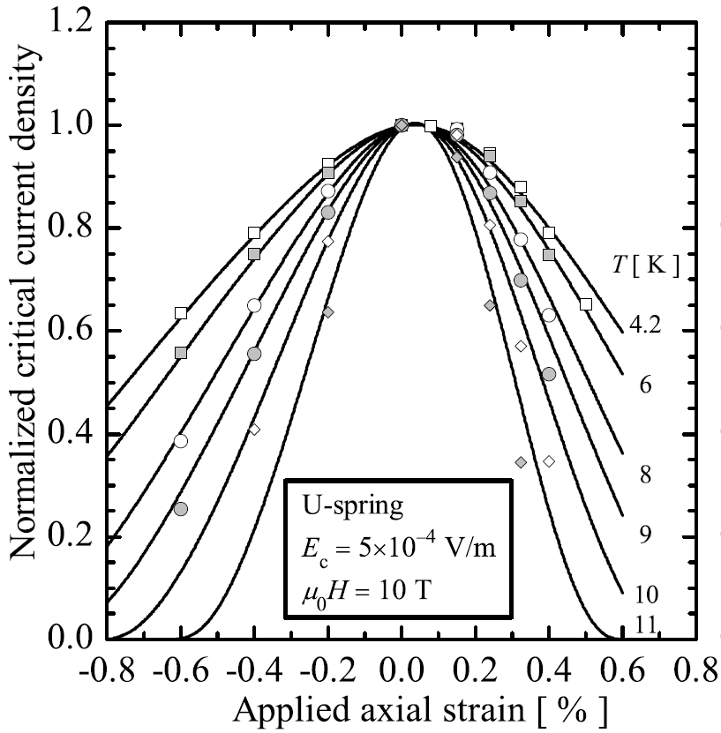
Basic Characteristics of Superconductors
Zero Resistance
T_{c}
J_{c} vs T_{c} & B_{c}
Critical
Temperature
Meissner Effect
B_{c}
第一类超导体
J_{c} vs ε
第二类超导体
Fundamentals & advances in superconducting magnets, QXU，Feb 2023
7

Slide 8
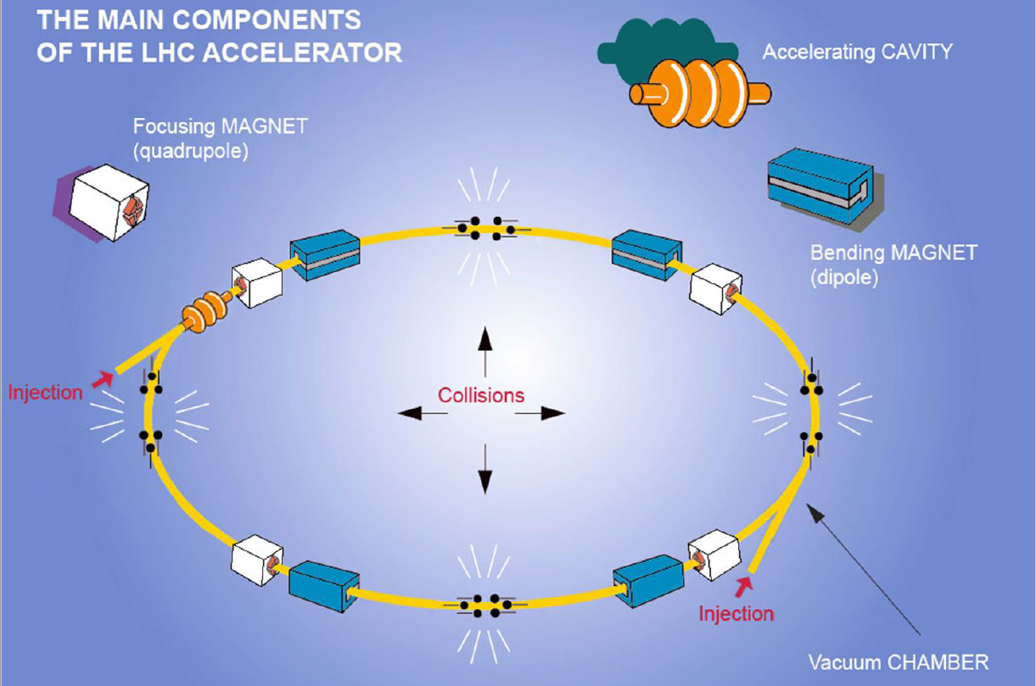
PRINCIPLES of a Circular Collider
Lucio Rossi

Slide 9
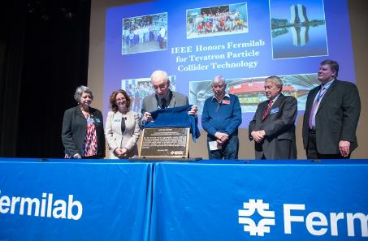
The 1st Superconducting Accelerator in the World
Tevatron accelerator at Fermilab. Construction completed in 1980s.
774 superconducting NbTi dipole magnets + 240 NbTi quadrupole magnets
IEEE Milestone Award: The first large-scale use of superconducting magnets enabled the construction of the Tevatron. Established the superconducting wire manufacturing infrastructure that made applications such as Magnetic Resonance Imaging (MRI) viable.

Slide 10
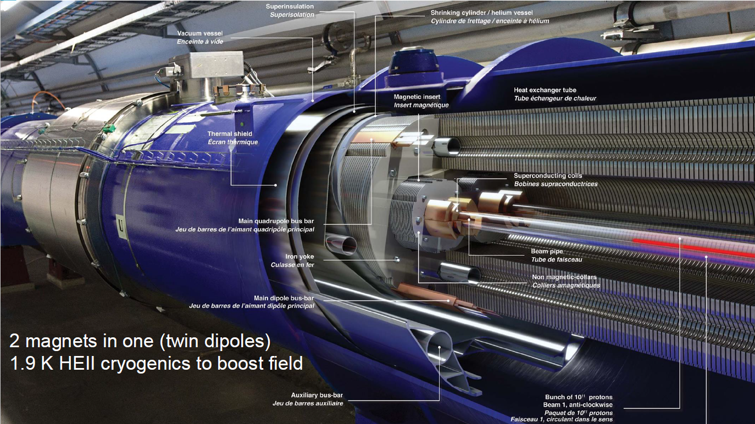
The Largest Application of
Superconductivity so far: LHC
1232 SC dipoles–15 m –8.33 T. 500 SC Quadrupoles. 8000 Corrector Magnets.
16 SC Cavities. 40 pairs large Current Leads in HTS
Lucio Rossi

Slide 11
Hadron Colliders in the Past and Future
SPPC
FCC

Slide 12
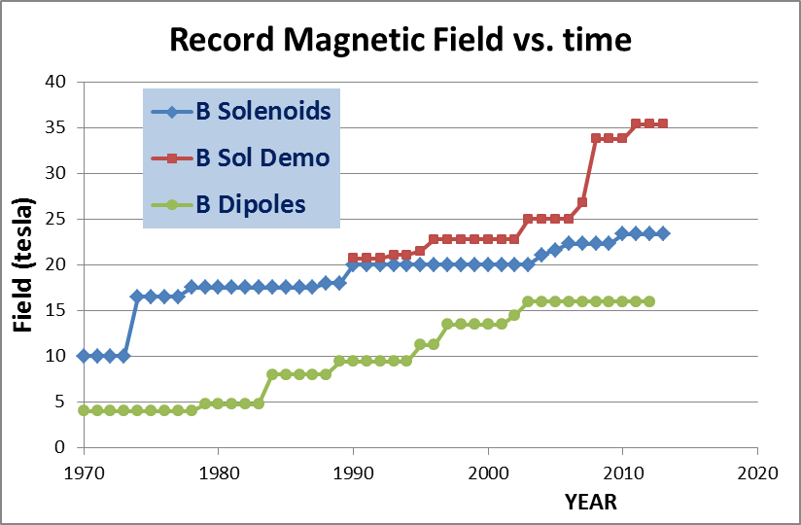
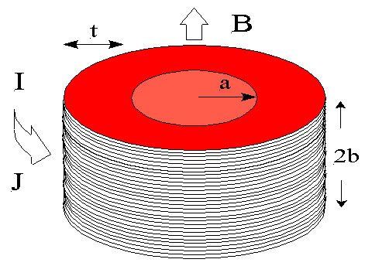
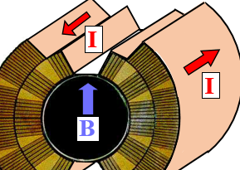
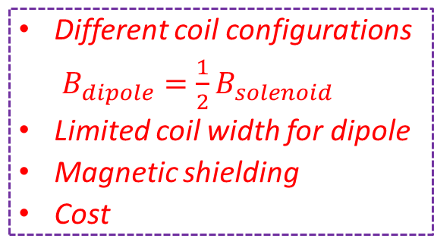
Dipole vs. Solenoid
Dipole
Solenoid
Different coil configurations
$B_{dipole}=\frac{1}{2}B_{solenoid}$
Limited coil width for dipole
Magnetic shielding
Cost
J_{e} – Current density
t – Coil thickness
J_{e} – Current density
t – Coil thickness
LHC dipole
Lucio Rossi
Martin Wilson

Slide 13
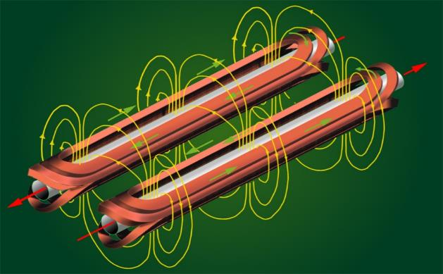
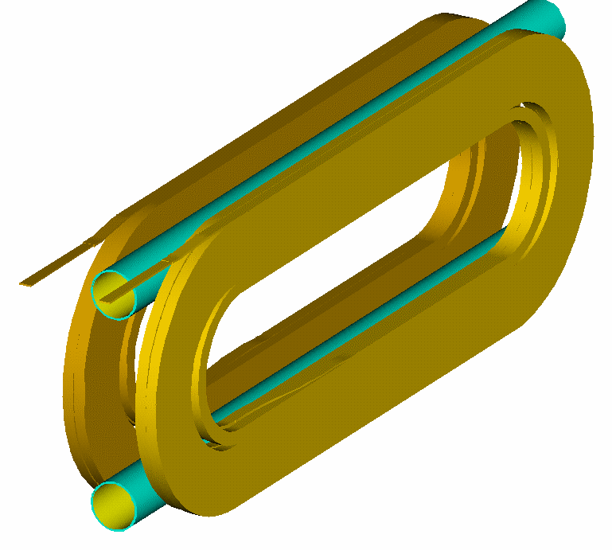
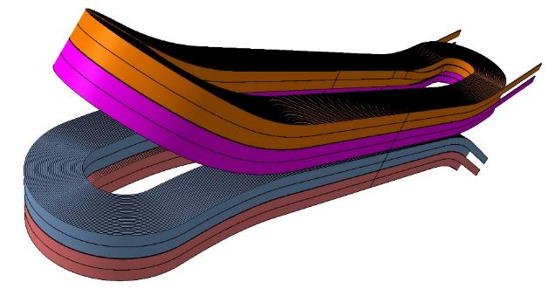
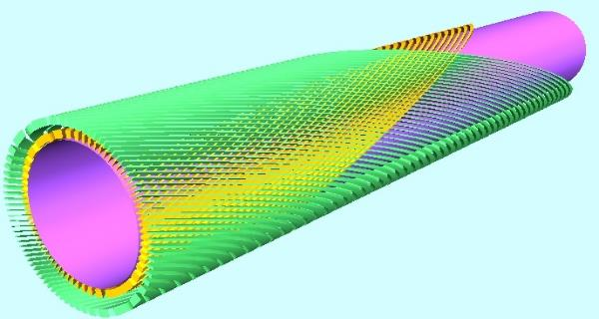
Coil Configurations for Dipole Magnets
Efficiency, field quality, stress management, quench protection…
Cos-theta dipole
Highest efficiency, complicated ends with hard-way bending
Common coil dipole
Simplest structure with large bending radius, lower efficiency
Block type dipole
Simpler structure with hard-way bending, lower efficiency
Canted cos-theta dipole
Lowest stress level in coil, lowest efficiency

Slide 14
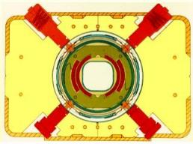
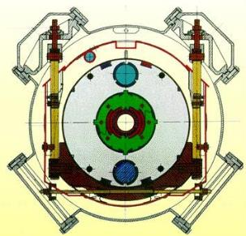
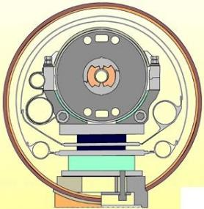
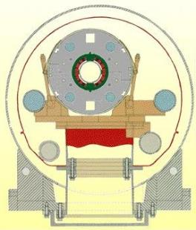
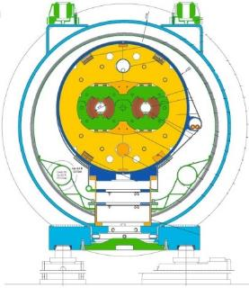
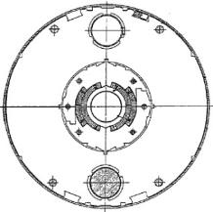
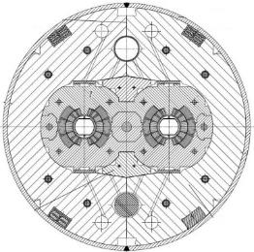
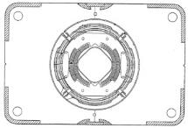
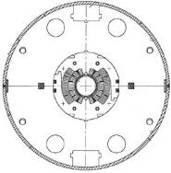
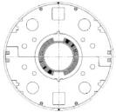
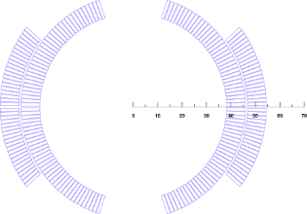
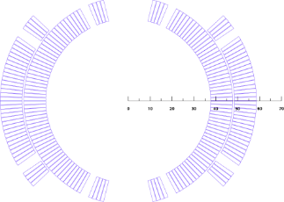
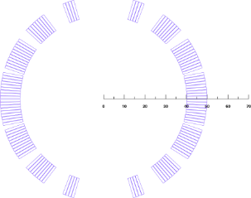
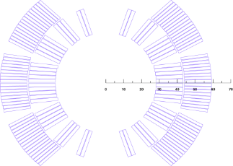
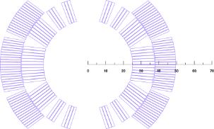
The Dipole Magnets in Past Years
Tevatron
HERA
SSC
RHIC
LHC

Slide 15
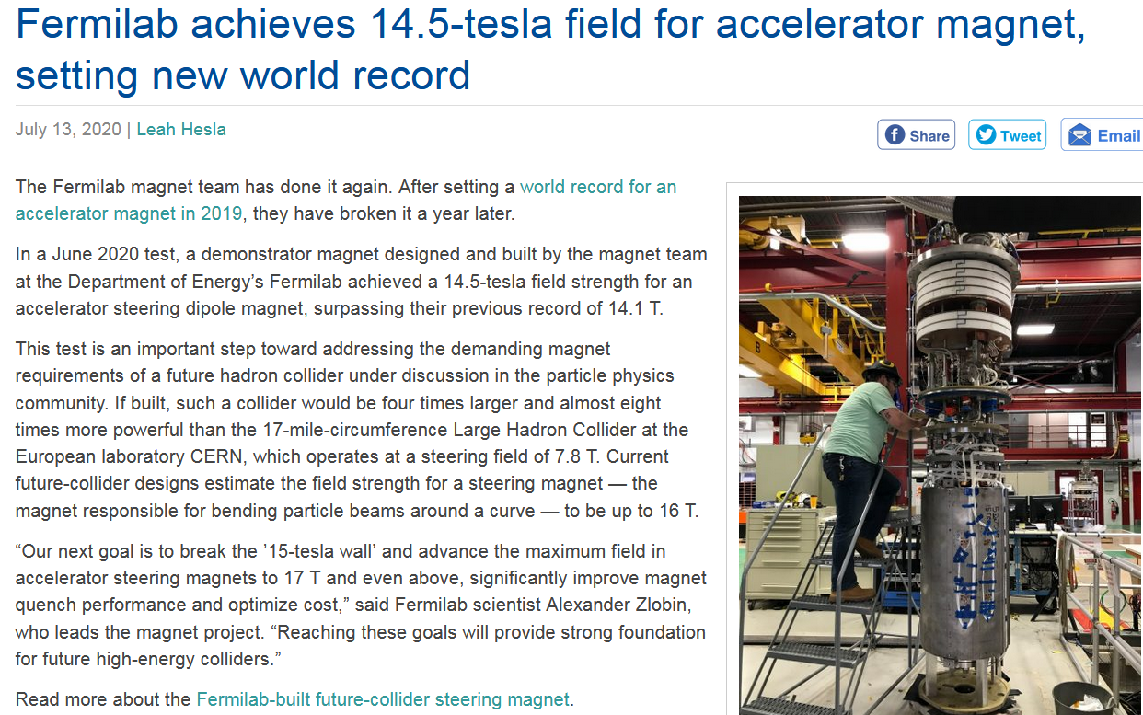
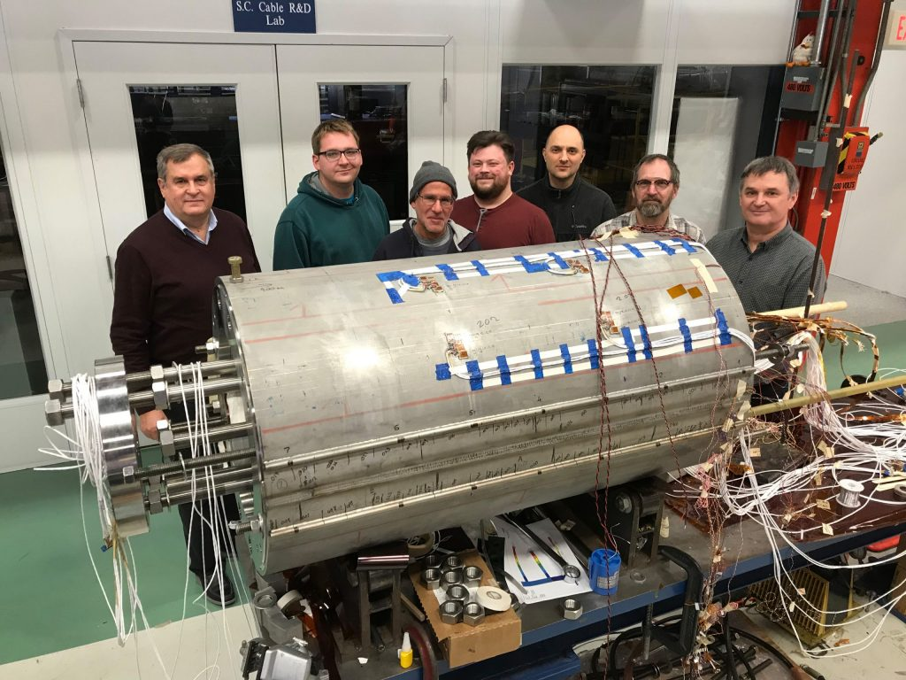
New Record：14.5 T Dipole by Fermilab

Slide 16
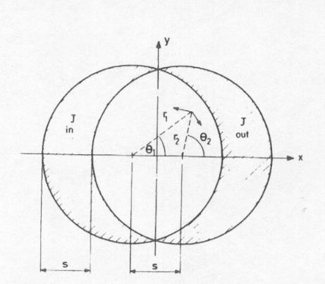
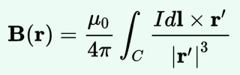
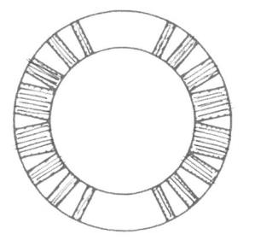
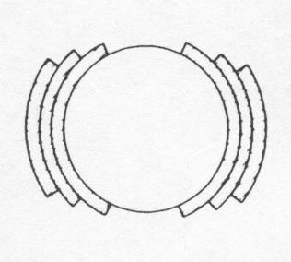
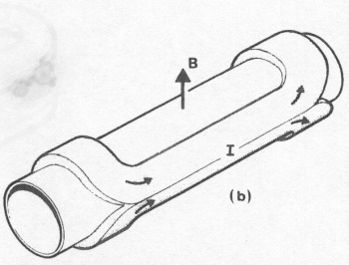
Field Harmonics
Perfect Dipole
Biot-Savart law
  Cosθ: a current density proportional to cosθ in an annulus - it can be approximated by sectors with uniform current density
From M. N. Wilson, pg. 28
A practical winding with one layer and wedges
[from M. N. Wilson, pg. 33]
A practical winding with three layers and no wedges
[from M. N. Wilson, pg. 33]
Artist view of a cosθ magnet
[from Schmuser]
An ideal cosθ

Slide 17
Field Harmonics
  Perfect quadrupole
  Cos2θ, a current density proportional to cos2θ in an annulus- approximated by sectors with uniform current density and wedges
  (Two) intersecting ellipses
    Perfect sextupoles: cos3θ or three intersecting ellipses
    Perfect 2n-poles: cosnθ or n intersecting ellipses
Quadrupole as an ideal cos2θ
Quadrupole as two intersecting ellipses
Fundamentals & advances in superconducting magnets, QXU，Feb 2023
17

Slide 18
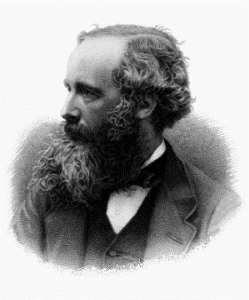
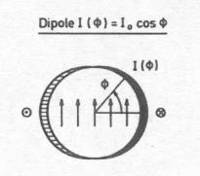
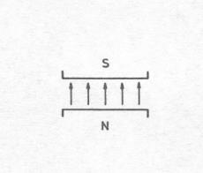




Field Harmonics
Maxwell equations for magnetic field
In absence of charge and magnetized material
and for 2D constant longitudinal field,
Gauss's law for magnetism
Ampère's circuital law
James Clerk Maxwell,
Scottish
(13 June 1831 – 5 November 1879)
A dipole
A quadrupole
[from P. Schmuser et al, pg. 50]
A sextupole

Slide 19



Field Harmonics
Iron saturation effect: shaping the iron – the RHIC dipole
    The field in the yoke is larger on the pole
    Drilling holes in the right places, one can reduce saturation of b₃ from 40 units to less than 5 units (one order of magnitude), and to correct also b₅
Fundamentals & advances in superconducting magnets, QXU，Feb 2023
19

Slide 20



Electro-magnetic Force
The e.m. forces in a dipole magnet tend to push the coil
- Towards the mid-plane in the vertical-azimuthal direction (F_{y} , F_{θ} < 0)
- Outwards in the radial-horizontal direction (F_{x} , F_{r} > 0)
Tevatron dipole

Slide 21


Electro-magnetic Force
LHC dipole at 0 T LHC dipole at 9 T
Usually, in a dipole or quadrupole magnet, the highest stresses are reached at the mid-plane, where all the azimuthal e.m. forces accumulate (over a small area).
Displacement scaling = 50

Slide 22


Electro-magnetic Force
The e.m. forces in a quadrupole magnet tend to push the coil
Towards the mid-plane in the vertical-azimuthal direction (F_{y}, F_{θ} < 0)
Outwards in the radial-horizontal direction (F_{x}, F_{r} > 0)
TQ

Slide 23


Electro-magnetic Force
In the coil ends the Lorentz forces tend to push the coil Outwards in the longitudinal direction (F_{z} > 0)
Similarly as for the solenoid, the axial force produces an axial tension in the coil straight section.

Slide 24



Electro-magnetic Force
Nb-Ti LHC MB (values per aperture)
  F_{x} = 340 t per meter
    ~300 compact cars
    Precision of coil positioning: 20-50 μm
  F_{z} = 27 t
    ~weight of the cold mass
Nb₃Sn dipole (HD2)
  F_{x} = 500 t per meter
  F_{z} = 85 t
  These forces are applied to an object with a cross-section of 150x100 mm !!!
    and the material is brittle!

Slide 25
Superconducting Materials
Discovered in 1911 by Kammerling-Onnes, observed that the resistance of a mercury wire disappeared at 4.2 K.
Nb₃Sn and Nb-Ti, discovered in 1954 and 1961, are the most commonly used type II superconductors, suitable for practical application .
The critical temperature T_{c} is 9 K for NbTi and 18 K for Nb₃Sn at 0 T, they are defined as low temperature superconductors (LTS).
Discovered from 1986, High temperature superconductors (HTS) have a T_{c} of up to 40-120 K.
B<B_{c1}
B_{c1}<B<B_{c2}
by L. Bottura
Type II superconductors

Slide 26

Timeline of Superconducting Materials
By PJRay - Own work, CC BY-SA 4.0, https://commons.wikimedia.org/w/index.php?curid=46193149

Slide 27


Nb-Ti vs Nb₃Sn
Nb-Ti
Nb₃Sn
critical surface : B (T), J (A/mm²), T (K)

Slide 28


Copper vs Superconductors
Cu
Nb-Ti
Nb₃Sn
Typical operational conditions (0.85 mm diameter strand)
J_{e} ~ 5 A/mm²
I ~ 3 A
B = 2 T
J_{e} ~ 600-700 A/mm²
I ~ 300-400 A
B = 8-9 T
J_{e} ~ 600-700 A/mm²
I ~ 300-400 A
B = 12-13 T

Slide 29




Superconductors for Accelerator Magnets
The superconductors for accelerator magnets should
  subdivided in filaments of small diameters
    to reduce flux jumps
    to minimize field distortions due to magnetization
  twisted together
    to reduce inter-filament coupling and AC losses
  embedded in a copper matrix
    to protect the superconductor after a quench
    to reduce flux jumps
NbTi LHC wire (A. Devred)
NbTi SSC wire (A. Devred)
Nb₃Sn bronze-process wire (A. Devred)
Nb₃Sn PIT process wire (A. Devred)

Slide 30
Flux Jumps
  An external magnetic field penetrates in a type-II superconductor in the mixed state through fluxoids.
  If the superconductor is subjected to a thermal disturbance, the local change in J_{c} produces a motion or “jump” of fluxoids, which is accompanied by power dissipation.
  The stability criteria for a slab in the adiabatic condition
  where a is the half-thickness of the slab, j_{c} is the critical current density [A m⁻²], γ is the density [kg m⁻³], C is the specific heat [J kg⁻¹], and θ_{c} is the critical temperature.
  Nb-Ti filament diameters are usually less than 50 µm.
  High conductivity copper reduces instability.

Slide 31

Hysteresis of the Magnetization
From A. Jain, USPAS 2007, Dynamic effects in superconducting magnets, pg. 18
  Field distortions are proportional to r_{f}. LHC filament diameter 6-7 µm; HERA filament diameter 14 µm.

Slide 32

Interfilament Coupling
  When a multi-filamentary wire is subjected to a time varying magnetic field, current loops are generated between filaments.
  If filaments are straight, large loops are generated, with large currents
    Big losses
  If the strands are magnetically coupled the effective filament size is larger
    Flux jumps
  To reduce these effects, filaments are twisted with a twist pitch of the order of 20-30 times of the wire diameter.
M.N. Wilson

Slide 33
Quench Protection and Stabilization
  Superconductors have a very high normal state resistivity. A filament of Nb-Ti, if quenched in free space, could reach very high temperatures in few ms.
  If the filament is embedded in a copper matrix, when quench occurs, the current redistributes in the low-resistivity matrix and the peak temperature can typically be maintained below 300 K.
  The copper matrix facilitates quench protection: it allows the quench to propagate and it provides time to act on the power circuit.
  In the case of a small volume of superconductor heated beyond the critical temperature (for instance because of a flux jump), the current can flow in the copper for a short moment, allowing the filament to cool-down and recover superconductivity.
    The matrix also helps stabilizing the conductor against flux jumps (dynamic stability).

Slide 34

Superconducting Cables
Most of the superconducting coils for particle accelerators are wound from a multi-strand cable.
The advantages of a multi-strand cable are:
  reduction of the strand piece length;
  reduction of number of turns
    easy winding;
    smaller coil inductance
      less voltage required for power supply during ramp-up;
      after a quench, faster current discharge and less coil voltage.
  current redistribution in case of a defect or a quench in one strand.
The strands are twisted to
  reduce inter-strand coupling currents
    Losses and field distortions
  provide more mechanical stability
The most commonly used multi-strand cables are the Rutherford cable and the cable-in-conduit.
A. Devred

Slide 35

AC losses
Hysteresis: Reduce _{deff}
Coupling: Reduce twist pitch; Modify inter-filament resistance
Eddy currents: laminations

Slide 36



Fabrication of NbTi wires
The copper to superconductor ratio is specified for quench protection.
The filament diameter is chosen to minimize flux jumps and field errors due to persistent currents.
The inter-filament spacing is kept small for drawing operation, and large enough to prevent filament couplings.
A copper core and sheath is added to reduce cable degradation.
A. Devred

Slide 37

Fabrication of Nb₃Sn wires
Reaction of a PIT wire
A. Godeke

Slide 38


Fabrication of Rutherford cable
The final shape of a Rutherford cable can be rectangular or trapezoidal.
The cable design parameters are:
  Number of wires N_{wire}
  Wire diameter d_{wire}
  Cable mid-thickness t_{cable}
  Cable width w_{cable}
  Pitch length p_{cable}
  Pitch angle ψ_{cable} (tanψ _{cable} = 2 w_{cable} / p_{cable})
  Cable compaction (or packing factor) k_{cable}
Typical cable compaction: from 88% (Tevatron) to 92.3% (HERA).

Slide 39




Fabrication of Coils for Accelerator Magnets

Slide 40

Heat Reaction

Slide 41

Quench
Analysis of SQ02, LBNL

Slide 42




Quench Protection
Magnetic energy
Quench
Converted to heat
Normal zone growth
Detection
Power supply switched off
Trigger protection options
Protection heaters
Extraction
Quenchback
Current decay in the magnet

Slide 43




Quench Protection
In most accelerator magnets, the “natural” resistance growth is insufficient to provide a good protection => Need to enhance the resistance
Method 1:
  Add an external resistor
Method 2:
  Protection heaters mounted on the coils
    Optimized to minimize thermal diffusion time
Method 3:
  Use of couple secondary circuits
    Can be external or internal to the coil
    Quench back
Method 4:
  Coil subdivision
Cold

Slide 44




Quench Protection
Coupling-Loss Induced Quench Protection
CLIQ
METROSIL Quench Protection
E. Ravaioli et al.
G. Kirby et al.

Slide 45

Quench Protection
In the LHC main ring, the dipoles are connected in series. The principle is
  to “by-pass” the quenching magnet to avoid dumping all the string energy in one magnet
  To de-excite the rest of the magnets into a dump resistor
Combination of various methods: heaters, dump resistor, diodes

Slide 46


Training
Training is characterized by two phenomena
  The occurrence of premature quenches
    Frictional motion of a superconductor
    Epoxy failure
    ……
  The progressive increase of quench current
    Some irreversible change in the coil’s mechanical status.
In R&D magnets, training may not be an issues.
For accelerator magnets it can be expensive, both in term of time and cost.

Slide 47
Quench Origins
  Depending on the shape of the voltage signal, it is possible to identify
    Conductor limited quenches: slow, gradual resistive growth
    Flux jump induced quenches: low-frequency flux changes
    Motion induced quenches: acceleration-deceleration-ringing
Conductor limited
Flux-Jump
Motion

Slide 48



Modeling from magnets to filaments
A. Godeke
D. Arbelaez et al, “Cable Deformation Simulation and a Hierarchical Framework for Nb3Sn Rutherford Cables,” EUCAS, pp. 1–11, 2009

Slide 49
HTS 16+ Tesla Accelerator Magnet?
Precondition (Iron based conductor, ReBCO, Bi-2212,…)
The Je of the HTS conductors is high enough for accelerator application
The cost is lower than or similar with the LTS conductors
Mechanical performance is qualified
Main challenges of the HTS technology
Quench protection：quench propagation speed of HTS conductors is about two orders of magnitude lower than the LTS case
Cable fabrication：how to fabricate high-current cable with tapes?
Coil layout：compact, high efficiency, stress control, …
Field quality control：10⁻⁴ field uniformity needed for accelerators
Advantages of the all-HTS magnet：
Possibility of raising the operation temperature of the magnet（4.2K -> ?K）

Slide 50
Outline
Fundamental Principles of the Superconducting Accelerator Magnets
PRINCIPLES of Superconductivity and Particle Accelerators
CHARACTERISTICS and MAIN CHALLENGES of the Superconducting Accelerator Magnets
Case Study
Progress of the High Field Magnet R&D at IHEP
Progress of the CCT Magnets for HL-LHC

Slide 51








Fabrication Steps of the High Field Accelerator Magnets
51
Tension control, deformation
J_{c} and RRR degradation,
Flux jump…
Temperature control,
Thermal stress control
J_{c} and RRR degradation.
Pre-stress control
Stress of coils,
Mechanical
Stability…
Cabling Coil winding HT VPI Magnet assembly Test
Material, Structure, Processing,…
J_{c,} RRR, Cu ratio,
Filament size…
Stress control,
Size control,
Electrical insulation
J_{c} and Field quality
degradation,
Electrical short…
Impregnation quality control: type of epoxy, procedures;
Mechanical strength and stability
EM force, Quench protection
Training,
Strain of coils…

Slide 52


High Field Model Dipole Magnet: 12.47T @ 4.2K
Picture of LPF1-U

Slide 53

High Field Model Dipole Magnet: 16-T Design
LTS (13 T) + HTS (3 T)
OD:640 mm
Nb₃Sn
YBCO
Nb₃Sn
Main field: 16 T
AP:30 mm
5
1
2
3
4
6
54
24
50
20
58
42
58
24
120 mm
The cross-section of LPF3
Field and flux distribution in coils
Coil layout (yoke 1/8)
Main parameters of LPF3
Current | 7580/143 A |  | Blocks | Block 1 | Block 2 | Block 3 | Block 4 | Block 5 | Block 6 | Block 7
Main field | 16.03 T |  | Peak field (T) | 12.81 | 10.68 | 10.82 | 10.58 | 10.48 | 10.38 | 16.18
 |  |  | LL ratio (%) | 77.66 | 75.61 | 77.56 | 76.15 | 78.45 | 77.87 | -
Peak field | 16.74 T |  | Blocks | Block 8 | Block 9 | Block10 | Block11 | Block12 | Block13 | Block14
 |  |  | Peak field (T) | 15.98 | 16.18 | 15.95 | 16.64 | 16.25 | 16.74 | 16.56
Harmonics | Max: 5.27 U |  | b3: -4.4 | b5: -5.27 | b7: -0.3 | b9:-1.62 | a2:-1.15 | a4: 2.77 | a6:-0.95 | a8:-0.15

Slide 54







High Field Model Dipole Magnet: 16-T Design
The angle between the flux direction and the tape wide surface has been optimized
Block with SC
Harmonics | b3 | b5 | b7 | b9 | a2 | a4 | a6 | a8
Unit | -3.2 | -7.7 | -3.8 | -0.9 | 0.9 | -5.5 | -2.5 | -0.6

Slide 55





High Field Model Dipole Magnet: 16-T Design
Magnet structure
Stress distribution in different loading steps
After assembly at RT: Peak stress on shell- 128 Mpa; On rod- 468 Mpa; On coils- 28.1 Mpa
Cooling down at 4.2 K: Peak stress on shell- 215 Mpa; On rod- 618 Mpa; On coils- 72.3 Mpa
Excited to 13 T: Peak stress on shell- 218 Mpa; On rod- 612 Mpa; On coils- 93 Mpa

Slide 56




High Field Model Dipole Magnet: 16-T Design
A simplified circuit was established in COMSOL
A 1-dimensional adiabatic model was established
Varistor and heaters are applied to the quench protection of LPF3
Simplified circuit
Main parameter of the magnet
Heaters
Parameter of heaters
 | Thickness of stainless steel /μm | Resistance/Ω | Power（W/cm^2) | Charging voltage/V | Resistivity
coil1 | 50 | 2.505 | 50 | 389.76 | 0.5μΩ·m
coil2 | 100 | 1.698 | 50 | 339.6
coil3 | 100 | 1.878 | 50 | 375.6
The calculation indicates that the temperature of hot spot is 237 K and the max voltage is 952 V. Safe.
Temperature distribution near hot spots

Slide 57










High Field Model Dipole Magnet: 16-T Fabrication
Nb₃Sn Rutherford cable fabrication
Coil fabrication
Heat treatment test
Inner splice soldering
Nb₃Sn Rutherford cable has been fabricated for LPF3
A dummy coil has been fabricated and heat treated to test the furnace property
The inner joints fabrication test and the pre-assembly of LPF3 has been carried out.
The coils of LPF3 is under construction and the fabrication of the LPF3 is expected to be competed in mid 2023.
Pre-assembly

Slide 58




High Field Model Dipole Magnet: 16-T CCT option
High lights:
Canted-Cosine-Theta (CCT) technology;
  Superior field quality;
  Stress management
  Developed industrial assembly line;
Graded Nb₃Sn Rutherford cables;
Multiple replaceable coil modules;
B_{M}
B_{O}
B_{I}
Ribs
The geometry of the 4 module CCT magnet
Spar
CCT subscale
At 4.2 K, the magnet produces 16 T at 100% load-line with 8.8 kA operating current

Slide 59


High Field Model Dipole Magnet: 16-T CCT option
The CCT magnet has an intrinsic good field quality
High-order harmonics along axis - Bn
High-order harmonics along axis - An
Harmonics： 10⁻⁴ | b2 | a2 | b3 | a3 | b4 | a4 | b5 | a5 | b6 | a6 | b7 | a7 | b8 | a8
Cross section-2D | 0.6259 | 0.0119 | 2.9824 | -0.0006 | 0.0537 | 0.0002 | 0.5189 | 0.0002 | 0.0183 | -0.0020 | -0.0845 | 0.0016 | -0.0036 | 0.0009
Integrated-3D | 1.5989 | 0.0101 | 3.8649 | -0.0320 | 0.3047 | 0.0802 | 1.4069 | -0.0175 | 0.0750 | -0.3695 | 0.1163 | 0.0734 | -0.0223 | -0.2090

Slide 60





High Field Model Dipole Magnet: HTS Cable R&D
Cable design
In-plane bending performance of the REBCO tapes
Schematic illustration of the transposed cable and the fabrication steps
The advantages of the designed cable:
High current-carrying compacity
Low dynamic loss
High mechanical stability
J. Wang et al, Superconductivity 3 (2022) 100019
Time chart of research progress of transposed cables

Slide 61









High Field Model Dipole Magnet: HTS Cable R&D
REBCO transposed cable
10-m cable samples bas been fabricated
Most of the tapes extracted from the cable showed almost no degradation.
Cable current reached ~2000 A
IBS transposed cable
strand
cable
heat treatment
Terminal fabrication
test
The measured V-I curves of the IBS transposed cable

Slide 62






IBS Technology: Status and Outlook
Z. Zhao
IBS (T_{c} 55K)
100-m 7-core IBS tape fabricated
IBS solenoid at 32 T
Racetrack at 10 T
2008.02
2008.04
2008.09
2016
2018
2020
2022
Discovery of IBS
Discovery of
122 phase IBS
IBS solenoid at 24 T
Racetrack at 8 T
H. Hosono
IBS (T_{c} 26K)
The engineering current density of the long-length IBS still needs a significant improvement, to reach the similar level as ReBCO or Bi-2212 conductors.
The materials of stabilizer should be shifted to copper or any other low-cost metals to realize the low cost of IBS.
Structure and fabrication methods of IBS and corresponding coils should be further optimized to minimize the J_{c} degradation at high field and high stress.
And many other issues like detailed magnetic and mechanical properties study of IBS, quench detection and protection of the IBS coils / magnets and etc.

Slide 63

IBS Technology: Status and Outlook
Stainless-steel stabilized IBS tape achieved the highest J_{e} in 2022!
Significantly reduced the cost and raised the
mechanical properties.
IBS 2025
IBS 2022
IBS 2019

Slide 64





IBS Magnet R&D: High Field Model Coils
Two racetrack coils have been made using 100- m length Iron-Based Superconducting tapes.
The coils reached 86.7% of the I_{c} of the short sample at 4.2 K, 10 T, 81.25% of the quench current under self-field,
with highest compressive stress of 120 MPa.
Zhang, et al., SuST,. 34 (2021) 035021
First IBS Racetrack Coil at 10 T
First IBS Solenoid Coil at 32 T
I_{c} of Φ34mm-17 turns-DPC reached 60 A at 4.2 K and 32 T, a new breakthrough！

Slide 65



R&D Roadmap for next years
Nb₃Sn+HTS
2*ф30 aperture
15T @ 4.2K
Challenges: Fabrication process, stress control, quench protection
Field
(T)
20
NbTi+Nb₃Sn
2*ф10 aperture
10T @ 4.2K
Challenges: Fabrication process, stress control
Nb₃Sn+HTS or HTS
2*ф45 aperture
20T @ 4.2K
With 10⁻⁴ field quality
Challenges: Stress control, quench protection, field quality control
10
2018
2028
year

Slide 66


Development of CCT Dipole Magnets for HL-LHC
China provides 12+1 units CCT twin-aperture dipole magnets for HL-LHC project
5Tm dipole field in the two apertures at 1.9K, To be installed in the ATLAS & CMS interaction regions.
HL-LHC加速器升级中国贡献

Slide 67






Development of CCT Dipole Magnets for HL-LHC
MCBRD01
The first set of CCT superconducting magnets MCBRD01 with satisfactory field strength and field quality, has been shipped to Europe in October, 2021.
MCBRD02
The assembly of the 2nd set of HL-LHC CCT superconducting magnets has been finished in Jan, 2022, passed the performance test at IMP in May, being shipped to CERN this month.
Fabrication of a full size prototype magnet MCBRDP2 was completed in May, 2020. Both apertures reached the ultimate current.
MCBRDP2

Slide 68





Development of CCT Dipole Magnets for HL-LHC
2+10 apertures has been fabricated. Most of them reached design current, but with long training.
From CB09 an important modification to the design has been adopted, to improve the training performance of the CCT coils
CB09 & CB12 tested at IHEP shows excellent training performance, demonstrated the expected effect of the design upgrade.
Successful design upgrade to solve the “long training problem”, significantly reduced the times of quench during training, ensured the project progress “on track”.
CCT coils stand-alone test at IHEP
Design upgrade: times of training quench reduced by an order of magnitude
CCT Magnet under test at CERN

Slide 69






Applications of the Superconductivity Technology
科学前沿
能源前沿
精准医疗
高能量粒子加速器
磁约束核聚变装置
先进MRI成像设备
先进交通
清洁能源
先进电力
磁悬浮高速列车
超导发电
低损耗电力输送
Thanks! Questions and Discussions……

