Slide 1
Hands-on-training
Superconducting Magnet
Yasuhiro MAKIDA (KEK)

Slide 2
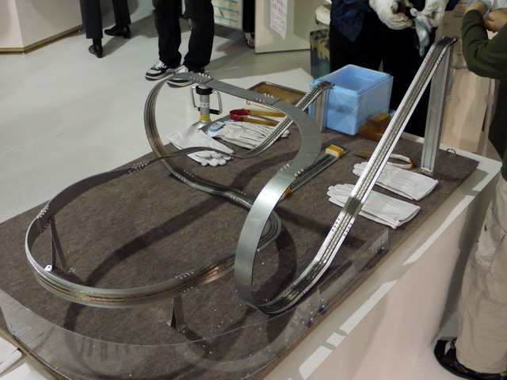
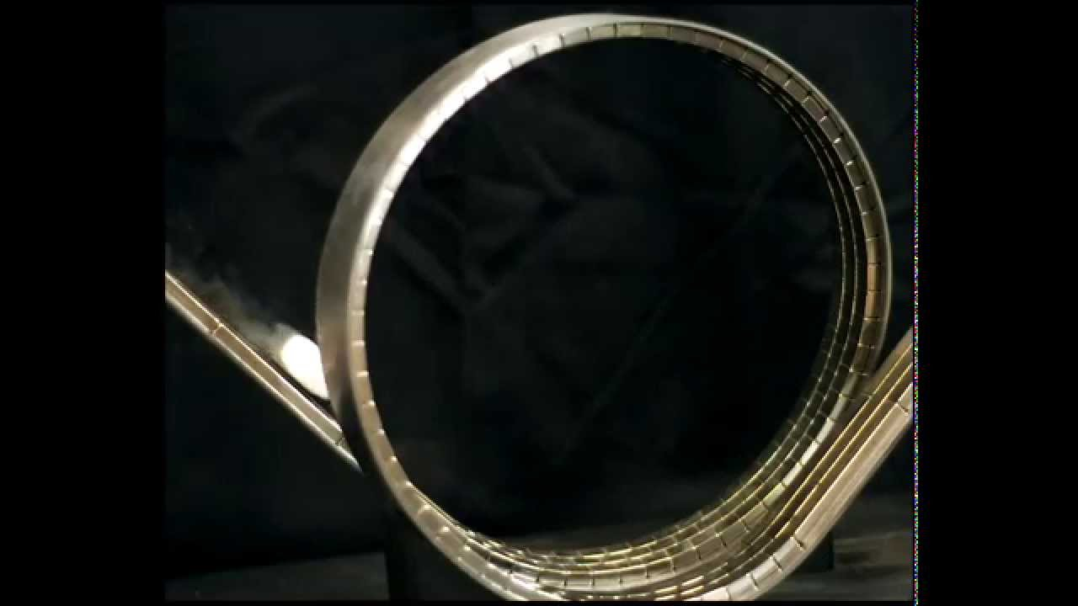
Let’s Play Superconducting Coaster
When your laboratory joins some public events, for example open-houses or university festivals, how do you attract the interest of the visitors to your cryogenic or superconductive researches.
Superconducting Coaster is one of the efficient exhibition due to its dynamic movement.
There are a lot of superconducting coasters in many laboratories and science museums. Almost of them need guide rail ways composed with large number of neodymium magnet pieces aligned. And this preparation takes long time and is tedious.
Today, we are going to create and play superconducting coasters with a simple guide rail way by using commercial available rubber magnetic belt and light coasters made of ReBCO tape conductor.
Enjoy it.
https://www.youtube.com/watch?v=fyWfEKTGXgo&ab_channel=KEK%E3%83%81%E3%83%A3%E3%83%B3%E3%83%8D%E3%83%AB
https://www.youtube.com/watch?v=uKnUCz8pads&ab_channel=IthacaCollegePhysics

Slide 3
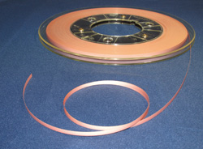
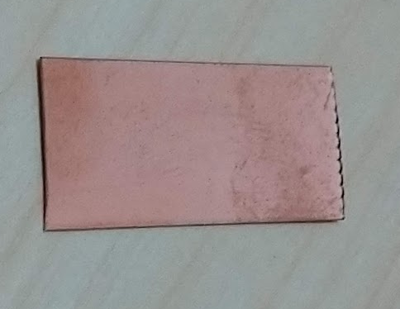
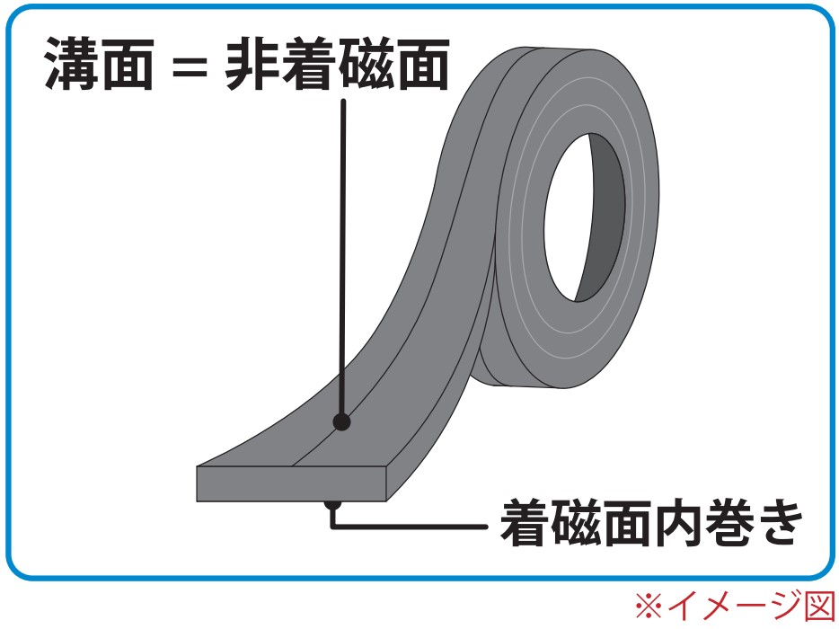
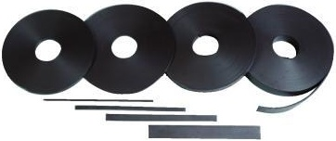
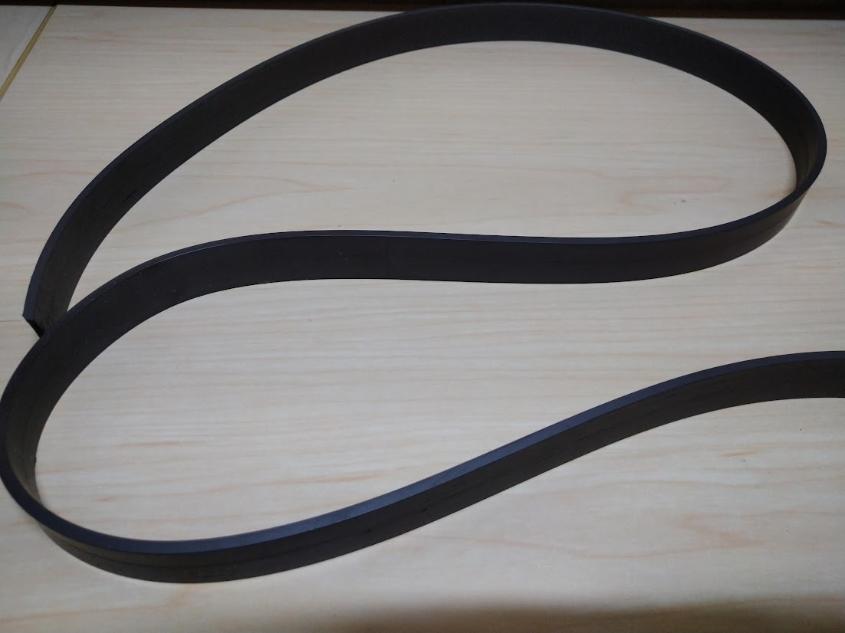
Materials for this Hand-on-training
ReBCCO Superconducting Tape by FUJIKURA, FYSC-SCH12
Ic : >550 A at 77 K
Copper Stabilizer Coating 20 μm
Silver Protection 2 μm
Superconductor [GdBa₂CuO_{y}] 2 μm
Middle layer [MgO, etc.] ~0.7μm
Metal substrate [Hastelloy®] 75μm
https://www.fujikura.com/solutions/superconductingwire/
Anisotropic Rubber Magnet Belt by MagX,
Grooved Surface
Non-magnetizing
Strontium Ferrite Particle Powder 0.24 mT Thttps://www.magx.co.jp/product/magnetsheet/
N
S
N
S
S
N
S
N
Flat Surface
Magnetizing

Slide 4
Superconducting Coaster Mechanism
Why ReBCCO tape can float on and be guided by the magnetic way ?
Key word : Hard(Dirty) Type II Superconductor, Pinning, Magnetization
ReBCCO
①
②
③
④
N
S
N
S
N
S
N
S
N
S
N
S
N
S
N
S
N
S
N
S
S
N
S
N
S
N
S
N
S
N
S
N
S
N
S
N
S
N
S
N
Repulsion Force due to induced current.
Forcibly contact.
Field penetration
Field Pinning.
Keeping fixed position.
②
①
N
S
N
S
S
N
S
N

Slide 5
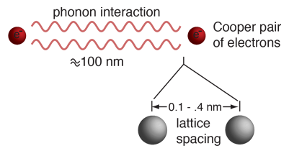
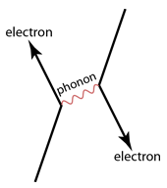
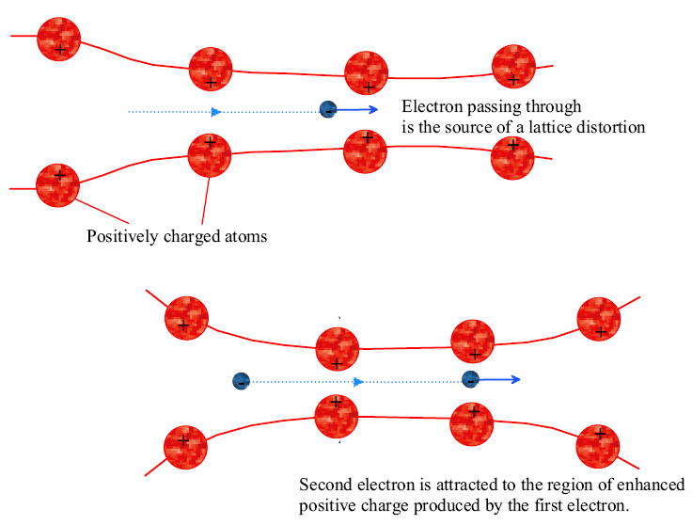
Superconductivity explained by BCS theory
Zero resistivity is modeled by BCS theory.
  by John Bardeen, Leon Cooper, and Robert Schrieffer
High resistivity at normal state and Isotope effect on Tc
  Large interaction between electron and lattice
The behavior of superconductors suggests that electron pairs are coupling over a range of hundreds of nanometers, three orders of magnitude larger than the lattice spacing.
Called Cooper pairs, these coupled electrons can move through lattice spacing without momentum loss, because one of them attract lattice position and this displacement of lattice attract the other electron.
Coherence Length, ξ
Electron Passing through
is the source of a lattice distortion
Second electron is attracted to the region of enhanced
positive charged produced by the first electron.
Positively charged atoms
This coupling is viewed as an exchange of phonons. Phonons is the quanta of lattice vibration energy.
Notes:
The disappearance of electrical resistivity was modeled in terms of electron pairing in the crystal lattice by John Bardeen, Leon Cooper, and Robert Schrieffer in what is commonly called the BCS theory.
The behavior of superconductors suggests that electron pairs are coupling over a range of hundreds of nanometers, three orders of magnitude larger than the lattice spacing. Called Cooper pairs, these coupled electrons can take the character of a boson and condense into the ground state.
This coupling is viewed as an exchange of phonons, phonons being the quanta of lattice vibration energy. Experimental corroboration of an interaction with the lattice was provided by the isotope effect on the superconducting transition temperature. The boson-like behavior of such electron pairs was further investigated by Cooper and they are called "Cooper pairs".

Slide 6
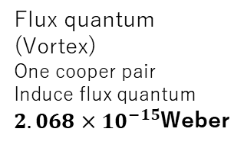


Type 1 & Type 2 with mixed phase
Type 1
Complete Meissner effect.
Pure metals which exhibit zero resistivity at low temperature.
Lower H_{c}( B_{c} ) & J_{c}
  for Magnet Conductor
Type 2
do not exhibit Meissner effect strictly.
exhibits an intermediate phase of mixed non-superconducting
They were found to have much higher critical fields and therefore could carry much higher current densities while remaining in the superconducting state.
Vortices SC current
Flux quantum
φ₀=h/2e
Ba
Density of SCe⁻ (CooperP)
$$e^{−}$$
２ξ
ξ
$$e^{−}$$
ξ: Coherence L,
ξ
0
r
Flux quantum
(Vortex)
One cooper pair
Induce flux quantum
$2.068×{10}^{−15}$Weber
Magnetic Field
r
Super.
Non-super.
２λ_{L}
Non-super.
0
r
Notes:
As Meissner and Ochsenfeld discovered, superconductors exhibit perfect diamagnetism. But some superconductors don’t exhibit Meissner effect strictly.
Type-II superconductor exhibits an intermediate phase of mixed non-superconducting and superconducting properties at intermediate temperature and fields above the superconducting phases. It also features the formation of magnetic field vortices with an applied external magnetic field. This occurs above a certain critical field strength Hc1. The vortex density increases with increasing field strength. At a higher critical field Hc2, superconductivity is destroyed.

Slide 7
Super-Normal Boundary of Type 2 Superconductor
Lowering of energy, due to pair formation, is more than the increase in energy due to magnetic contribution close to the N–S boundary resulting in a negative surface energy .
Penetration depth and coherence range at boundary.
Contributions to free energy.
Total free energy.
So, larger N-S boundary become stable.
Energy
>
B
B
e⁻
Energy
>
e⁻
e⁻
e⁻
Cooper Pair
Free electron
N-S boundary become stable

Slide 8
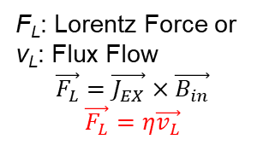
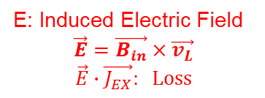
Transport Current and Pinning Force
Quantum Flux in the mixture region can be moved by Lorentz Force under transport current. The movement of the flux lines generates a finite voltage and a resistance appears.
B_{in}=n_{L}Φ₀
Φ₀
B_{in}=n_{L}Φ₀
Φ₀
F_{L}: Lorentz Force or
v_{L}: Flux Flow
$$\vec{F_{L}}=\vec{J_{EX}}×\vec{B_{in}}$$
$$\vec{F_{L}}=η\vec{v_{L}}$$
B_{EX}
Quantum Flux
B_{EX}
Φ₀
Φ₀
Φ₀
Φ₀
Φ₀
Φ₀
Φ₀
Φ₀
Φ₀
Φ₀
Φ₀
Current J_{EX}
E: Induced Electric Field
$$\vec{E}=\vec{B_{in}}×\vec{v_{L}}$$
$$\vec{E}∙\vec{J_{EX}}: Loss$$
External Field
External Field
The flux lines are however held back by the crystal lattice through a pinning force F_{P}. Imperfections, defects and impurities are introduced into the superconducting materials to create Pinning Centers. .
J_{c} versus magnetic field for type 2.
Notice high J_{c} in dirty (hard) superconductors
B_{EX}
Φ₀
Φ₀
superconductors in clean limit and the dirty limit with pinning centers. Jc in both the cases drops to zero at B_{c2}.
Φ₀
F_{P}: Pining Force
Φ₀
Φ₀
Current J_{EX}
Defects of SC lattice
(fixed normal core)
External Field
Notes:
The flux lines, however, experience a Lorentz force, FL under the influence of the transport current and the perpendicular transverse field which tries to move it in the third perpendicular direction (Fig. 3.4). The movement of the flux lines generates a finite voltage and a resistance appears. The flux lines are however held back by the crystal lattice through a pinning force FP. Imperfections, defects and impurities are introduced into the superconducting materials to create pinning sites. The pinning force is thus increased significantly and the superconductor can carry a much larger current.
https://technicalreports.ornl.gov/m/ornlm3063r1/contents.html

Slide 9
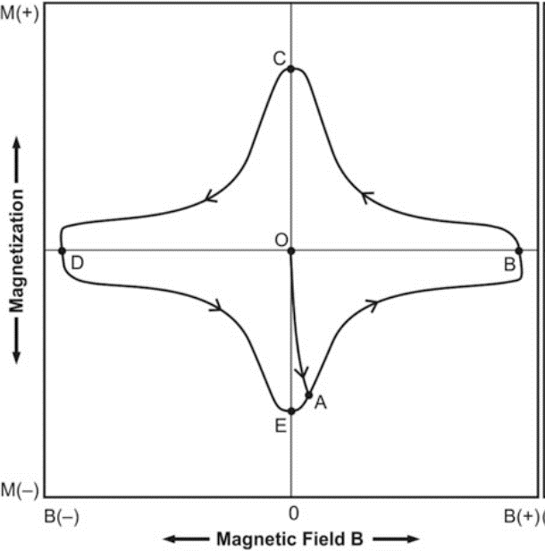

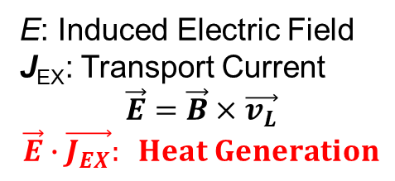
Flux Jump and Multifilament
This hysteresis energy dissipation appears as frictional heat and is caused by the movement of the flux bundles in and out of the conductor.
F_{L}: Lorentz Force or
v_{L}: Flux Flow (Flux Jump)
B_{EX}
E: Induced Electric Field
J_{EX}: Transport Current
$$\vec{E}=\vec{B}×\vec{v_{L}}$$
$$\vec{E}∙\vec{J_{EX}}: Heat Generation$$
Current J_{EX}
External Field
Composition of SC filament in matrix of metal with high conductivity
Temperature Rise
1~100 μm
Superconductor
Fast Flux Flow
Cooling
LHe
Slow Heat Flow
Heat
Heat Generation
Normal conductor (Cu etc)
Slow Flux Flow
Fast Heat Flow
Flux Flow -> Flux Jump
Multifilament Conductor

