Slide 1
Superconducting Magnet
Magnet Design
Y. Makida (KEK)
SAKURA Science Program
17. January. 2023
Notes:
In this second lecture, I’d like to talk about some subjects of superconducting magnet engineering and I hope you get some image of general magnet design protocol.

Slide 2
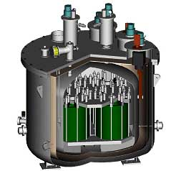
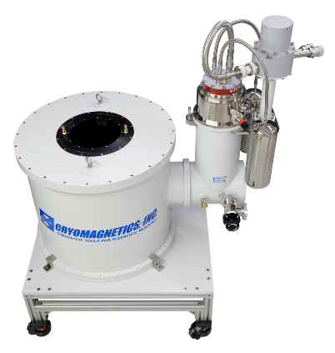
Introduction
Electro-magnets are a natural idea of superconductivity applications, because of abolishment of Ohm’ Low.
  High current density makes compact windings and high gradients.
  No power consumption for current flow
  Once the magnet is energized, it won’t loose its magnetic field because of persistent current.
From compact system for material science to km size accelerators or 10000 ton fusion devices, a lot of types of SC magnets have been developed and been working.
Technology issues in SC magnet are introduced in this lecture.
  Mainly about magnet for accelerators.
Medical, MRI
Laboratory
Energy system, SMES
MCZ：Magnetic field applied Czochralski Crystal Growing
Fusion, ITER
Accelerator, LHC
チョクラルスキー
Transportation, MAGLEV, Ship Motor
Notes:
Electro-magnets are a natural idea of superconductivity applications, because of abolishment of Ohm’ Low.
This means that
High current density makes compact windings and high gradients.
No power consumption for current flow
Once the magnet is energized, it won’t loose its magnetic field because of persistent current.
From compact system for material science to km size accelerators or 10000 ton fusion devices, a lot of types of SC magnets have been developed and been working
Technology issues in SC magnet are introduced in this lecture.
Mainly about magnet for accelerators

Slide 3
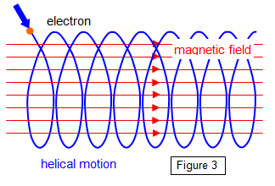
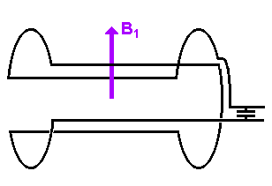
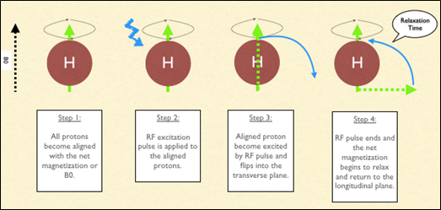
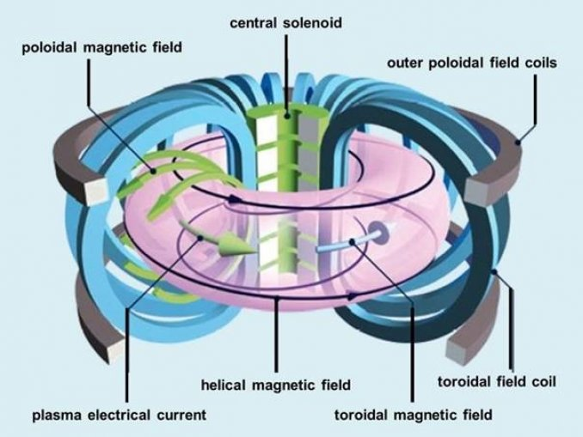
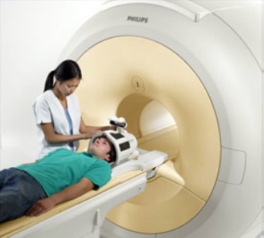
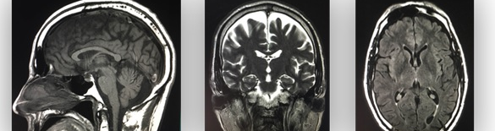
Availability of High Magnetic Field (1)
High Magnetic Field by SC mag can induce high electric-magnetic force.
  onto charged particles, electron, positron, proton, heavy ions through accelerators to control their orbit or to identify their momentum.
  onto plasma, ionized gas, in fusion devices to contain them for fusion reaction.
  onto hydrogen ions (H+) in a human body surrounded with a MRI to make body internal image.
Ion or electron
e-
Step 1
All protons become aligned with the net magnetization or B0
Step 2
RF excitation pulse is applied to the aligned protons.
Step 3
Aligned proton become excited by RF pulse and flips into the transverse plane
Step 4
RF pulse ends and the net magnetization begins to relax and return to the longitudinal plane
https://www.schoolphysics.co.uk/age16-19/Atomic%20physics/Electron%20physics/text/Electron_motion_in_electric_and_magnetic_fields/index.html
Poloidal Field
Central Solenoid
Poloidal Coil
Helical field
Toroidal Coil
Dipole Coil
plasma current
Toroidal Field
https://www.schoolphysics.co.uk/age16-19/Atomic%20physics/Electron%20physics/text/Electron_motion_in_electric_and_magnetic_fields/index.html
https://teachmeanatomy.info/the-basics/imaging/magnetic-resonance-imaging-mri/
Notes:
Availability of high magnetic field with low electric power is distinctive feature of SC magnet.

Slide 4
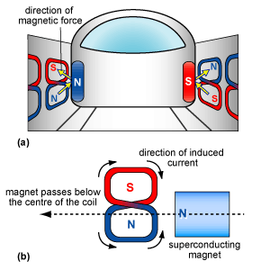
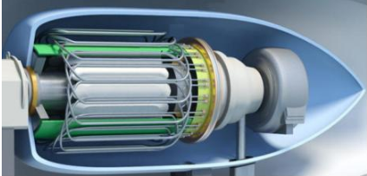
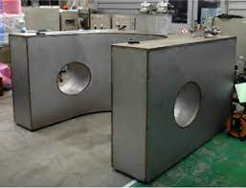

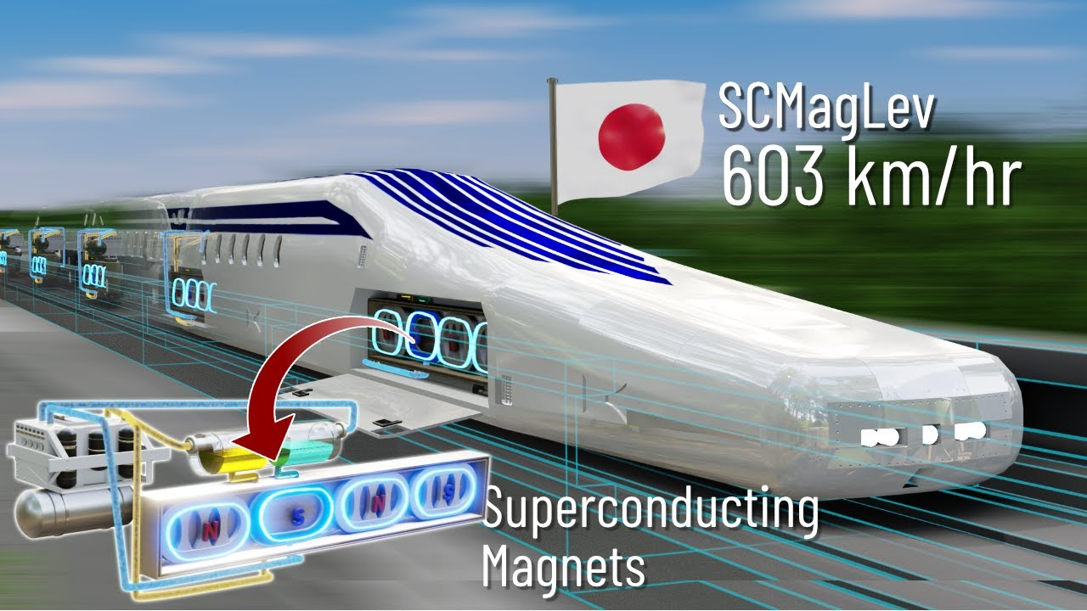
Availability of High Magnetic Field (2)
High Magnetic Field by SC mag can induce high electric-magnetic force.
  onto 8-shape coils along the MAGLEV track to levitate a train.
    https://www.youtube.com/watch?v=XjwF-STGtfE&t=325s&ab_channel=Lesics
  onto Silicon melt in its crystal growth process (MCZ method) to control its convection.
  onto a rotor or stator in a motor to generate high torque
Coil
Single-crystal Silicon
https://www.semanticscholar.org/paper/Design-of-All-Superconducting-Electrical-Motor-for-Kovalev-Nekrasova/003bf622cd273d44be67dd0610859ba3e421d511
Crucible
Silicon Melt
Heater
High Magnetic Field by SC mag can store electric-magnetic energy directly in SMES.
https://www.phy.cuhk.edu.hk/phyworld/articles/maglev/maglev_e.html
http://www.c-xsmt.com/en/index.php?m=Page&a=index&id=64
Notes:
Now I’ve shown some real applications of superconducting magnets.
Then, I’d like to show technical items you need to take account when you design SC magnet.

Slide 5
Outline : Technical Items for SC magnet design
Clarification of Required Magnetic Field
  Strength, Volume, Uniformity, Gradient, Response and Field-integral
  Stray Field,
Field Calculation, EMF Calculation
  Current distribution and coil shape, occasionally iron yoke configuration.
  Usually calculated by Computer Code to take account on non-linear permeability of iron.
  Check satisfactory Field Distribution.
  Peak field in Windings and check Jc in superconductor at 4.5 K, B_{peak}.,
  Stored energy, coil current and inductance for quench protection and power source design.
  EMF onto the Winding including Interaction with Iron.
Stress Analysis
  Within Allowable Stress, Reinforcement for Stiffness of Coil, Support Structure in Cryostat.
Stability Analysis and Quench Analysis
  J_{e} Check, Stabilizer Area (Copper Ratio) , Quench characteristics and protection (Heater, Propagator etc.)
Cryostat
  Suspending Coil (Cold Mass), Thermal Insulation Distance, Heat Leakage, Eddy Current Force at Quench,
Cryogenics
  Cooling Scheme ( Pool boiling, Forced Circulation, Conductive)
  Cold Source – LHe Transfer, He Liquefier, Cryocooler etc)
  He Phase – Saturated or Subcooled LHe, SHe, Superfluid He, LN₂, LH₂ etc.
Notes:
First clarifying magnetic field required by user.

Slide 6
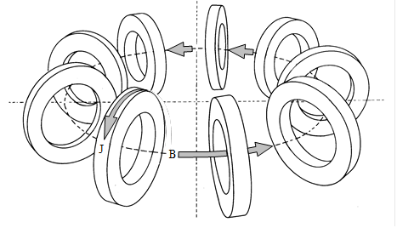
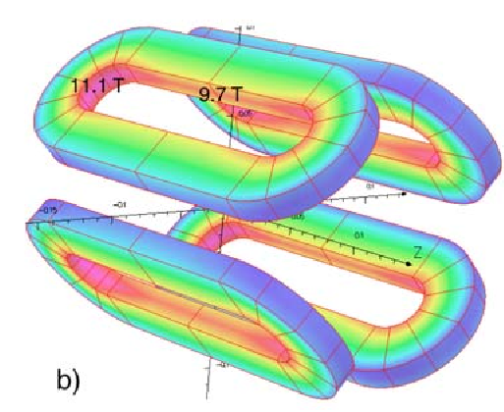
Windings to Produce Different Field Shapes
Toroidal
Solenoid type
B
B
B
I
B
I
I
B
I
Simple solenoid
Split pair for transverse access
End cheeks to improve field uniformity
Dipole type
N-poles type
B
B

Slide 7
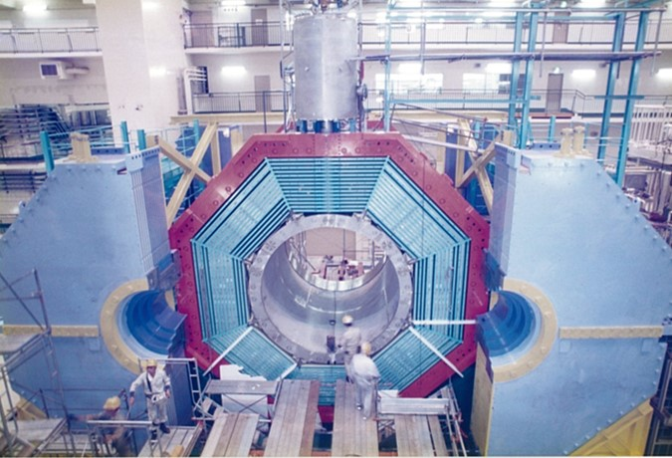
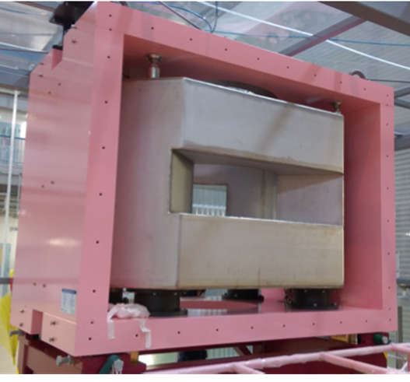
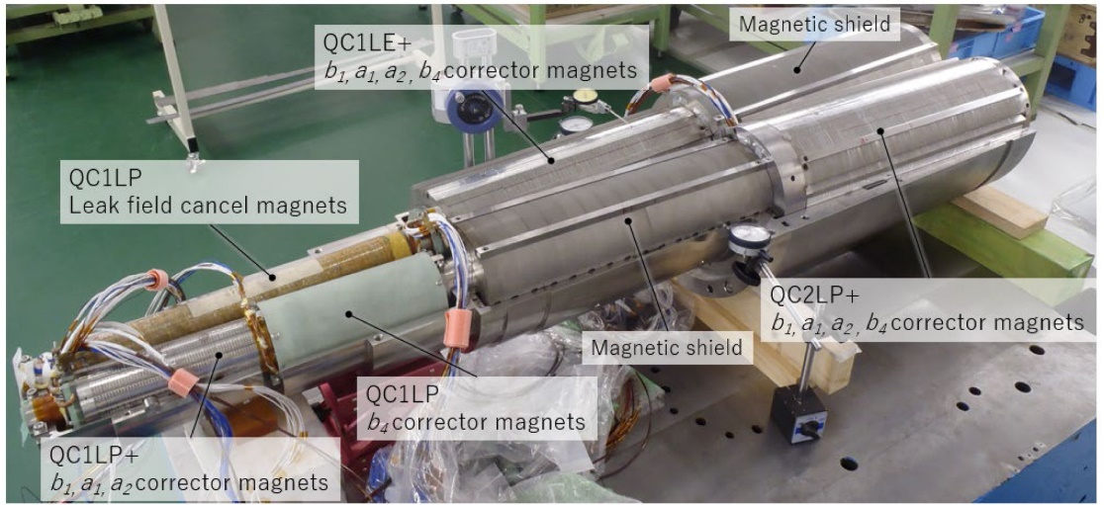
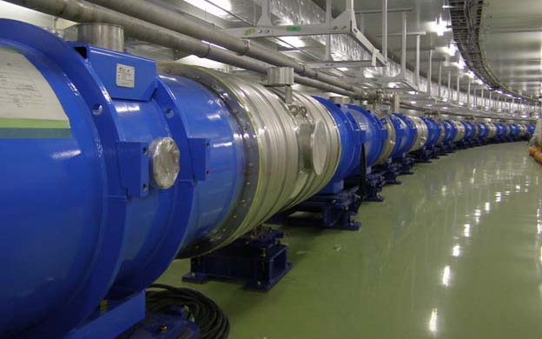
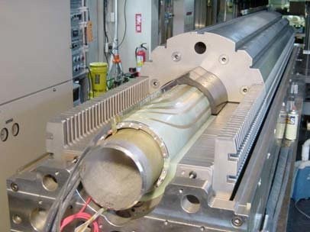
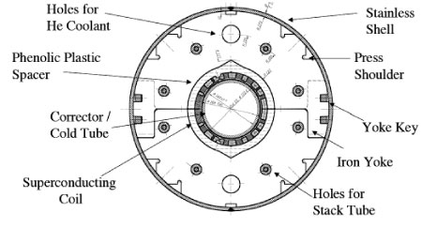
Examples of Different Field Shapes (in KEK)
Solenoid
Toroidal
Dipole
N-poles type
Belle detector
TREK detector
Hyperon Spectrometer @ J-PARC
Quadrupoles + Sextupoles + Solenoids
Dipole
SuperKEKB beam final focus
T2K neutrino beam bending and focusing

Slide 8
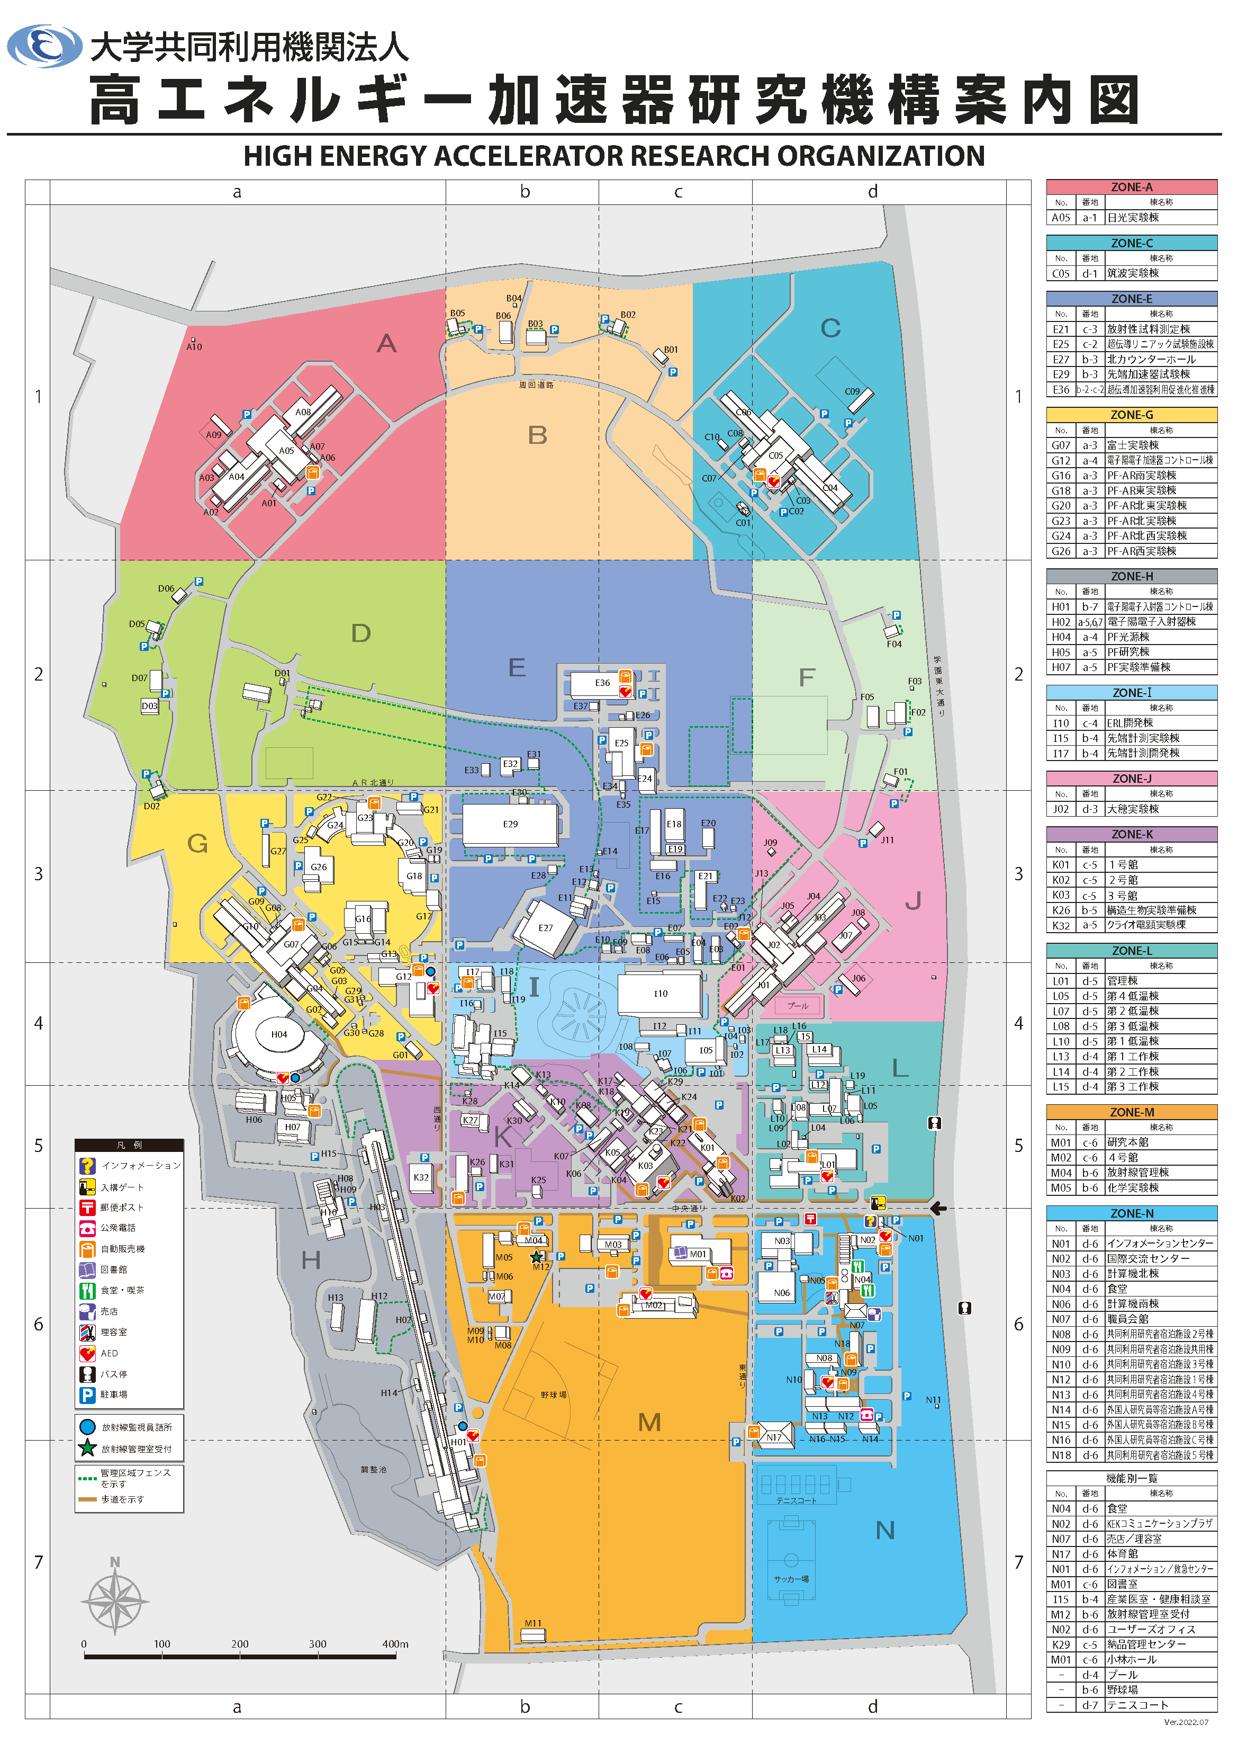
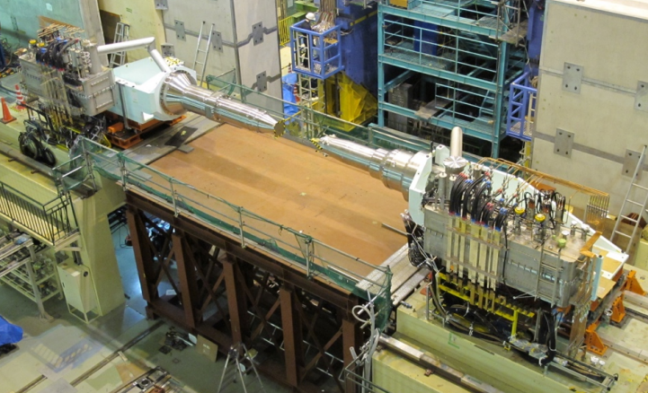
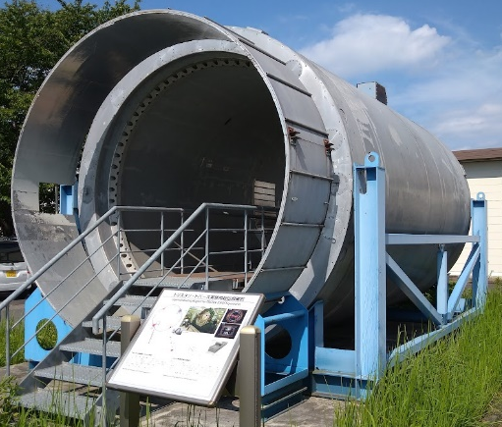
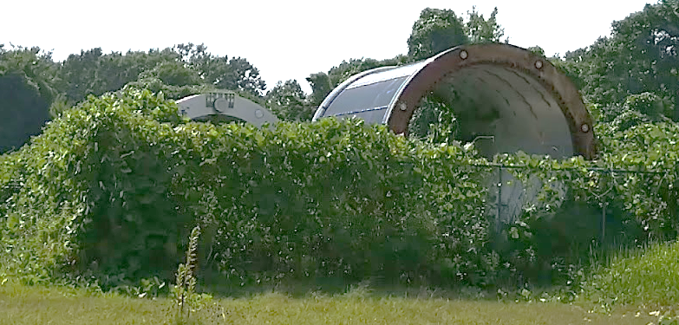
Superconducting Magnets in KEK/Tsukuba in operation, on exhibition, preserved, in field
Final Focus
Belle
TREK
TOPAZ
AMY
VENUS

Slide 9
Superconducting Magnet Design
Outline
Required Magnetic Field
  Strength, Volume, Uniformity, Gradient, Response and Field-integral
  Stray Field,
Field Calculation, EMF Calculation
  Coil shape and configuration
  Usually calculated by Computer Code. Non-linear Permeability. Current Density, Thermal Insulation Distance
  Check satisfactory Field Distribution
  Peak field in Windings and check Jc in superconductor at 4.5 K, B_{peak}., Inductance
  EMF onto the Winding including Interaction with Iron.
Stress Analysis
  Within Allowable Stress, Reinforcement for Stiffness of Coil, Support Structure in Cryostat.
Stability Analysis and Quench Analysis
  J_{e} Check, Stabilizer Area (Copper Ratio) , Quench Protection (Heater, Propagator etc.)
  Coil Current
Cryostat
  Suspending Coil (Cold Mass), Thermal Insulation Distance, Heat Leakage, Eddy Current Force at Quench,
Cryogenics
  Cooling Scheme ( Pool boiling, Forced Circulation, Conductive)
  Cold Source – LHe Transfer, He Liquefier, Cryocooler etc)
  He Phase – Saturated or Subcooled LHe, SHe, Superfluid He, LN₂, LH₂ etc.

Slide 10
Electric-Magnetic Force onto Solenoid Windings
Solenoid type
EMF on air core solenoid expand in radial and is compressed toward middle plate in axial. (Basic EMF)
Integrated outward radial force is changed into circumferential hoop stress.
Hoop stress is basically supported by winding itself. But hoop stress is over winding (conductor) stiffness, an outer support cylinder surrounds the winding to reinforce it.
Sprit coils are attracted by each other.
Winding is attracted by iron yoke, which change EMF direction. Decentering force need rigid support rods.
Iron Yoke
Outer Support Cylinder
to sustain hoop force.
Attraction b/w Sprit Coils
Unstable balance or decentering.

Slide 11
EMF onto Long Racetrack or Saddle Windings
To round coil
Notes:
Straight part of the coil conductor like to make circle configuration.
It is impossible for the coil winding to keep it straight section by its own stiffness. Some additional outer support structure is required.
As shown right side figures, coil windings is surrounded by a set of collars.

Slide 12
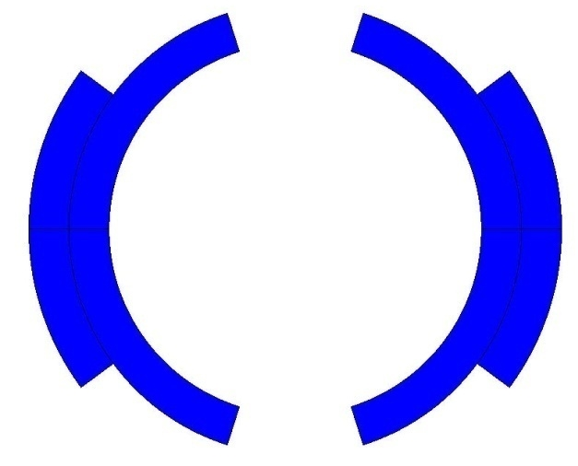
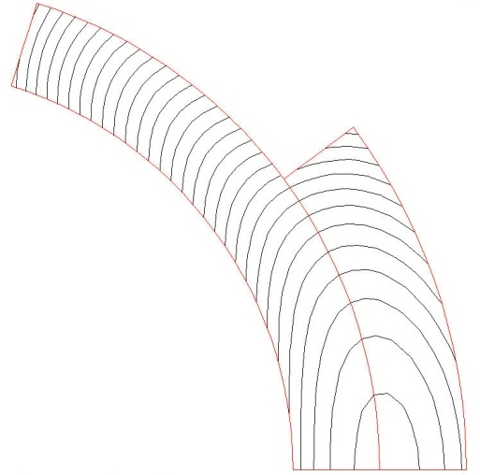
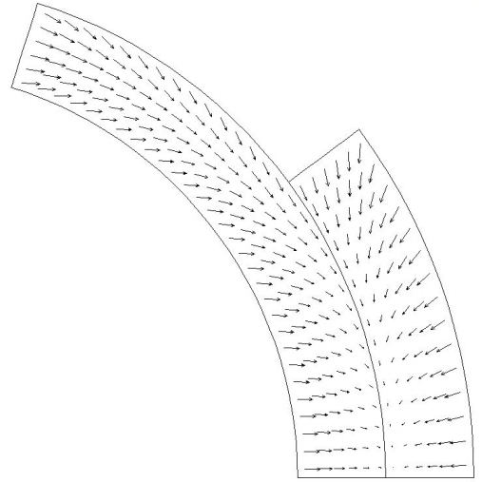
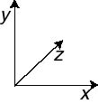
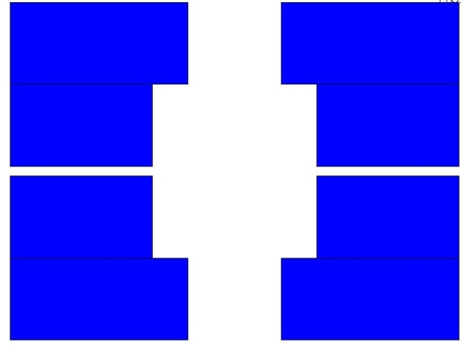
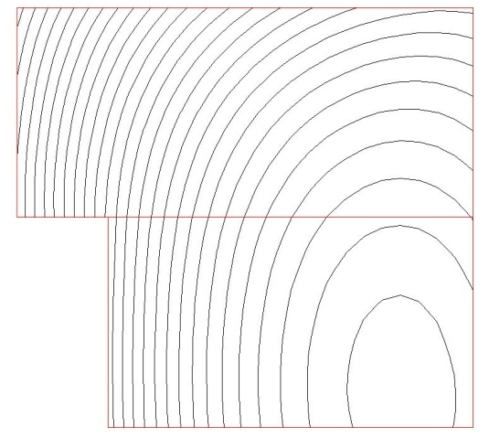
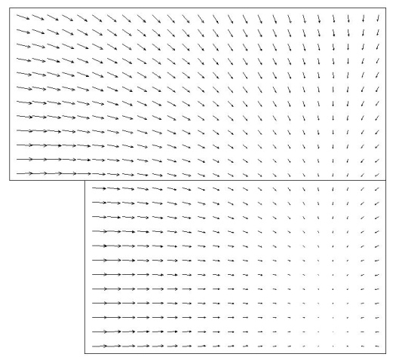
Electro-magnetic Force
The e.m. forces in a dipole magnet tend to push the coil
- Towards the mid-plane in the vertical-azimuthal direction (F_{y} , F_{θ} < 0)
- Outwards in the radial-horizontal direction (F_{x} , F_{r} > 0)
Tevatron dipole
HD2

Slide 13
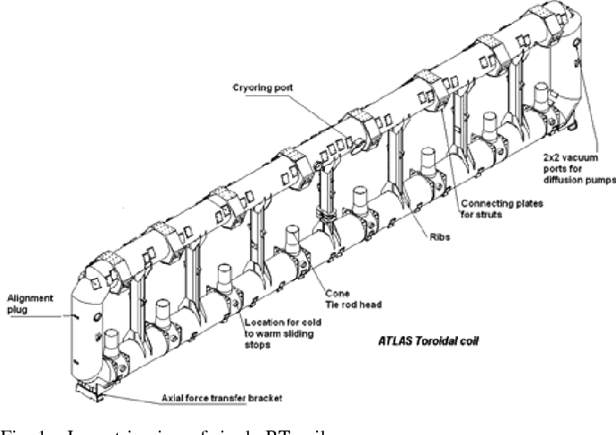
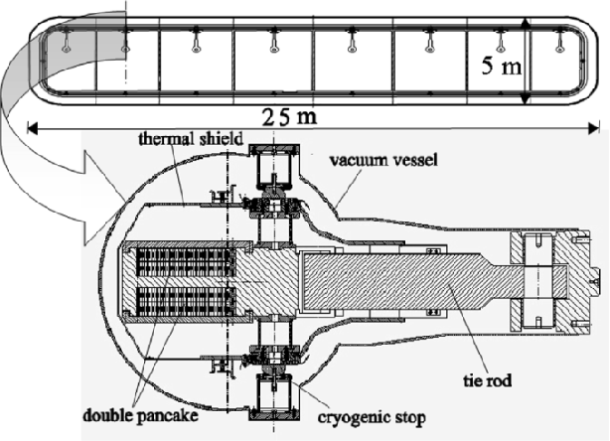
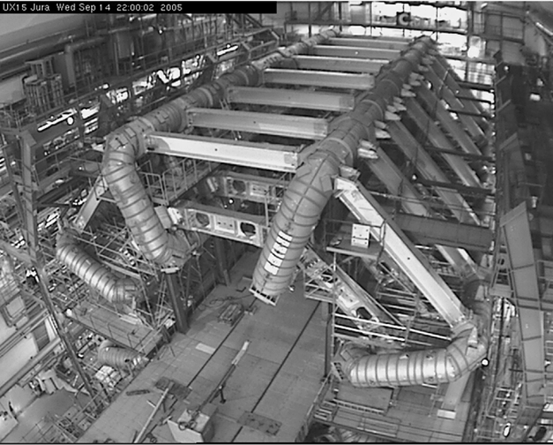
Electric-Magnetic Force onto Windings
ATLAS Barrel Toroid
Vacuum Vessel
Tie rod
Winding
Stopper

Slide 14
Outline
Required Magnetic Field
  Strength, Volume, Uniformity, Gradient, Response and Field-integral
  Stray Field,
Field Calculation, EMF Calculation
  Coil shape and configuration
  Usually calculated by Computer Code. Non-linear Permeability. Current Density, Thermal Insulation Distance
  Check satisfactory Field Distribution
  Peak field in Windings and check J_{c} in superconductor at 4.5 K, B_{peak}., Inductance
  EMF onto the Winding including Interaction with Iron.
Stress Analysis
  Within Allowable Stress, Reinforcement for Stiffness of Coil, Support Structure in Cryostat.
Stability Analysis and Quench Analysis
  J_{e} Check, Stabilizer Area (Copper Ratio) , Quench Protection (Heater, Propagator etc.)
  Coil Current
Cryostat
  Suspending Coil (Cold Mass), Thermal Insulation Distance, Heat Leakage, Eddy Current Force at Quench,
Cryogenics
  Cooling Scheme ( Pool boiling, Forced Circulation, Conductive)
  Cold Source – LHe Transfer, He Liquefier, Cryocooler etc)
  He Phase – Saturated or Subcooled LHe, SHe, Superfluid He, LN₂, LH₂ etc.

Slide 15
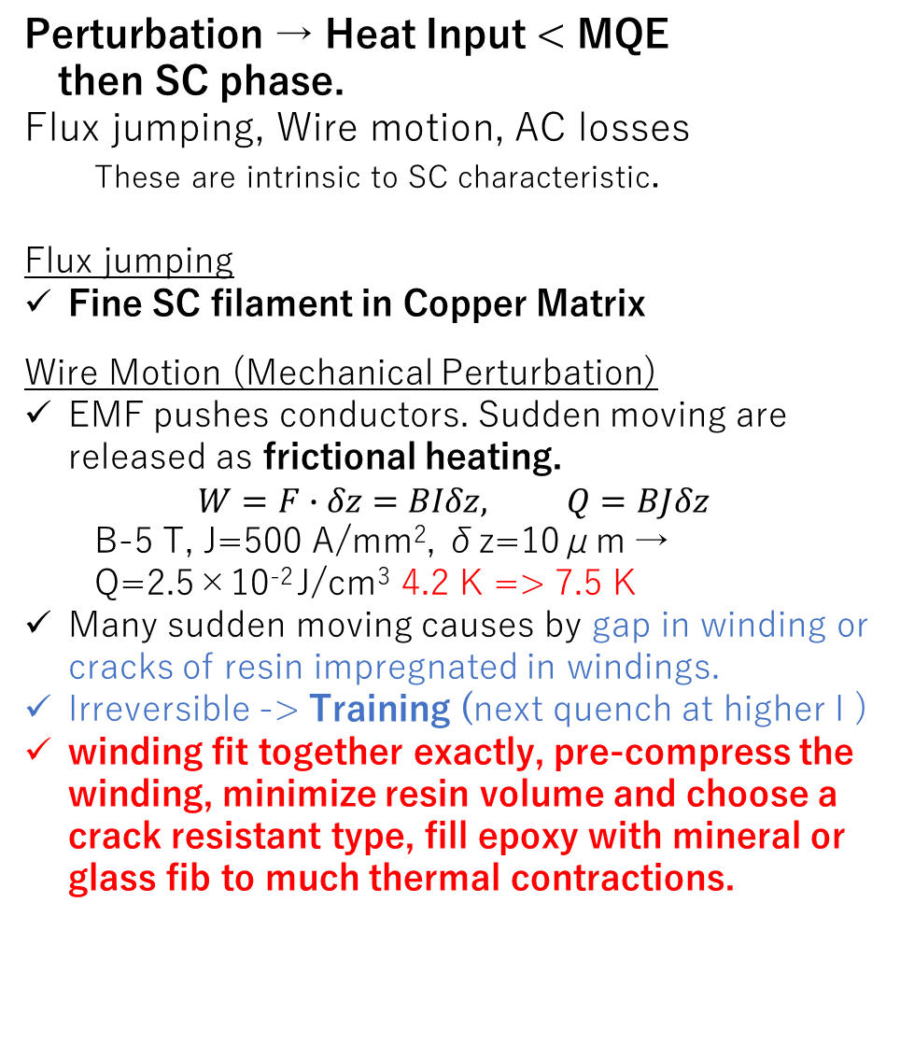
Stability VS Perturbation (1)
Perturbation → Heat Input < MQE
then SC phase.
Flux jumping, Wire motion, AC losses
  These are intrinsic to SC characteristic.
Flux jumping
Fine SC filament in Copper Matrix
Wire Motion (Mechanical Perturbation)
EMF pushes conductors. Sudden moving are released as frictional heating.
$$W=F∙δz=BIδz, Q=BJδz$$
  B-5 T, J=500 A/mm², δz=10μm →
  Q=2.5╳10⁻² J/cm³ 4.2 K => 7.5 K
Many sudden moving causes by gap in winding or cracks of resin impregnated in windings.
Irreversible -> Training (next quench at higher I )
winding fit together exactly, pre-compress the winding, minimize resin volume and choose a crack resistant type, fill epoxy with mineral or glass fib to much thermal contractions.
in the former lecture
A typical spectrum of the energy perturbations by the various mechanisms during normal operation of superconducting magnets as a function of the characteristic time for energy deposition.
The coil have to have enough stability beyond these perturbation.
Notes:
This figure shows a summary of the energy that can be deposited by the various mechanisms in a superconducting magnet as a function of the characteristic time for energy deposition, the
perturbation spectrum.
They should therefore be used with caution.
The representation of Fig. 7 clearly shows, however, that on the time-scale of fast energy deposition
(below 1 ms) the dominating mechanisms are those associated with wire and conductor motion. Flux
jumps with superconducting strands based on present-day technology are masked by the more
energetic mechanical events. At intermediate time-scales, in the range of a few milliseconds to a few
hundreds of milliseconds, the dominant energy perturbation in pulsed magnets is generated by a.c.
loss. For magnets operated in steady state in nuclear environments – for example, particle accelerators
– the a.c. loss is negligible and the main concerns in this time-scale are events associated with particle
showers and nuclear heat. Finally, if the magnet system operates in a steady-state condition and in a
quiet environment – for example, MRI and laboratory magnets – the dominant events are those
associated with conductor motion at the fast time-scale. For longer times, above 1 s, the dominant
perturbations are generated by the steady-state heat loads (heat leaks, nuclear heat, a.c. loss) and are no
longer a direct stability concern, as on this time-scale the heat is usually evacuated by the cooling
system.

Slide 16
Training Quench
Quench current gradually increases with every quench until “plateau” is reached
“Memory” of a previous quench current (= local strain state)!
Training is usually explained as gradual “compaction” of the winding under Lorentz forces, accompanied by a series of slip-stick or cracking/delamination events (causing a quench).
Training is costly! Eliminating magnet training is a challenging and important problem.

Slide 17
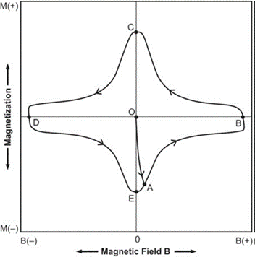
Stability VS Perturbation (2)
Perturbation → Heat Input < MQE then SC phase.
Flux jumping, Wire motion, AC losses
  These are intrinsic to SC characteristic.
AC Loss
Eddy current through coupling of
  filaments and matrix (IFCC)
  cable strands (ISCC)
  generates joule heat in normal metal part.
IFCC
Higher resistance inter filaments or strands → Decreases coupling current.
Balance of thermal conductivity b/w them.
  Remember copper matrix function to cool flux jumping loss in filaments.
Hysteresis (Flux Flow)
ISCC

Slide 18














Stability (Minimum Quench Energy)
Perturbations initiate Normal (Resistive) Zone in Superconductor.
Joule Heating in NZ vs. Cooling ⇔ Quench vs. SC Zone Recovery
Heat Balance, Check dθ/dt at NZ.
  $$C\frac{dθ}{dt}=∇∙\left(k∇θ\right)+ρJ^{2}−g_{q} ≅ \frac{d}{dx}\left(k\frac{dθ}{dx}\right)+ρJ^{2}−g_{q}$$
Define MPZ (minimum propagation zone) $l_{mpz},$
apploach $\frac{dθ}{dx}= \frac{θ_{0}−θ_{c}}{l_{,mpz}}$and $\frac{dθ}{dt}=0$
  $$0=2kA\frac{θ_{0}−θ_{c}}{l_{mpx}}+l_{mpz}AρJ^{2}−l_{mpz}hp\left(θ_{c}−θ_{0}\right)$$
  $$l_{mpz}=\sqrt{\frac{2kA\left(θ_{c}−θ_{0}\right)}{ρJ^{2}}+\frac{hp}{A}\left(θ_{c}−θ_{0}\right)}=\sqrt{\frac{2kA\left(θ_{c}−θ_{0}\right)}{ρJ^{2}}}$$
MQE
  $$E_{mqe}=A\int_{−∞}^{∞}{\int_{θ_{0}}^{θ_{c}}{C\left(θ\right)}dθ}dx≅Al_{mpz}\left(h_{c}−h_{0}\right)$$
Larger A and k, lower ρgives larger MQE -> larger Cu area
Check temperature
Increase or Decrease
Joule heating in NZ
Heat transfer to coolant
Include or exclude
Conductive cooling along conductor
approximation
$$θ$$
$$\frac{θ_{0}−θ_{c}}{l_{mpx}}=k\frac{dθ}{dx}$$
Quench Expansion
$$θ_{c}$$
$$θ_{g}$$
2 mean both SC/N zone boundary
A is conductor cross section
h is heat transfer coefficient
p is perimeter of conductor
$$θ_{0}$$
Recovery
MPZ
$$x$$
$$AρJ^{2}$$
Heating
Cooling
Cooling
$$Ak\frac{dθ}{dx}$$
$$Ak\frac{dθ}{dx}$$
Cryogenic stability
Adiabatic
$$l_{mpz}AρJ^{2}$$
$${−l}_{mpz}/2$$
$$l_{mpz}/2$$
$$x$$
Notes:
Now we define MPZ

Slide 19
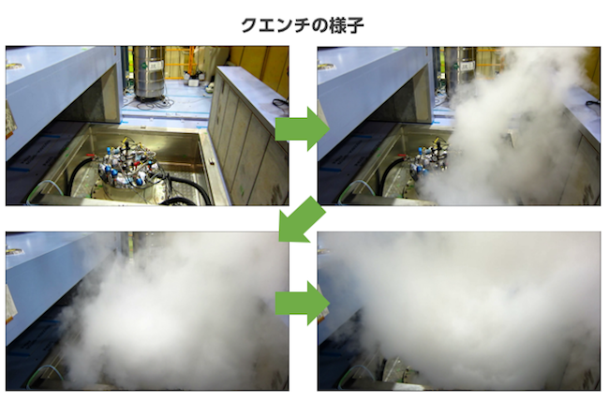
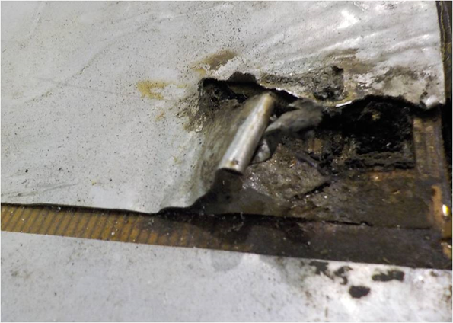
Quench
Quench in Superconducting Magnet
  Resistive zone initiated by perturbation grows over MPZ, it expands over windings by thermal conduction.
  It is impossible for the magnet to keep operational field.
  Stored energy ½ LI² of the magnet dissipated as heat.
  greatest integrated heat dissipation is at the quench origin.
  Internal voltage much greater than terminal voltage appears.
  Excessive heat dropping burns winding out and breaks electric insulation and the coil is damaged.
  But, quench is one of normal operation of SC to quick discharge of magnetic field.
  Quenching is therefore considered a natural part of the magnet operation, and magnet systems should be designed to handle it safely..
Magnetic Energy is consumed by He veiling off.

Slide 20
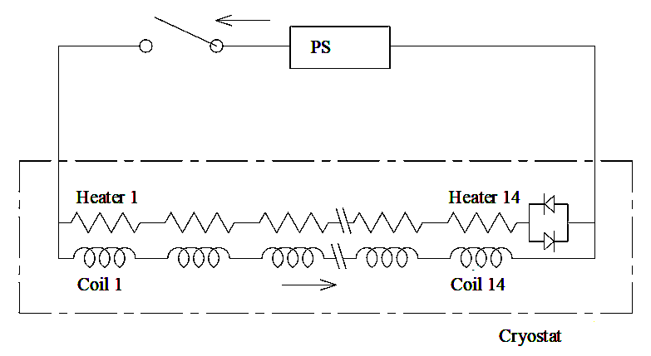
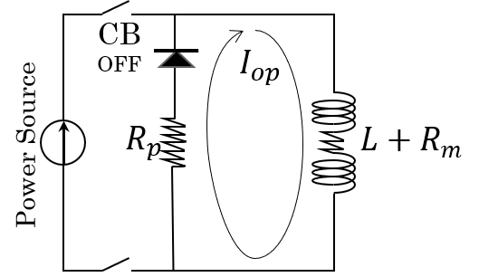
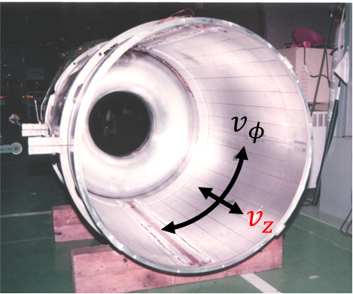
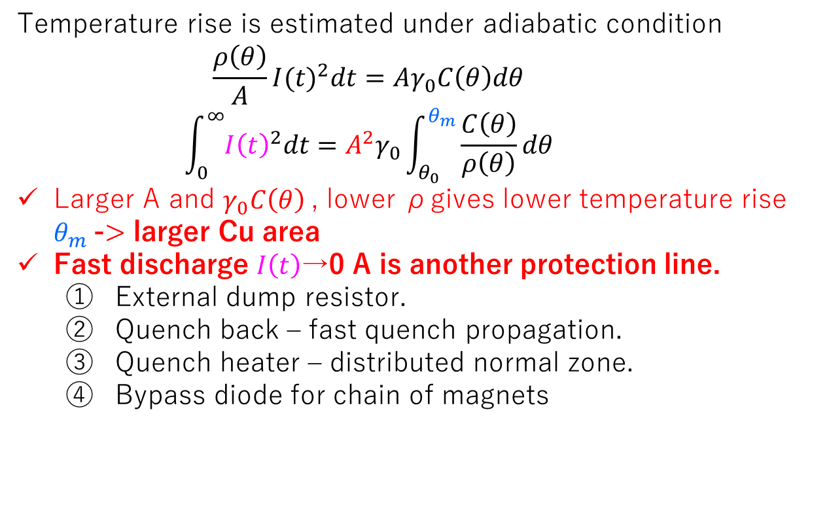
Quench Protection
Temperature rise is estimated under adiabatic condition
    $$\frac{ρ\left(θ\right)}{A}{I(t)}^{2}dt=Aγ_{0}C\left(θ\right)dθ$$
    $$\int_{0}^{∞}{{I\left(t\right)}^{2}dt}=A^{2}γ_{0}\int_{θ_{0}}^{θ_{m}}{\frac{C\left(θ\right)}{ρ\left(θ\right)}dθ}$$
Larger A and $γ_{0}C\left(θ\right)$, lower ρgives lower temperature rise $θ_{m}$-> larger Cu area
Fast discharge $I\left(t\right)$→0 A is another protection line.
  External dump resistor.
  Quench back – fast quench propagation.
  Quench heater – distributed normal zone.
  Bypass diode for chain of magnets

Slide 21
Quench Detection
Imbalance detector
Imbalance bridge circuit detects resistive voltage in any branch of the coil winding, by comparing potential of a pre-selected voltage tap to that provided by a resistive divider.
Inductive voltage is canceled in the bridge circuit.
Several(at least 2) imbalance circuits are used in order to detect symmetric quenches.
Typical Imb. threshold is~100 mV for research magnets. A time interval over which voltage rises above the threshold is often called “detection time”
Non voltage quench diagnostics
Temperature rise and pressure rise beyond threshold start discharge as prevention of quench.
Acoustic emission detection/triangulation system uses arrays of piezoelectric sensors to detect mechanical events/quench precursors in the magnet, and also to localize quenches using triangulation technique.

Slide 22

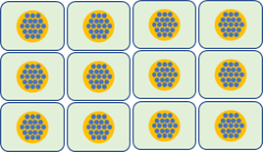
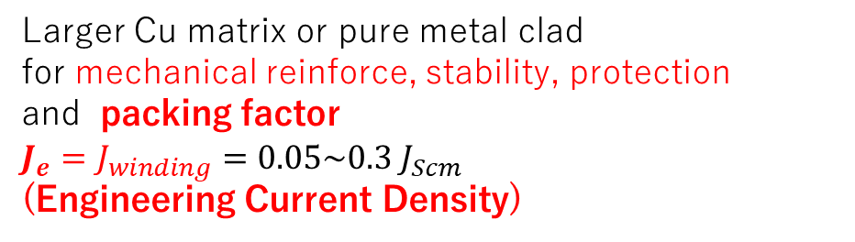

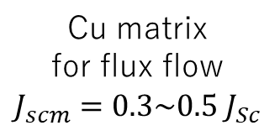


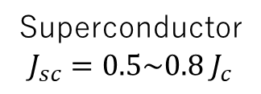



Review : Effective Current Density over the Magnet
Induced magnetic field $B∝NI∝Jwinding$, and $JC$ in SC $≫Jwiniding≫J_{cryo}$ in SC magnet.
$J$ in SC magnet > $J$ in normal (copper) magnet ?
Superconductor
$$J_{sc}=0.5\sim 0.8 J_{c}$$
Cu matrix
for flux flow
$$J_{scm}=0.3\sim 0.5 J_{Sc}$$
Larger Cu matrix or pure metal clad
for mechanical reinforce, stability, protection
and packing factor
$$J_{e}=J_{winding}=0.05\sim 0.3 J_{Scm}$$
(Engineering Current Density)
10⁴
$$J_{c}$$
$$J_{sc}$$
Initially 50 A/mm² used
10³
$$J_{cryo}$$
Vacuum Vessel
$$J_{scm}$$
Critical current density Jc (A/mm²)
Engineering current density (A/mm²)
10²
$$J_{e}$$
Cold Mass
$$J_{cryo}$$
LHe vessel or
Winding Case
Conventional
Iron yoke
Magnet.
10
Coil Structure and Cryostat reduce effective current density.
2 4 6 8 10 1214 16 18 20 22
Magnetic field (tesla)

Slide 23
Outline
Required Magnetic Field
  Strength, Volume, Uniformity, Gradient, Response and Field-integral
  Stray Field,
Field Calculation, EMF Calculation
  Coil shape and configuration
  Usually calculated by Computer Code. Non-linear Permeability. Current Density, Thermal Insulation Distance
  Check satisfactory Field Distribution
  Peak field in Windings and check J_{c} in superconductor at 4.5 K, B_{peak}., Inductance
  EMF onto the Winding including Interaction with Iron.
Stress Analysis
  Within Allowable Stress, Reinforcement for Stiffness of Coil, Support Structure in Cryostat.
Stability Analysis and Quench Analysis
  J_{e} Check, Stabilizer Area (Copper Ratio) , Quench Protection (Heater, Propagator etc.)
  Coil Current
Cryostat
  Suspending Coil (Cold Mass), Thermal Insulation Distance, Heat Leakage, Eddy Current Force at Quench,
Cryogenics
  Cooling Scheme ( Pool boiling, Forced Circulation, Conductive)
  Cold Source – LHe Transfer, He Liquefier, Cryocooler etc)
  He Phase – Saturated or Subcooled LHe, SHe, Superfluid He, LN₂, LH₂ etc.

Slide 24
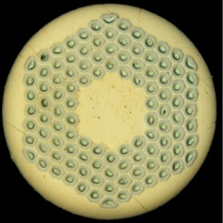




Large Current Cable
Large Current Cable
The larger magnet need the larger current to reduce turn number and keep L low enough.
$$E_{magnet}=\frac{1}{2}LI^{2}=\int{\frac{1}{{2μ}_{0}}B^{2}dv≅}\frac{1}{{2μ}_{0}}{B_{0}}^{2}V_{magnet}$$
Otherwise, larger L needs higher voltage for quick $±\dot{B}$.
14.85
LHC 13 kA
30, 57
ATLAS CS 8.4 kA, BT 20.3 kA
φ43.7
ITER 68 kA

Slide 25



Large Current Cable
Aluminum Stabilized Superconductor for detector magnet

Slide 26


Large Current Cable
Cable-In-Conduit Conductor
The cable-in-conduit conductor concept was proposed by MIT in 1975 for use with NbTi superconductors, as a way of achieving good helium contact and therefore stability.
Improved understanding of the manufacturing and design issues, driven by ITER R&D on conductor samples, led to the selection of the concept for all of the ITER conductors.
Notes:
Magnetic field : Application of magnetic field to a superconducting specimen brings a stage when for H=Hc, the critical field, the superconductor behaves like a normal material i.e., the superconductivity disappears.
Current : If the magnetic field around the superconductor is increased beyond the critical field the superconductivity is destroyed and the sample behaves as a normal material. Therefore the supercurrent will flow only up to its critical value .Once the field exceeds Hc(T) the current becomes just the ordinary current.

Slide 27
Outline
Required Magnetic Field
  Strength, Volume, Uniformity, Gradient, Response and Field-integral
  Stray Field,
Field Calculation, EMF Calculation
  Coil shape and configuration
  Usually calculated by Computer Code. Non-linear Permeability. Current Density, Thermal Insulation Distance
  Check satisfactory Field Distribution
  Peak field in Windings and check Jc in superconductor at 4.5 K, B_{peak}., Inductance
  EMF onto the Winding including Interaction with Iron.
Stress Analysis
  Within Allowable Stress, Reinforcement for Stiffness of Coil, Support Structure in Cryostat.
Stability Analysis and Quench Analysis
  J_{e} Check, Stabilizer Area (Copper Ratio) , Quench Protection (Heater, Propagator etc.)
  Coil Current
Cryostat
  Suspending Coil (Cold Mass), Thermal Insulation Distance, Heat Leakage, Eddy Current Force at Quench,
Cryogenics
  Cooling Scheme ( Pool boiling, Forced Circulation, Conductive)
  Cold Source – LHe Transfer, He Liquefier, Cryocooler etc)
  He Phase – Saturated or Subcooled LHe, SHe, Superfluid He, LN₂, LH₂ etc.

Slide 28
Cooling Scheme
Not only LHe bath cooling, there are several type of cooling scheme.
Cooling scheme is chosen or considered in
  Cooling temperature and pressure – He phase selection – Saturated LHe, Supercritical He, SFHe, Dry
  Heat load type – Heat leak, Joule heat at joints or current leads, AC loss, Nuclear or radiation heat etc
  Effective removing thermal load from the SC without deceasing SC performance.
    Layout of cooling channels, cooling pipes, thermal conductor (pure AL or Cu)
    Conductivity of SC itself,
    Larger cooling channel reduce coil stiffness and Je.
  Cooling source : cryocooler, particular liquefier, LHe transfer
    Cryocooler -> Conduction, Recondense and initial LHe transfer
    Choice of whether cryocooler or particular liquefier. Boundary 10 -15 W thermal load
Liquefier + Subcooler
(Pump, Current Leads etc)
Insulation pipes
Conductor include cooling pipes CICC(Cable in Conduit Conductor )
for Fusion
Cryocooler
(Recondense)
Liquefier + Subcooler
(SHe,SFHe, Pump etc)
Current Leads
(Cu + HTS)
Liquefier + Subcooler
(Pump, Current Leads etc)
Cryocooler
LHe
LHe
LHe (SHe, SFHe, Sat.He etc)
Conductive cooling through
thermal conductor (Cu or Al)
for Lab. MCZ, Detector
Coil impregnated resin
for Lab. or MRI, MAGLEV
Coil with cooling channels
Large coil (Fusion, Accelerator)
Cooling pipes + Coil Conductivity for Large Detector,

Slide 29





Radiator
He Refrig.
Claude Cycle
Comp.
Belle
Turbine Exp.
JTV Exp.
φ25
CMS
φ24 マニホールド
φ14 フィッシュボーン
Forced Flow
Thermo-syphon

Slide 30
Summary
Superconducting Magnet Design Concepts are introduced.
Required Magnetic Field
Field Calculation, EMF Calculation
Stress Analysis
Stability Analysis and Quench Analysis
Cryostat
Cryogenics
Today’s lecture is just introductions. References for further reading are listed.
R.G Sharma, “ Superconductivity Basis and Applications to Magnets”, Springer, 2015
M. Tinkham, “Introduction to Superconductivity”, 1996
V. V. Schmidt, “The Physics of Superconductors”, Springer ,1997
R.D. Parks, “Superconductivity”, (v.1 &2), Marcel Dekker Inc., 1962
K.-H. Mess, P. Schmuser, S. Wolf, “Superconducting Accelerator Magnets”, World Scientific, 1996
M. N. Wilson “Superconducting magnets”, Oxford Science Pub. 1983
Y. Iwasa, “Case Studies in Superconducting Magnets”, Springer 2009
(about history)M.N. Wilson, “100 Years of Superconductivity , 50 Years of Superconducting Magnets”, CERN Symposium, Dec 2011.

Slide 31
Summary
Cryogenic properties (1-300 K) of many solids, including thermal conductivity, specific heat, and thermal expansion, have been empirically fitted and the equation parameters are available free on the web at www.cryogenics.nist.gov
Plots and automated data-look-up using the NIST equations are available on the web for a fee from www.cpia.jhu.edu
Other fee web sites that use their own fitting equations for a number of cryogenic material properties include: www.cryodata.com(cryogenic properties of about 100 materials), and www.jahm.com(temperature dependent properties of about 1000 materials, many at cryogenic temperatures).
Commercially supplied room-temperature data are available free online for about 10 to 20 properties of about 24,000 materials at www.matweb.com
https://htess.com/software-products/
GASPAK
properties of pure fluids from the triple point to high temperatures.
HEPAK
properties of helium including superfluid above 0.8 K, up to 1500 K.
METALPAK
reference properties of metals and other solids, 1 -300 K.
CRYOCOMP
properties and thermal design calculations for solid materials, 1 -300 K.
SUPERMAGNET
four unique engineering design codes for superconducting magnet systems. .

