Slide 1
Superconducting Magnet
- from Discovery to Magnet Conductor
Y. Makida (KEK)
SAKURA Science Program
6. December. 2022

Slide 2
Introduction

Slide 3
Discovery of Superconductivity
H. Kamerlingh-Onnes in University of Leiden found that the resistance in a solid mercury wire immersed at 4.2 K in liquid helium suddenly vanished in 1911.
Kamerlingh-Onnes had previously been the first to liquefy helium in 1908. Having liquid helium enabled this discovery.
He reported that "Mercury has passed into a new state, superconductive state".
For some materials, the resistivity vanishes at some low temperature: they become superconducting.
Resistance (Ω)
Superconductivity is the ability of certain materials to conduct electrical current with no resistance. Thus, superconductors can carry large amounts of current with little or no loss of energy.
Heike Kamerlingh Onnes
(1853-1926)
Temperature (K)
K. Onnes, in Procs. of koninklijke akademie
van wetenschappen, Vol. 14 (1911)

Slide 4
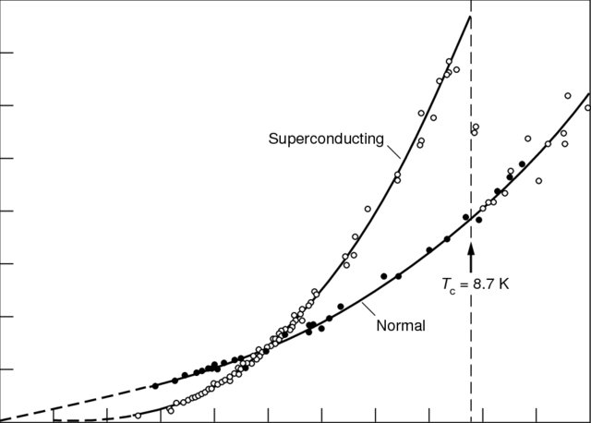
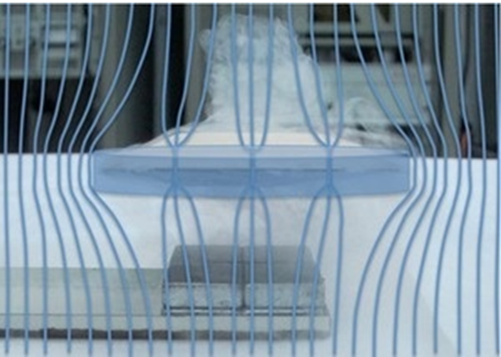
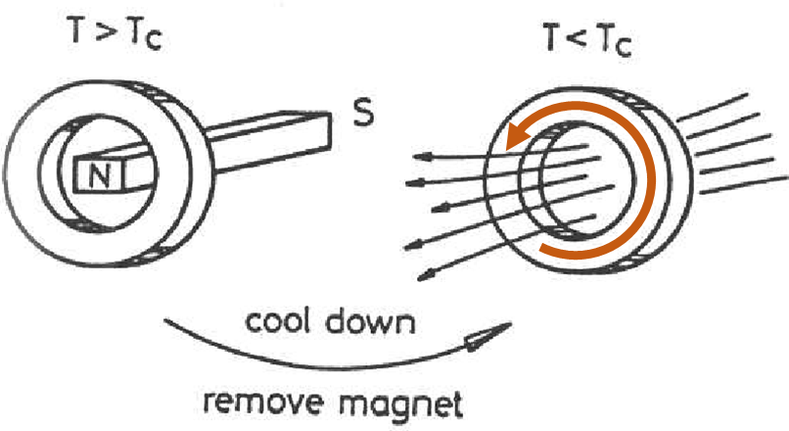
PROPERTIES VIS-A-VIS SUPERCONDUCTIVITY
Properties affected :
Magnetic properties change
  Perfect diamagnetism
  Meissner-Ochsenfeld effect
  Flux pinning (Type II superconductor)
Electrical properties : as the electrical resistivity tend to zero at T=T_{c}
All thermo-electric effects disappear for T ≤ T_{c}
  Low thermal conductivity
Specific heat shows a discontinuous change
Some latent heat of transition may also be involved
Entropy shows a decrease for T ≤ T_{c}
Properties not affected :
Elastic properties
Thermal expansion
Photoelectric properties
Internal arrangement of crystal lattice as confirmed by X-ray diffraction pattern before and after such a transition
Tc=8.7 K
Superconducting
Normal
(with B)
Persistent Current
Specific Heat Signature of the Superconducting Transition in Niobium
https://www.researchgate.net/publication/286351978_Plutonium_condensed-matter_physics_-_A_survey_of_theory_and_experiment
Diamagnetism with flux pinning
Notes:
If a ring made of superconducting material is cooled in a magnetic field from ordinary temeprature to a value below its critical temperature and then the magnetic field is removed, an induced current is set up in the ring. The resistance in the superconducting state being practically zero, the decay of thie induced current will take infinitely long time.

Slide 5
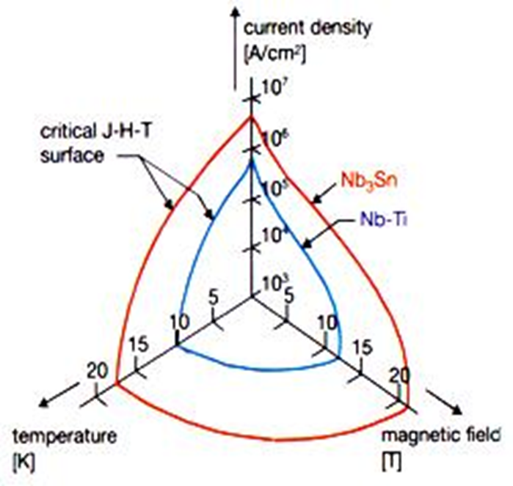
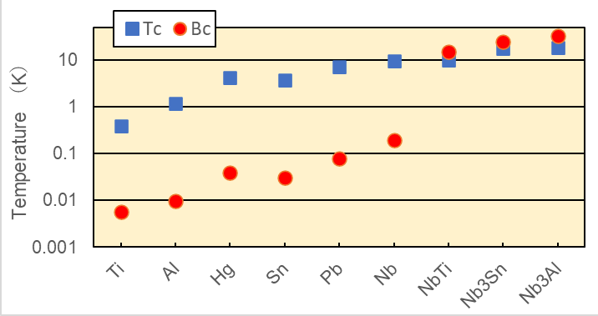
Discovery of Superconductivity
Zero resistance can flow large current without joule heating loss, which produce high field electromagnet.
Type 1
Type 2
Critical Magnet Field (T)
Hg (0.04 T), Pb (0.08 T)
Superconducting Phase
T < T_{c} (critical temperature )
B < B_{c} ( critical field )
J < J_{c} ( critical current density )
Jc（T, B）referred for magnet design
Superconductive state is limited by Magnetic field.
Actual superconducting magnet became realistic in 1960s due to discovery NbSn₃ and NbTi.
Notes:
Magnetic field : Application of magnetic field to a superconducting specimen brings a stage when for H=Hc, the critical field, the superconductor behaves like a normal material i.e., the superconductivity disappears.
Current : If the magnetic field around the superconductor is increased beyond the critical field the superconductivity is destroyed and the sample behaves as a normal material. Therefore the supercurrent will flow only up to its critical value .Once the field exceeds Hc(T) the current becomes just the ordinary current.

Slide 6
Chronology of Superconductivity
Ginzburg-Landau theory
Pippard equation
Nb₃Sn Discovery
BCS theory
London equation, He II Discovery
Pauli exclusion principle
Matrix Mechanics by Heisenberg
He Liquefaction by K. Onnes
Schrodinger wave equation
Quantum-mechanical principle
Superconductivity Discovery
Meissner–Ochsenfeld effect
Bohr atom model
type-II superconductor
NbTi Discovery
SQUID Invention
Planck's law
1900
1910
1920
1930
1940
1950
1960
1970
Industrialization of MRI magnet
Industrialization of NbTi composite
Industrialization of MCZ magnet
Iron based SC Discovery
The superconducting discovery is the dawn of the quantum theory. An elucidation of the expression mechanism (BCS theory) took 46 years.
Actually, magnet application became realized after NbTi and Nb₃Sn discovery.
Cu oxide SC. Discovery
MgB₂ Discovery
LHC(CERN)
RHIC(BNL)
TEVATRON(FNAL)
KEKB(KEK)
TRISTAN(KEK)
HERA(DESY)
1970
1980
1990
2000
2010

Slide 7
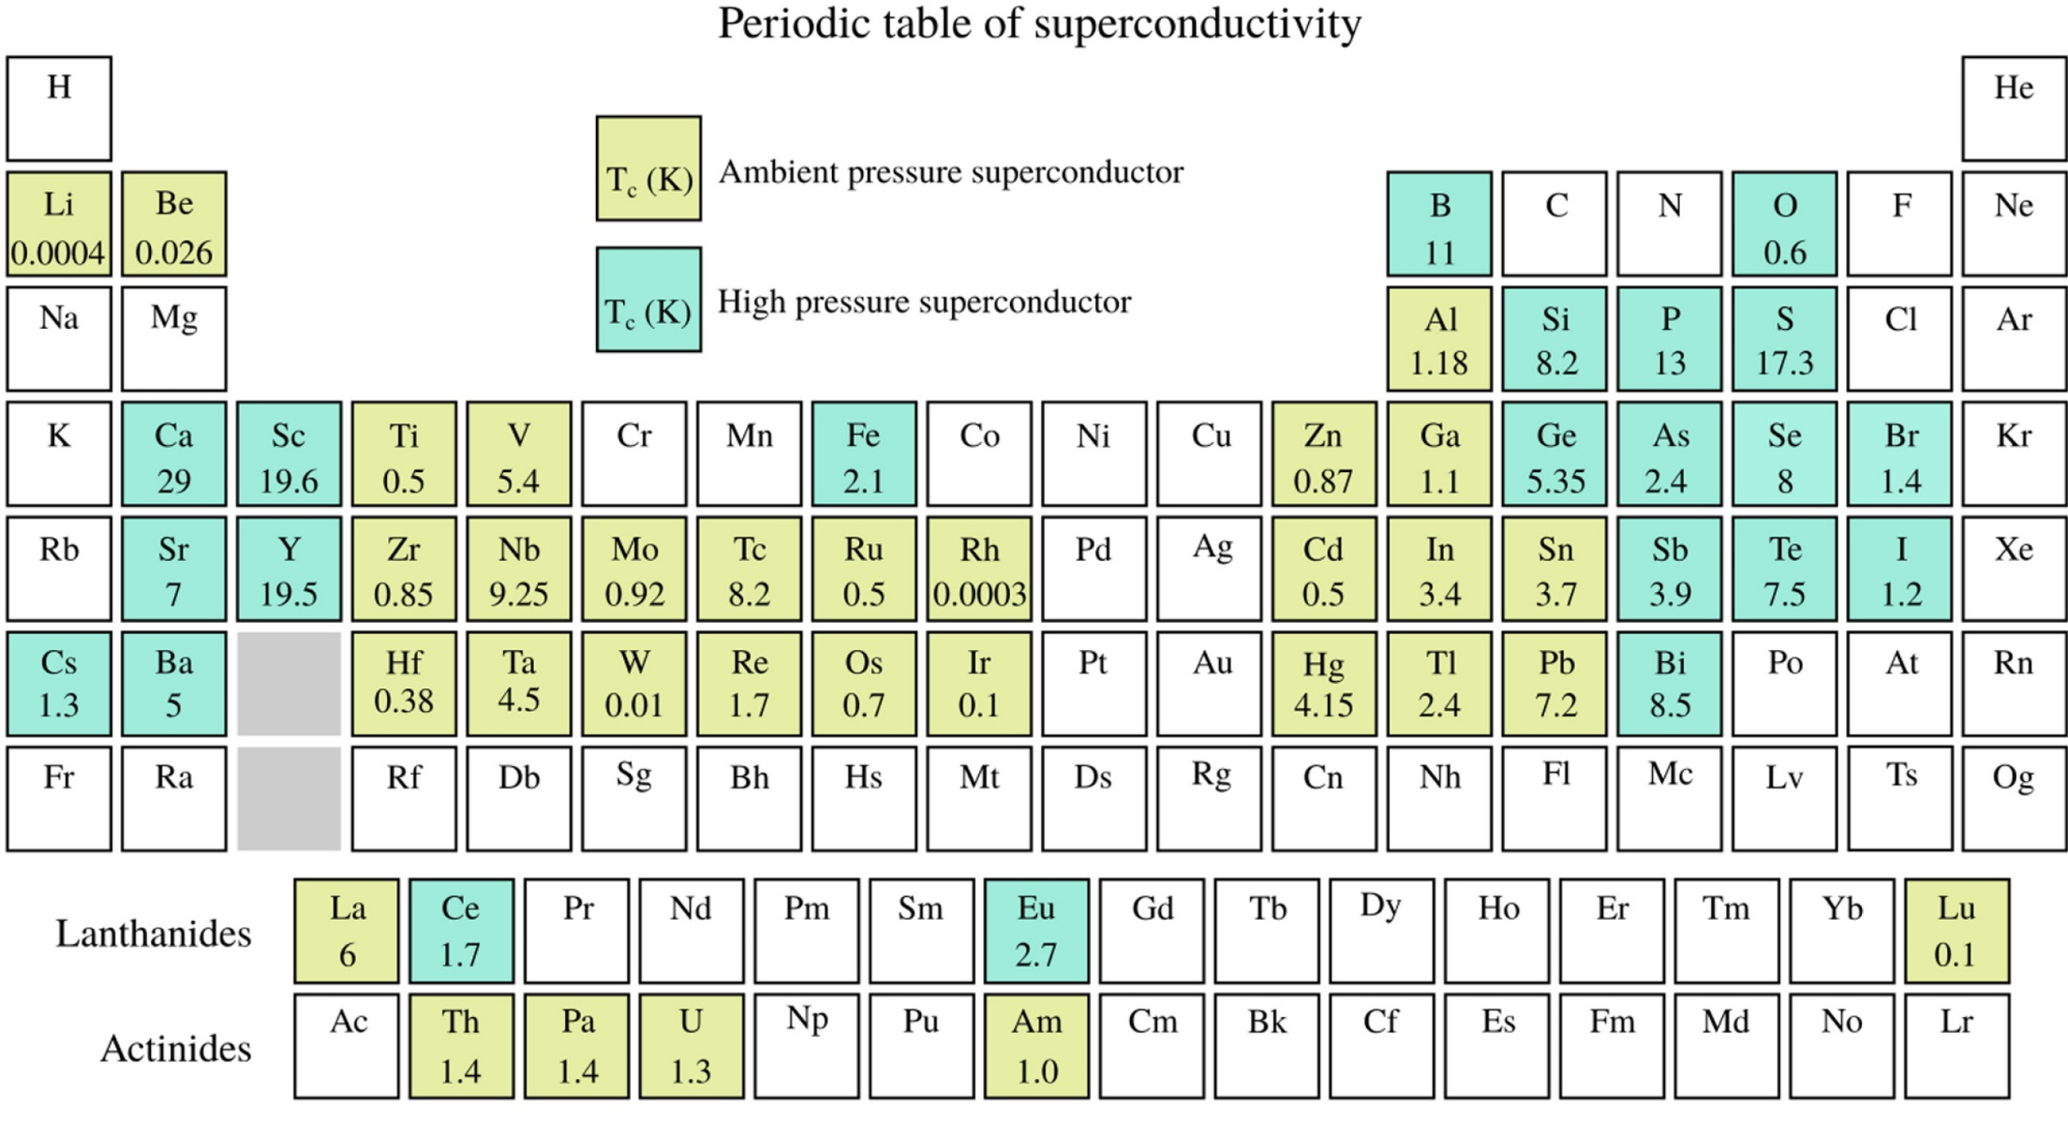
Superconducting Elements
Good conductors are not superconductor

Slide 8
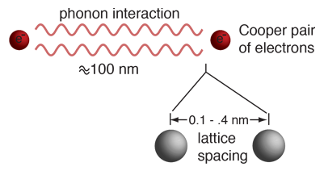
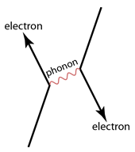
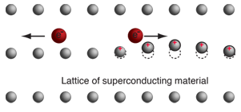
Superconductivity explained by BCS therory
Zero resistivity is modeled by BCS theory.
  by John Bardeen, Leon Cooper, and Robert Schrieffer
High resistivity at normal state, Isotope effect on Tc
  Large interaction between electron and lattice
The behavior of superconductors suggests that electron pairs are coupling over a range of hundreds of nanometers, three orders of magnitude larger than the lattice spacing.
Called Cooper pairs, these coupled electrons can move through lattice spacing without momentum loss.
Coherence Length, ξ
Lower temperature
This coupling is viewed as an exchange of phonons, phonons being the quanta of lattice vibration energy.
Notes:
The disappearance of electrical resistivity was modeled in terms of electron pairing in the crystal lattice by John Bardeen, Leon Cooper, and Robert Schrieffer in what is commonly called the BCS theory.
The behavior of superconductors suggests that electron pairs are coupling over a range of hundreds of nanometers, three orders of magnitude larger than the lattice spacing. Called Cooper pairs, these coupled electrons can take the character of a boson and condense into the ground state.
This coupling is viewed as an exchange of phonons, phonons being the quanta of lattice vibration energy. Experimental corroboration of an interaction with the lattice was provided by the isotope effect on the superconducting transition temperature. The boson-like behavior of such electron pairs was further investigated by Cooper and they are called "Cooper pairs".

Slide 9
Meissner–Ochsenfeld effect
Found by Fritz Meissner and Robert Ochsenfeld in 1933.
Perfect Diamagnetism.
Fritz Walther Meissner (1882 –1974)
Robert Ochsenfeld (1901-1093)

Slide 10
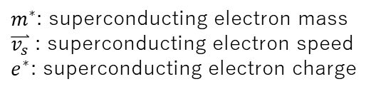
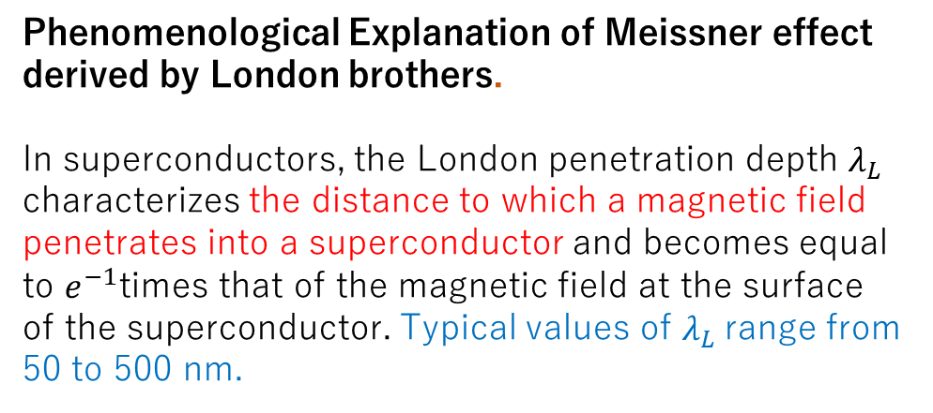



London Penetration Depth
Phenomenological Explanation of Meissner effect derived by London brothers.
In superconductors, the London penetration depth $λ_{L}$ characterizes the distance to which a magnetic field penetrates into a superconductor and becomes equal to $e^{−1}$times that of the magnetic field at the surface of the superconductor. Typical values of $λ_{L}$range from 50 to 500 nm.
Motion equation of superconducting electron $e^{∗}$ in $\overset{⃑}{E}$
$m^{∗}$: superconducting electron mass
$\overset{⃑}{v_{s}}$ : superconducting electron speed
$e^{∗}$: superconducting electron charge
Current density of superconducting electron
$n_{s}$: superconducting electron mass
Current density of superconducting electron
$\overset{⃑}{∇}×$ and
$$\overset{⃑}{∇}×E=−\frac{dB}{dt} then$$
L
*
L
*
London brothers set
then
London penetration depth

Slide 11
Type 1 & Type 2 Superconductor
Type 1
Complete Meissner effect.
Pure metals which exhibit zero resistivity at low temperature.
Lower H_{c}( B_{c} ) & J_{c}
  for Magnet Conductor
Type 2
do not exhibit Meissner effect strictly.
They were found to have much higher critical fields and therefore could carry much higher current densities while remaining in the superconducting state.
Vortex SC current
Flux quantum
φ₀=h/2e
Ba
Density of SCe⁻ (CooperP)
２ξ
ξ: Coherence L,
0
r
r
Magnetic Field
２λ_{L}
0
r
Notes:
In superconductivity, a type-II superconductor is a superconductor that exhibits an intermediate phase of mixed ordinary and superconducting properties at intermediate temperature and fields above the superconducting phases. It also features the formation of magnetic field vortices with an applied external magnetic field. This occurs above a certain critical field strength Hc1. The vortex density increases with increasing field strength. At a higher critical field Hc2, superconductivity is destroyed. Type-II superconductors do not exhibit a complete Meissner effect.

Slide 12
Super-Normal Boundary of Type 2 Superconductor
Lowering of energy, due to pair formation, is more than the increase in energy due to magnetic contribution close to the N–S boundary resulting in a negative surface energy .
Penetration depth and coherence range at boundary.
Contributions to free energy.
Total free energy
So, larger N-S boundary become stable.
Energy
>
B
B
e⁻
Energy
>
e⁻
e⁻
e⁻
Cooper Pair
Free electron
Notes:
In superconductivity, a type-II superconductor is a superconductor that exhibits an intermediate phase of mixed ordinary and superconducting properties at intermediate temperature and fields above the superconducting phases. It also features the formation of magnetic field vortices with an applied external magnetic field. This occurs above a certain critical field strength Hc1. The vortex density increases with increasing field strength. At a higher critical field Hc2, superconductivity is destroyed. Type-II superconductors do not exhibit a complete Meissner effect.

Slide 13
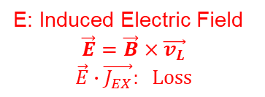
Transport Current and Pinning Force
Quantum Flux in the mixture region can be moved by Lorentz Force under transport current. The movement of the flux lines generates a finite voltage and a resistance appears.
B=n_{L}Φ₀
Φ₀
Φ₀
B_{EX}
Quantum Flux
B_{EX}
Φ₀
Φ₀
Φ₀
Φ₀
Φ₀
F_{L}: Lorentz Force or
v_{L}: Flux Flow
Φ₀
Φ₀
Φ₀
Φ₀
Φ₀
Φ₀
Current J_{EX}
E: Induced Electric Field
$$\vec{E}=\vec{B}×\vec{v_{L}}$$
$$\vec{E}∙\vec{J_{EX}}: Loss$$
External Field
External Field
The flux lines are however held back by the crystal lattice through a pinning force F_{P}. Imperfections, defects and impurities are introduced into the superconducting materials to create Pinning Centers. .
J_{c} versus magnetic field for type 2 Notice high J_{c} in dirty (hard) superconductors
Φ₀
B_{EX}
Φ₀
Φ₀
superconductors in clean limit and the dirty limit with pinning centers. Jc in both the cases drops to zero at B_{c2}.
Φ₀
F_{P}: Pining Force
Φ₀
Φ₀
Current J_{EX}
Defects of SC lattice
(fixed normal core)
External Field
Notes:
The flux lines, however, experience a Lorentz force, FL under the influence of the transport current and the perpendicular transverse field which tries to move it in the third perpendicular direction (Fig. 3.4). The movement of the flux lines generates a finite voltage and a resistance appears. The flux lines are however held back by the crystal lattice through a pinning force FP. Imperfections, defects and impurities are introduced into the superconducting materials to create pinning sites. The pinning force is thus increased significantly and the superconductor can carry a much larger current.
https://technicalreports.ornl.gov/m/ornlm3063r1/contents.html

Slide 14
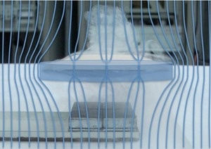
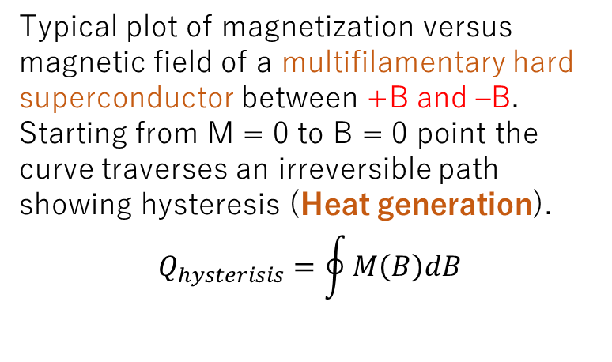
Irreversible Magnetization and Hysteresis Loss
A real type II superconductor has imperfection and show magnetic irreversibility in flux density (a) and in magnetization (b). Material can retain finite flux and magnetization even after the field is reduced to zero.
Typical plot of magnetization versus magnetic field of a multifilamentary hard superconductor between +B and –B. Starting from M = 0 to B = 0 point the curve traverses an irreversible path
showing hysteresis (Heat generation).
$$Q_{hysterisis}=\oint{M\left(B\right)dB}$$
Notes:
Only ideal type II superconductors without pinning show reversibility but real type II superconductors (hard superconductors) show irreversibility in their magnetization behavior as shown in these figures. The reason for this magnetic irreversibility is that the normal cores where the fluxoids are pinned are not free to move. Consequently on increasing the field from zero there is no sudden entry of flux inside the material until Bc1. Thus there is rounding in the flux density and the magnetization curves at Bc1. Likewise on reducing the field from above Bc2, the two curves do not retrace their paths, but show hysteresis instead.
Flux may be left trapped permanently as some flux line remain pinned down and are not able to detach and move out. Imperfections like dislocations, grain boundaries
and impurities can cause this type of magnetic irreversibility. The magnetic field has to be reversed to bring down magnetization M to zero but the situation at B = 0
and no trapped flux is retrieved only by warming the material to normal state.
Figure(right) shows a typical magnetization versus magnetic field loop observed in a multifilamentary conductor. To draw the full M–B loop we start from point O (M = 0, B = 0). The negative magnetization M increases with field up to the field Bc1 (point A) and starts decreasing with the further increase of the field. Magnetization drops to zero at Bc2 (point B). The anomalous behavior of these hard superconductor is that when the field starts decreasing the M–B curve does not retrace the earlier path. Instead magnetization changes sign and starts increasing to oppose the changing magnetic field attaining a peak value at C. Now if we reverse the direction of the magnetic field and start increasing it, M again drops to zero at point D. With the decreasing field M again increases in the negative direction to a peak value at point E. Thus we find that even after a full cycle from +B to −B, the magnetization does not drop to zero at zero field. Warming of the superconductor to normal state seems to be the only way-out.
Notice that the curve is almost a straight line till a small field (=Bc1) and then it traverses an irreversible path showing hysteresis. It is seen from Fig. 3.10 that the irreversibility behavior is associated with the hysteresis and the consequent dissipation. It is interesting to note that the curve is not symmetric around the horizontal axis. This asymmetry is caused by the magnetic moments produced by the surface screening currents opposing the flux entry. Area of the hysteresis loop is the measure of the dissipation. The dissipation can be estimated from the area of the loop using the formula:

Slide 15
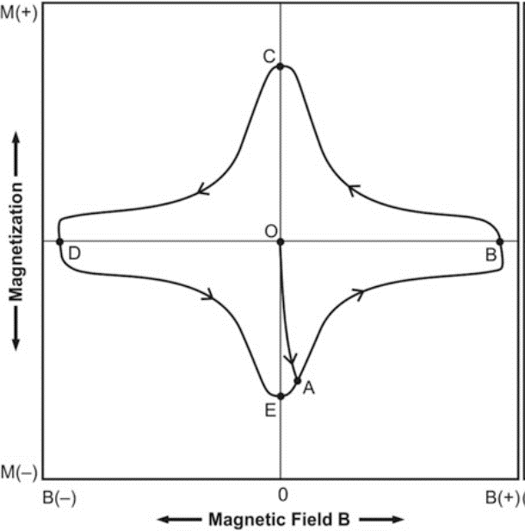

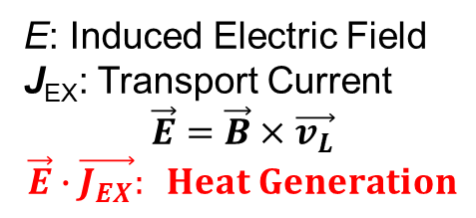
Flux Jump and Multifilament
This hysteresis energy dissipation appears as frictional heat and is caused by the movement of the flux bundles in and out of the conductor.
F_{L}: Lorentz Force or
v_{L}: Flux Flow (Flux Jump)
B_{EX}
E: Induced Electric Field
J_{EX}: Transport Current
$$\vec{E}=\vec{B}×\vec{v_{L}}$$
$$\vec{E}∙\vec{J_{EX}}: Heat Generation$$
Current J_{EX}
External Field
Temperature Rise
1~100 μm
Superconductor
Fast Flux Flow
Cooling
LHe
Heat Generation
Slow Heat Flow
Normal conductor (Cu etc)
Slow Flux Flow
Slow Heat Flow
Flux Flow -> Flux Jump
Multifilament Conductor

Slide 16
Multifilament Superconductor
Pinning Center
Small Magnetization
SC (NbTi) Filaments
φ~5 μm
Copper Matrix

Slide 17

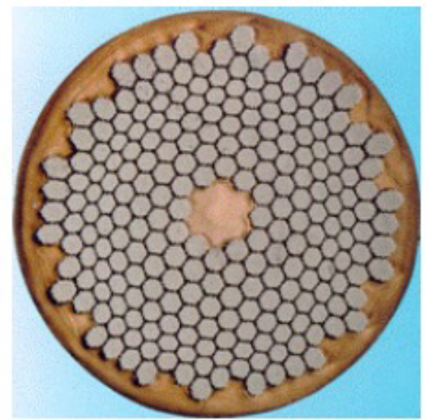
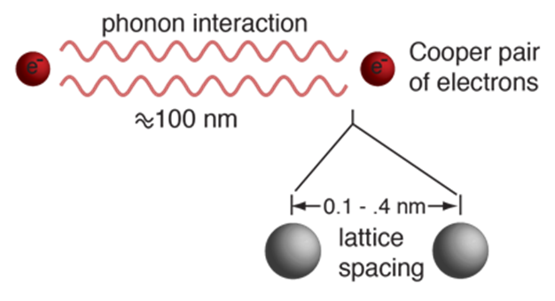
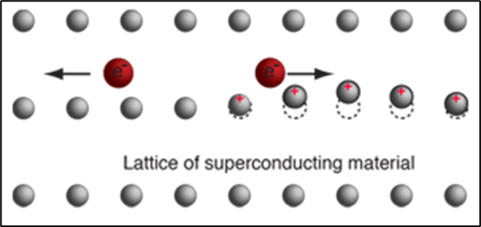
Summary of Lecture 1
H. Kamerlingh-Onnes, who had succeeder helium liquefaction at 4.2 K, found that the resistance in a solid mercury wire suddenly vanished in 1911.
Electro-magnet with Superconductor was tried immediately, but it took almost half century.
  Superconductor have three limitations, T_{c}, B_{c} and J_{c}.
  In superconductor discovered early period is limited with low B_{c} and low J_{c.} In Lead, ~0.06 T and ~4.2 A/mm².
  NbTi (15 T) and Nb₃Sn (22 T) discovered after 1950s are realistic superconductor for magnets.
  TYPE 1 Superconductor : Simple elements, Perfect Diamagnetism, Low B_{c},
  TYPE 2 Superconductor : Alloys and Compounds, NbTi and Nb₃Sn. Perfect Diamagnetism (< B_{c1}), Quantum Flux Distribution in Mixed state Superconductor (B_{c1} < B_{ex} < B_{c2}). B_{c2} is practically large enough, but Lorentz force due to transport current applied the quantum flux move(Flux flow) and heat loss is generated.
  Hard (Dirty) Type 2 Superconductor with Pining Center : Defects in the superconductor become fixed normal core for quantum flux. Artificial pinning increase J_{c,} drastically.
  Multifilament in Copper matrix configuration : Although, in Hard type 2 superconductor, flux bundles in and out conductor due to magnet charge up and down. Heat induced by flux motion in superconductor immediately removed by copper surrounding narrow SC filaments.
Superconductivity is explained by BCS theory.
  At low temperature, two electrons forms Cooper Pair, which can move inside superconducting lattice without energy loss. Momentum loss of one e- is transferred momentum gain of the other e- through the lattice wave (phonon).

