Slide 1
4th Asian School on Superconducting and Cryogenics for Accelerators
(ASSCA 2022)
Feb. 13-19, 2023
Eun-San Kim
Department of Accelerator Science
Korea University Sejong Campus

Slide 2
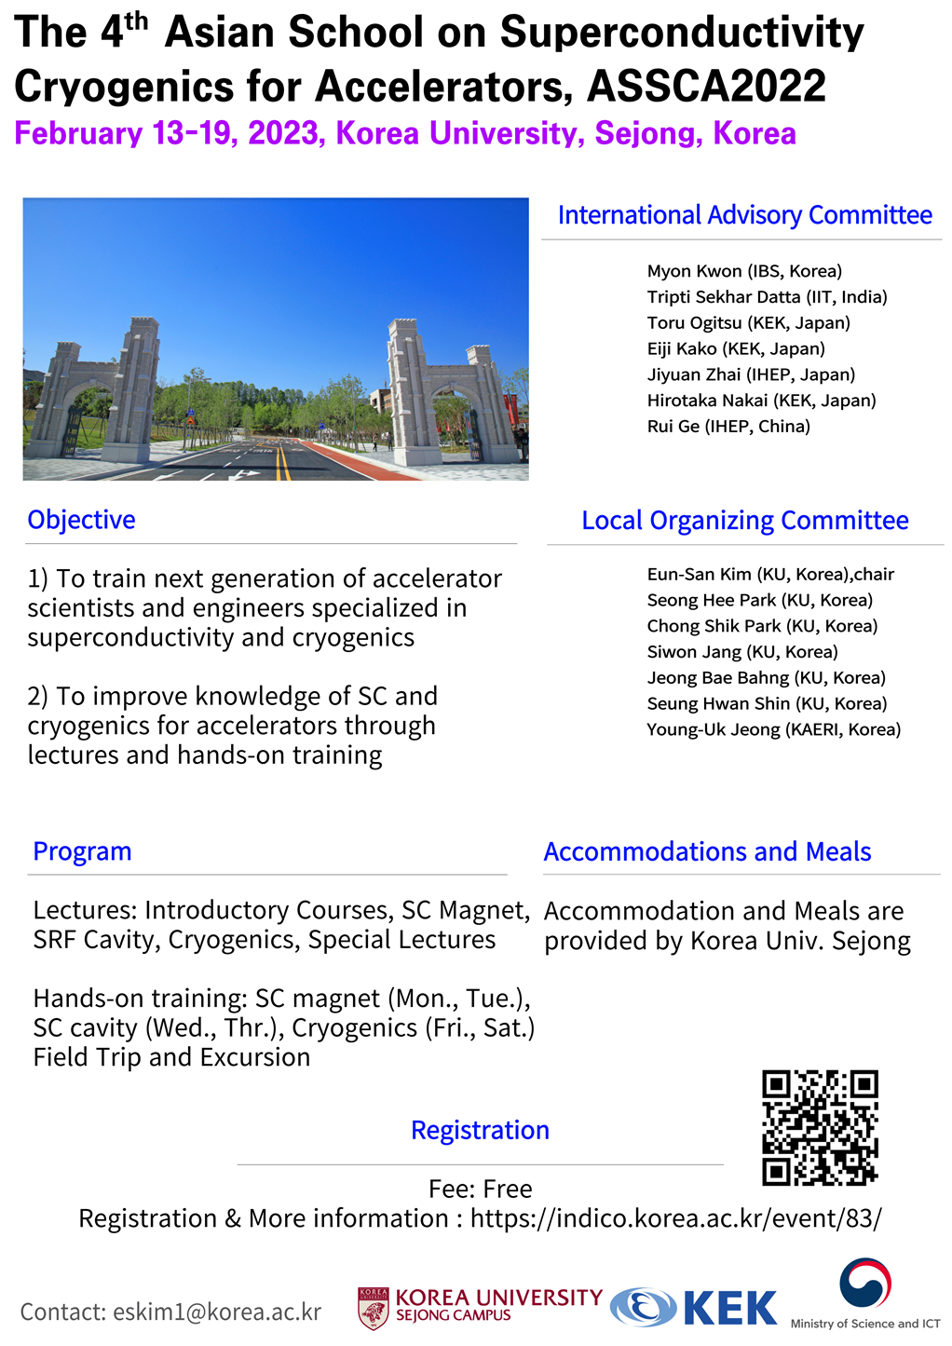

Slide 3
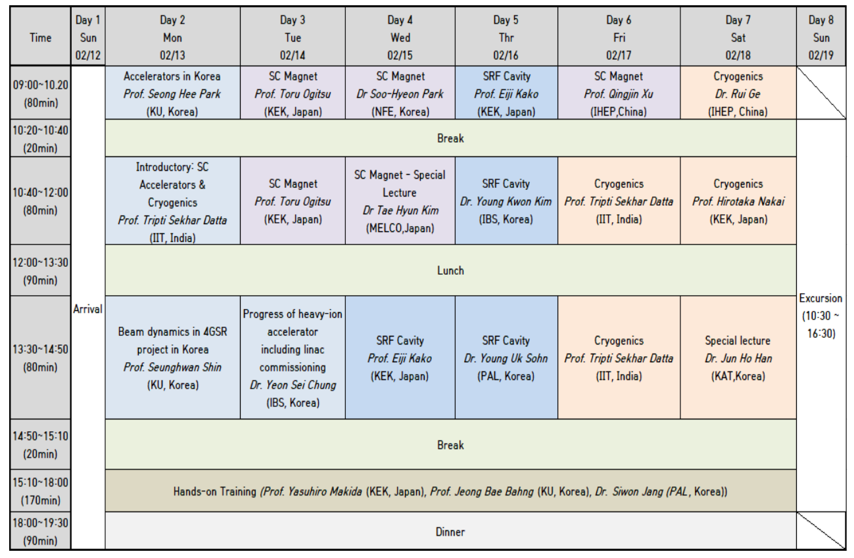
program
Hands-on training : SC magnet, SC cavity, Cryogenics
@ accelerator and ICT building

Slide 4
Lecturer
1 | Yasuhiro Makida | KEK (Japan)
2 | Hirotaka Nakai | KEK (Japan)
3 | Toru Ogitsu | KEK (Japan)
4 | Eiji Kako | KEK (Japan)
5 | Tae-Hyun Kim | Mitsubishi Electric (Japan)
6 | Rui Ge | IHEP (China)
7 | Qingjin Xu | IHEP (China)
8 | Tripti Sekhar Datta | Indian Institute of Technology (India)
9 | Seong Hee Park | Korea University (Korea)
10 | Seunghwan Shin | Korea University (Korea)
11 | Jeong Bae Bahng | Korea University (Korea)
12 | Siwon Jang | Pohang Accelerator Lab. (Korea)
13 | Young Uk Sohn | Pohang Accelerator Lab. (Korea)
14 | Soo-Hyeon Park | Korea Institute of Fusion Energy (Korea)
15 | Yeon Sei Chung | Institute for Basic Science (Korea)
16 | Jun Ho Han | KAT (Korea)
17 | Young Kwon Kim | Institute for Basic Science (Korea)

Slide 5
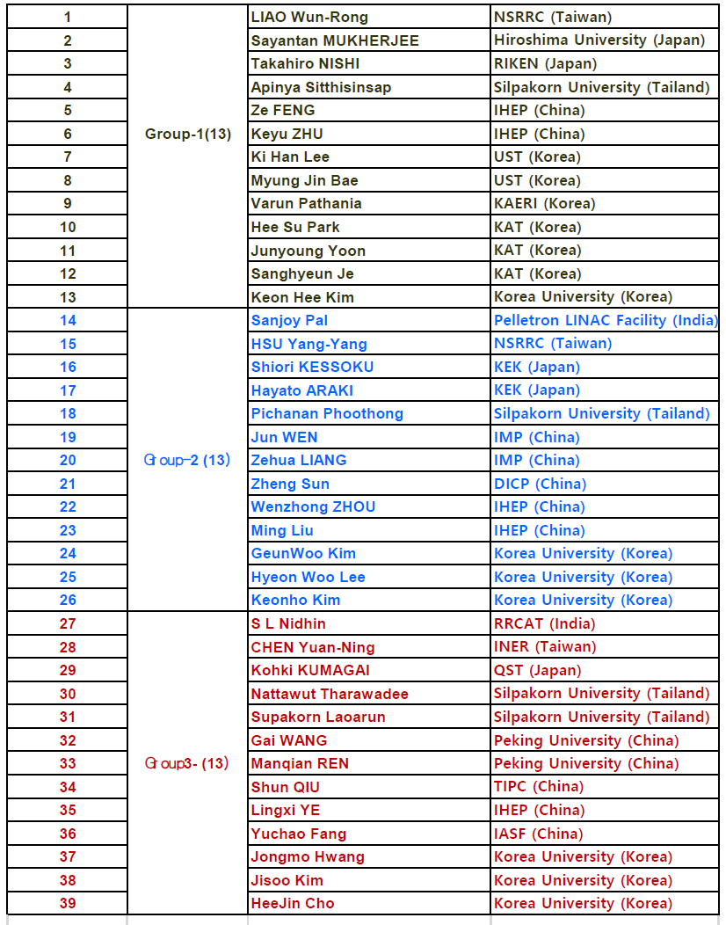
Participants

Slide 6
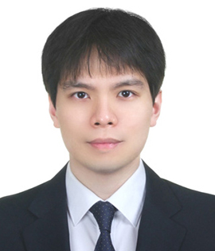
Contact person
■ If you need inquires and helps, please contact in anytime
to KIM KeonHee ( alphaover2pi@korea.ac.kr )
■ We will have photo-time after 1st lecture.

