Slide 1
RAON Beam Dynamics
Dong-O Jeon
중이온가속기연구소
Institute for Basic Science
가속기여름학교 2026.07.08.

Slide 2
Basic Concepts

Slide 3
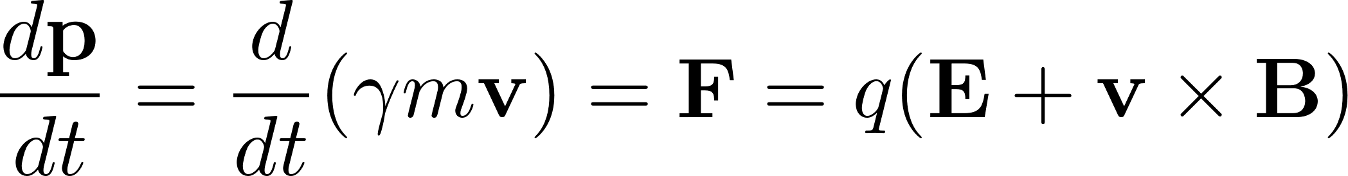
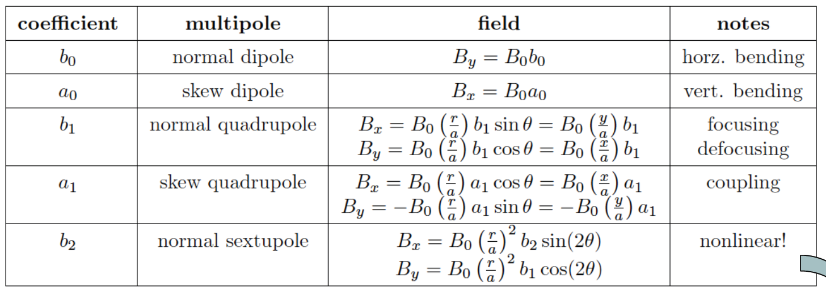

Lorentz equation
Lorentz equation governs the equation of motion of the beam.
Electric field or magnetic field is used to apply force to the beam.
Magnetic field multipoles are expressed as follows:

Slide 4
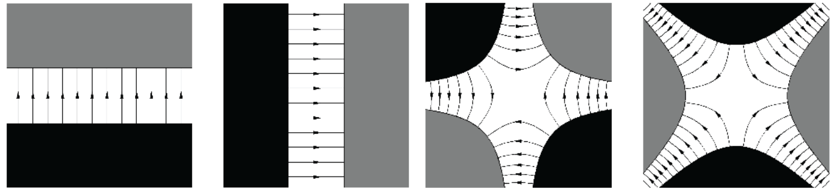
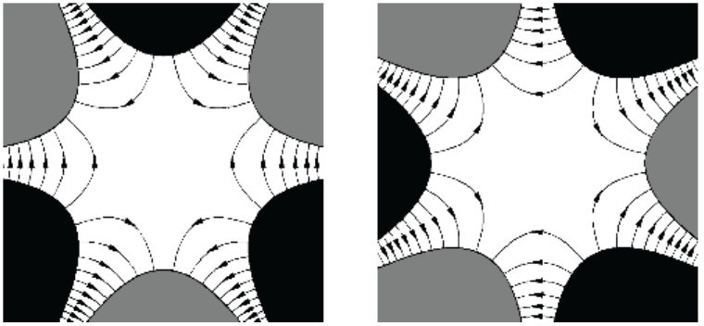
Magnet Multipoles
Dipole Skew Dipole
Quadrupole Skew Quadrupole
N
S
N
S
N
S
S
N
Sextupole Skew Sextupole
N
S
N
S

Slide 5
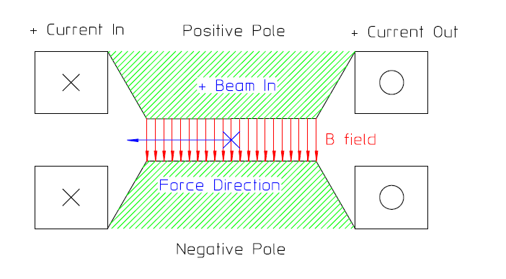
Dipole
Dipole is used to bend the beam.
Field is constant.
A standard technique for insulating magnet coils is to use epoxy resin, reinforced with fiberglass.

Slide 6
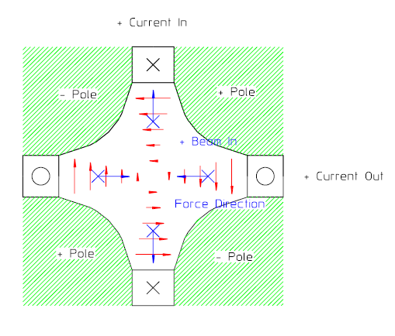
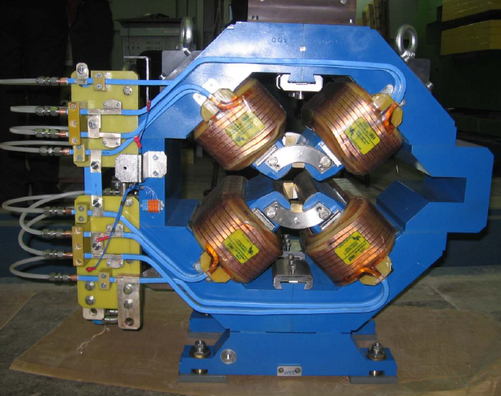
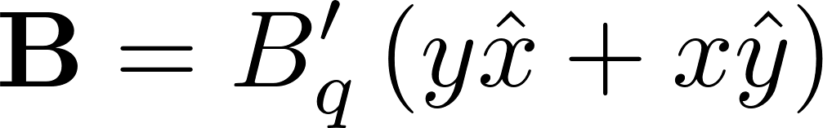
Quadrupole
Quadrupoles are used to focus the beam transversely.
Field varies linearly.
However, focusing in one plane, defocusing in the other plane.

Slide 7
Strong Focusing using quadrupoles
L
Transformation Matrix
Focusing is essential in accelerating beams.
Using focusing and defocusing quadrupoles, the net effect is focusing in both planes. → strong focusing

Slide 8
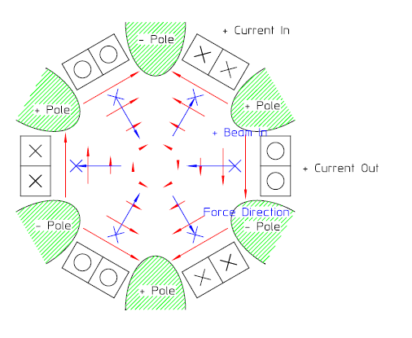
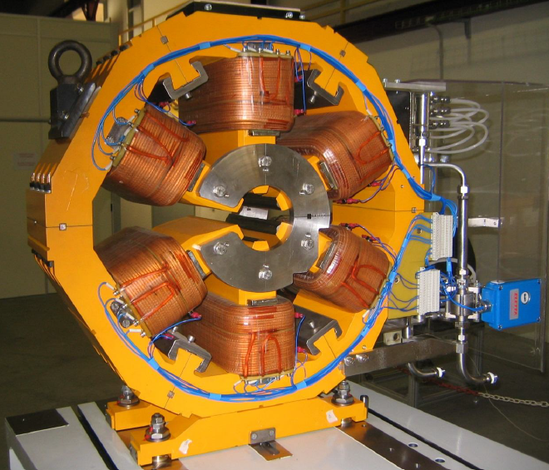
Sextupole
Field varies quadratically.
Sextupoles are used to ensure that particles with slightly different energies or momenta are focused equally, preventing beam instability and particle loss in circular accelerators.

Slide 9
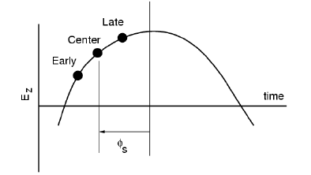
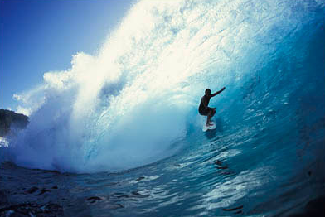
Longitudinal Beam Dynamics
Longitudinal electric field Ez : both accelerating and focusing
synchronous particle
synchronous phase
Less acceleration when arrive early
More acceleration when arrive late

Slide 10

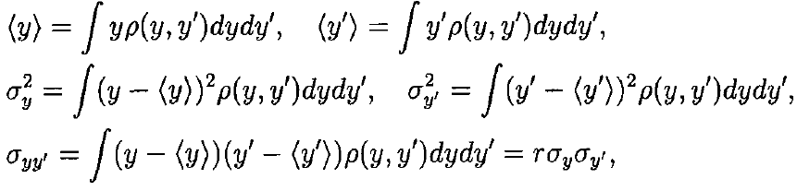
Beam Emittance in Phase Space ~ beam quality
Beam emittance is a measure of beam quality (roughly speaking phase space area).
RMS emittance is widely used for beam distributions.
x’ [mrad]
rms emittance
X [mm]
x’
x

Slide 11
RAON heavy ion accelerator

Slide 12
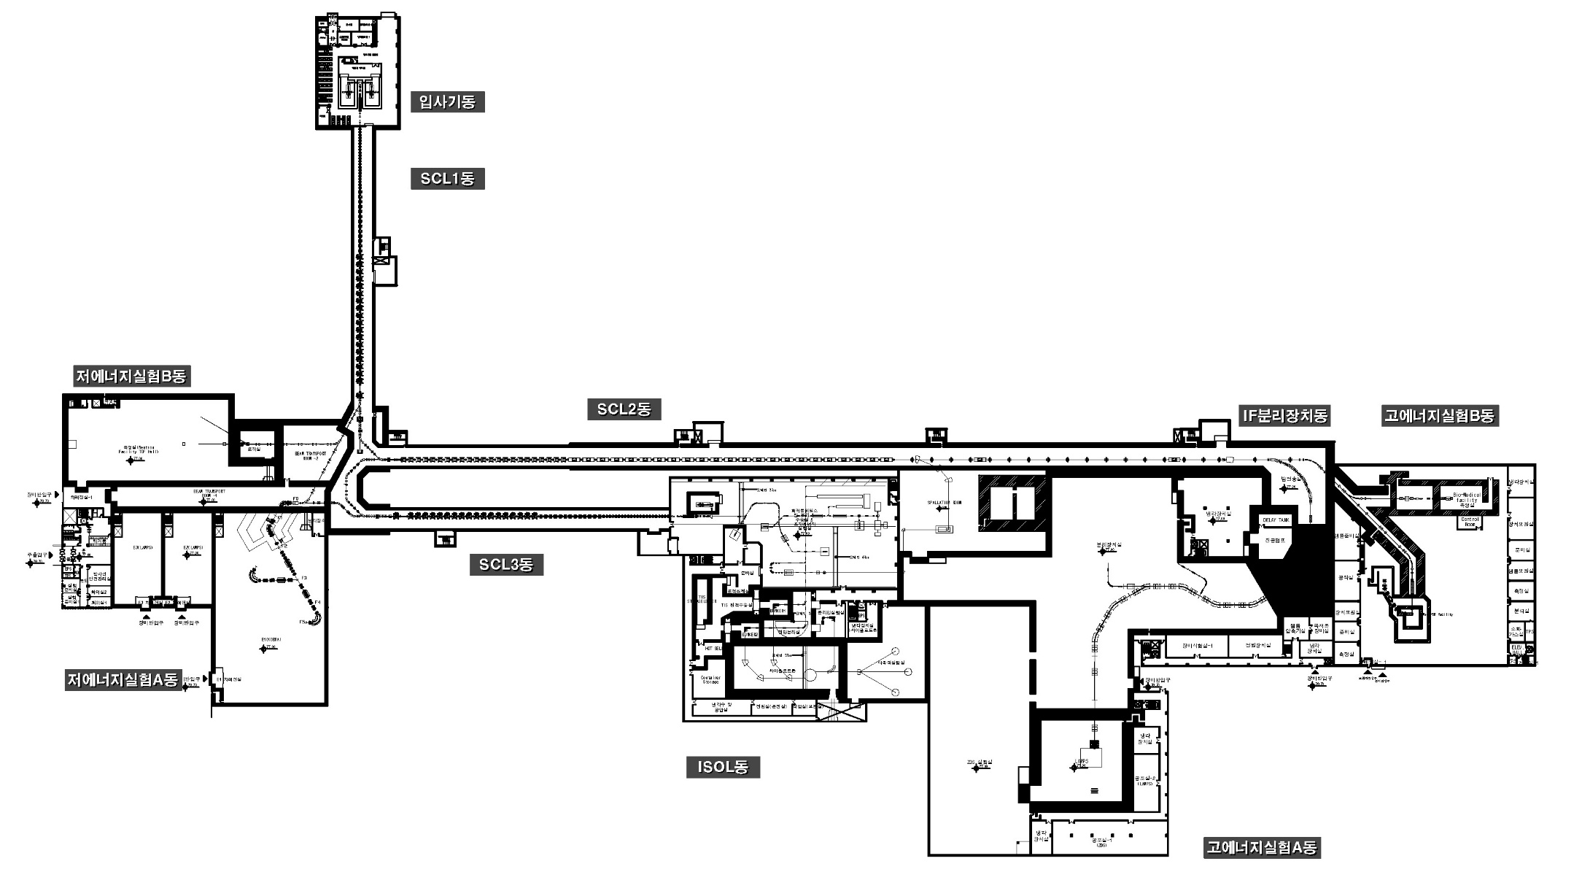
Layout and Beam Parameters
 | Driver Linac |  |  |  | Post Acc. | Cyclotron
Particle | H⁺ | O⁺⁸ | Xe⁺⁵⁴ | U⁺⁷⁹ | RI beam | proton
Beam energy (MeV/u) | 600 | 320 | 251 | 200 | 18.5 | 70
Beam current (pμA) | 660 | 78 | 11 | 8.3 | - | 1000
Power on target (kW) | > 400 | 400 | 400 | 400 | - | 70
RISP 4.6
Neutron Science
Facility
High Energy Exp Bldg (B)
RISP 4.7
Bio-medical Research Facility
RISP 4.3
High-precision
Mass Measurement Facility
RISP 4.4
Collinear Laser Spectroscopy
RISP 3.2
ISOL Facility
RISP 4.1
Recoil Spectrometer (KOBRA)
Low Energy Exp Bldg
RISP 4.5
μ-SR
Zero-Degree Spectrometer
RISP 3.3
IF Facility
RISP 4.2
Large Acceptance Spectrometer
High Energy Exp Bldg (A)

Slide 13
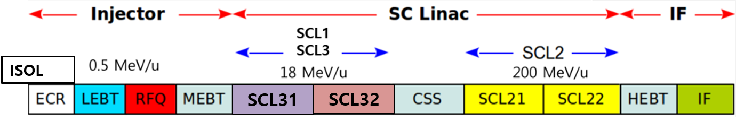
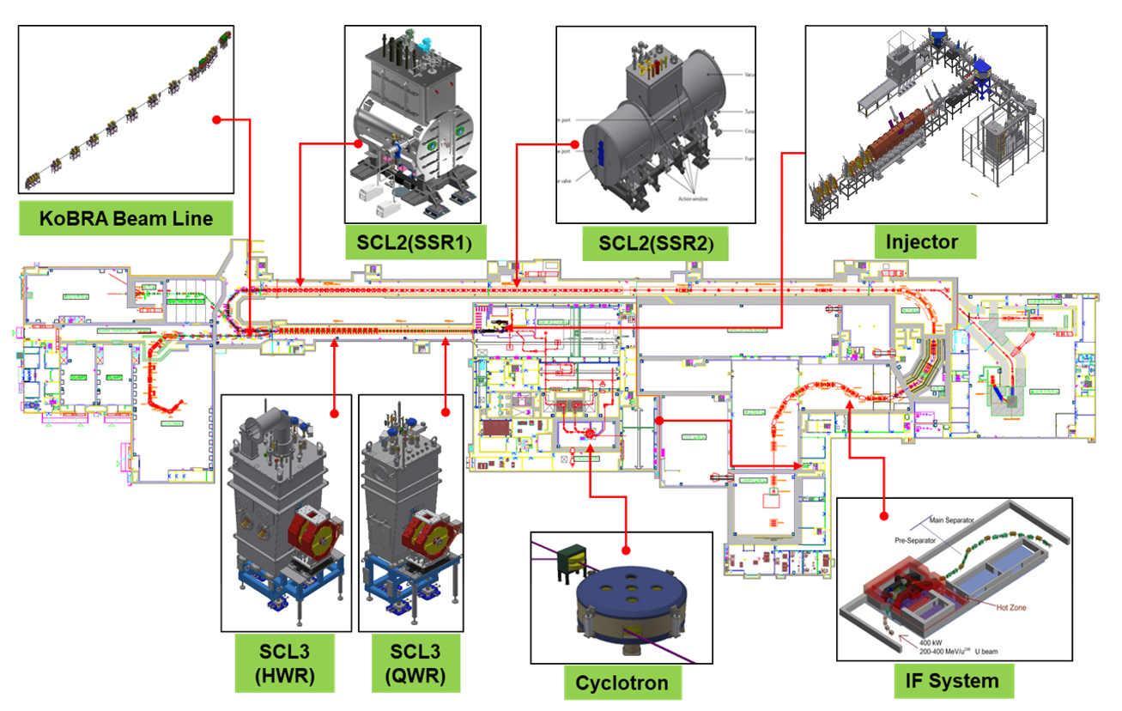
Accelerator Systems

Slide 14
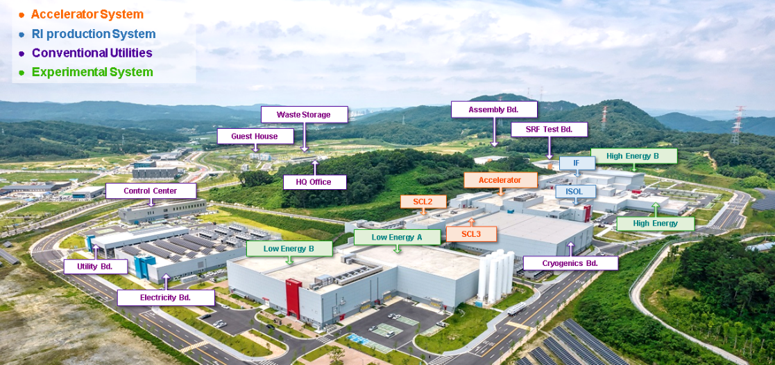
RAON heavy ion accelerator
Campus Area: 952,066 m²

Slide 15
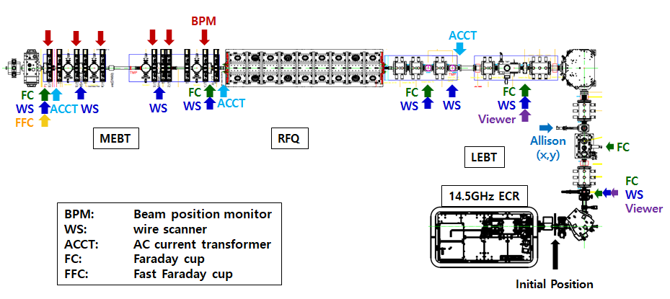
Injector
There are 28 GHz and 14.5 GHz ECR Ion Sources to generate ions.
LEBT (Low Energy Beam Transport) is to transport and match the beam from the ECR-IS to the RFQ (Radio-Frequency Quadrupole).
81.25 MHz RFQ (10 keV/u to 500 keV/u)
Medium Energy Beam Transport is to transport and match the beam from the RFQ to the SCL (Super-Conducting Linac)
SCL

Slide 16
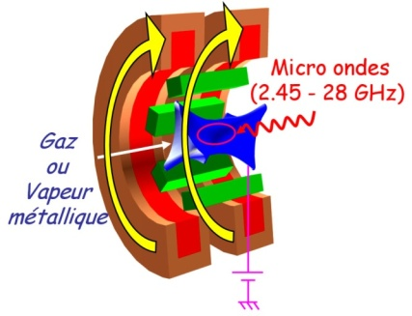
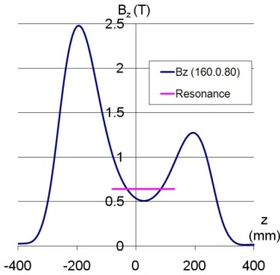
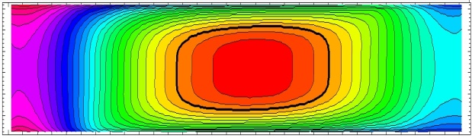
ECR Ion Source
(Electron Cyclotron Resonance)
ECR ion source is to generate charged ions from gas or metals.
High performance ECR ion source is needed to generate high charged beams.
Performance
High intensities
High charge states
Increase the ECR frequency to increase the plasma density
Present state
- 28 GHz Superconducting ECR IS: US, Japan, China, Korea
28 GHz
18 GHz
ω_{ce} = q_{e} B / M_{e} = ω_{HF}
B axial
+
B radial
=
Minimum B
n_{e}∝ ω_{rf}²
q_{opt} ∝ log B
n_{e}T_{e}τ _{ion} ∝ B
Resonant electron heating
e•B
ω_{e} = = ω_{rf}
m

Slide 17
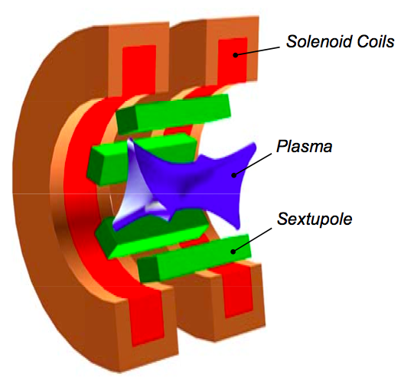
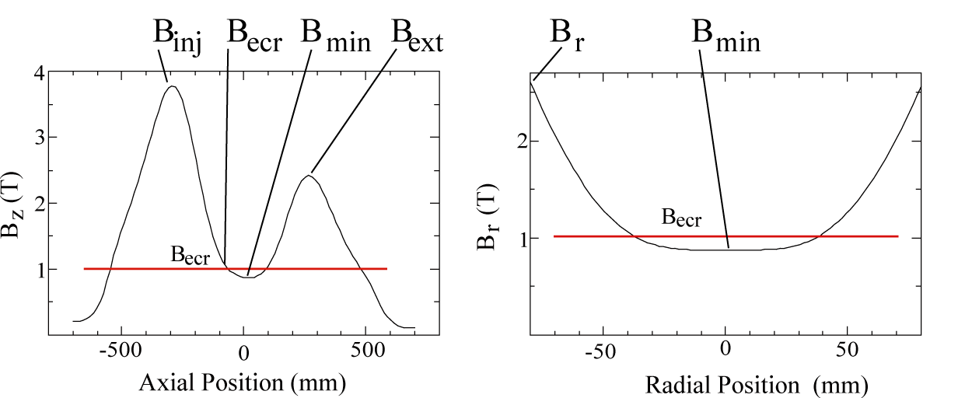
28 GHz ECR Ion Source
Plasma is produced and heated by microwave.
Plasma is confined by minimum B structure. (solenoids + sextupoles)
To produce highly charged or high current ion beams
need high ne (electron density) and long Tion (ion confinement time)
➔ high ωRF ➔ high B-field
28-GHz ECR IS needs B ~ 3.5T and requires superconducting magnets.

Slide 18
ECR IS Design Parameters
Frequency (GHz) | 28 + (18)
RF Power (kW) | 10
Plasma Chamber Diameter (mm) | 150
Plasma Chamber Material | Aluminum
Mirror Length (mm) | 500
V_{ext} (kV) | 30
SC Wire | NbTi
Number of Solenoid Coils | 4
Sextupole Winding Type | Saddle
B_{inj} (T) | 3.5
B_{r} (T) | 2
B_{ext} (T) | 2
B_{min} (T) | 0.4 ~ 0.8

Slide 19
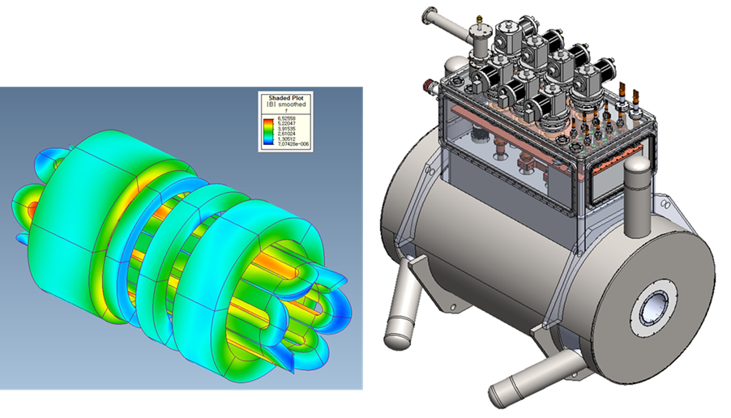

28-GHz ECR Ion Source
항 목 |  |  | 단 위 | 사 양
Outside Diameter of Cryostat |  |  | mm | 898
RT bore if Cryostat |  |  | mm | 170
Material of Cryostat |  |  | mm | STS
Length of Cryostat |  |  | mm | 1714
Weight of Cryostat(iron york제외) |  |  | kg | <1600kg
Vacuum Rate of Cryostat |  |  | torr | <~9x10⁻⁵
He Leak Rate of Cryostat |  |  | mbar.l/sec | <~9x10⁻⁹
LHe Vessel | Volume |  | liter | <1000
 | Outer Dimeter |  | mm | 740
 | Inner Diameter |  | mm | 195
 | Heater |  | W | 25
Top plate | Number of CL | 500A CL | pair | 1
 |  | 300A CL | pair | 4
 | Electrical feedthrough |  | ea | 3
 | LHe Transfer & safety & vent port |  | ea | 1
 | Relief valve |  | ea | 1
 | Rupture disk |  | ea | 1
냉동기 (6대) RDK-415 | 1단 (50K) |  | W | 300
 | 2단 (4.2K) |  | W | 9
냉동기 (1개) RDK-400 | 1단 (40K) |  | W | 74
Number of HTS CL | 500A Current Lead |  | pair | 1
 | 300A Current Lead |  | pair | 4
Number of 60K Thermal Shield |  |  | layer | 1
Number of Cooler Port |  |  | ea | 6
B_{inj}= 3.5 T, B_{ext}= 2.2 T,
B_{r}= 2 B_{ecr} , B_{min}= 0.7 T
총 7대의 cryocooler 사용
2단 냉동기 6대, 1단 냉동기 1대
재응축형으로 운전

Slide 20
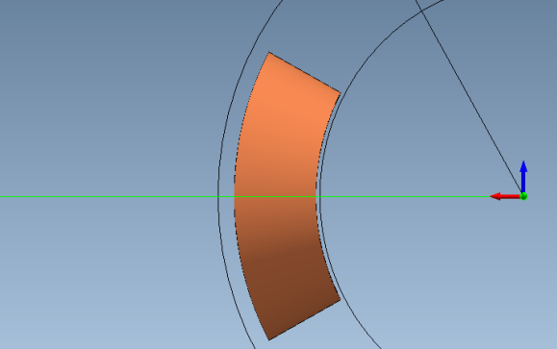
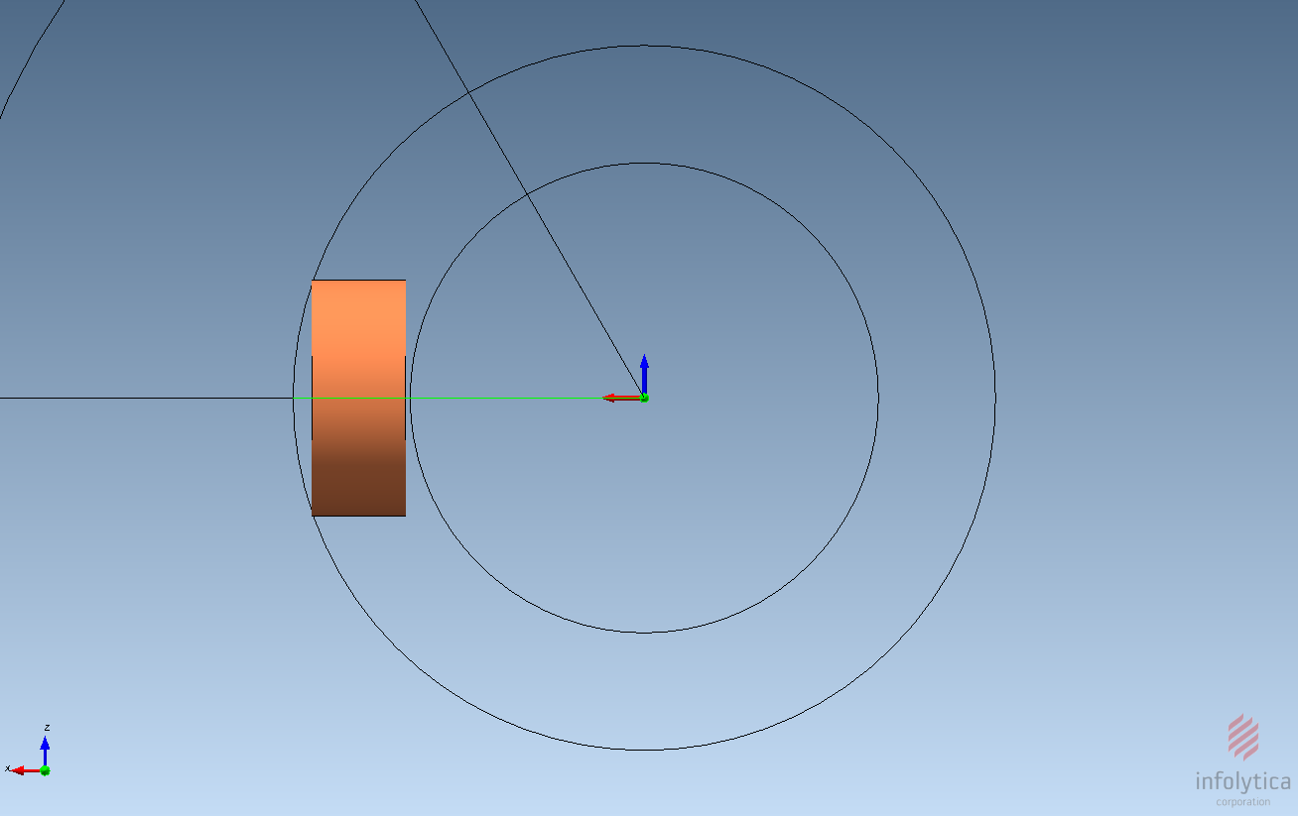
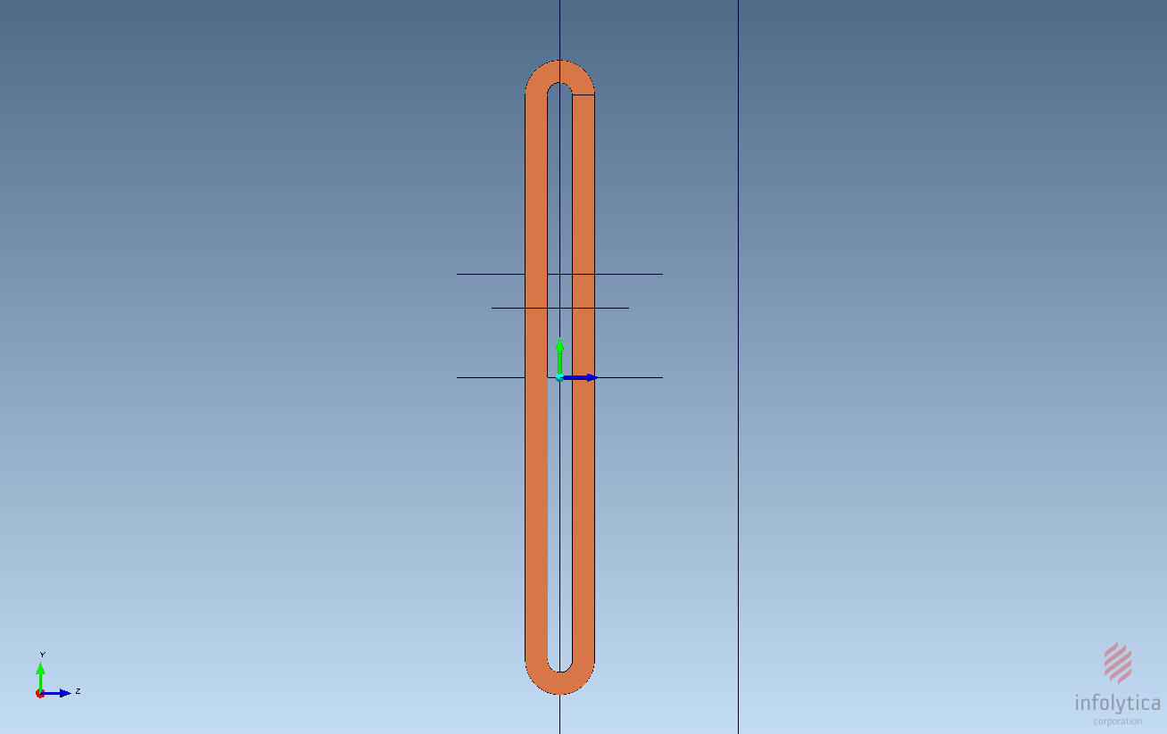
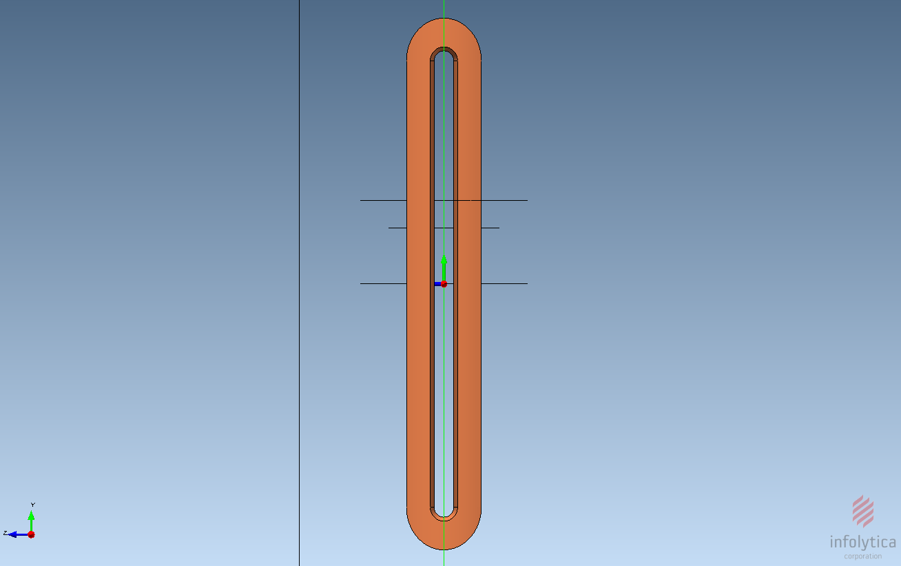
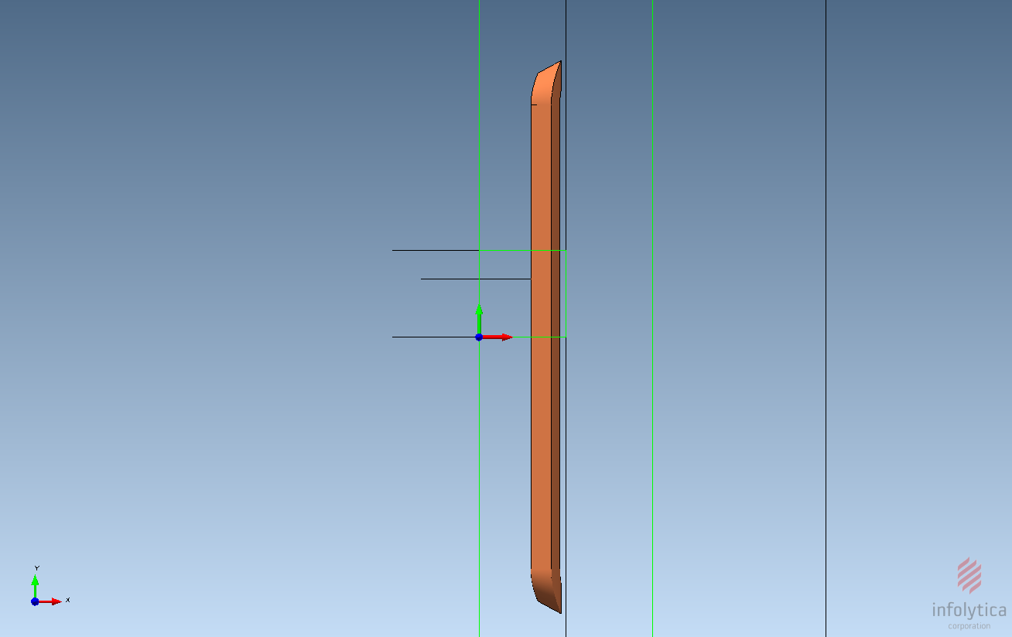
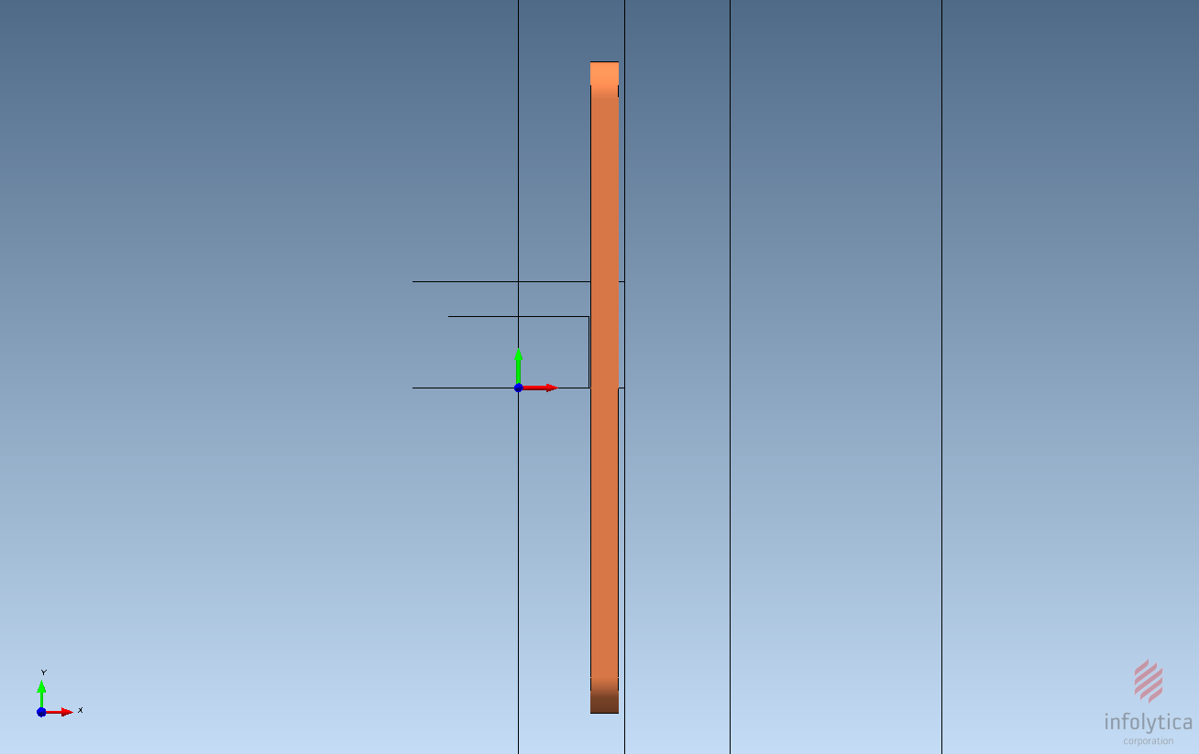
Sextupole of ECR IS
The comparison between the racetrack type and the saddle type
Saddle type
Racetrack type

Slide 21
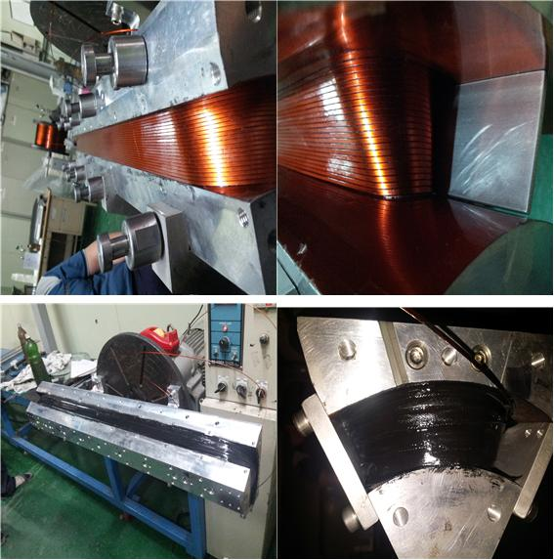
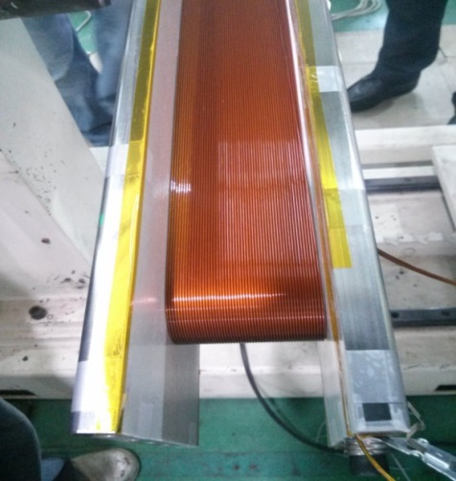
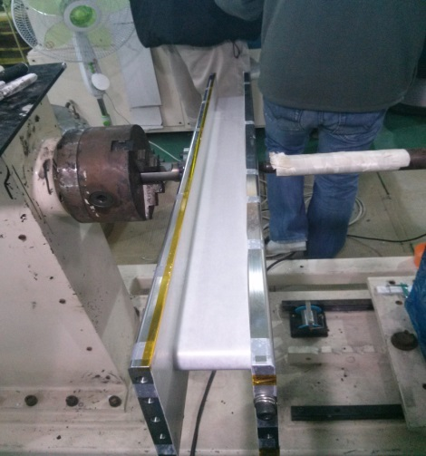
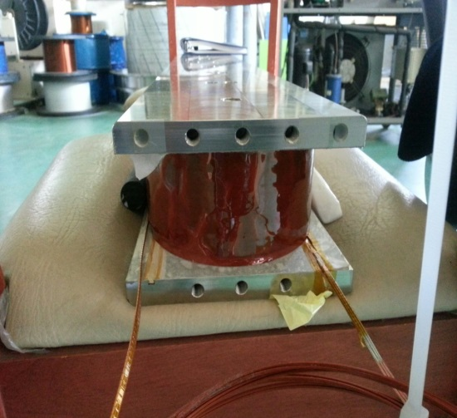
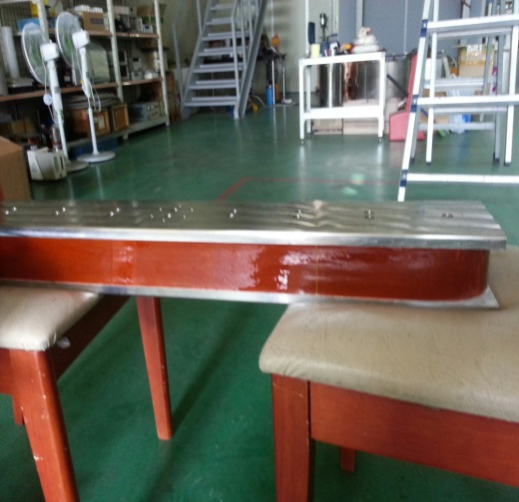
Sextupole Prototypes
Saddle type
Racetrack type

Slide 22
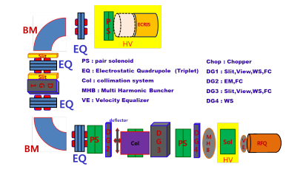
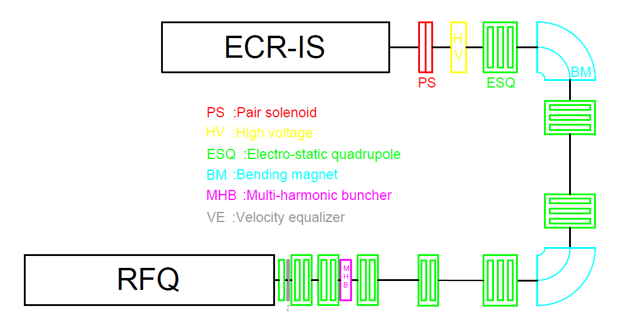
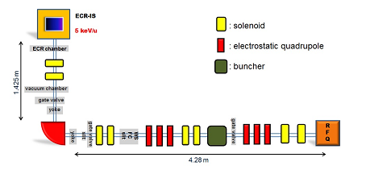
Low Energy Beam Transport (LEBT)
LEBT layout (TDR)
- SCL1 LEBT: 180° bending (Uranium beam)
- SCL3 LEBT: 90° bending (RI beam)
Present LEBT layout (Uranium, RI beam)
- 180° bending
28 GHz ECR IS
[SCL1 LEBT layout (TDR) ]
[ Present LEBT layout ]
[SCL3 LEBT layout (TDR) ]

Slide 23
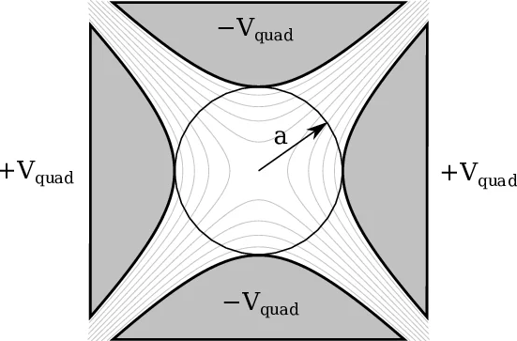
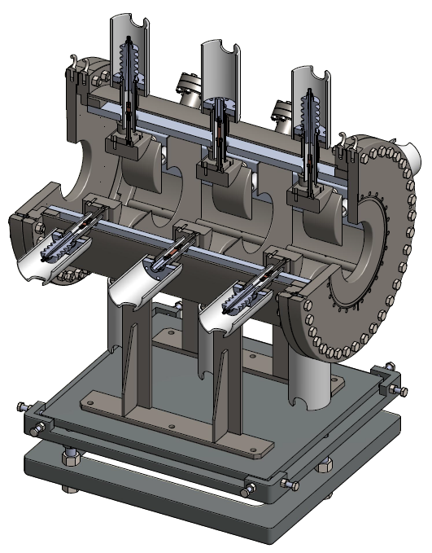
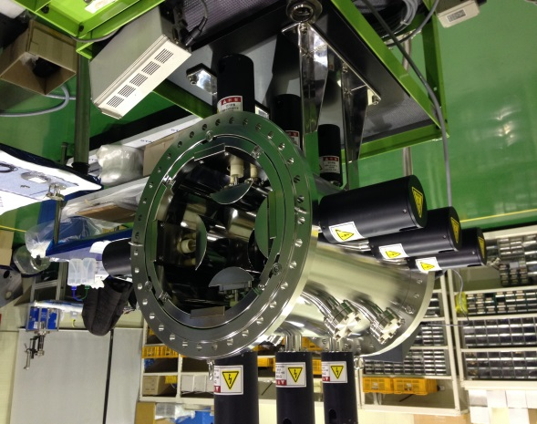
ESQ (Electro-Static Quadrupole)
Electro-Static Quadrupole (ESQ) is used for transverse focusing in the LEBT.
Force is independent of particle velocity.

Slide 24
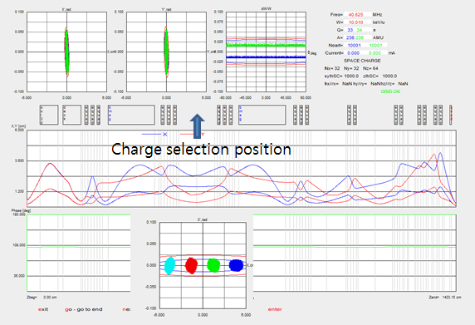
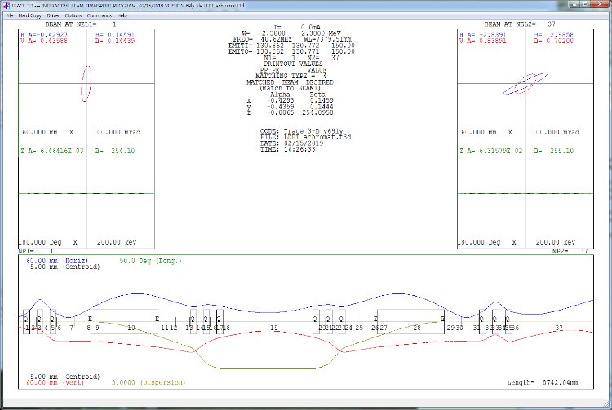
LEBT beam dynamics (28-GHz ECR IS)
LEBT functions
- charge selection (selecting U 33+, 34+)
- first order achromat design
- chopping
[ Achromat design ]
[ TRACK simulation : charge selection ]

Slide 25
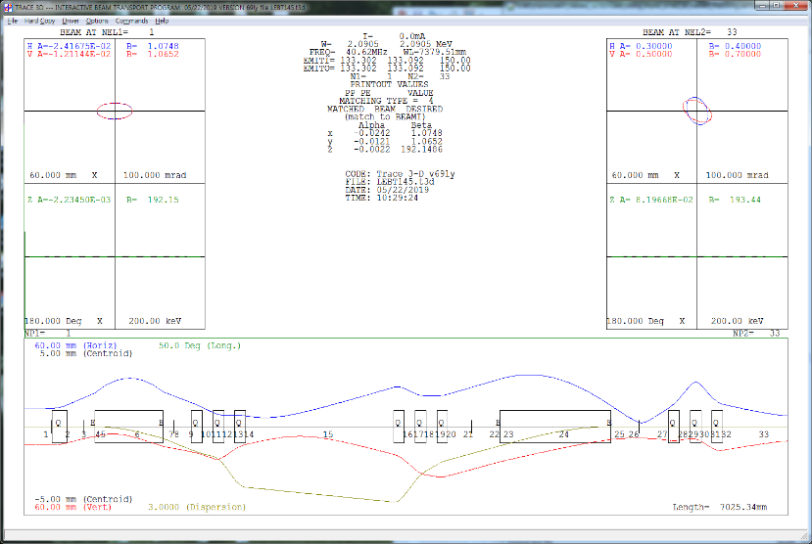
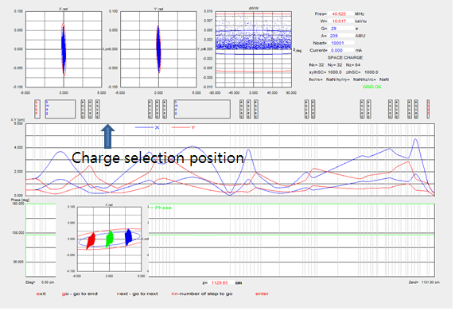
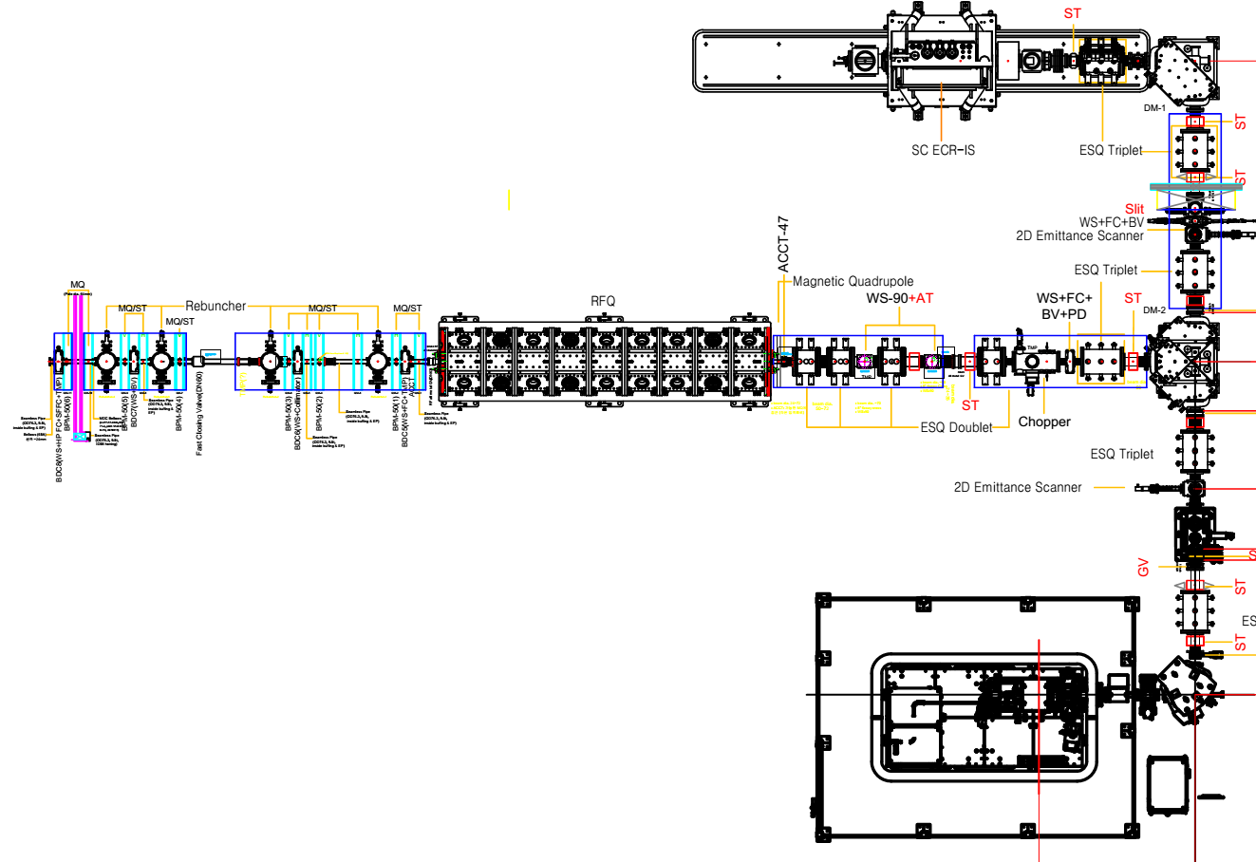
LEBT beam dynamics (14.5-GHz ECR IS)
LEBT functions:
- charge selection
- first order achromatic design
- chopping
[ Achromat design ]
[ 28GHz ECR IS ]
[ TRACK simulation : charge selection ]
[ 14.5GHz ECR IS ]
25

Slide 26
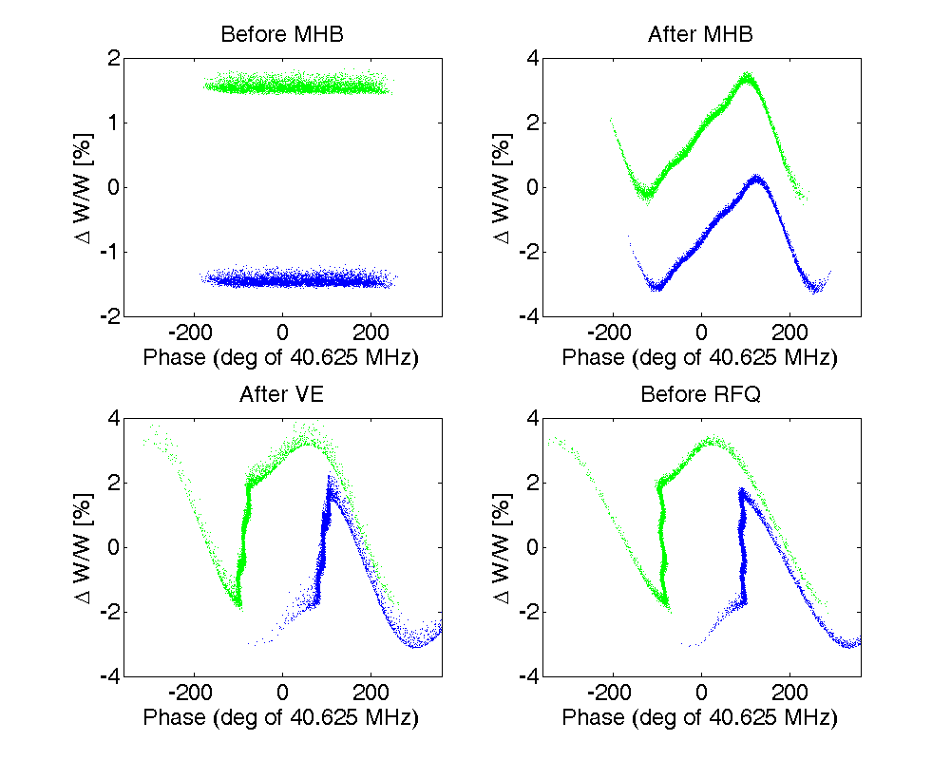
Multi Harmonic Buncher (MHB) & Velocity Equalizer (VE)
reduces RFQ output beam longitudinal rms emittance,
MHB uses 3 harmonics : 40.625 MHz, 81.25 MHz, 121.875 MHz,
separating U 33+ and 34+ beam,
making input energy equal and inject to RFQ.
Before MHB
After MHB
U³⁴⁺
U³³⁺
After VE
Before RFQ

Slide 27
Operation without MHB
MHB (Multi Harmonic Buncher) & VE (Velocity Equalizer) are very essential to FRIB RFQ design
FRIB RFQ transmission 80%
RAON RFQ employs shaper and gentle buncher. So MHB & VE are not essential.
RAON RFQ transmission 98%
We studied whether beam operation is feasible without MHB through machine imperfection study.
Longitudinal Emittance | with MHB, VE (keV/u-ns) | without MHB, VE (keV/u-ns) | Change (%)
RMS emittance | 0.380 | 0.916 | 141% increase
99.9% emittance | 14.92 | 15.70 | 5% increase

Slide 28
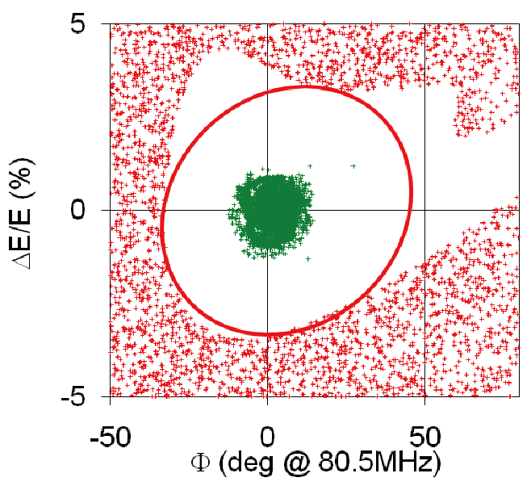
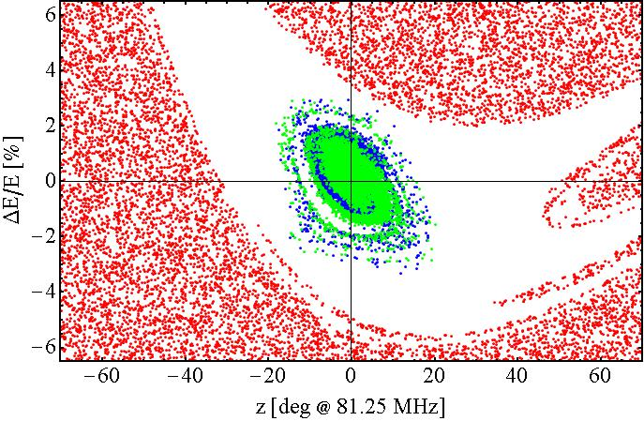
RFQ comparison
FRIB
FRIB RFQ
Accelerates from 12keV/u to 500keV/u
Less adiabatic bunching
Cuts off 20% of the beam
Transmission is low ~80%
Z emittance is small ε_{n,rms} : 0.08 keV/u-ns
ε_{nz,99.5 %} : 1.3 keV/u-ns
Segment1 acceptance
RAON
RAON RFQ
Accelerates from 10keV/u to 500keV/u
Adiabatic bunching
Transmits almost all the beam
Transmission is high ~98%
Z emittance is big ε_{n,rms} : 0.91 keV/u-ns
ε_{nz,99.5 %} : 8.5 keV/u-ns
SCL3 acceptance
~30 keV/u-ns
~27 keV/u-ns

Slide 29
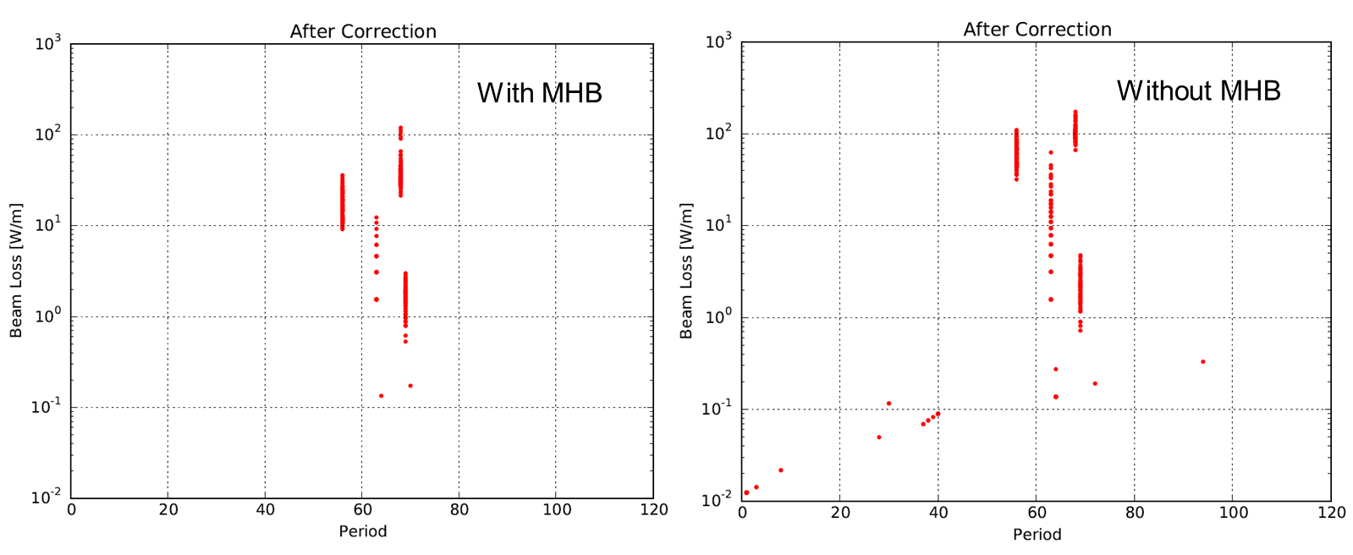
Operation possible without MHB
P2DT
collimators
Machine imperfection studies show that 400 kW operation is possible without MHB and VE for the RAON.
End-to-end machine imperfection study showed that beam loss requirement < 1 W/m is met.

Slide 30


RFQ Radio Frequency Quadrupole
Perfect link between ion source (DC beam) and linac (bunched beam).
Bunches and accelerates DC input beam into a bunched beam → reduces beam loss dramatically.
Accelerate high current and small emittance beam to reasonably high energy.

Slide 31
RFQ history
1970 Kapchinskij and Teplyakov proposed the idea of the radiofrequency quadrupole (I. M. Kapchinskij and V. A. Teplvakov, Prib. Tekh. Eksp. No. 2, 19 (1970)).
1974 experimental test of K&T idea at USSR Institute for High Energy Physics in Protvino. A 148.5-MHz RFQ accelerated 100-KeV protons to 620 KeV with a transmission of 50%.
1977 RFQ concept is published in the western world. Strong interest in Los Alamos National Laboratory (USA). Decision to test the RFQ principle for possible application in development of high current low emittance beams. Developments of computer codes for RFQ design.
1979 Start of P.O.P. (Proof-of-principle experiment) at Los Alamos. 425 MHz RFQ accelerates a 100-keV proton beam to 640 keV with a transmission of 90%, as predicted by the codes. (1980.02.14.)
Nowadays hundreds of RFQ accelerators are operating in the world.

Slide 32


RFQ
Proton is accelerated to a few MeV
and heavy ions to < 1 MeV/u

Slide 33




RFQ four-vane type or four-rod type
four-vane type
Frequency depends on cylinder dimension
Need dipole mode stabilization
vane
rod
four-rod type
Easy to machine
Problems with end cells
Less efficient than four-vane type

Slide 34


RFQ design parameters
RFQ accelerates and bunches the CW beam from the ECR ion source.
PARAMETER | VALUE
Beam Properties:
Frequency | 81.250 MHz
Particle | H⁺¹ to U₂₃₈⁺³³
Input Energy | 10 keV/u
Input Current | 0.4 mA
Input Emittance: transverse (rms, norm) | 0.012 .cm. mrad
Output Energy | 0.507 MeV/u
Output Current for 0.4mA in. | ~0.39 mA
Output Emittance: transverse (rms, norm) longitudinal (rms) | 0.0125 .cm. mrad ~26 keV/u-Degree
Transmission | ~98 %
Structures and RF:
Peak surface Field | 1.70 Kilpatrick
Structure Power (for U₂₃₈⁺³³) | 92.4 kW
Beam Power (for 0.2mA each U₂₃₈^{+33&+34}) | 1.44 kW
Total Power | 94 kW
Duty Factor | 100%
RF Feed | 1 Drive loops
Mechanical:
Length | 4.94 meter
Operating Temperature | TBD Degree C
X
Y
φ
E
X-Xp
Y-Yp
φ-E

Slide 35


RFQ Beam Dynamics
RAON
σ_{0t}
longitudinal
σ_{0l}
transverse
σ_{0t} and σ_{0l}
(transverse and longitudinal focusing)
along the RFQ
Transverse and longitudinal
rms emittances along the RFQ

Slide 36



RFQ design
- 4940.07 mm
- 9 Modules
- each ~547 mm long
- alternating slug and vacuum port
- 12 Vacuum Ports
- 20 Tuner Ports
- 10 Pickup Ports
- 2 Coupler Ports
2 x pickup
2 x RF coupler
4 x pickup
4 x pickup

Slide 37







Cooling channel
HE
$$T_{LE End undercut}=42.6 ℃$$
Coolant temperature 20 $℃$
$$T_{HE End undercut}=98.7 ℃$$
Coolant temperature 20 $℃$
Cooling channel

Slide 38



EM & Thermal design
With tuner : 81.26 MHz
Tuner insertion depth
: 60 mm
Operating temperature: 30°
Max : 60.15°
@ dummy

Slide 39



RFQ prototype and fabrication
RFQ Engineering Design (2013.08)
Design review (2013.11)
RFQ Prototyping
RFQ prototype completed successfully through domestic vendor (2014.10)
RFQ contract awarded (2015.04)
RFQ fabrication completed through domestic vendor (2016.08)
RFQ
prototype
RFQ
prototype

Slide 40
NDPS requires single bunch beam
NDPS (Nuclear Data Production System) requires single bunch beams with < 1 MHz from the SCL3.
This requires a very fast chopper system in the MEBT that consists of a chopper and a beam stop.
The following slides show the requirement for the NDPS and the MEBT is modified according to the requirement.

Slide 41



Medium Energy Beam Transport (MEBT)
MEBT Layout (TDR)
- SCL1, SCL3 MEBT: 2 Normal Conducting QWR type buncher cavity
- SCL1 MEBT: 1-m space for bending magnet
[ MEBT layout for SCL1 ]
[ MEBT layout for SCL3 ]
Present Layout
- Lattice modified to accommodate the single bunch selector
* 4 Bunchers, 11 Quadrupoles
[ Present MEBT layout for SCL3 ]

Slide 42


MEBT of SPIRAL2 (France)
Total length of MEBT = 7.5 m
0.75 m
0.40 m
2008, Giacomo, DESIGN OF THE MEBT REBUNCHERS FOR THE SPIRAL2

Slide 43

Modified MEBT
chopper
beam stop
X beam size
SCL3
2.41 m
Y beam size
The modified MEBT requires additional 3 quadrupoles and 1 buncher.
The distance between the chopper and the beam stop is 2.41 meter.
The length changes from 5640 mm to 6450 mm (810 mm increase).
The modified MEBT was configured to minimize the beam size along the MEBT.

Slide 44
RAON Superconducting Linac

Slide 45
Advantages of Superconducting Linac
Higher electric field gradient can be achieved than normal conducting linac.
Practically all the rf power can be used to accelerate beams, due to practically zero power dissipation to the cavities (superconducting).
Construction and operating costs are less compared with the normal conducting linac.
The large bore of the SC cavity reduces linac component activation due to beam loss.
One cavity type can accelerate wide range of velocities.
In case of RAON, four cavity types are used to accelerate from 0.5 MeV/u to > 200 MeV/u.

Slide 46
SCL design principle
SCL (Super-Conducting Linac) is to accelerate various ion beams from light ions to heavy ions with 400 kW target beam power.
Beam loss is kept under 1 W/m for hands-on maintenance.
Cavity types have been selected that are optimal for the corresponding beam velocity.
SCL should be designed anticipating beam power increase in the future.

Slide 47
SCL design principle
RAON’s linac lattice design, cryomodule and cavity design are carefully chosen to avoid the following potential issues
Issues and operation complications due to 8T solenoids next to SC cavities in cryomodules,
Alignment of solenoids in cryomodules,
SC cavity RF design issues of detachable bottom plates.
Maximize cavity apertures to reduce the risk of cavity damage by beam loss: QWR, HWR cavities (aperture 40 mm), spoke cavities (aperture 50 mm).
Beam diagnostics and collimation are flexible with the RAON design.

Slide 48





Quarter Wave Resonator (QWR)
48 ≤ f ≤ 160 MHz, 0.001 ≤ β ≤ 0.2
Compact, Modular, High performance, Low cost, easy access
Dipole steering, Mechanical Stability, Quadrupole components
FRIB QWR β=0.085
161 MHz
CEA QWR β=0.07
88 MHz
TRIUMF HWR β=0.07
106 MHz

Slide 49



Half Wave Resonator (HWR)
160 ≤ f ≤ 352 MHz, 0.09 ≤ β ≤ 0.3
No dipole steering, Lower Ep than QWRs, Wide beta range
Not easy access, difficult to tune, Less efficient than QWR, Quadrupole components
SARAF HWR β=0.09
176 MHz
INFN HWR β=0.17
352 MHz
ANL HWR β=0.26
172.5 MHz

Slide 50
HWR choice
QWR cavities are not suitable for high intensity beam acceleration.
Many high intensity accelerators opt for HWR cavities.
IFMIF, PIP-II (Fermilab), CiADS (China) employ HWR cavities:
IFMIF : RFQ + HWR (deuteron 125 mA)
PIP-II (Fermilab) : RFQ + HWR + SSR (proton 25 mA)
CiADS (China) : RFQ + HWR + SSR (proton 10 mA)
RAON employs HWR cavity following a short QWR section, enabling high-intensity beam acceleration in the future and keeping away from dipole field kicks of QWR.

Slide 51

Choice of geometric beta (2012)
SSR2
SSR1
For U beam
QWR
HWR
RAON: 0.047, 0.120, 0.30, 0.53
FRIB: 0.041, 0.085, 0.29, 0.53

Slide 52

Superconducting Cavity
Parameters | Unit | QWR | HWR | SSR1 | SSR2
β_{g} | - | 0.047 | 0.12 | 0.30 | 0.51
F | MHz | 81.25 | 162.5 | 325 | 325
Aperture | mm | 40 | 40 | 50 | 50
QR_{s} | Ohm | 21.3 | 41.6 | 97.6 | 112
R/Q | Ohm | 470 | 305 | 230 | 296
V_{acc} | MV | 1.1 | 1.5 | 2.5 | 4.1
E_{peak} | MV/m | 35 | 35 | 35 | 35
B_{peak} | mT | 57 | 55 | 58 | 64
Q_{calc}/10⁹ | - | 2.1 | 4.2 | 9.0 | 10.5
Temp. | K | 4.5 | 2 | 2 | 2
(E_{peak} = 35MV/m)
Prototype cavities fabricated through domestic vendors (2014)

Slide 53


QWR prototype test (2014.12)
Tested in collaboration with TRIUMF
Field Emission
Operating point
LFD | -19.8 Hz/(Mv/m)²
df/dp | -42.9 Hz/Torr
BCS | 0.14 nΩ (2K) 4.7 nΩ (4K)
Residual | 2.5 nΩ
QWR designed by the IBS, fabricated by domestic vendors met the specification, tested at the TRIUMF.
QWR achieved 160% of design at 4K test.
QWR achieved 210% of design at 2K test.

Slide 54


HWR prototype test (2014.12)
Tested in collaboration with TRIUMF
LFD | -8.8 Hz/(Mv/m)²
df/dp | -10.8 Hz/Torr
BCS | 0.11 nΩ (2K) 9.8 nΩ (4K)
Residual | 16.8 nΩ
The prototype met the specification and achieved more than 200% of design field at 2K,
Need to improve the Q factor at 2K
Design change to remedy the multipacting band near the operating point.

Slide 55


Driver SC Linac Lattice
Design to accelerate high intensity heavy ion beams
Flexile operation to meet the needs of various user groups
QWR
NC quadrupole
beam box
HWR
SCL
with SC solenoids
SCL
with NC doublets

Slide 56
Machine imperfection study (2012)
Max. envelope
Centroid
Emittance
76% increase
10% increase
baseline
350% increase
130% increase
solenoid
The shade region represents the bounds of envelope, centroid and emittance due to misalignment and field errors.
The apertures of quadrupole and solenoid are 40 mm.

Slide 57
RAON SCL Layout
SCL layout provides good beam diagnostics configuration for machine tuning.
Necessary beam diagnostics can be installed at beam boxes.
Enables flexible beam loss collimation configuration, improving beam quality for users, reducing beam loss.
Beam
cryomodule
quadrupole
beam box
collimator

Slide 58




SCL cryomodule design
FRIB cryomodule
FRIB cryomodules contain both cavities and solenoids
RAON cryomodules contain cavities only and quadrupoles are outside
solenoid
RAON cryomodule
quadrupole

Slide 59
Solenoid issues in cryomodules
FRIB
8T solenoids in a cryomodule
Can magnetically pollute the environment
FRIB cavity is exposed to ~15 G fringe field
need local 4K magnetic shield for cavities
Can degrade cavity performance during quench through trapped flux
Must use non-magnetic materials (even bolts and nuts) inside cryomodules
Solenoid magnetic shield can be magnetized
RAON
Quadrupoles outside a cryomodule
No magnetic pollution of the cryomodule environment
Achieving B field < 15 mG is not an issue
Conventional magnetic shield is enough
Cavity performance is not affected
Materials inside cryomodules not issue

Slide 60
Alignment & Tuning
FRIB
Alignment of superconducting solenoids is not trivial
Solenoids in a cryomodule experiences ~3 mm shift during cool-down to 4K
FRIB is aiming at 2 RMS < ±1.0 mm alignment error
Misalignment of solenoids causes emittance growth and beam loss
When cavity or solenoid quench happens, turn-on procedure is very complicated
Beam loss can cause solenoids to quench
RAON
Alignment of quadrupoles is not an issue
Quadrupole alignment is independent of cryomodule cool-down
Quadrupoles can be aligned < ± 0.15 mm with ease
Emittance growth from quadrupole misalignment can be easily controlled
When cavity quench happens, turn-on procedure is simple
More suitable for high power beam acceleration beyond 400 kW

Slide 61
Beam Dynamics
Baseline design of the SCL3, Charge Stripper Section and SCL2, HEBT was done.
End-to-end beam dynamics simulations were done for the entire linac.
Transfer line of P2DT was designed for charge separation/selection.
Machine imperfection studies were done.

Slide 62

SCL3 beam dynamics
lattice
- HWR A type 13 cryomodules, HWR B type 19 cryomodules
[ rms emittance 증가 ]
 | input | output | 증가(%)
x | 0.134 | 0.136 | 1.7
y | 0.132 | 0.135 | 2.6
Long. | 0.917 | 1.150 | 25.4
Transverse
Transverse: mm-mrad
Longitudinal: keV/u-ns
Longtudinal

Slide 63


P2DT layout
P2DT selects and transports Uranium beam 5 charge states
Quadrupole magnets reduced: 26 → 18
Sextupole magnets added: 8
bunchers
bunchers
[ TDR P2DT Layout ]
[ Present P2DT Layout ]

Slide 64


P2DT beam dynamics
[ rms emittance increase (5Q) ]
lattice features:
- Isochronous design
- 2nd order achromatic design
 | input | output | Increase (%)
x | 0.165 | 0.176 | 7.0
y | 0.158 | 0.161 | 1.8
Long. | 1.164 | 1.278 | 9.9
+81
+80
+79
+78
+77
Uranium beam distributions
at beam selection location

Slide 65

P2DT Diagnostics & Collimation
DN63 FVs are located where beam sizes are relatively small.

Slide 66
P2DT Diagnostics & Collimation
Beam diagnostics configuration has been identified.
Beam collimation positions are identified to control the beam loss to the buncher cryomodules and to SCL2.
Collimators should meet the following:
water-cooling up to 100 W,
adjustable depth (with independent actuators),
should have ports for X and Y collimators.

Slide 67

Mismatch induces halo formation
Matching is essential, as the beam enters the next section of a linac.
Mismatch has long been known as a source of halo formation.
establish matching as best as one can
Envelope instability and 4th order resonance manifest when zero-current phase advance is above 90°. keep the phase advance below 90°
Matched
beam
Mismatched
beam

Slide 68
Start-To-End Beam Dynamics (SCL3-P2DT-SCL2)
₁₃₂Sn⁺²⁰ → ₁₃₂SN⁺⁴⁵
0.5 MeV/u → 183.6 MeV/u
Zero-current phase advances are kept below ~100° to avoid 4th order space-charge resonance and envelope instability.
After SCL3
After P2DT
After SCL2

Slide 69

Start-to-end simulation (²³⁸U^{33+,34+} : 28GHz → SCL2)

Slide 70

Start-to-end simulation (¹³²Sn³³⁺ : ISOL → SCL2)

Slide 71
Start-to-End Beam Dynamics Uranium
 | QWR | HWR |  | STRIP | SSR1 | SSR2
CM (mm) | 450 | 1400 | 2720 |  | 2216 | 5600
GV/CM/GV (mm) | 620 | 1570 | 2890 |  | 2386 | 5770
WS (mm) | 590 | 670 | 670 |  | 820 | 820
1 period (mm) | 1210 | 2240 | 3560 |  | 3206 | 6590
length (m) | 26.6 | 29.1 | 49.1 | 27.9 | 67.3 | 118.6
linac length (m) | 26.6 | 55.7 | 105.6 | 133.5 | 200.8 | 319.4
# of periods | 22 | 13 | 19 |  | 23 | 23
# of cavity per period | 1 | 2 | 4 |  | 3 | 6
# of cavities | 22 | 26 | 76 |  | 69 | 138
energy (MeV/u) | 2.5 | 7.4 | 18.5 |  | 68.0 | 206.8

Slide 72
Start-to-End Beam Dynamics Proton
 | QWR | HWR |  | STRIP | SSR1 | SSR2
CM (mm) | 450 | 1400 | 2720 |  | 2216 | 5600
GV/CM/GV (mm) | 620 | 1570 | 2890 |  | 2386 | 5770
WS (mm) | 590 | 670 | 670 |  | 820 | 820
1 period (mm) | 1210 | 2240 | 3560 |  | 3206 | 6590
length (m) | 26.6 | 29.1 | 49.1 | 27.9 | 67.3 | 118.6
linac length (m) | 26.6 | 55.7 | 105.6 | 133.5 | 200.8 | 319.4
# of periods | 22 | 13 | 19 |  | 23 | 23
# of cavity per period | 1 | 2 | 4 |  | 3 | 6
# of cavities | 22 | 26 | 76 |  | 69 | 138
energy (MeV/u) | 7.5 | 34.2 | 87.4 |  | 222.2 | 630.0

Slide 73
Machine imperfection study
Accelerators include a certain level of imperfections.
End-to-end machine imperfection studies were done.
All the imperfections were taken into consideration:
Uranium 33+ and 34+ beams using the TRACK code
Macro-particle numbers : 50k + 50k
Number of seeds : 100
Input beam was generated with initial waterbag beam by tracking from the LEBT to the RFQ
imperfections | values | type
quad displacement | ± 0.15 mm | uniform, peak-to-peak
quad rotation | ± 5 mrad | uniform, peak-to-peak
cavity displacement | ± 1 mm | uniform, peak-to-peak
cavity rf amplitude | ± 1 % | 3σ truncated Gaussian, peak-to-peak
cavity rf phase | ± 1° | 3σ truncated Gaussian, peak-to-peak

Slide 74


400 kW beam operation possible
without Orbit Correction
SCL3
P2DT
SCL2
SCL3
P2DT
SCL2
Beam loss < 1 W/m is observed at SCL2 transition with updated cavities.
When all the cavities are operating, 400-kW beam operation is feasible.
Even without orbit correction, 1 W/m beam loss requirement is met.

Slide 75
Beam Commissioning

Slide 76




Accelerator Systems
Low Energy Superconducting Linac (SCL3)
Cryomodule(CM) & Warm section was assembled in the clean booth at tunnel
Total Particle counts < 30 counts / 10 min (size > 0.5um)
CM
CM
CM
SCL3
Warm section

Slide 77
Beam Commissioning
Measurements for commissioning
Emittance (X and Y) : Allison scanners, wirescanners, quad scan methods
Cavity RF set-point (phase scan, BPM)
Beam energy (phase scan, TOF with BPMs)
Beam current, transmission (ACCT, FC)
Orbit correction (BPM / Wirescanner & dipole steerer)
Beam transverse profile (wirescanner)
Beam longitudinal profiles (Fast Faraday Cup)
Transverse matching (wirescanner)
Physics applications for commissioning
BIPAM (Beam Input Parameters And Matching)
CAPS (Cavity Amplitude and Phase Scan)
Orbit correction application
Emittance data analysis & wirescanner data analysis
77

Slide 78

The RAON Injector
- RAON injector: 14.5 GHz ECR IS (10keV/u), LEBT, RFQ (507 keV/u) , MEBT
- Injector beam commissioning: Ar⁹⁺, Ar⁸⁺, O⁶⁺, Ne⁴⁺, Ne⁶⁺, He²⁺, H⁺ beams
QWR

Slide 79



LEBT beam parameters
Beam parameter measurement (Allison scanners, wire-scanners)
- measuring emittances, beam sizes, beam parameters
controlling beam optics
Emittance measurement (Allison scanner, beam size fitting, quad scan)
Beam emittance
(Allison scanner)
Beam size fitting method
Quad scan
(beam emittance)
emittance comparison
 | X | Y
Allison | 0.048 | 0.067
Quad Scan | 0.041 | 0.038

Slide 80



LEBT beam measurements for various beams
- By using the Allison data and wirescanner data, we established beam matching to RFQ.
- Beam dynamics: using TRACK or DYNAC codes
Initial Allison scanner result of Ne4+
After adjusting quadrupoles for Ne4+
TRACK results after beam matching to RFQ

Slide 81




Experiment vs Simulation (LEBT)
- We compared WS data with TRACK simulation in LEBT
* TRACK input: calculated from Allison emittance data
* In general, TRACK simulations and WS data are in good agreement
with each other.
J.H. Jang
He2+
Ar9+
Ne4+
Ar8+

Slide 82



LEBT beam parameters: beam size fitting
O6+ 48uA
injector transmission: 90%
H+ 98uA
LEBT transmission: 97%
X beam size
Y beam size
LEBT
RFQ
LEBT
RFQ
Ar8+ 50uA
injector transmission: 95%
Beam parameters are measured by fitting the beam size or by emittance scan.
Beam optics is controlled.
Matching can be performed.
LEBT
RFQ

Slide 83



H⁺ beam in LEBT
ε_{x}=0.105 mm-mrad
ε_{y}=0.189 mm-mrad
The H⁺ beam displays large emittances and strong beam tails.
X emittance displays extended tails. So the beam is collimated.
Beam transmission in the LEBT is 97%.

Slide 84



RFQ set-point
RFQ transmission: (ACCT in LEBT and ACCT in MEBT)
RFQ transmission is greater than 90%.
RFQ transmission is low for Ne beams due to tails
⇒ We can improve it by using the slits in LEBT
 | Ar9+ | Ar8+ | Ne4+
Transmission | 93.4% | 95.4% | 85.7%
Set value | 51.5 kW | 62.9 kW | 67.4 kW
MEBT
RFQ set-point for Ar9+
RFQ set-point for Ar8+
RFQ set-point for Ne4+

Slide 85

Matching Ar8+ beam to RFQ
MEBT wirescanners
WS1
The following are crucial in order to achieve good beam quality
matching to the RFQ
on-axis injection to the RFQ
Beam profiles are almost Gaussian.
WS2
WS3
85

Slide 86



On-axis injection to RFQ
reference
ε_{x}=0.086 mm-mrad
ε_{y}=0.064 mm-mrad
Y kick
ε_{x}=0.098 mm-mrad
ε_{y}=0.146 mm-mrad
X kick
ε_{x}=0.114 mm-mrad
ε_{y}=0.068 mm-mrad
On-axis injection to RFQ is crucial: Off-axis injection increases output beam rms emittances and beam tails.
Jeon et al, NIM A 1052, 168250 (2023)
86

Slide 87



MEBT beam emittance
Beam size fitting
WS data
MEBT beam parameter measurements:
using wire-scanners
beam parameters used for matching to SCL3
Beam size fitting method and quad scan show consistent results.
quad scan technique takes rather long time
Beam size fitting requires single scan of wire-scanners
Quad scan
emittance comparison
X plane
Y plane
 | ε_{x} _{mm-mrad} | ε_{y} _{mm-mrad}
Beam size fitting | 0.068 | 0.044
Quad Scan | 0.064 | 0.049

Slide 88





Experiment vs Simulation (MEBT)
J.H. Jang
- Adjust RFQ output beam parameters
by using WS results.
- Compare TRACK simulation and 3 WS data
* Different results between TRACK simulation
and WS data ⇒ Adjust RFQ output beam
Ar9+
Ne4+
rms beam size through MEBT
He2+
Ar8+

Slide 89


Matching between sections (Ar8+)
X beam size
X beam size
Y beam size
Y beam size
MEBT
QWR
QWR
HWR
MEBT to QWR matching
QWR to HWRA matching
Matching between linac sections are demonstrated with four quadrupoles:
MEBT to QWR
QWR to HWRA

Slide 90


Simulation reveals hardware issues
Comparison with simulations identifies problems.
Inconsistency in Y-plane turned out to be MEBT QM09 power-supply.
Large discrepancy between MEBT QM09 set value and readback value → turned out to be Power Supply issue
readback value
set value
MEBT
QWR
MEBT
QWR

Slide 91


Ar8+ beam in the LEBT and in the SCL3
Ar8+ 45uA
injector transmission: 95%
X beam size
X beam size
Y beam size
Y beam size
LEBT
RFQ
MEBT
SCL3(QWR)
ε_{x}=0.059 mm-mrad
ε_{y}=0.033 mm-mrad
ε_{x}=0.091 mm-mrad
ε_{y}=0.063 mm-mrad
91

Slide 92


SCL3 Diagnostics and Phase Scan
cryomodule
quadrupole
beam box
For RF set-point, phase scan technique is used to set the RF set-point.
92

Slide 93

Phase Scan
RF set-points of superconducting cavities are set by phase scan technique using two BPMs.
Phase scan determines cavity RF amplitude & phase, input & output beam energy.

Slide 94
Beam Commissioning of SCL3
First Beam commissioning with ⁴⁰Ar⁺⁹ beam: 1Hz, 100 μsec
- Sep. 2022: Start cool-down
- Oct. 2022: Cool down to 4.5K finished
- Oct. 2022: Beam commissioning with initial 5 cavities of QWR finished
- Dec. 2022: QWR beam commissioning finished
- Jan. 2023: Cool down to 2K finished
- May 2023: SCL3 beam commissioning finished
* 10 cavities (out of 124) were not used due to control issues, cold leak, etc.
* Accelerating fields: QWR < 5 MV/m (design 6.1 MV/m), HWR < 4 MV/m (design 6.6 MV/m)
- June 2023: KoBRA beam test (May 30 ~ June 2)
Second Beam commissioning with ⁴⁰Ar⁺⁸ beam: 1Hz, 100 μsec
- March 2024: Cooled down to 2K
- April 29, 2024: SCL3 beam commissioning started
* 8 cavities are excluded for similar reasons
* Accelerating fields: QWR < 5 MV/m (design 6.1 MV/m), HWR < 5 MV/m (design 6.6 MV/m)

Slide 95

BPM phase jitters improved
Last HWR cavity (2023)
Last HWR cavity (2024)
Cavity RF set-points are obtained by phase scan technique using 2 BPMs.
In 2024, BPM phase jitters are reduced compared with the 2023 run.
Beam phase jitter is still large and tighter LLRF control is necessary.
95

Slide 96

2024 Ar8+ beam commissioning
3 QWR cavities were turned off.
5 HWR cavities were turned off.
RF set-points of near-by cavities were adjusted to minimize beam loss.
Cavities were set using phase scan:
beam energy: 18.53 MeV/u
Beam transmission ~ 93%.
Energy discrepancy observed (phase scan vs dipole) → Now BPM calibration is done and cross-checking with dipole will be performed.
96

Slide 97


Beam energy is consistent (2026) phase scan vs dipole scan
BPM calibration enables to determine the input beam energy with an accuracy of tens of keV/u.
⁴⁰Ar⁸⁺ beam energy : 18.92 MeV/u (phase scan),
18.71 MeV/u (dipole scan)
²²Ne⁶⁺ beam energy : 24.05 MeV/u (phase scan),
24.47 MeV/u (dipole scan)
2026 campaign ⁴⁰Ar⁸⁺
Typical phase scan result

Slide 98



SCL3 beam transmission
Orbit correction
- Beam transmission through SCL3:
ACCTs in MEBT and in P2DT beam line
- Beam transmission: < 70% in 2023, ~93% in 2024.
- Orbit correction is important, but there is more beam
loss than expected.
[ SCL3 Transmission (2023) ]
[ SCL3 Transmission (2024) ]
[ Transmission before and after orbit
correction (2024) ]

Slide 99

Beam Loss & Longitudinal Acceptance
Longitudinal Acceptance: Important factor to beam loss.
Off cavities reduce acceptance and increase beam loss.
Error Analysis: Beam loss can be described qualitatively.
Longitudinal
Acceptance
Beam Loss
[ All cavities ON ]
[ 8 cavities OFF ]
[ QWR3 revived ]
[ QWR3,12 revived ]

Slide 100
Phase Space Tomography

Slide 101
Tomography
Tomography is an advanced imaging technique that creates cross-sectional slices of a three-dimensional object.
Instead of a single projection like a traditional X-ray, tomography involves taking multiple measurements from different angles around the subject. A computer then processes these measurements using mathematical procedures to assemble a complete 3D volume made up of individual slices.
Tomography technique has been applied to particle accelerators to reconstruct beam distribution in phase space from multiple profile measurements.

Slide 102
Hybrid tomography method
Tomography reconstruction has been applied to cases where emittance scanner is not available (due to space limitation or high beam energy).
Most tomography method is based on linear mapping.
However, sometimes it is needed to include nonlinearities such as space charge effect, optical nonlinearities.
Space charge effect is self field effect of charged particle beams.
102

Slide 103

Hybrid tomography method
Dimov et al, HB2016
At CERN, a hybrid tomography method was developed, utilizing the beam dynamics code Travel that include the space charge effect and nonlinearities.
103

Slide 104

Tomography in the MEBT
Tomography reconstruction was applied to get the RFQ output beam distribution using the 4 wire-scanners in the SCL.
Wire-scanners are located at optically periodic positions.
Phase advances between two consecutive wire-scanners are 87° ~ 80°.
beam
104

Slide 105

Measurement vs. Tomography (SCL wire-scanners)
Tomography reconstruction manifests excellent agreement between the measurement and tomography reconstruction.
Beam profiles hint that the beam is close to Gaussian.
105

Slide 106

Reconstruction of the RFQ output beam
Tomography reconstructed data indicates:
actual RFQ output beam is close to Gaussian and to the beam dynamics simulation.
Tomography:
ε_{x}= 0.0964
ε_{y}= 0.0782
106

Slide 107

MEBT beam size fitting
X beam size
Y beam size
MEBT
SCL
Beam size fitting method
using Gaussian initial beams
ε_{x}= 0.0894 mm-mrad
ε_{y}= 0.0606 mm-mrad
107

Slide 108
Tomography vs Beam size fitting
Excellent agreement is observed between the tomography method and the beam size fitting method, primarily because
the actual RFQ output beam is close to Gaussian;
Beam size fitting method uses Gaussian input beams.
Tomography emittances are slightly bigger due to the low intensity tails.
 | Tomography | Beam size fitting
ε_{x} (rms, mm-mrad) | 0.0964 | 0.0894
β_{x} (mm/mrad) | 0.833 | 0.758
α_{x} | -2.726 | -1.907
ε_{y} (rms, mm-mrad) | 0.0782 | 0.0606
β_{y} (mm/mrad) | 1.194 | 1.141
α_{y} | 3.182 | 3.588
108

Slide 109

Tomography in the LEBT
Tomography reconstruction was applied using the 4 wire-scanners in the LEBT.
There are two dipoles in the LEBT and the beam energy is 10 keV/u.
Nonlinear effects can be important.
In the LEBT, there are Allison emittance scanners.
Excellent opportunity to validate the tomography reconstruction with the actual emittance data.
109

Slide 110
How to handle nonlinearities
It should be noted that there are two dipoles in the LEBT.
The beam energy is only 10 keV/u even though the beam current is 50 uA.
It may be necessary to include the space charge effect and the 2nd order geometric and magnetic field effects of dipoles.
110

Slide 111

Measurement vs. Tomography (LEBT wire-scanners) with space charge & 2nd order
Beam is far from Gaussian in the LEBT.
Tomography reconstruction manifests good agreement between the measurement and tomography reconstruction.
Quality of Y reconstruction is inferior to X.
111

Slide 112

Comparison with the Allison data with space charge & 2nd order
Tomography
ε_{x}= 0.0534 mm-mrad
ε_{y}= 0.0655 mm-mrad
Allison
ε_{x}= 0.0668 mm-mrad
ε_{y}= 0.0584 mm-mrad
Excellent reconstruction.
Data quality in Y plane is inferior.
112

Slide 113

LEBT beam size fitting
LEBT
RFQ
Beam size fitting method
using Gaussian initial beams
ε_{x}= 0.0412 mm-mrad, β_{x}= 2.073, α_{x}= 0.012
ε_{y}= 0.0384 mm-mrad, β_{y}= 2.874, α_{y}= 0.497
113

Slide 114
Comparison
Comparison of emittance data vs tomography vs beam size fitting.
Tomography method reconstructs the beam distribution well even when the actual beam is far from Gaussian.
Beam size fitting method is not accurate, for the actual LEBT beam is far from Gaussian (pronounced tails and deformation).
 | Allison scanner | Tomography | Beam size fitting
ε_{x} (rms, mm-mrad) | 0.0668 | 0.0522 | 0.0412
β_{x} (mm/mrad) | 2.197 | 2.782 | 4.771
α_{x} | 0.312 | 0.198 | 0.105
ε_{y} (rms, mm-mrad) | 0.0584 | 0.0616 | 0.0384
β_{y} (mm/mrad) | 2.188 | 3.327 | 4.438
α_{y} | -0.198 | -0.834 | -0.289
114

Slide 115

Comparison with the Allison data with and without nonlinear effects
without nonlinear effects
with nonlinear effects
Allison data

Slide 116
Space charge effects: particle resonances & parametric instabilities why zero current phase advance is limited below 90° for high intensity linear accelerators

Slide 117

Physics of high intensity beam
external potential
potential by space charge effect
beam
Beam self-field effect is called “space charge effect”.
Space charge field can be comparable to the external focusing field for today’s accelerators.
Space charge potential has many nonlinear terms that can drive interesting nonlinear effects.
Accelerator is a rich source of nonlinear dynamics.

Slide 118
Resonances in circular accelerators
beam
kick
accelerator
has been known for a long time for circular accelerators.
happens when beam passes through the same point (kick) over and over.
widely known that there is no resonance in linear accelerators …

Slide 119

4ν=1 resonance in circular accelerators
unstable fixed points
stable fixed points
4 stands for the order of the potential term ~ X⁴ of Hamiltonian.
1/4 stands for the tune (= 90°/360°).
There are four stable and unstable fixed points.

Slide 120

Drowned in a swamp of terms…?
Resonances
Incoherent
resonances
Parametric resonances
Parametric
instabilities
Structure
resonances
Coherent
resonances
Coherent
instabilities
Instabilities

Slide 121
Space-charge halo mechanisms
There are largely two families of space-charge mechanisms: particle resonances and parametric instabilities.
Their differences were well pointed out in references:
(particle) resonances: a.k.a. single particle resonances, resonances, incoherent resonances …
(parametric) instabilities: a.k.a. parametric resonances, structure resonances, coherent resonances, coherent instabilities, mode instabilities, instabilities …
Here, we focus on space charge mechanisms in linear accelerators.
Jeon et al, NIM A 832, 43 (2016);
Jeon, J Korean Phys Soc 72, 1523 (2018)
121

Slide 122



There are look-alike people
There are look-alike people ...
But they have different parents.

Slide 123
What is the difference?
(parametric) instabilities
FFT resonance frequency component X
Parametric instabilities : Fixed points do not exist in the phase space.
(particle) resonances
FFT resonance frequency component O
Particle resonances : Fixed points exist in the phase space.

Slide 124


Parametric Instability vs Particle Resonance
Jeon, J Korean Phys Soc 72, 1523 (2018)
KV distribution
Gaussian dist.
σ_{o}=112°
σ=85°~93°
parametric instability
particle resonance
FFT resonance frequency for the particle resonance.
No FFT resonance frequency for the parametric instability.

Slide 125
Particle resonances in linear accelerators

Slide 126
Particle resonances in high-intensity linacs
(Particle) Resonances in circular accelerators are well known.
In 2009, 4σ = 360° particle resonance was discovered in high-intensity linacs. [Jeon et al, PRST-AB 12, 054204 (2009)]
Confirmed by two experiments.
In 2015, 6σ = 720° particle resonance was discovered. [Jeon et al, PRL 114, 184802 (2015)]
In 2016, higher order particle resonances were discovered:
8σ = 1080° resonance, 10σ = 1440° resonance [Hofmann, HB2016]
126

Slide 127


4th order particle resonance in high-intensity linacs
FFT frequency spectrum
Jeon et al, PRST-AB 12, 054204 (2009)
σ=85°
σ=92°
1/4
σ=75°
tune
4σ = 360° particle resonance in high-intensity linacs discovered in simulations.
Resonance effect in 90° < σ_{o} and σ < 90°.
FFT resonance frequency peak at 1/4.
Confirmed by two experiments.
127

Slide 128


Experiment 1: 4th order particle resonance
GSI UNILAC
Groening et al, PRL 102, 234801 (2009)
simulation
P_{x}
X
σ_{o} [deg]
128

Slide 129




Experiment 2: 4th order particle resonance
SNS linac
Jeon, PRAB 19, 010101 (2016)
simulation
experiment
σ=80°
σ=80°
σ=65°
σ=65°
simulation
experiment
σ=88°
σ=88°
σ=80°
σ=80°

Slide 130


6th order particle resonance in high-intensity linacs
Jeon et al, PRL 114, 184802 (2015)
Gaussian dist.
1/3
6th order resonance
FFT analysis shows a peak at 1/3.
6σ = 720° particle resonance in σ < 120°.
No resonance effects in σ > 120°.

Slide 131


6th order particle resonance in high intensity linear accelerators
Jeon, J Korean Phys Soc 72, 1523 (2018)
Gaussian dist.
waterbag dist.
6th order resonance
10 mA Gaussian beam
6th order resonance
20 mA waterbag beam
Resonance frequency peak at 1/3 for lattice σ < 120° for non-KV beams.
No resonance effect for σ > 120°.

Slide 132
Parametric instabilities

Slide 133

Parametric instabilities
Examples of eigenmodes of Vlasov-Poisson model
(Parametric) instabilities are instabilities of beam eigenmodes.
Beam eigenmodes of Vlasov and Poisson equations.
Analytical solution is available only for the KV distribution.
Beam
distribution
y
x
Courtesy of Hofmann, PRE 57, 4713 (1998)

Slide 134


Parametric instabilities
In 1959, Kapchinskij and Vladimirskij found a self-consistent high-intensity beam distribution (called “KV distribution”) and derived the envelope equation: $x^{"}+k\left(s\right)x−\frac{ε^{2}}{x^{3}}−\frac{K\left(s\right)}{x}=0$.
In 1979, Haber et al. found an instability of KV distribution.
In 1983, Hofmann derived various instabilities of KV distributions from Vlasov-Poisson equations:
instabilities of beam eigen-modes.
The 2nd order instability is widely called “the envelope instability”.
They are also called “parametric resonances” by some.
They are not resonances of beam particles.
Moreover, there are also parametric resonances of “particles”, which causes confusion.
Haber et al, PRL 42, 1479 (1979)

Slide 135

envelope instability (2nd order) in high intensity linear accelerators
Gaussian distribution
Envelope instability for a constant- σ_{o} lattice with σ_{o} = 100° and σ = 70°.
Observed for KV, Gaussian, waterbag distributions in σ_{o} > 90°.
The envelope instability is excited following the 4th order resonance.

Slide 136


When does the envelope instability develop?
Jeon et al, NIM A 832, 43 (2016)
Gaussian dist.
σ_{o} = 100° linac
The envelope instability manifests when the 4th order resonance fades away (as σ goes near and above 90°) for non-KV beams.
136

Slide 137

3rd order instability in high intensity linear accelerators
waterbag distribution
Jeon et al., NIM A 832 (2016) 43
1/6
1/3
3σ_{o} –Δσ_{3,coh} = 180° instability for a lattice with σ_{o} = 92° and σ = 40° (90 mA beam).
Observed for KV and waterbag distributions, but not for Gaussian distribution.
Not a particle resonance: no resonance peak around 1/3 or 1/6 in the FFT spectrum.

Slide 138

4th order instability in high intensity linear accelerators
KV distribution
Jeon, J Korean Phys Soc 72, 1523 (2018)
1/4
4σ_{o} –Δσ_{4,coh} = 360° instability for a lattice with σ_{o} = 112° and σ = 85°.
Observed only for a KV distribution when σ is close to 90°.
Not a particle resonance: no resonance peak around 1/4 in the FFT spectrum.

Slide 139

4th order instability in high intensity linear accelerators
Courtesy of Haber and Maschke,
PRL 42, 1479 (1979)
KV distribution
σ_{o} = 90° and σ = 30°
Courtesy of Hofmann (HB2016)
waterbag distribution
σ_{o} = 70° and σ = 35°
These are 4σ_{o} –Δσ_{4,coh} = 180° instability.
Observed mainly for KV and waterbag distributions.
Observed when σ is far away from 90°.

Slide 140
Parametric instabilities observed in multiparticle simulations
4(σ_{o}-Δσcoh)
=180º
instability
waterbag
3(σ_{o}-Δσcoh)
=180º
instability
waterbag
σ : depressed phase advance per period
σ_{o} : zero current phase advance
σ=30°
σ=60°
σ=90°
σ=120°
σ=135°
4(σ_{o}-Δσcoh)
=180º
instability
KV
4(σ_{o}-Δσcoh)
=360º
instability
KV
envelope
instability
non-KV, KV
3rd and 4th order parametric instabilities have been observed in multi-particle simulations for waterbag distribution and KV distribution.
140

Slide 141
Parametric instabilities in actual linacs?
Few parametric instabilities have been observed in multiparticle simulations for waterbag distribution;
But, not observed for Gaussian distribution, → indicating that most of parametric instabilities are not observable in actual linacs.
- Jeon, J. Korean Phys. Soc. 72, 1523 (2018);
HB2018 and Space Charge 2019
Parametric instability | KV | waterbag | Gaussian
2nd order | Observed | Observed | Observed
3rd order, 4th order | Observed | Observed | Not observed
higher order | Observed | Not observed | Not observed
141

Slide 142




No 3rd order parametric instability in actual linacs
Jeon et al, Nucl Eng. Technol. 58, 104379 (2026)
σ_{o}=92°, σ=40°, 80 mA
waterbag dist
Gaussian dist
realistic dist
3rd order parametric instability is not manifested for Gaussian or realistic distributions.

Slide 143




No 4th order parametric instability in actual linacs
Jeon et al, Nucl Eng. Technol. 58, 104379 (2026)
σ_{o}=71°, σ=35°, 40 mA
waterbag dist
Gaussian dist
realistic dist
4th order parametric instability is not manifested for Gaussian or realistic distributions.

Slide 144

Landau damping
Landau damping suppresses most of parametric instabilities except the envelope instability for Gaussian distribution.
Only the envelope instability is observable in actual linacs.
Hofmann et al, PRAB 24, 024201 (2021)
Waterbag distribution
Gaussian distribution
144

Slide 145


Envelope instability effect reduced for (SNS) realistic distribution
Jeon et al, Nucl Eng. Technol. 58, 104379 (2026)
Realistic distribution of SNS 35-mA H⁻ beam is used.
4th order particle resonance effect is stronger for realistic distribution.
However, onset of the envelope instability is delayed, emittance growth reduced.

Slide 146


Envelope instability effect reduced for (SNS) realistic distribution
Jeon et al, Nucl Eng. Technol. 58, 104379 (2026)
For a lattice with flat σ_{o} ≈ 100°, σ stays below 90° and envelope instability not induced.
Mismatch (by increasing β_{x} and β_{y} by 20%) increases beam emittance.

Slide 147
Related Experiments

Slide 148


No sign of parametric instabilities in experiment data
Tiefenback’s thesis stated: Our work shows no evidence of any unstable behavior … up to about σ_{o} = 88°.
No sign of parametric instabilities in the GSI experiment:
Tiefenback’s thesis, LBL Report No LBL-22465 (1986)
2σ_{trans} - 2σ_{long} = 0 resonance
4σ = 360° resonance
Trans. emittance [mm mrad]
Trans. emittance [mm mrad]
σ_{o} [deg]
σ_{o} [deg]
Groening et al, PRST-AB 11, 094201 (2008)
Groening et al, PRL 102, 234801 (2009)
148

Slide 149
Tiefenback’s experiment
Tiefenback’s PhD thesis (1986) reported an experiment observation of “four-pointed structure” for the σ_{o}=98° lattice.
But misidentified it as the “fourth order structure resonance” (parametric instability).
It was the fourth-order particle resonance.
σ_{o}=98° lattice
Figure 5.15 of Tiefenback’s thesis
149

Slide 150
In multi-particle simulations
4(σ_{o}-Δσcoh)
=180º
instability
waterbag
3(σ_{o}-Δσcoh)
=180º
instability
waterbag
4th order
resonance
non-KV
6th order
resonance
non-KV
8th, 10th order
resonance
non-KV
σ=30°
σ=60°
σ=90°
σ=120°
σ=135°
4(σ_{o}-Δσcoh)
=180º
instability
KV
4(σ_{o}-Δσcoh)
=360º
instability
KV
envelope
instability
non-KV, KV
Around particle resonances, no parametric instabilities are manifested except the envelope instability for non-KV beams.
The rest parametric instabilities manifest away from particle resonances for waterbag beam, but not for Gaussian.
150

Slide 151
However, in actual linear accelerators
4th order
resonance
non-KV
6th order
resonance
non-KV
8th, 10th order
resonance
non-KV
σ=30°
σ=60°
σ=90°
σ=120°
σ=135°
envelope
instability
non-KV
Only particle resonances and the envelope instability are observable in actual linacs.
The rest parametric instabilities are damped by Landau damping.
151

Slide 152
Summary
Particle resonances and the envelope instability are observable in actual high-intensity linear accelerators.
The rest parametric instabilities are damped by Landau damping in actual linear accelerators.
Realistic distributions show that onset of the envelope instability is delayed and the emittance growth reduced.
152

Slide 153





ECR Ion Source Design
3D modeling
Axial field
Radial field
ECR field surface
Boundary condition :
Design result :
B_{inj} >3.5B_{ecr} , B_{ext}~2B_{ecr} , B_{r}~2B_{ecr} , B_{min}~0.8B_{ecr}
B_{inj}= 3.61 T, B_{ext}= 2.07 T, B_{r}= 2.17 B_{ecr} , B_{min}= 0.545 T

