Slide 1
Introduction to
PLS-II & PAL-XFEL
2026. 7. 6
Changbum Kim
Pohang Accelerator Laboratory

Slide 2
Contents
Pohang Accelerator Laboratory (PAL)
Pohang Light Source-II (PLS-II)
PAL X-ray Free Electron Laser (PAL-XFEL)

Slide 3


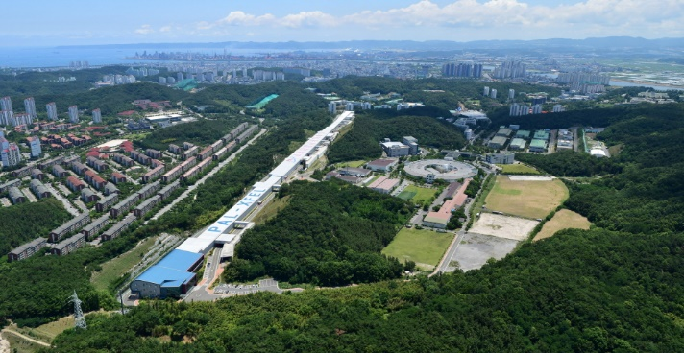

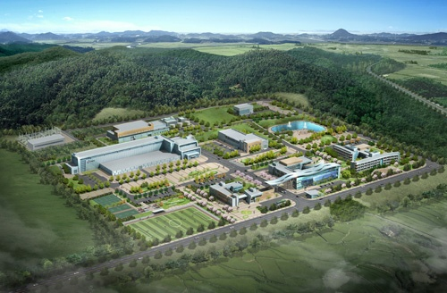
Accelerator Facilities in Korea
KLS (Under construction)
PLS-II and PAL-XFEL
RAON
KOMAC

Slide 4
국내 가속기 비교
종류 | 가속입자 | 주요활용목적 | 대표시설
방사광가속기 | 전자 | 물질의 미세구조 실시간 관측 | PLS-II, PAL-XFEL, KLS (오창)
중이온가속기 | 양성자보다 무거운 원소 이온 | 희귀 동위원소 생성, 우주 기원 탐구, 핵물리 | RAON (대전)
양성자가속기 | 양성자 | 물질 변형, 중성자 생성, 나노 바이오 연구 | KOMAC (경주)
중입자가속기 | 탄소 이온 | 암 치료 | 서울대병원 (기장)

Slide 5

Pohang Accelerator Laboratory
PLS-II
PAL-XFEL

Slide 6

박태준 회장과 김호길 총장

Slide 7
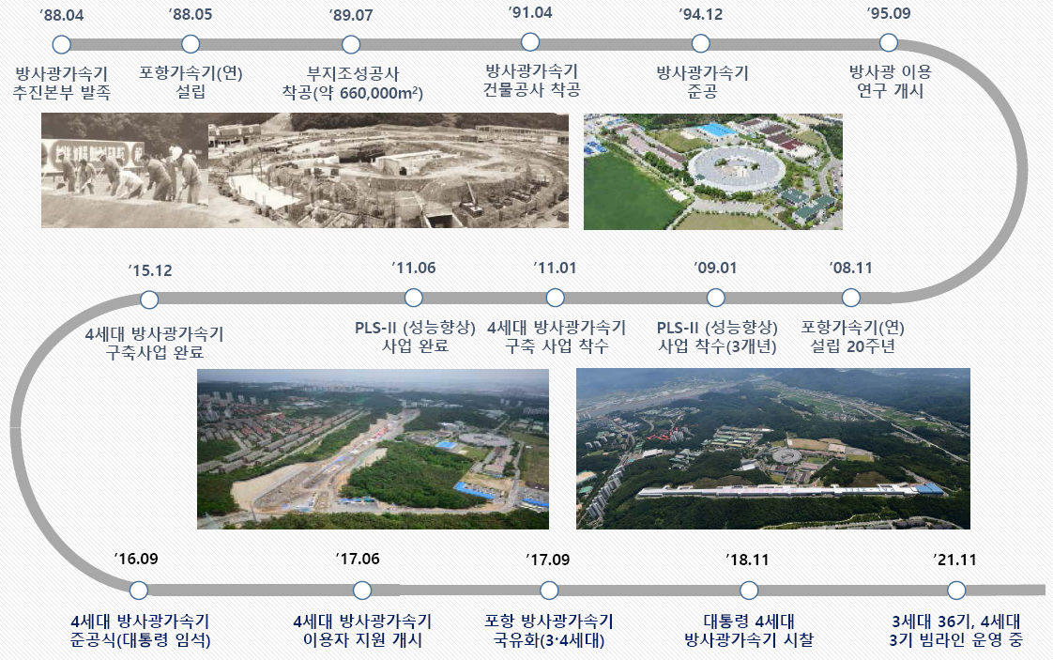
History of PAL

Slide 8
Contents
Pohang Accelerator Laboratory (PAL)
Pohang Light Source-II (PLS-II)
PAL X-ray Free Electron Laser (PAL-XFEL)

Slide 9
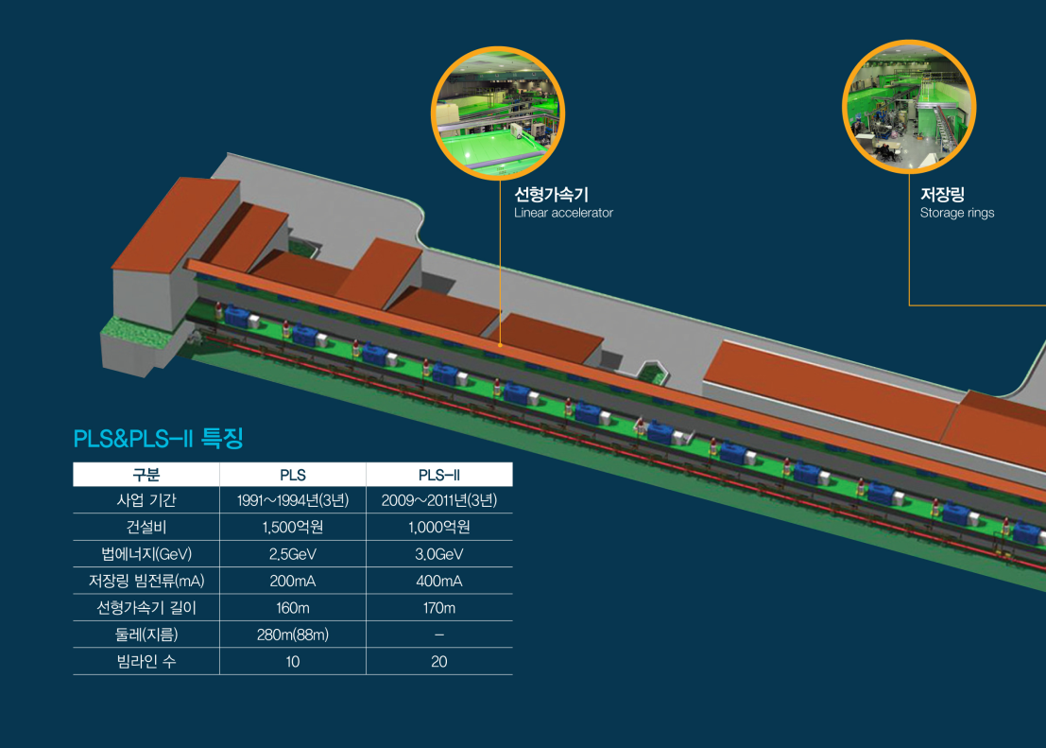
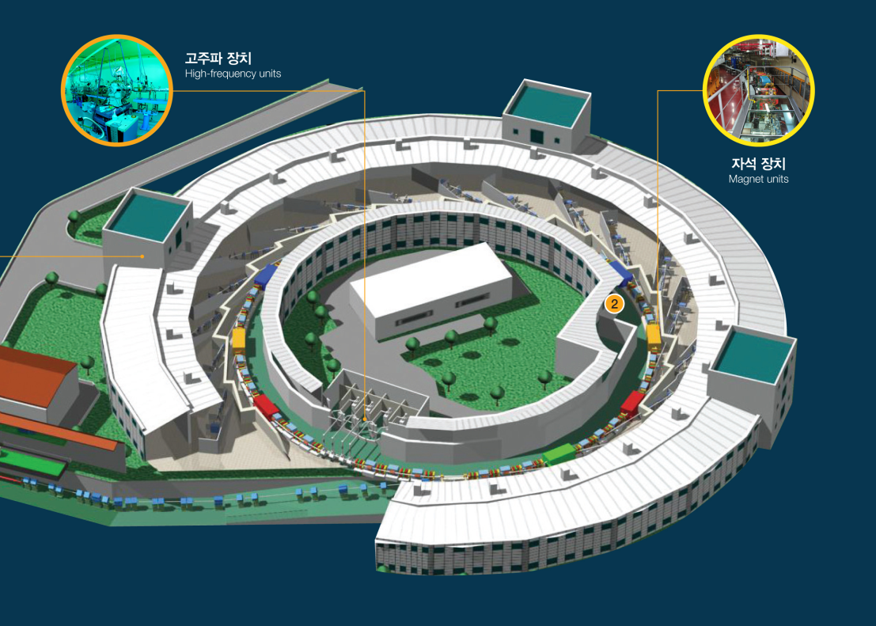
Layout of PLS-II

Slide 10
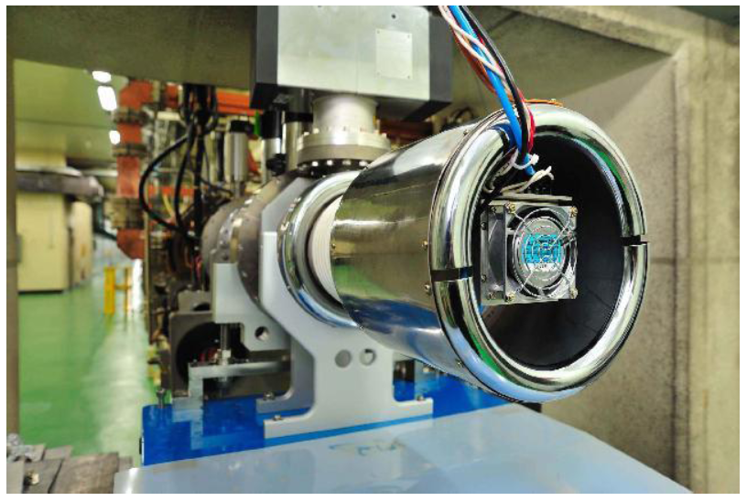
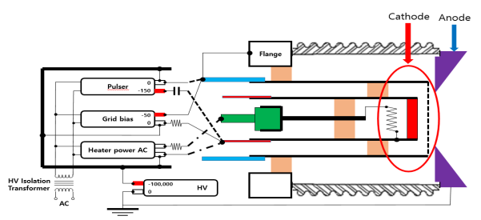
PLS-II Electron Gun
Circuit Diagram of Electron Gun
PLS-II Thermionic Electron Gun

Slide 11
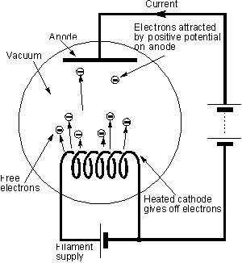
Generation of Electron Beam (Thermionic Gun)
Thermal electron :
When the metal is heated hot, conduction band electrons escape from metal surface
I ~ T²e^{-W/kT}
W : work function
* 1 eV ~ 11200 K

Slide 12
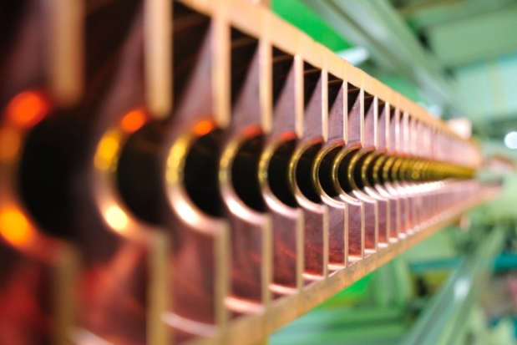
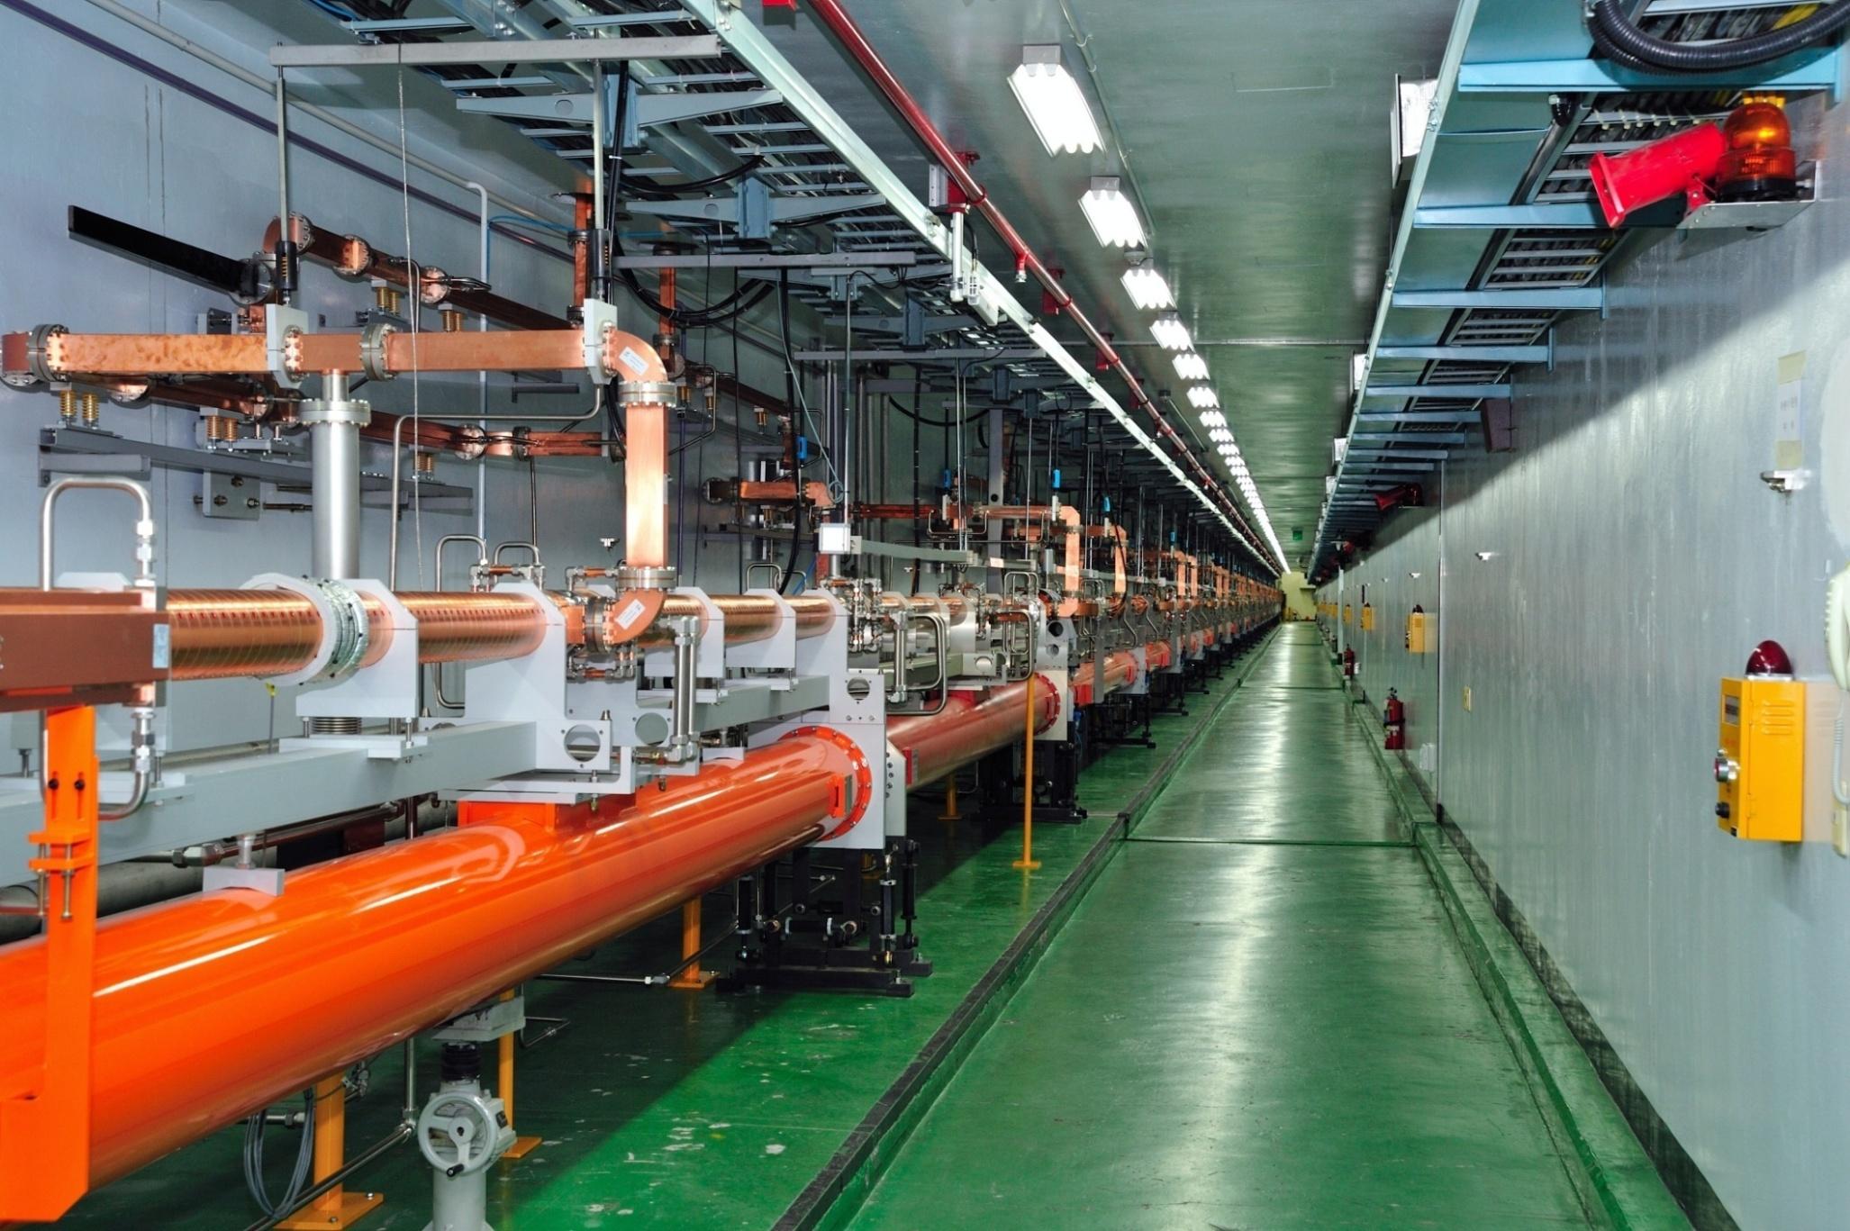
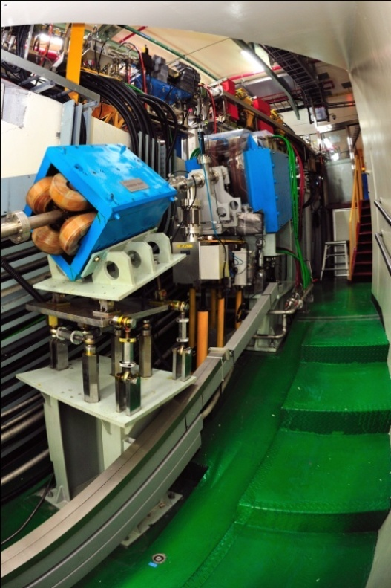
Linear Accelerator (Basement Tunnel)
Length: 180m
Thermionic electron gun
1 A, 10Hz pulsed beam
Norm. emittance: 150 µmrad
46 accelerating columns
3.0 GeV, full energy injection
빔전송계(BTL)

Slide 13
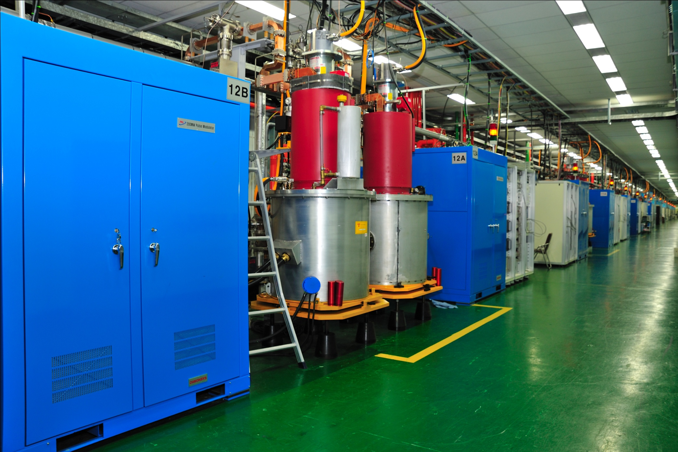
Linear Accelerator (First Floor)
2,856 MHz (S-band)
17 modulators (200MW, 7.5µs)
17 klystrons (80 MW, 4µs)
16 energy doublers (gain=1.5)

Slide 14
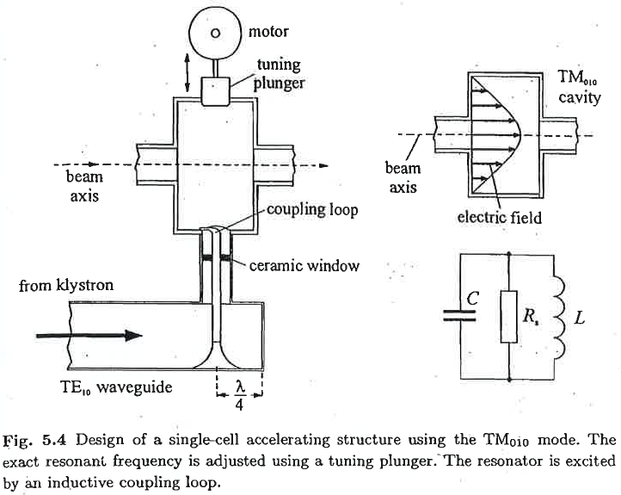
Accelerating Structure
Klaus Wille, The Physics of Particle Accelerators: An Introduction

Slide 15
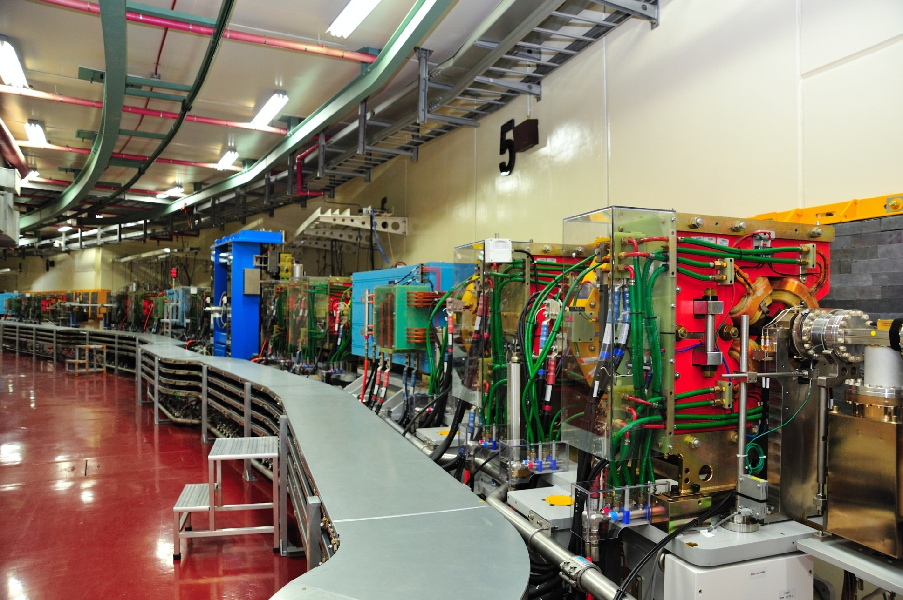
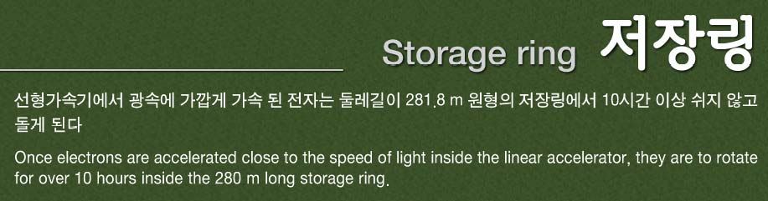
Storage Ring

Slide 16
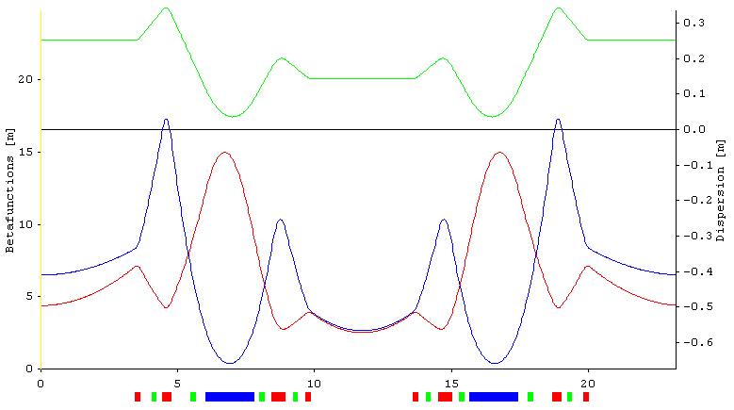
PLS-II Lattice (Double Band Achromat)
ηx
βx
βy
3.4 m
6.86 m
Bend
Quadrupole
Sextupole

Slide 17
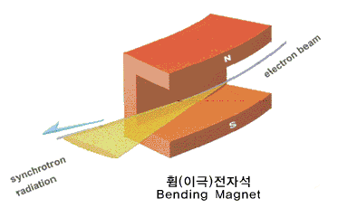
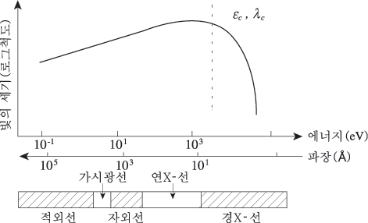
Synchrotron Radiation

Slide 18
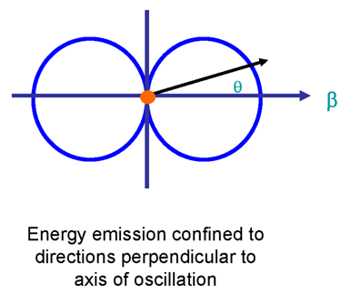
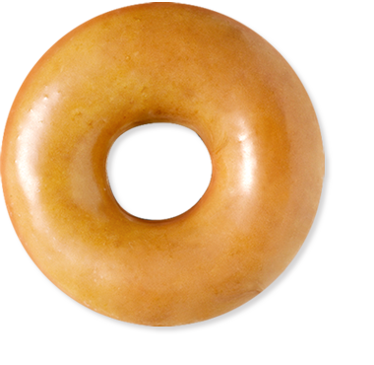
Radiation

Slide 19
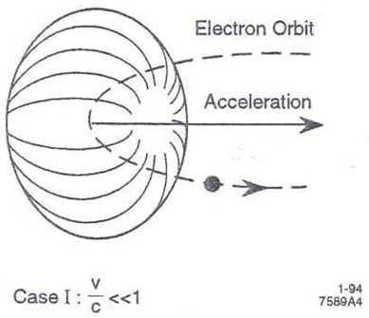
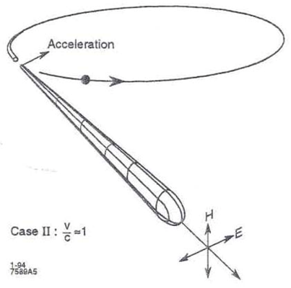
Radiation from Circular Electron Motion

Slide 20
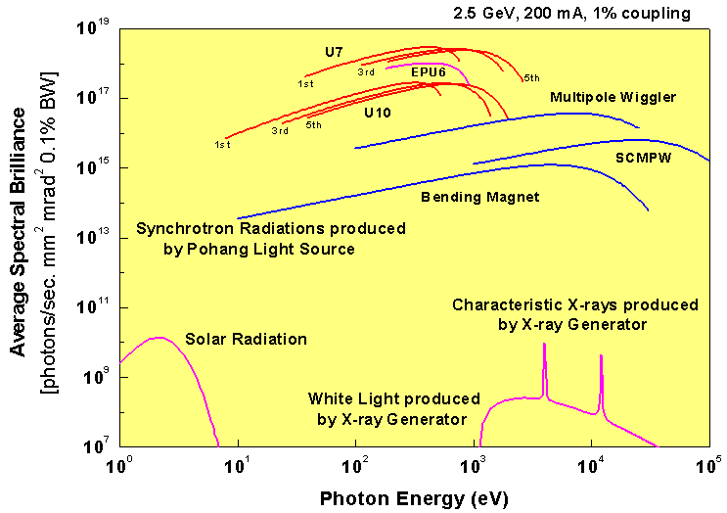
Characteristics of Synchrotron Radiation

Slide 21
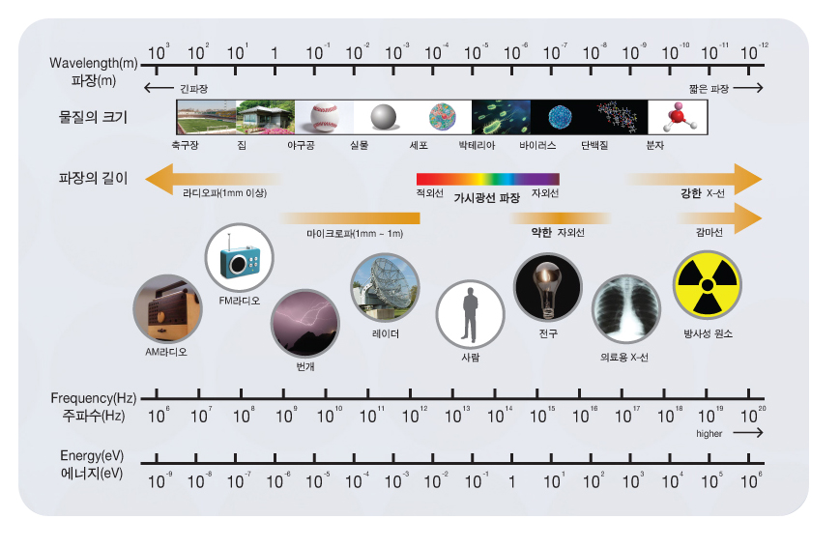
Wavelength of Electromagnetic Wave

Slide 22
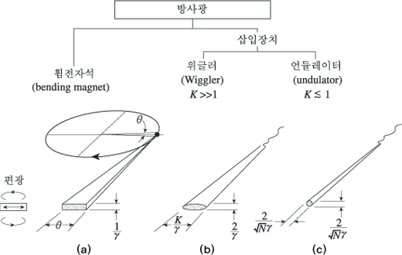
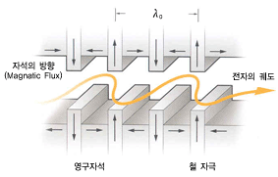






Insertion Devices
$$\sqrt{N_{p}}$$
$$\sqrt{N_{p}}$$
I $≈N_{e}$
I $≈N_{e}×N_{p}$
I $≈N_{e}×N_{p}^{2}$

Slide 23
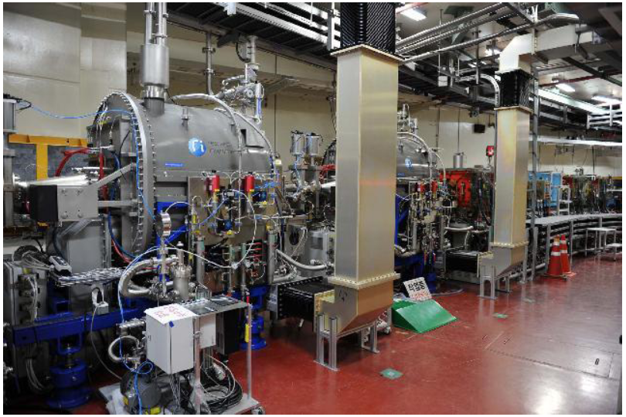
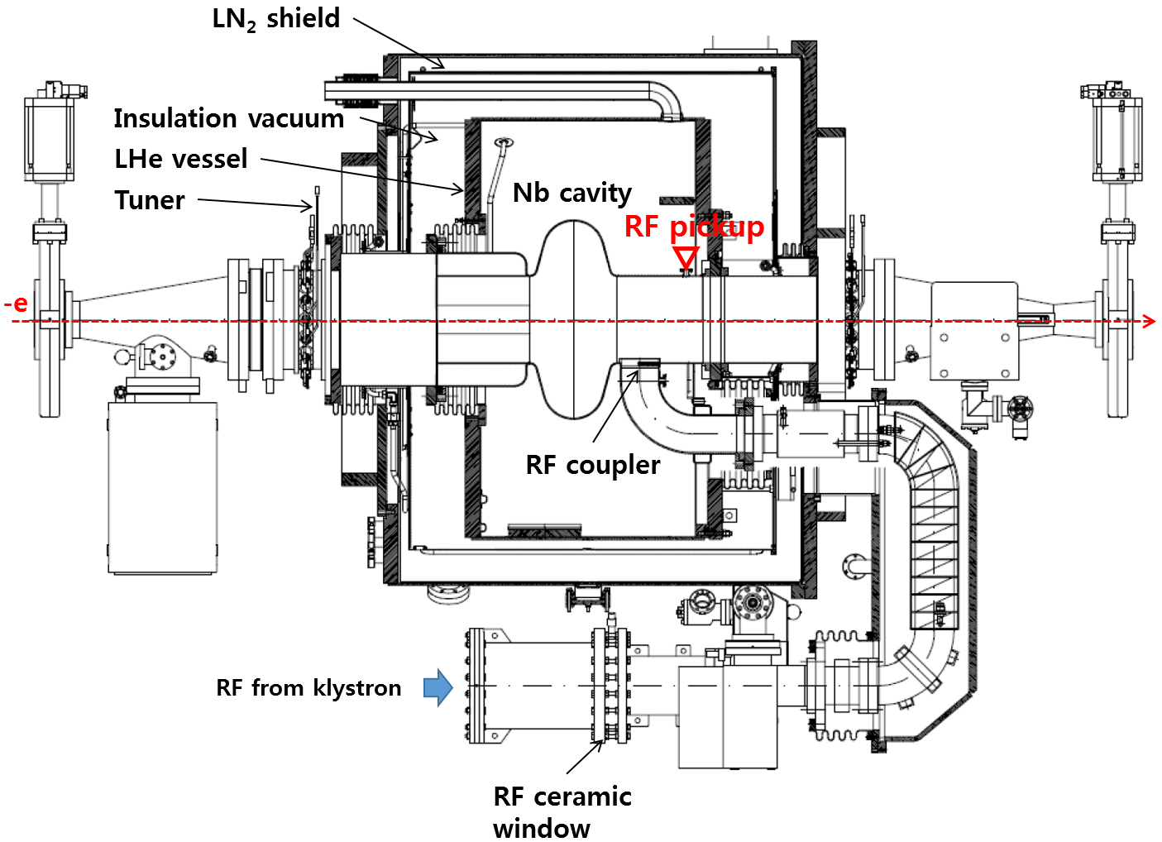
Superconducting RF Cavity

Slide 24
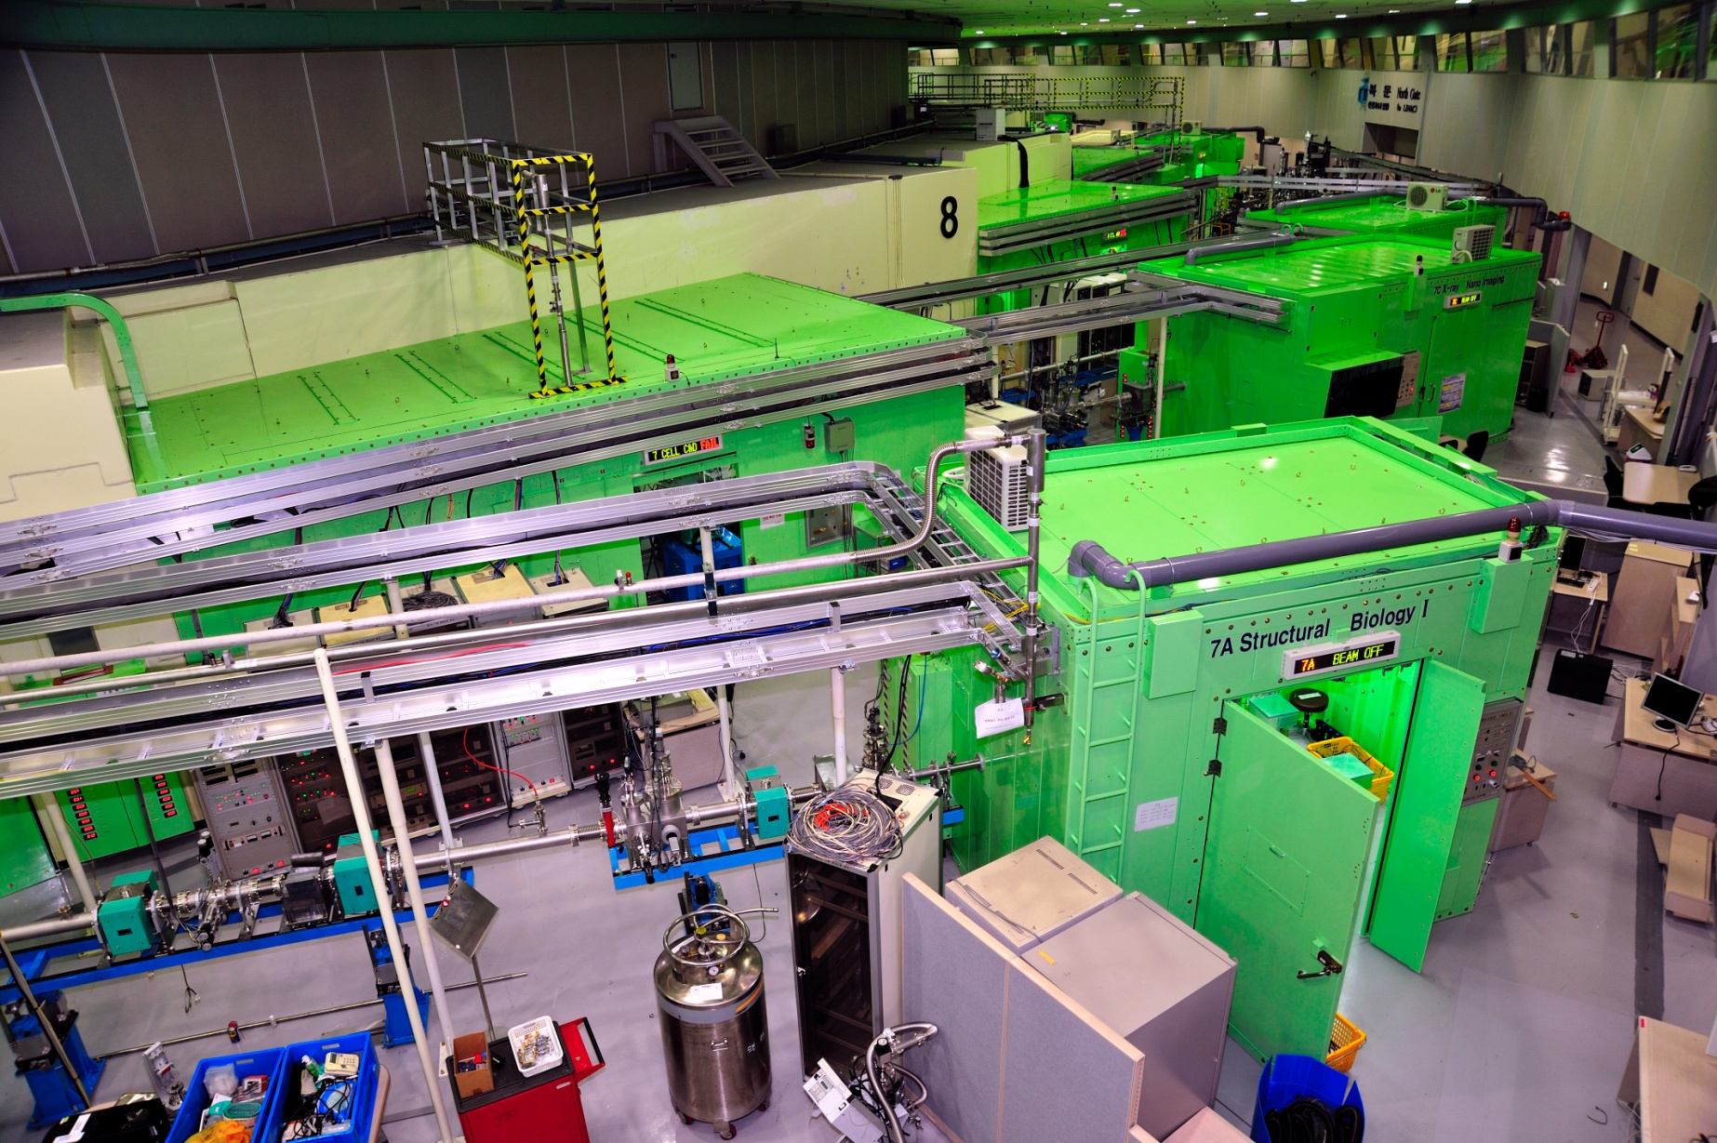
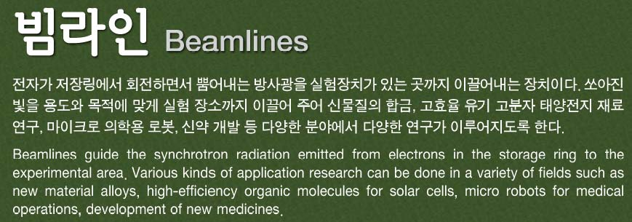
Beamlines

Slide 25
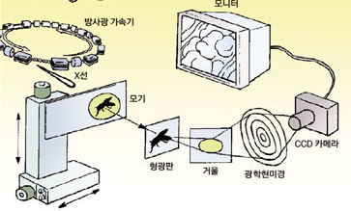
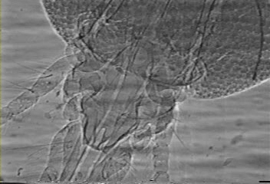
Imaging

Slide 26
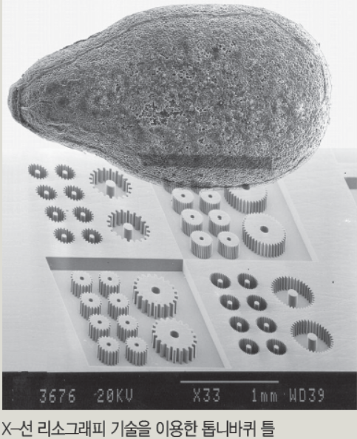
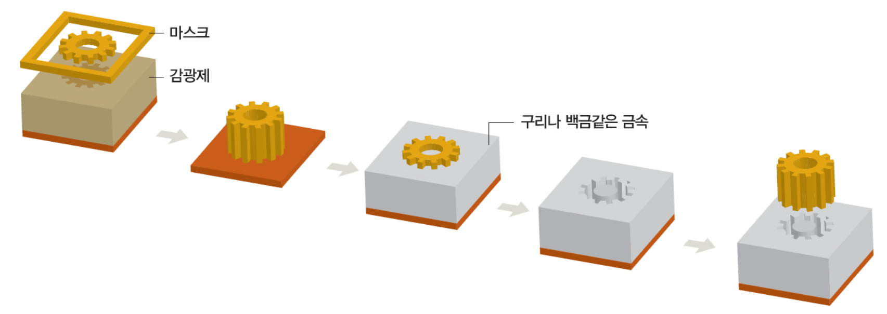
X-ray Lithography

Slide 27
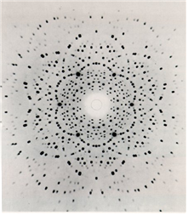
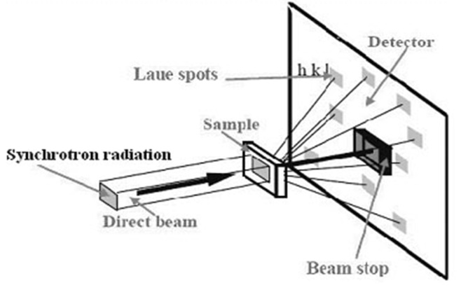
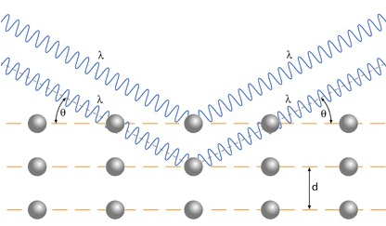

Structure Analysis
$$2dsinθ=nλ$$

Slide 28
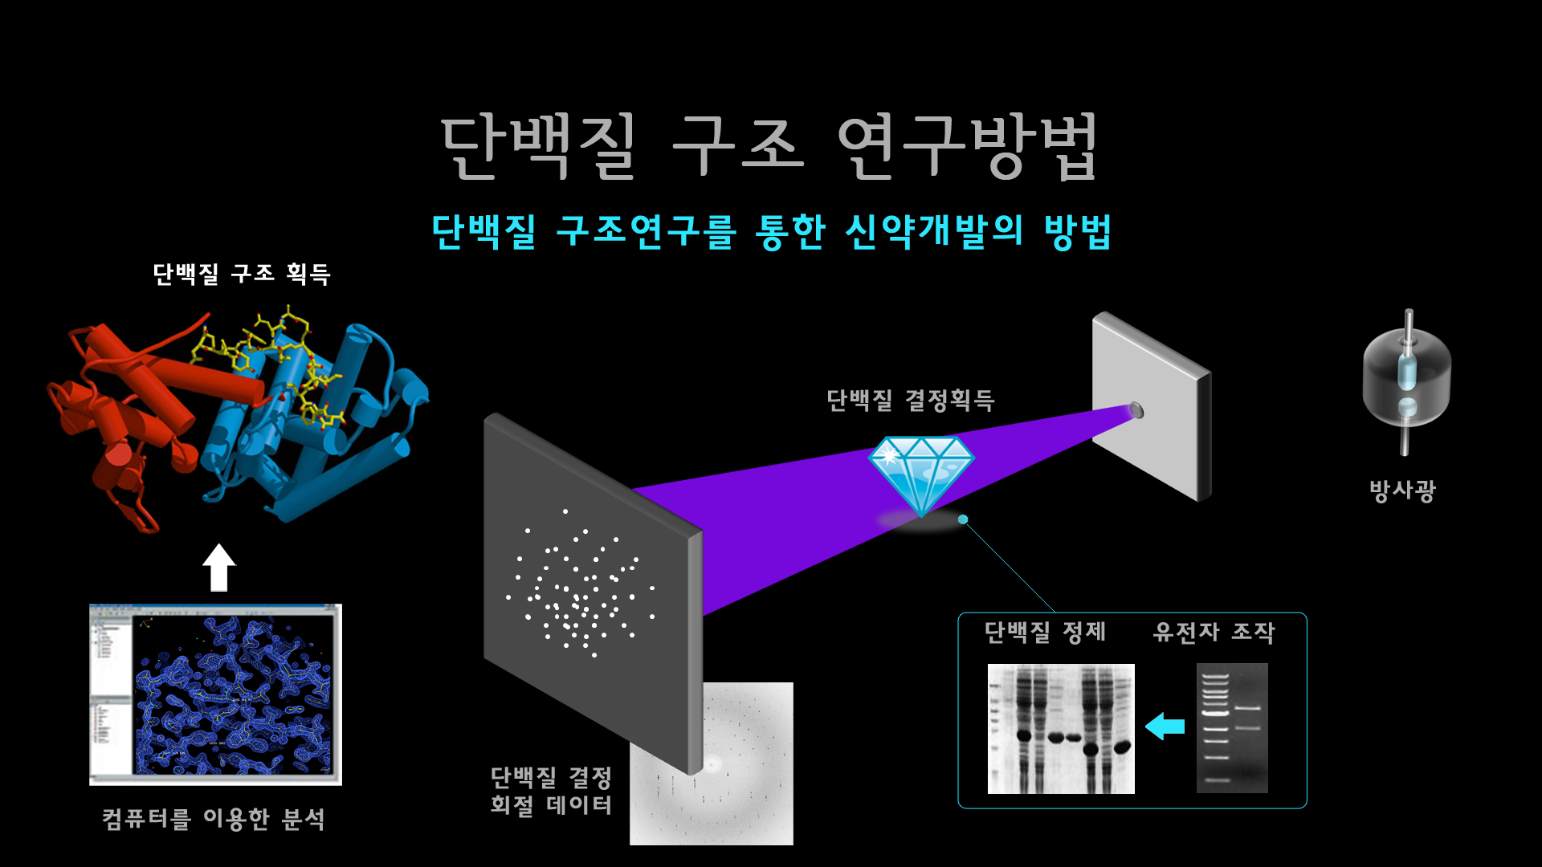

Slide 29
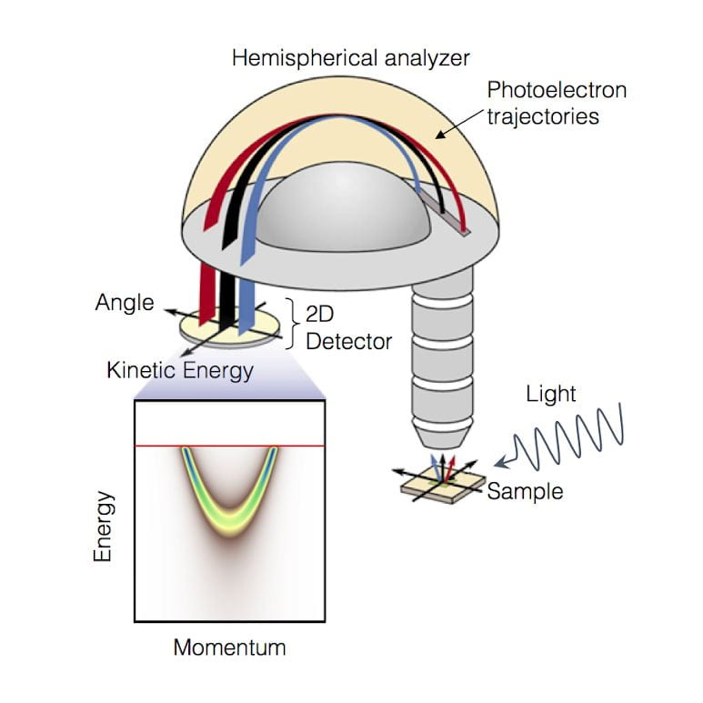
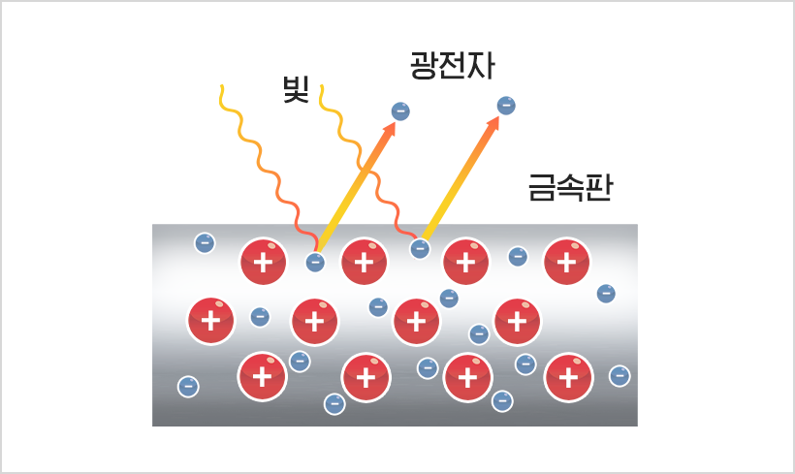
Spectroscopy
Angle-Resolved Photoemission Spectroscopy

Slide 30
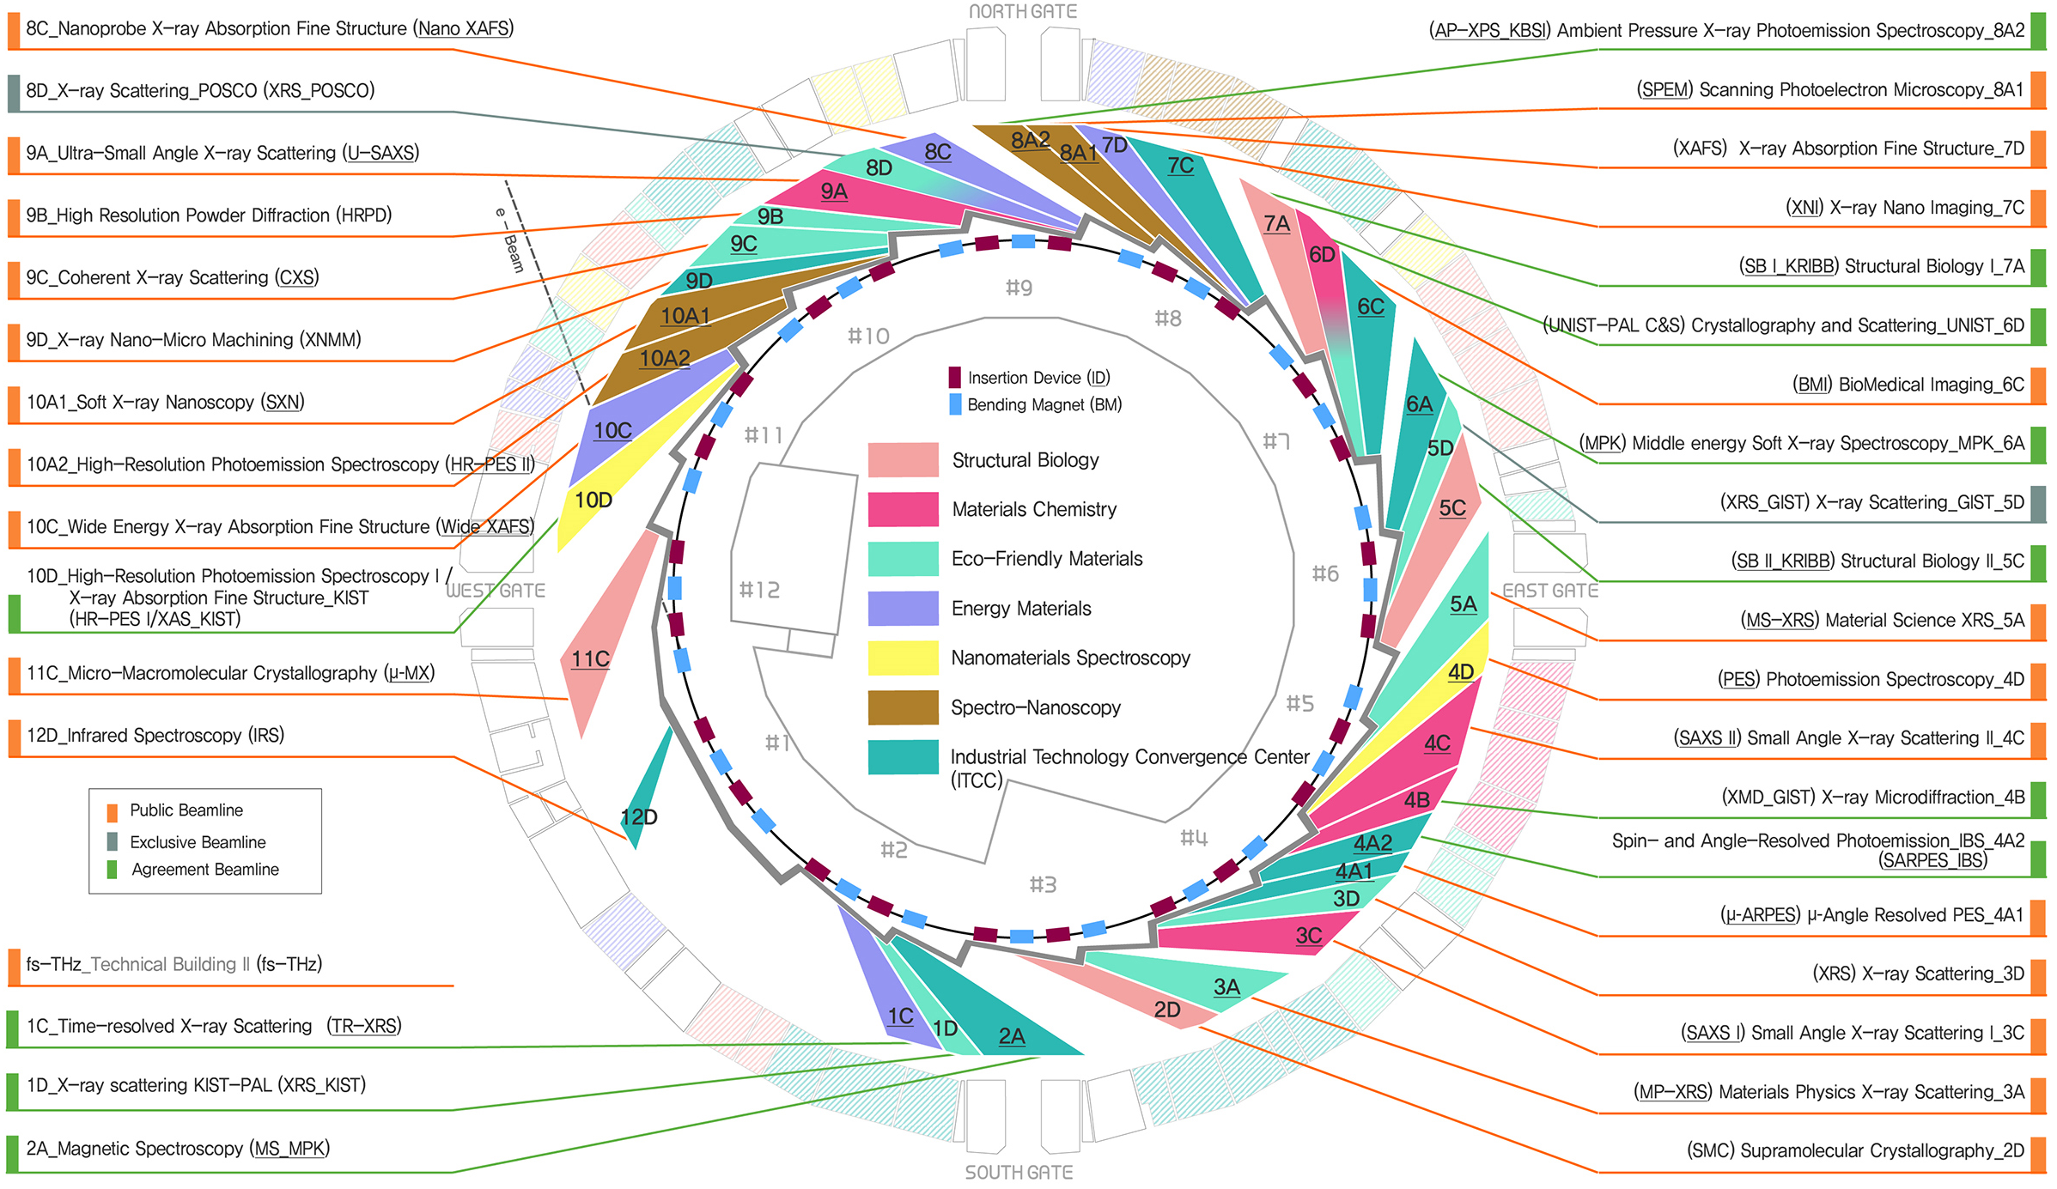
36 Beamlines in PLS-II
User Service: 190 days/year, Experiments: > 2000

Slide 31
Contents
Pohang Accelerator Laboratory (PAL)
Pohang Light Source-II (PLS-II)
PAL X-ray Free Electron Laser (PAL-XFEL)

Slide 32
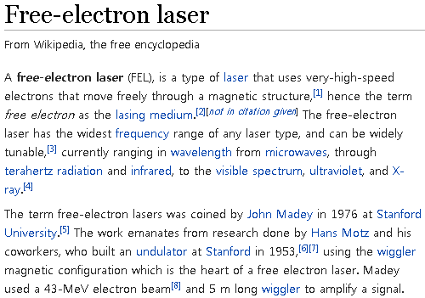
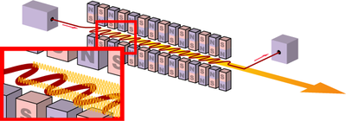

Slide 33
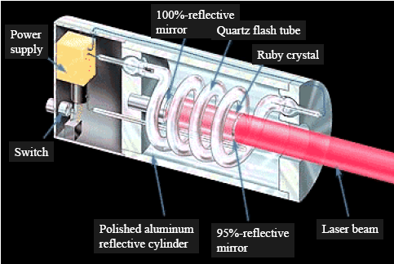
First Ruby Laser

Slide 34
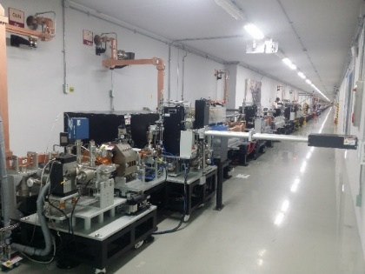
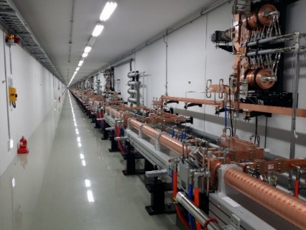
PAL-XFEL Layout & Parameters
30A
2 ps
200A
300fs
1kA
60fs
3kA
20fs
Self-seeding
  Main parameters
  e⁻ Energy 11 GeV
  e⁻ Bunch charge 20-200 pC
  Slice emittance < 0.4 mm mrad
  Repetition rate 60 Hz
  Bunch length 5 fs – 50 fs
  Peak current 3 kA
  SX line switching Kicker Magnet
Undulator Line | HX | SX
Photon energy [keV] | 2.0 ~ 15 | 0.25 ~ 1.25
Beam Energy [GeV] | 4 ~ 11 | 3.0
Wavelength Tuning | Energy | Gap
Undulator Type | Planar | Planar
Undulator Period / Gap [mm] | 26 / 8.3 | 35 / 9.0

Slide 35
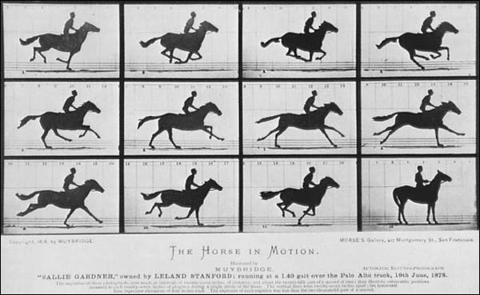
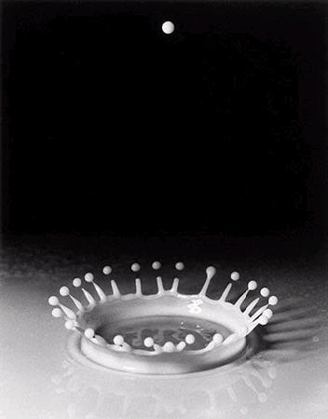
Ultra-fast Dynamics
The Horse in Motion
by Eadweard Muybridge
Turner et. al., New J. Phys. 2008, 10, 053023
Milk Drop Coronet
by Harold E. Edgerton

Slide 36
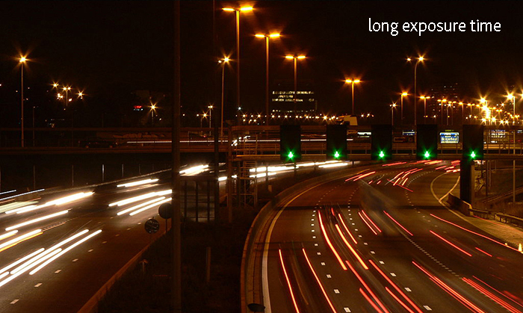
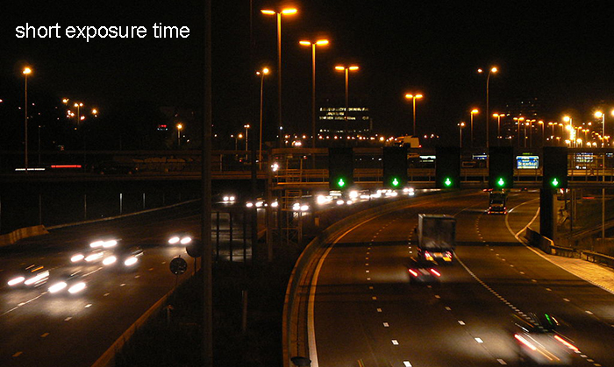
Long vs Short Exposure
www.thiot-ingenierie.com/en/2017/12/12/how-we-capture-the-invisible/

Slide 37


Slide 38
PAL-XFEL Parameters
30A
2 ps
200A
300fs
1kA
60fs
3kA
20fs
Self-seeding
Undulator Line | HX | SX
Photon energy [keV] | 2.0 ~ 15 | 0.25 ~ 1.25
Beam Energy [GeV] | 4 ~ 11 | 3.0
Wavelength Tuning | Energy | Gap
Undulator Type | Planar | Planar
Undulator Period / Gap [mm] | 26 / 8.3 | 35 / 9.0
  Main parameters
  e⁻ Energy 11 GeV
  e⁻ Bunch charge 20-200 pC
  Slice emittance < 0.4 mm mrad
  Repetition rate 60 Hz
  Bunch length 5 fs – 50 fs
  Peak current 3 kA
  SX line switching Kicker Magnet

Slide 39

Generation of Electron Beam (Photocathode RF Gun)
Photo-electron :
When a photon is absorbed by the metal surface, electrons can escape from metal surface
W ~ hν ~ E_{binding}
(Cu work function: ~4.6 eV ~250 nm)

Slide 40



Photocathode RF Gun

Slide 41


Bunch Compressor
Low E
$$ϕ$$
High E
400 mm
High E
Low E

Slide 42



Pump Probe Experiment
- No timing jitter correction
- averaged by 50 trials of the time delay scan and normalized by GaSb(111) Bragg peak intensity
- Only slow time-drift correction
- Vibration Frequency : 2.7 THz
- Instrument Response: 137 fs (FWHM)
Bragg intensity
Bi (111) thin film
XFEL
Optical Pump
Bi(111) thin film (50 nm) on GaSb(111)/Si(111)
X-ray: 6 keV
X-ray size: ~ 60 x 60 um²
Laser: 800 nm, 100 fs
Detector: MPCCD 0.5M

Slide 43




Ultra-high Resolution
2D Membrane Protein Crystallography

Slide 44
PAL-XFEL Parameters
30A
2 ps
200A
300fs
1kA
60fs
3kA
20fs
Self-seeding
Undulator Line | HX | SX
Photon energy [keV] | 2.0 ~ 15 | 0.25 ~ 1.25
Beam Energy [GeV] | 4 ~ 11 | 3.0
Wavelength Tuning | Energy | Gap
Undulator Type | Planar | Planar
Undulator Period / Gap [mm] | 26 / 8.3 | 35 / 9.0
  Main parameters
  e⁻ Energy 11 GeV
  e⁻ Bunch charge 20-200 pC
  Slice emittance < 0.4 mm mrad
  Repetition rate 60 Hz
  Bunch length 5 fs – 50 fs
  Peak current 3 kA
  SX line switching Kicker Magnet

Slide 45

Klystron & Modulator Gallery
Parameter | Unit | Value
Operation frequency | MHz | 2856
No. of Klystron, Modulator |  | 51
Max. repetition rate | Hz | 60
Operation pulse length | μs | 4

Slide 46

Linear Accelerator Tunnel
Parameter | Unit | Value
Energy | GeV | 10
Charge | pC | 200
No. of SLED |  | 42
No. of Acc. Column |  | 173

Slide 47

Synchrotron Radiation

Slide 48




High Brightness

Slide 49

PAL-XFEL Parameters
30A
2 ps
200A
300fs
1kA
60fs
3kA
20fs
Self-seeding
Undulator Line | HX | SX
Photon energy [keV] | 2.0 ~ 15 | 0.25 ~ 1.25
Beam Energy [GeV] | 4 ~ 11 | 3.0
Wavelength Tuning | Energy | Gap
Undulator Type | Planar | Planar
Undulator Period / Gap [mm] | 26 / 8.3 | 35 / 9.0
  Main parameters
  e⁻ Energy 11 GeV
  e⁻ Bunch charge 20-200 pC
  Slice emittance < 0.4 mm mrad
  Repetition rate 60 Hz
  Bunch length 5 fs – 50 fs
  Peak current 3 kA
  SX line switching Kicker Magnet
$$N_{e} =\frac{160 pC}{1.60×{10}^{−19}C}={10}^{9}$$

Slide 50

Undulators
Parameter | Unit | Value
No. of Undulator |  | 21
Length | m | 5
Period | mm | 26.0
Gap | mm | 8.3
Wavelength | nm | 0.1
Magnetic field | Tesla | 0.8124
K |  | 1.9727

Slide 51

Electron Energy Change I
Brain McNeil, How an FEL Works

Slide 52


Electron Energy Change II
$$20×{10}^{−15}\left[sec\right]×3×{10}^{8}\left[\frac{m}{sec}\right]=6 [μm]$$
Brain McNeil, How an FEL Works

Slide 53

Electron Bunching I
Brain McNeil, How an FEL Works

Slide 54

Electron Bunching II
Brain McNeil, How an FEL Works

Slide 55


Microbunching Instability

Slide 56


Radiation Power of Incoherent and Coherent Radiation
Brain McNeil, How an FEL Works

Slide 57

Radiation Source & Intensity

Slide 58




Highly Coherent
Coherent X-ray Diffraction Imaging
평양 5월1일 경기장
아리랑1호, 2호 위성영상

Slide 60


Beamline
Experimental Station: Coherent X-ray Imaging, Hard X-ray Pump & Probe, Soft X-ray Pump & Probe

Slide 61


Slide 62

XFELs in Operation

Slide 63

Thank you for your attention!

Slide 64


Future of XFEL
Energy Recovery Linac
XFEL Oscillator

