Slide 1
Korea-4GSR Project Overview and Current Progress in LLRF Development
Chong Shik Park, Ph.D
Korea University, Sejong
Department of Accelerator Science and Accelerator Research Center
On behalf of Korea-4GSR Group
Korea-France Collaboration Meeting on a LLRF Noise Reduction
Jan. 29, 2026

Slide 2
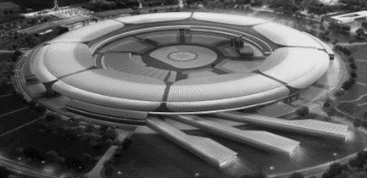





Overview of the Korea-4GSR Project
Period & Budget
Land & Building
Location
^{Period} | 2021~2029
^{Budget} | 1.1643 Trillion KRW = USD 834 M
^{Land} | 540,000 m²
^{Building} | 69,959 m²
^{Location} | Ochang, Cheongju-si, Chungcheongbuk-do
Location of Ochang
Characteristics
Seoul
^{Beam Energy} | 4 GeV
^{Beam Emittance} | less than 100 pm·rad (Design: 62 pm·rad)
^{Circumference} | 800 m
^{Beamlines} | 10 in the first phase (more than 40 in final phase)
^{Accelerator} | Gun, Injector LINAC, 4 GeV Booster and Storage Ring
^{Lattice} | Hybrid 7 Bend Achromat (H7BA)
⁻ | Normal conducting RF cavity and 500 MHz
Daejeon
Ochang
Pohang

Slide 3
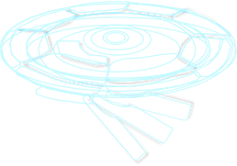
Korea-4GSR Project Timeline
2021 | 2022 | 2023 | 2024 | 2025 | 2026 | 2027 | 2028 | 2029 | 2030
Korea-4GSR(Multipurpose Synchrotron Radiation Construction) Project
Site Construction
Building & Facility Construction
Building Design
CDR
TDR
Accelerator & Beamlines
Installation
Design Review
1st
2nd
3rd
Commissioning
Operation

Slide 4
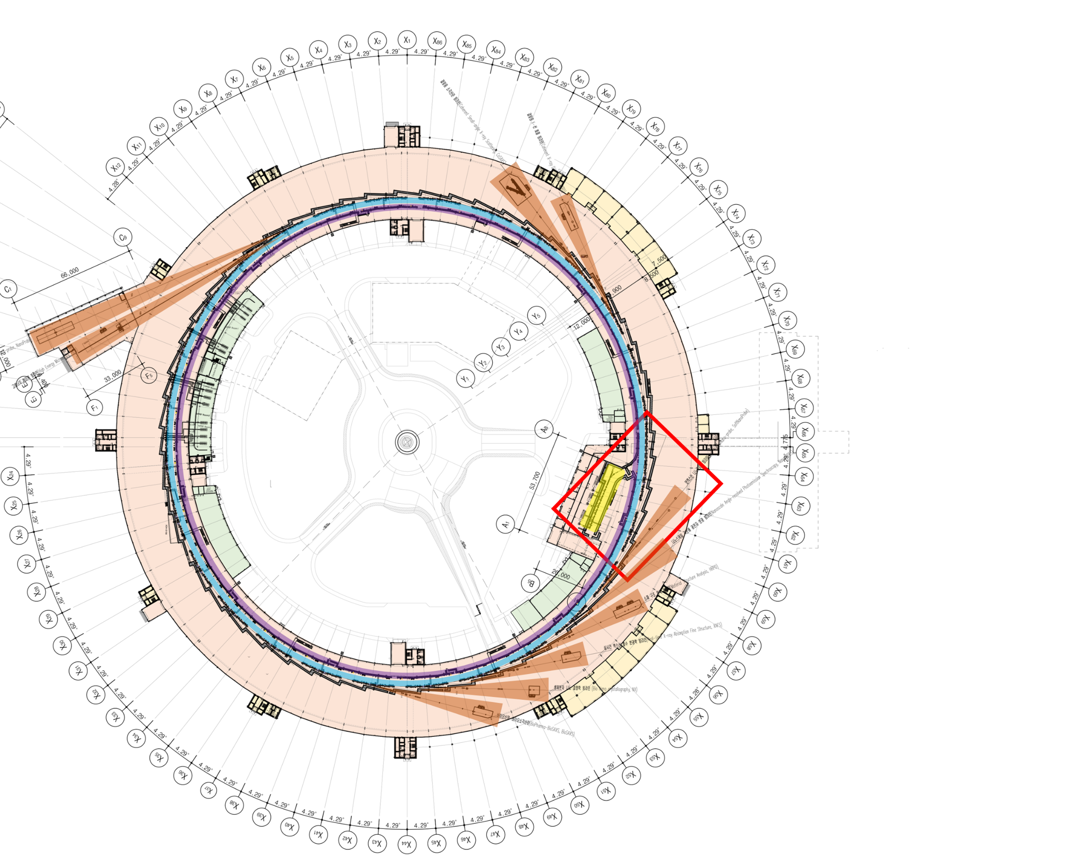
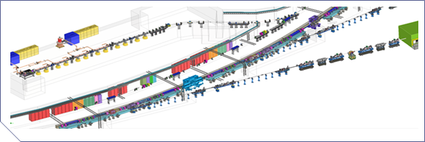




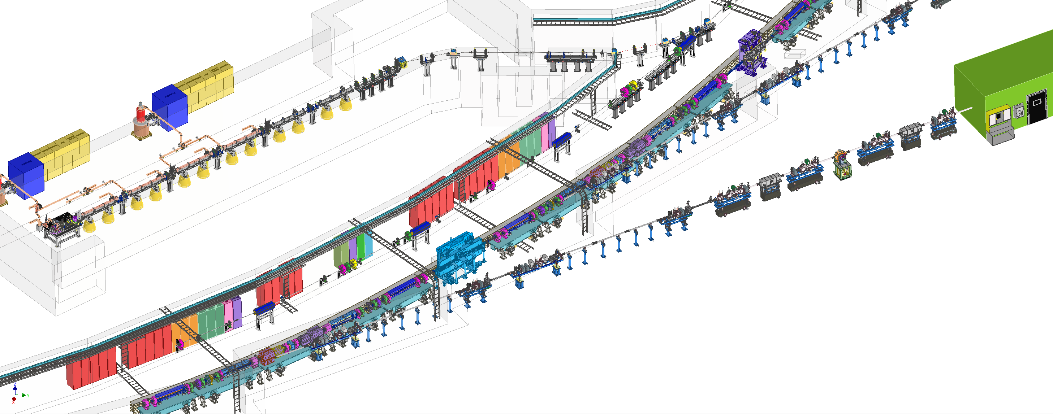

Machine Parameters
 | SR Ring Parameter | Vaule
 | Energy [GeV] | 4.0
 | Beam current [mA] | 400
 | Nat. Emittance [pm∙rad] | 61.57 (WO Ids), 52.55 (W 9 IDs)
 | Emittance coupling [%] | 10
 | Energy spread | 1.26E-3
 | Bunch Length(rms) [mm] | 3.6 (without HC) / 14.4 (with HC)
 | Lattice | Hybrid 7 Bend Achromat
 | Ring Circumference [m] | 799.297
 | Length of Straight Sections [m] | 6.06
 | Tune (H/V) | 68.18 / 23.26
 | (corrected) Chromaticity (H/V) | 5.8 / 3.5
 | Momentum compaction factor | 7.8 x 10⁻⁵
 | Number of buckets | 1332
 | Injection scheme | 4 Kicker bumps, off-axis, 2Hz
 | SR RF Parameter | Vaule
 | RF frequency [MHz] | 499.5935
 | RF Voltage [MV] | 3.5
 | Energy loss per turn [KeV] | 1098 (with 9 IDs: 1449)
SR Ring
01
02
03
04
Linac
Booster
Storage Ring
Beamline
200 MeV
Photocathode
gun
C ~ 773 m
0.2-4 GeV
$ε_{0}$ ~ 11 nm
FODO lattice
Same tunnel
SR RF

Slide 5


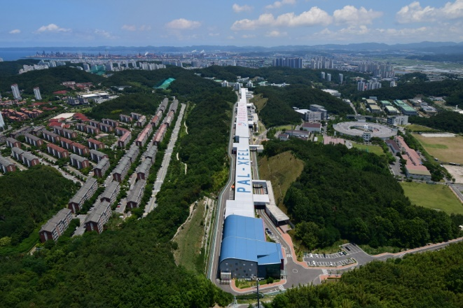

Progress on 4GSR LLRF Prototype Development
RF Group
Pohang Accelerator Laboratory, POSTECH
January 26, 2026

Slide 6
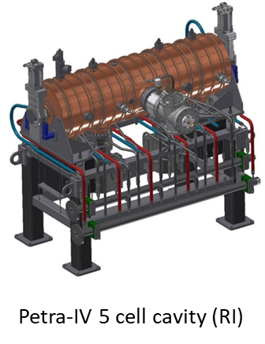
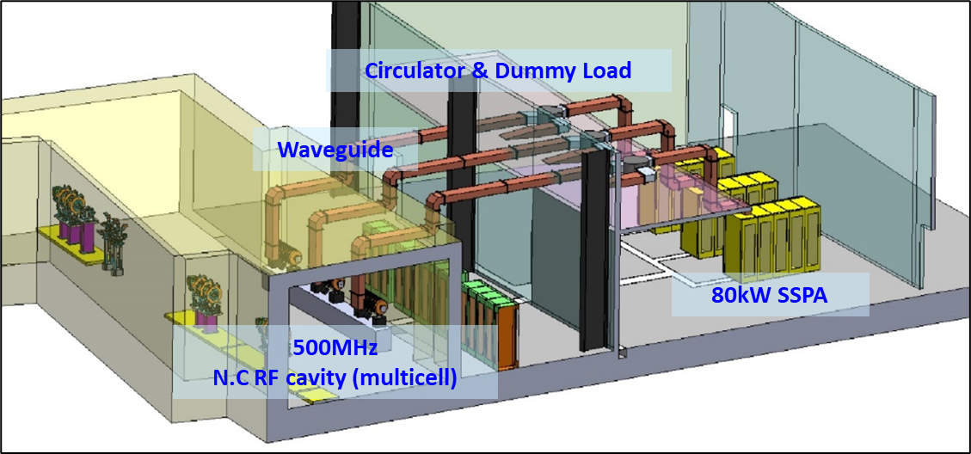
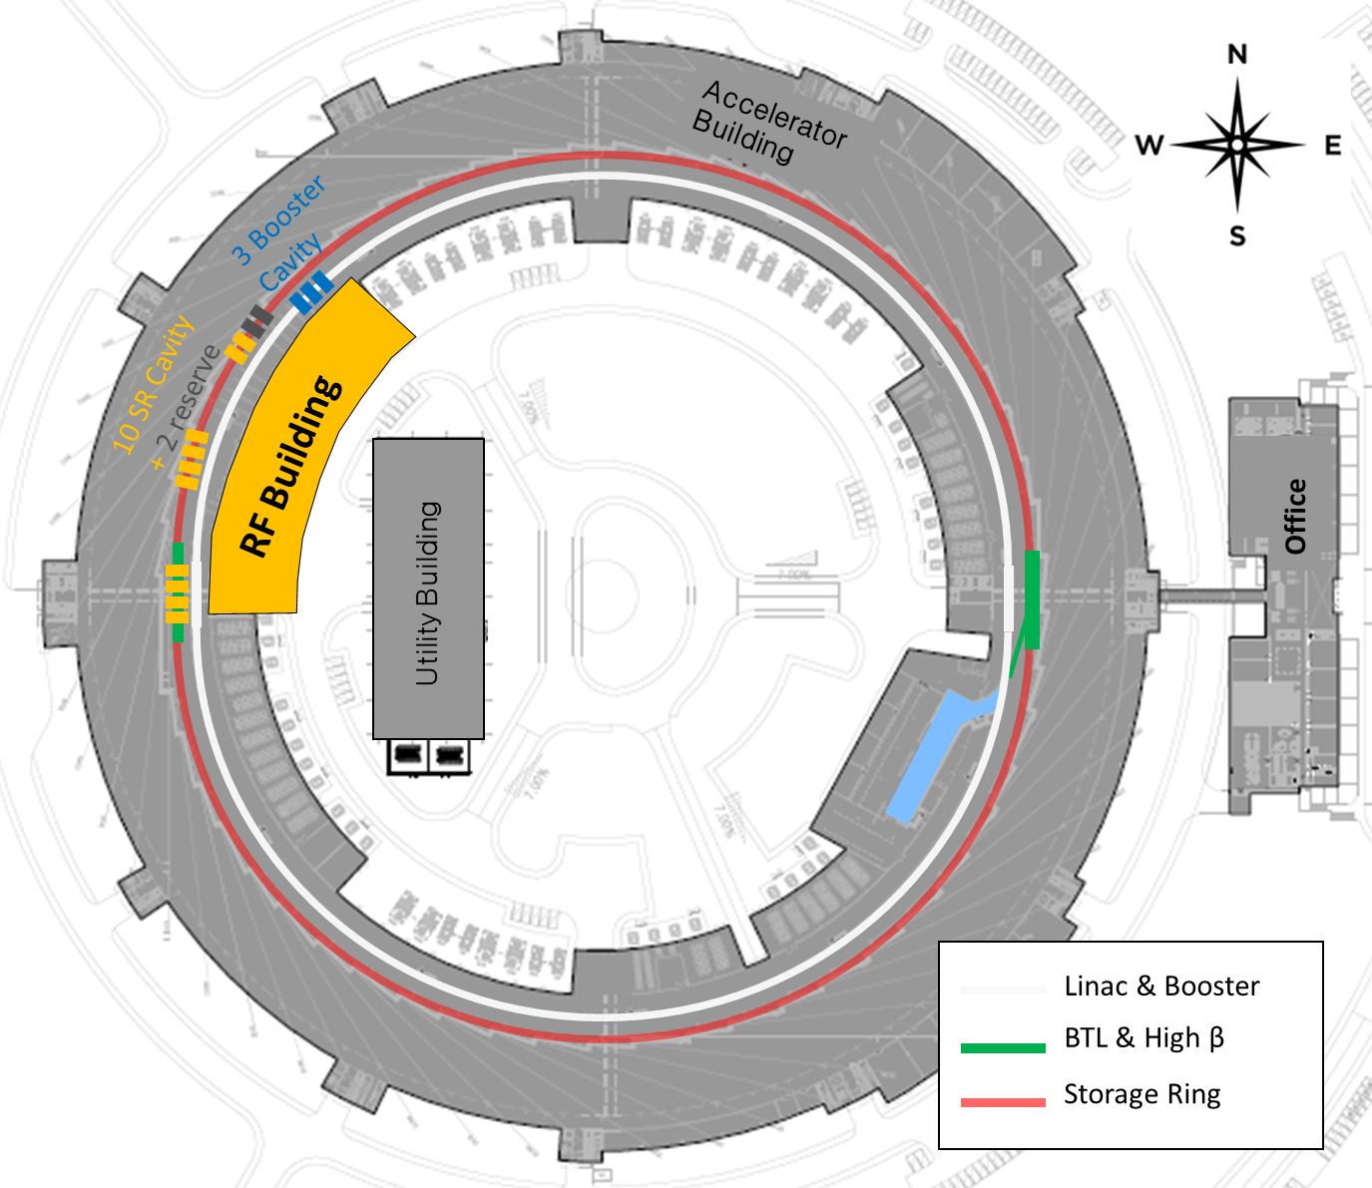
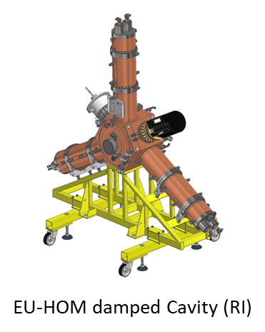
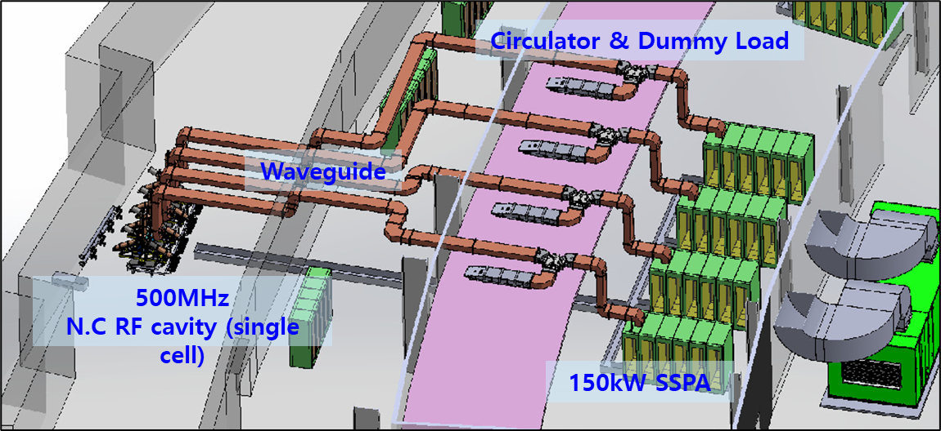
Introduction
Korea-4GSR RF system
Storage ring has total 10 of EU-HOM damped cavities
Booster ring has total 3 Petra-IV 5 cell cavities
Total 3 straight sections will be required for 10 cavities and 3 booster cavities
To place RF devices, including booster cavities, in one RF building, three booster cavities were places adjacent to the storage ring cavities.

Slide 7
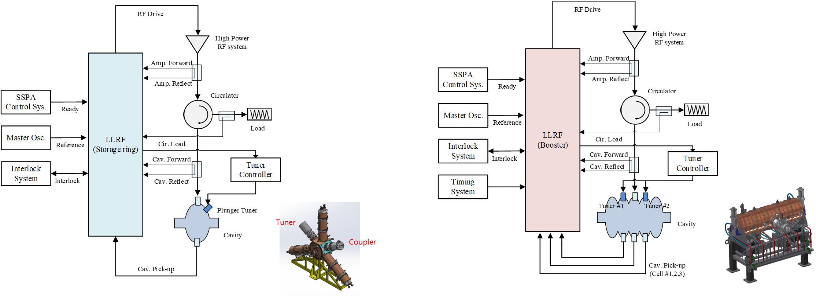
Introduction
Functional Requirements
RF amplitude & phase feedback loop (± 0.1% ± 0.1˚)
- Control mode selection (Tone, GDR)
- Amplitude & Phase set / readback
- Amplitude & Phase offset set (Drift calibration)
- PI control gain set / Readback
- Gradient limit set (Clamp function)
- Reference tracking
- Monitoring feeder forward / reflect
- Monitoring amplitude & phase error
Pulse generation
- Pulse repetition rate
- Pulse width
Frequency control
- Detune angle calculation
- Tuner detune angle offset set
- Communication interface (ethernet, SFP+, Serial)
Interlock protection
- Housekeeping function (LLRF status)
- SSPA ready
- External interlock
- Cavity interlock (for fast interlock)
- RF shutdown function
Ramping function
- External trigger synchronize (BNC, LEMO, Optic interface)
- Ramping profile generation
Field flatness control
- Field flatness calculation (Cell #2 & Cell #4)
- flatness window set
- Communication interface (ethernet, SFP+, Serial)

Slide 8
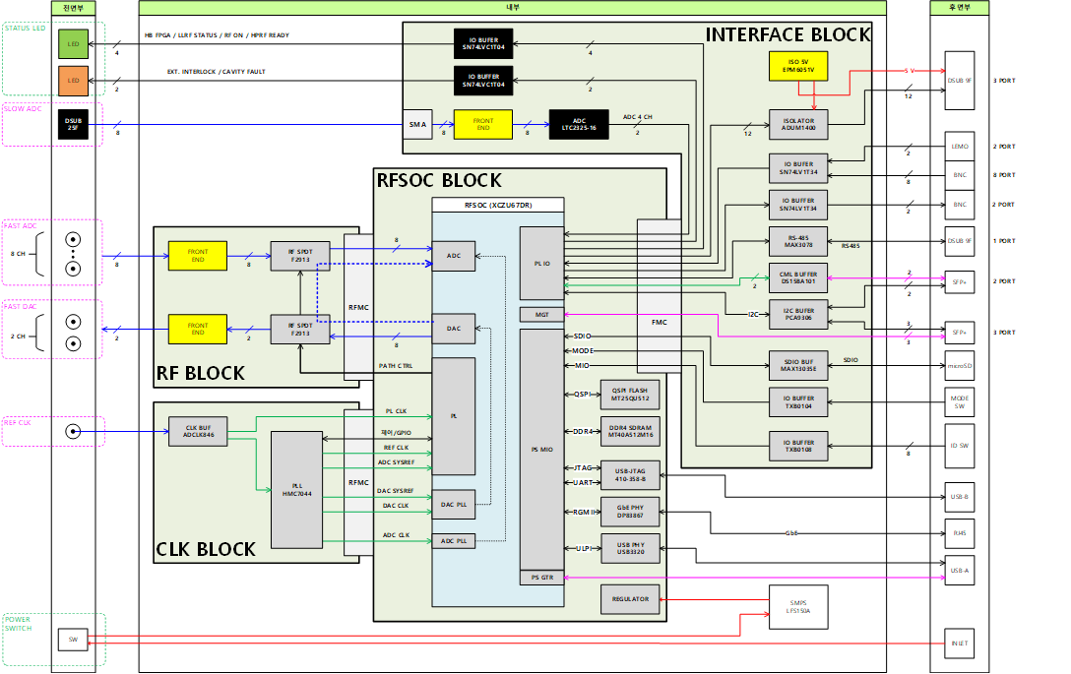
Introduction
Hardware architecture

Slide 9
Digital processing flow
Filed flatness control
Reference tracking
RF amplitude & phase feedback
Ramping / Pulse generation
Reflected power protection
Detune angle calculation

Slide 10
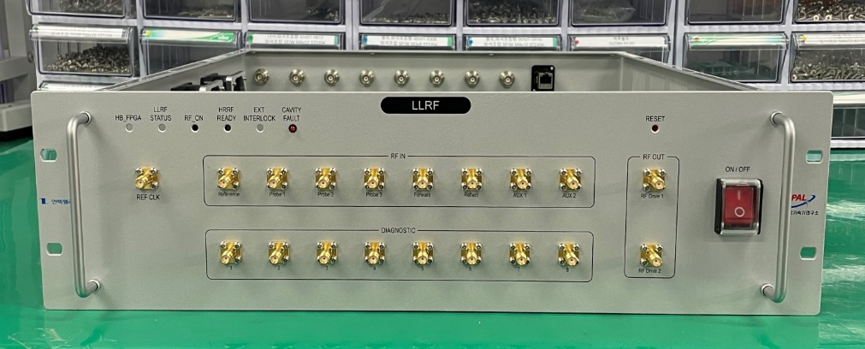
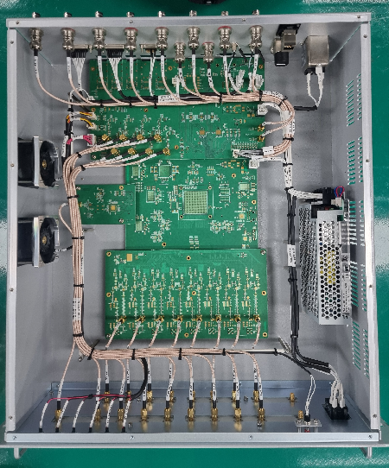
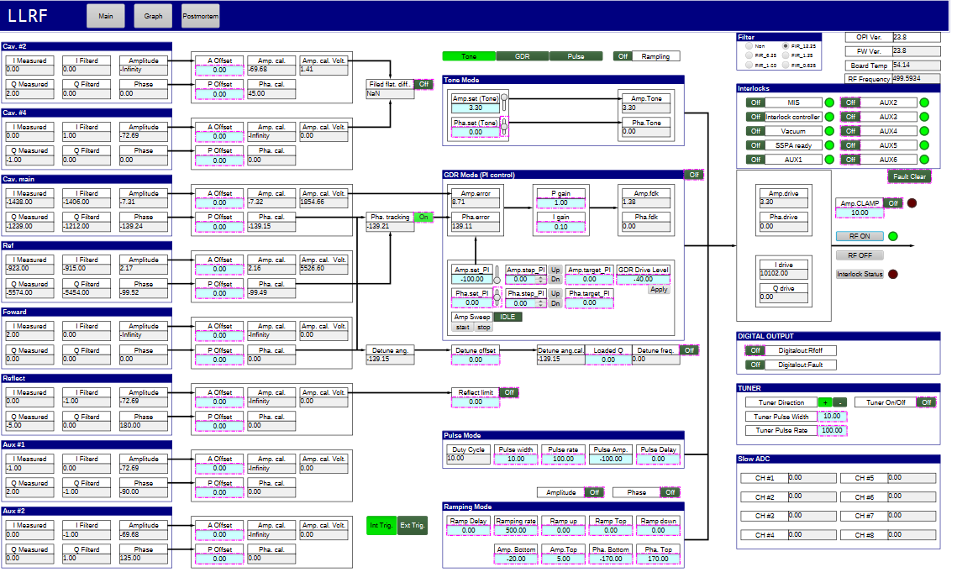
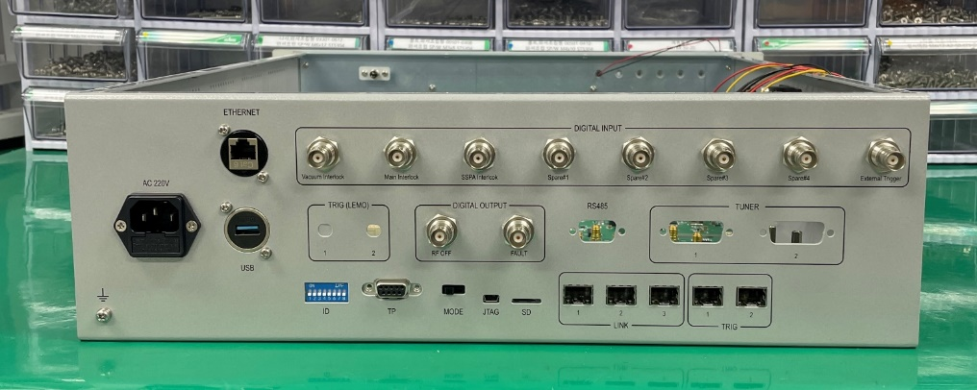
Implementation
LLRF Prototype
Pheobus GUI

Slide 11
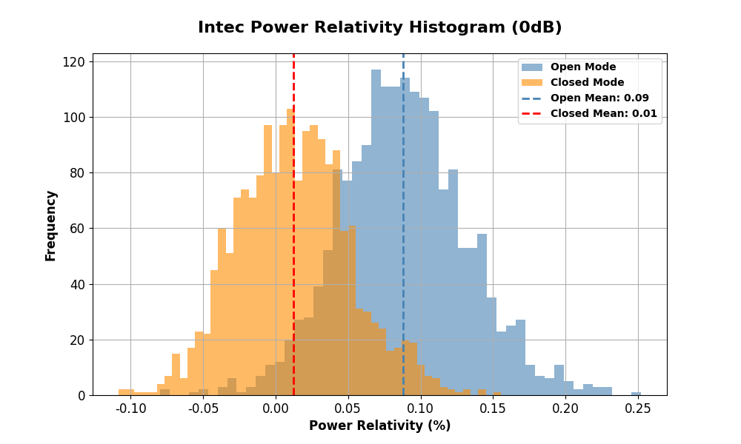
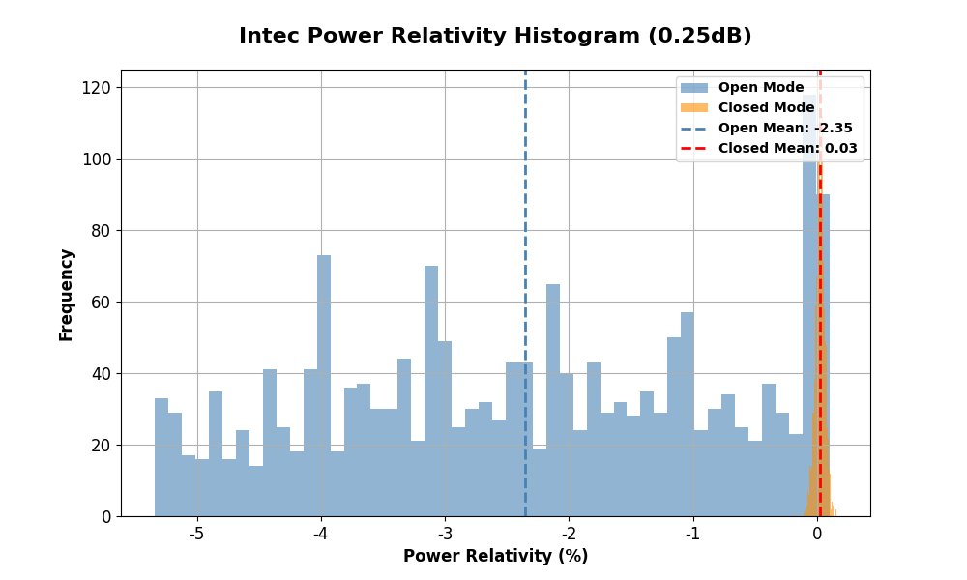
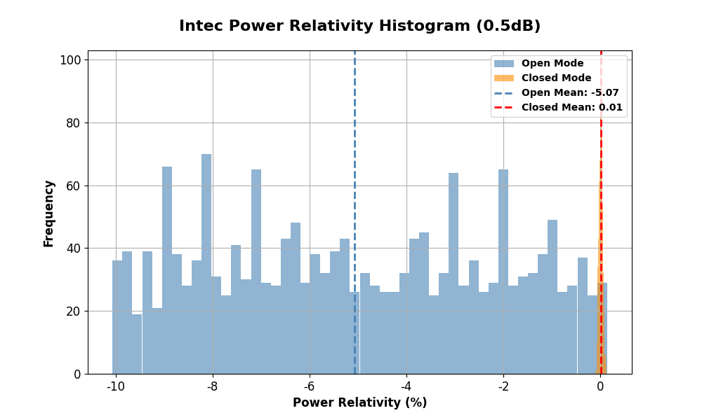
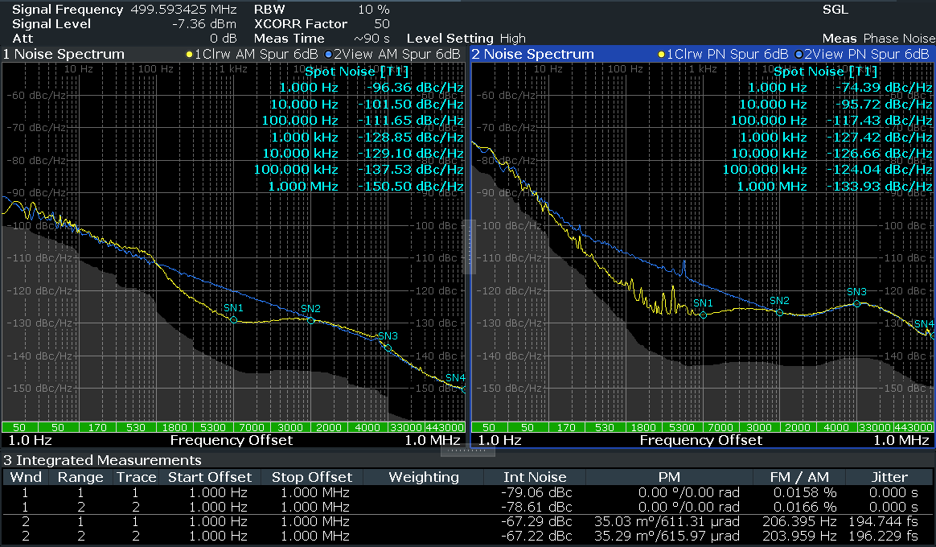
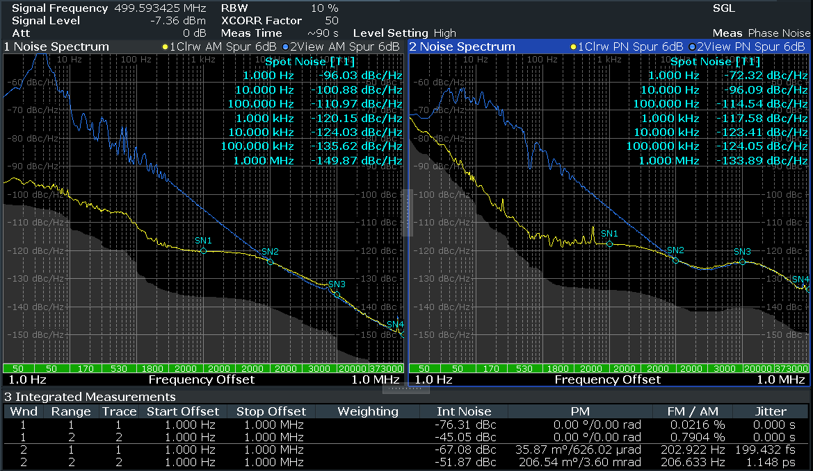
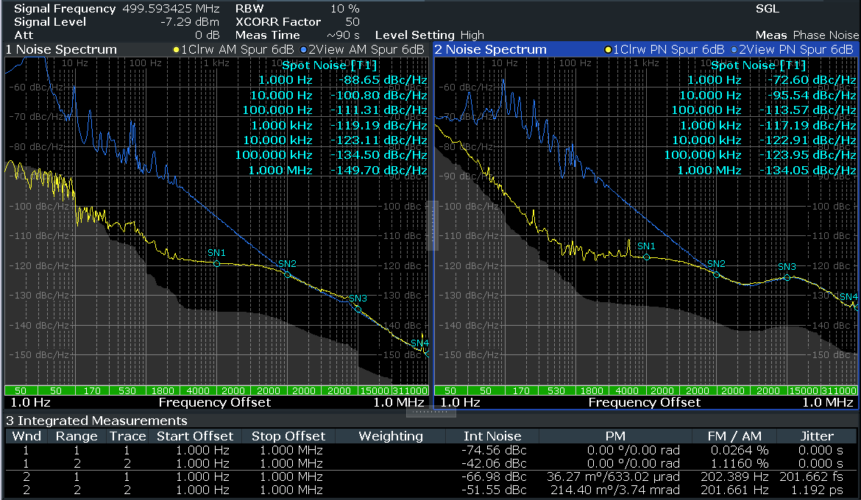
Performance test result
Intec | Open | Closed
Amplitude (%) | 0.0166 | 0.0158
Phase (deg.) | 0.03529 | 0.03503
Intec | Open | Closed
Amplitude (%) | 0.7904 | 0.0216
Phase (deg.) | 0.20654 | 0.03587
Intec | Open | Closed
Amplitude (%) | 1.1160 | 0.0264
Phase (deg.) | 0.21440 | 0.03627

