Slide 1
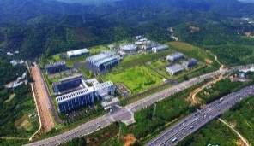
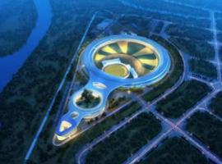
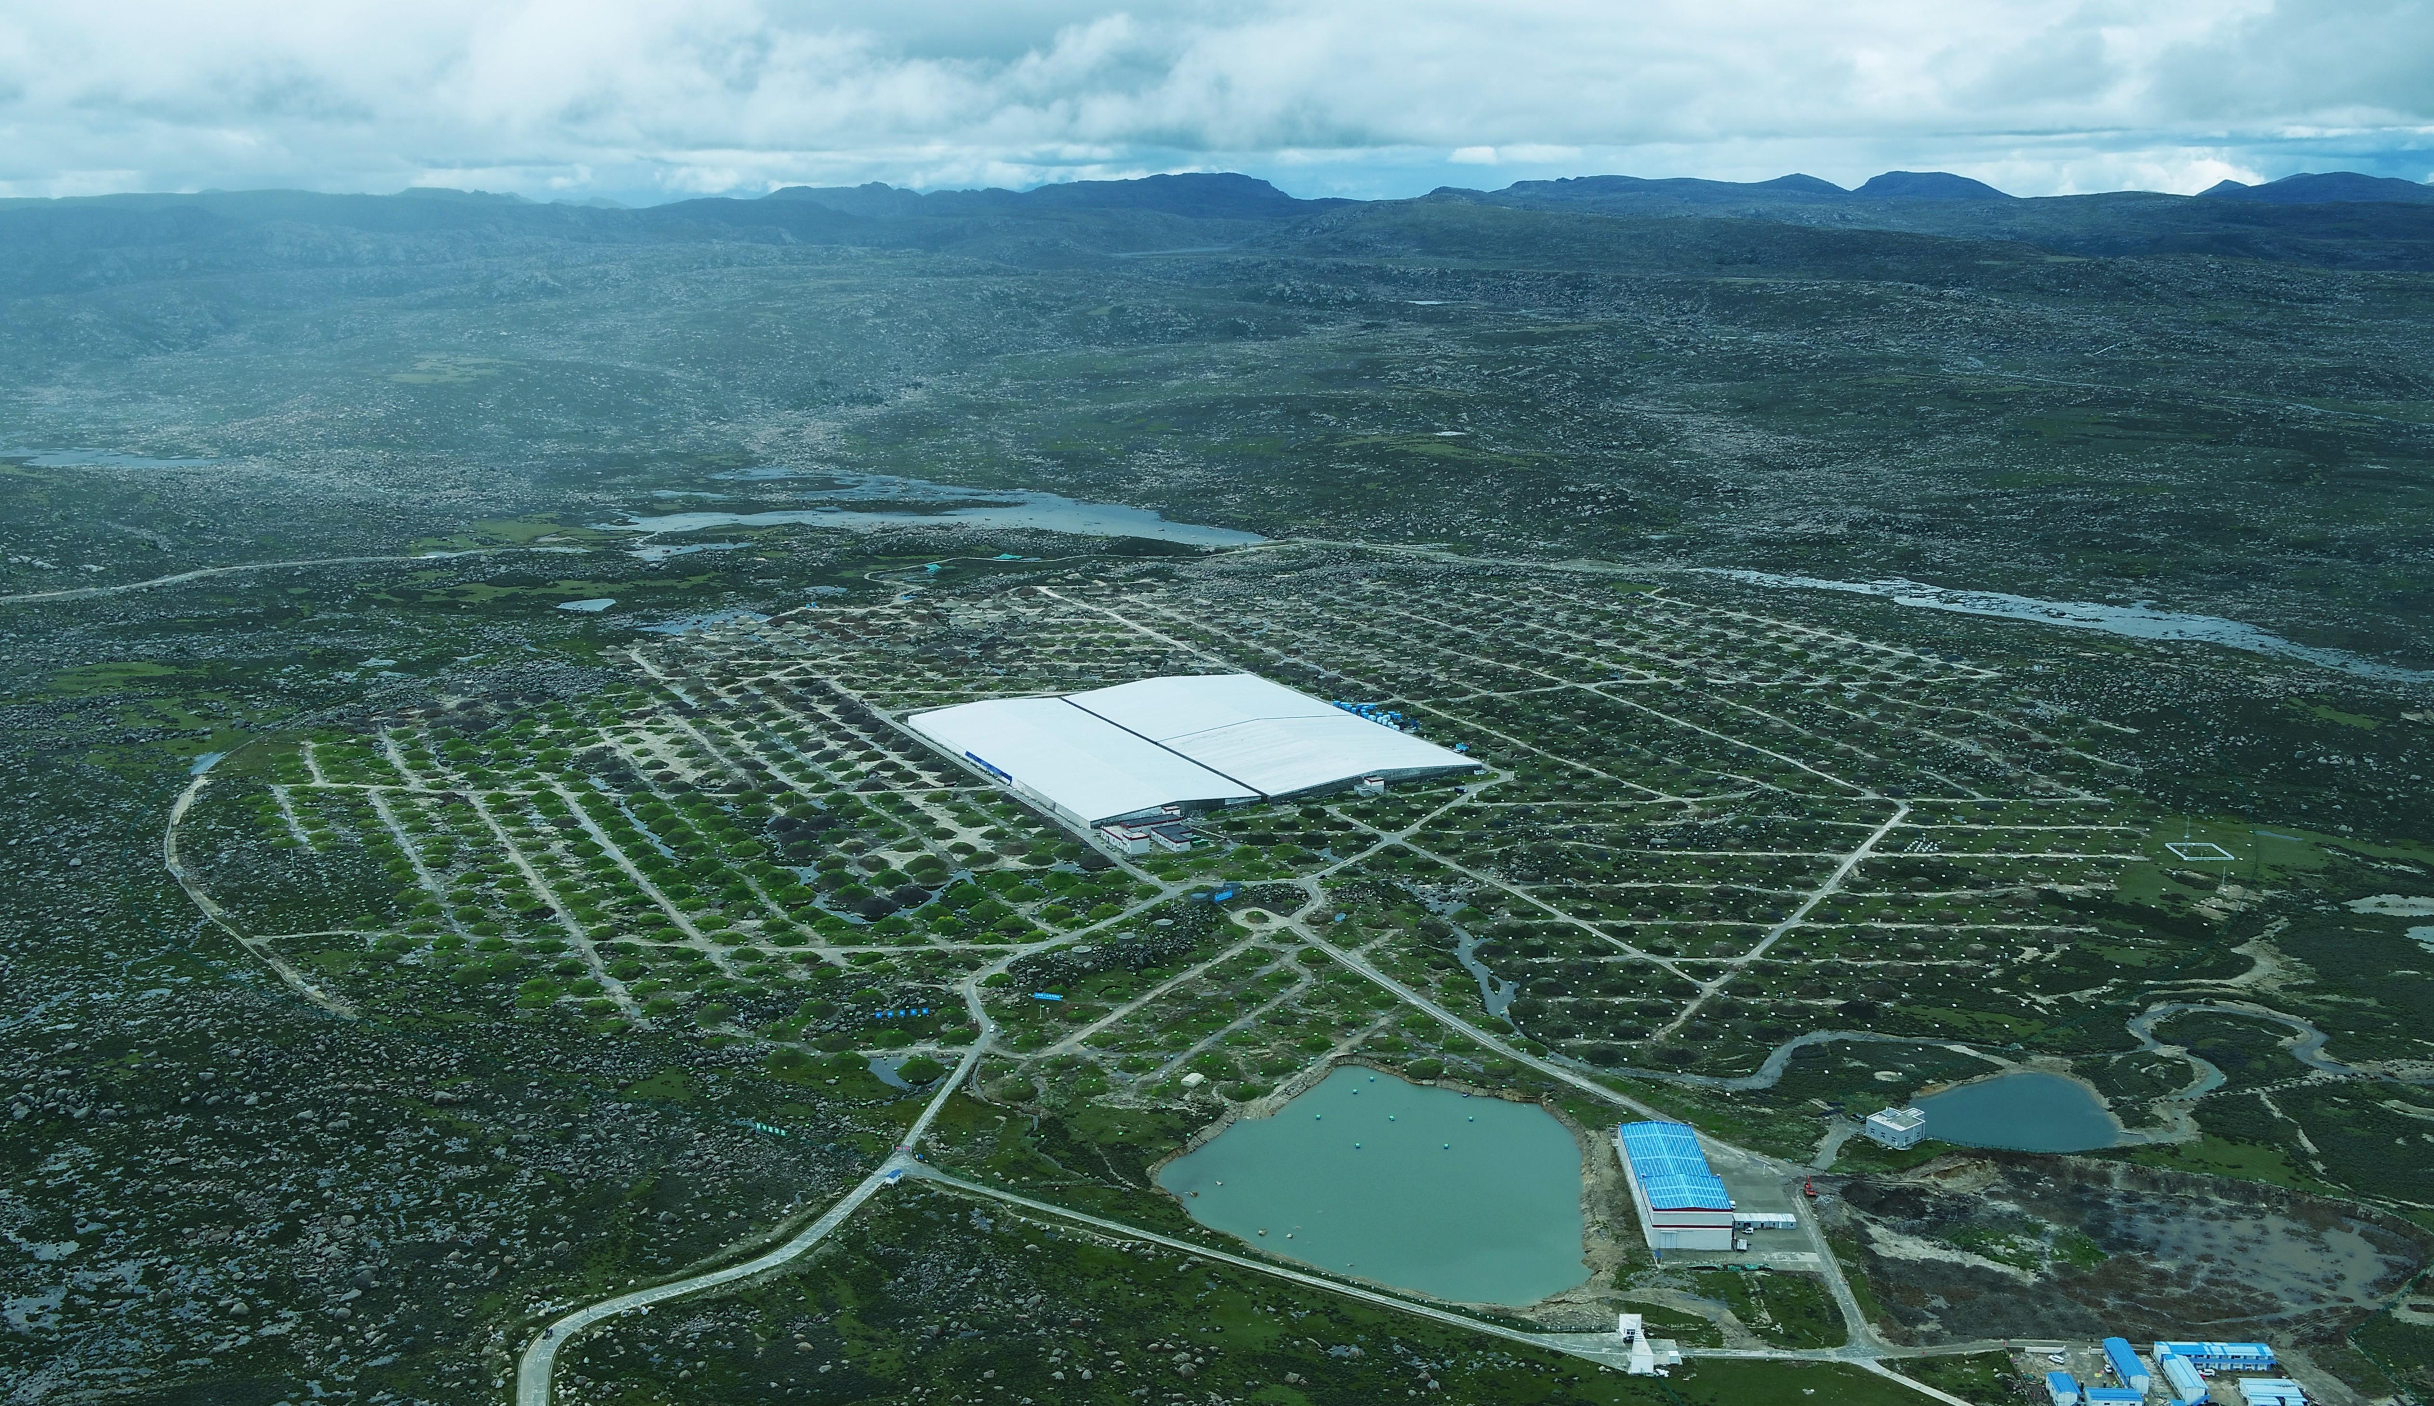
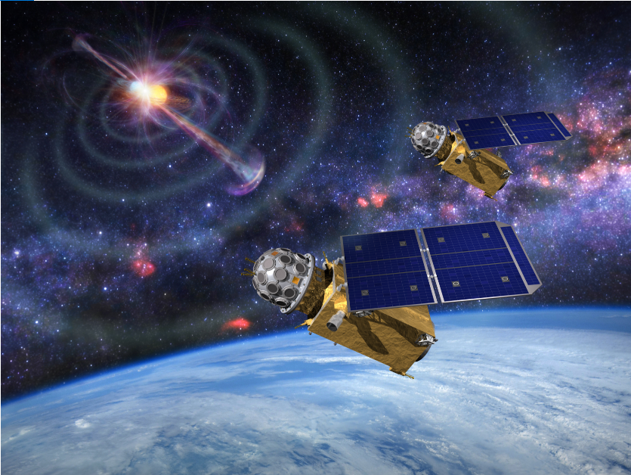
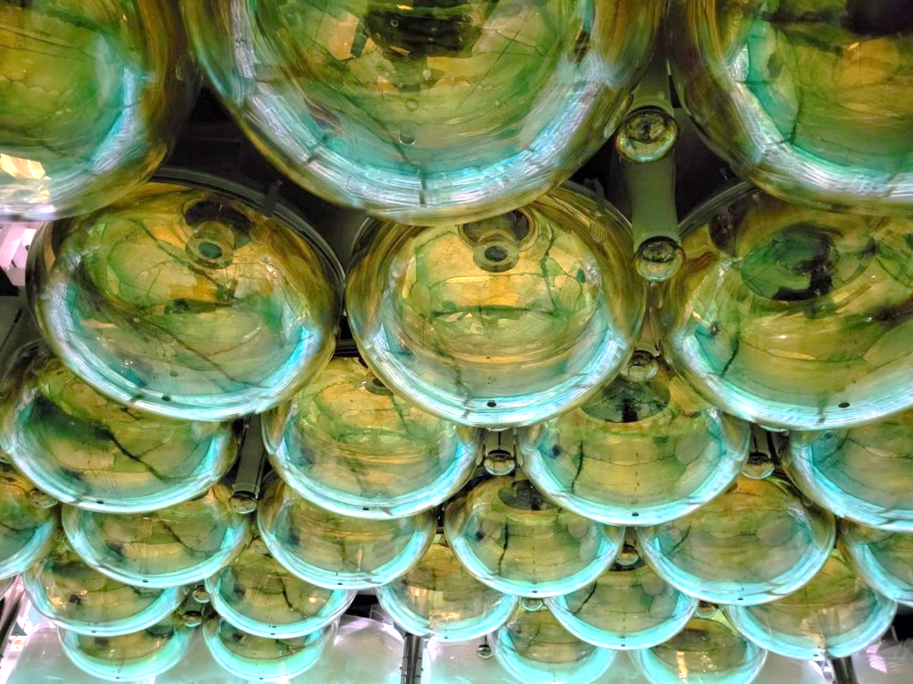
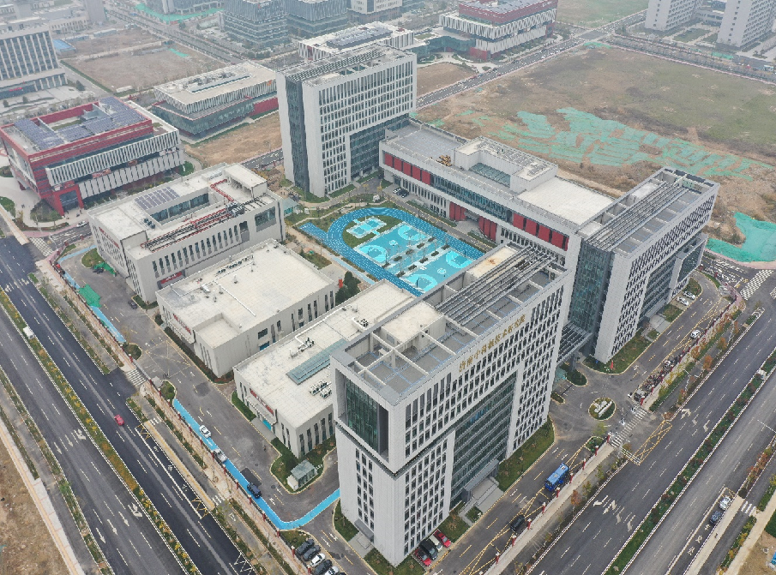
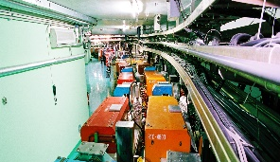
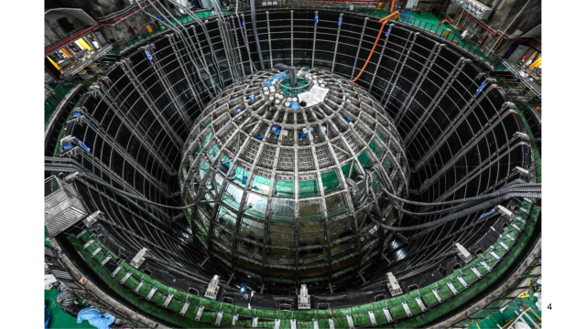
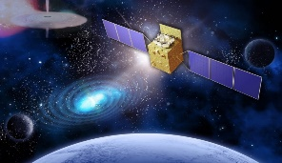
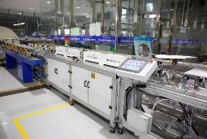
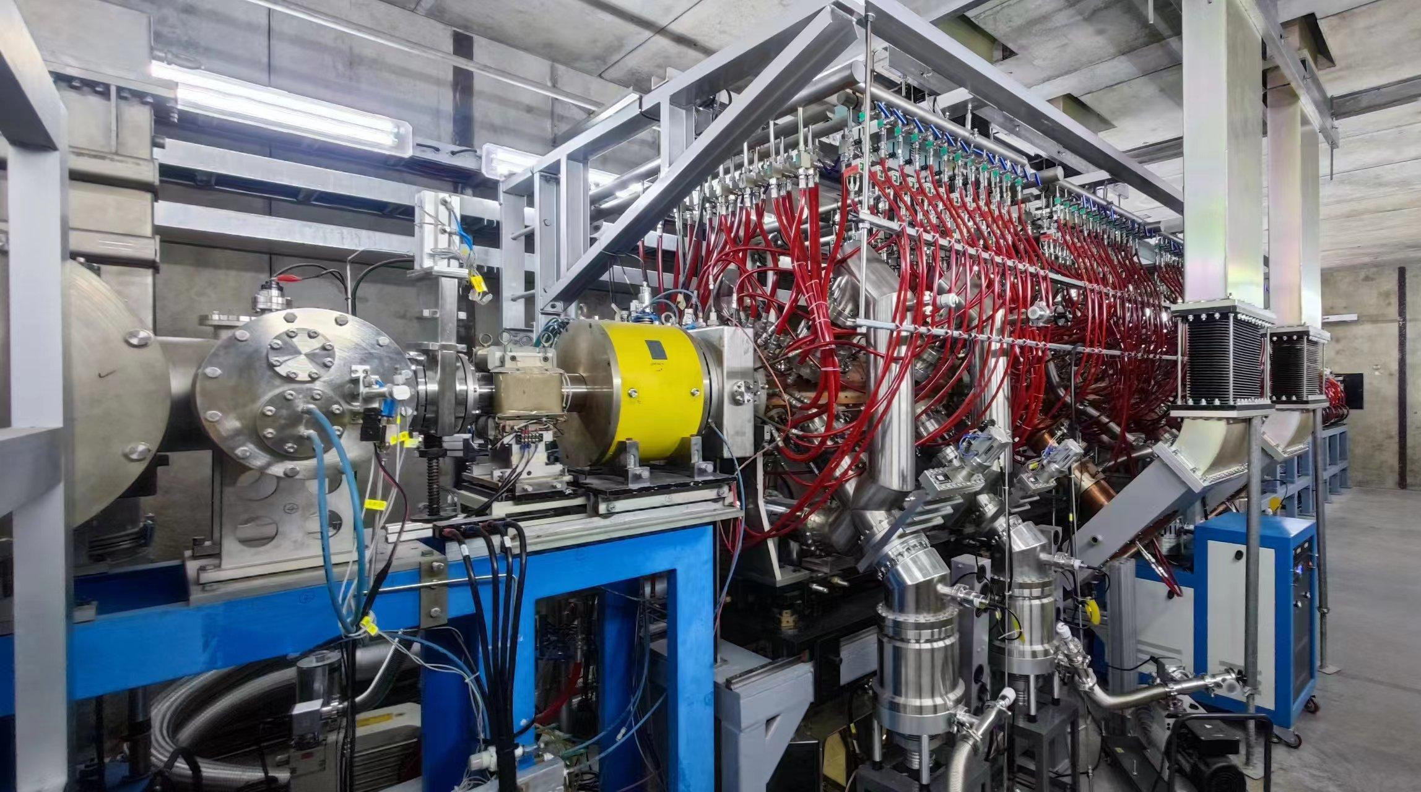
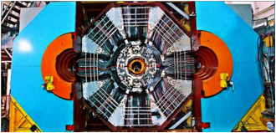
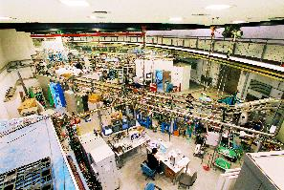
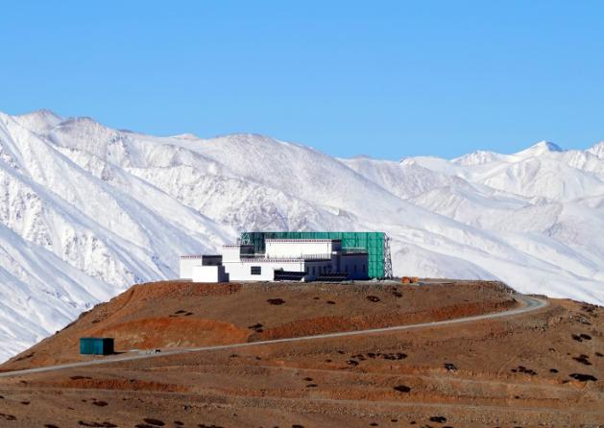
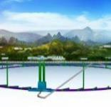
IHEP and its large scientific facilities
Yuhui Li
Institute of High Energy Physics,CAS
October 14, 2024

Slide 2
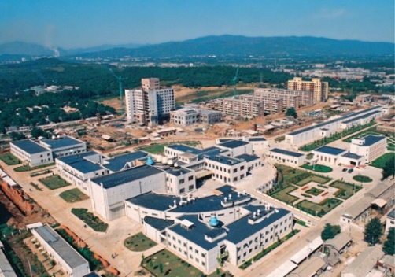
History
1950
1953
1958
1973
Institute of Modern Physics
Institute of Physics
Institute of Atomic Energy
Institute of High Energy Physics
The institute starts from the construction of Beijing Electron Position Collider (BEPC) in 80s, and now becomes a large research center
Multi-disciplinary research platforms
Frontiers of Basic Science
Strategic High-Tech
Particle Physics
Accelerator Physics
and Technologies
Radiation Technologies
and Applications
Accelerator-based HEP Experiments
Particle Astrophysics & Neutrino Experiments
Particle Detection and Electronics
Particle Physics Theory
High Luminosity Electron Accelerators
High Intensity Proton Accelerators
Applied Research and Technology Transfer
Synchrotron Radiation & Applications
Neutron Scattering & Applications
Nuclear Analytical Techniques & Applications
Basic research, Technological Research and Development,
Engineering Construction and Management
2

Slide 3
Organization
Experimental Physics Division
Particle Astrophysics Division
Accelerator Division
Multi-Disciplinary Research Division
Theoretical Physics Division
Computing Center
Division of Nuclear Technology and Applications
Research
Divisions
Science Committee
Directors’ Office
Office of Human Resources
Office of Research and Planning
Office of Finance and Assets
Office of Education
Office of Technology Transfer
Supporting Services
Directors
Administrative
Offices
Academic Degree Committee
Division of Facility Operation and Maintenance
Library and Information Services
Machine Shop
Office for Large Facilities
Technical Support Divisions
Branches
Dongguan Branch
Jinan Branch

Slide 4
Human Resources
Total number of permanent staffs has remained stable
Optimize the staff structure to develop a more competent innovative team

Slide 5
Human Resources
Permanent Staffs
~73.6% under 45 years old
31.1% Master’s degrees, and 53.6% doctorates
Age Group
Permanent Staff
Post-doc & Students

Slide 6
Education
A total of 628 (2019-2023) postgraduate degrees awarded: 501 PhDs, 127 Masters
Currently (2024), 439 PhD students (including 14 international students) [360 in 2017] and 307 [239] Masters students
Statistics of Master's and doctoral degrees
Destinations for IHEP postgraduates (2019-2023)

Slide 7
IHEP Funding
Total | 2018-2022 | 11717
 | 2013-2017 | 7434
2011-2023，Per capita funding income
58%
productivity

Slide 8
Scientific Output: Publications
Database | Papers | 2018 | 2019 | 2020 | 2021 | 2022
SCI- Indexed | All | 1193 | 1248 | 1250 | 1437 | 1487
EI-Indexed | All | 642 | 757 | 739 | 869 | 872
 | Duplicates removed | 105 | 138 | 67 | 58 | 119
ISTP- Indexed | All | 92 | 107 | 86 | 16 | 14
 | Duplicates removed | 28 | 28 | 28 | 13 | 5
Other full-text databases | All | 240 | 253 | 258 | 313 | 280
2018-2022 TOTAL | All | 1566 | 1667 | 1603 | 1821 | 1891
2013-2017 TOTAL | All | 1322 | 1470 | 1338 | 1519 | 1262
Total | 2018-2022 | 8548
 | 2013-2017 | 6911
User articles are not included in the statistics
ATLAS, etc, only IHEP contribution included
Five years: 23.7%

Slide 9
Technology Output：Patents
Patent applications: 923 [2013-2017: 322]
Patents granted: 610 [2013-2017: 230]
Numbers of patent applications and patents granted, 2018-2022.

Slide 10
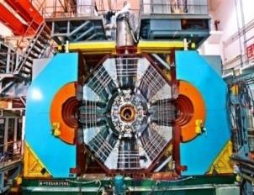
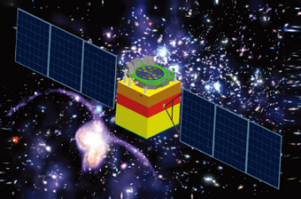
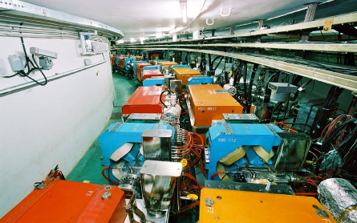
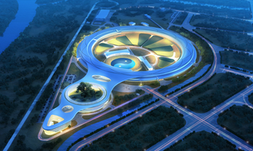
Research Field
Experimental Physics
Particle Astrophysics
Combine particle physics & astrophysics
e⁺e⁻ collider (BEPCII，CEPC)
Neutrino (Daya Bay, JUNO)
Higgs (LHC)
Detector technology
X-ray astro-physice in space (HXMT)
Cosmic-rays (LHAASO)
Space technology
Accelerator Physics & Tech.
Multi-Disciplinary Research
Design, construct & operates particle accelerators
Synchrotron radiation & cross-disciplinary study
Machine design Electron collider(BEPC,CEPC)
Spallation neutron sources(CSNS)
Light sources(HEPS)
Accelerator technology
Synchrotron radiation beams (BSRF,HEPS) and in-house research
Nuclear technology for trace analysis, Radiochemistry, etc.
X-ray technology
+
Theoretical Physics
Computing Tech.
Nuclear Technology and Applications

Slide 11

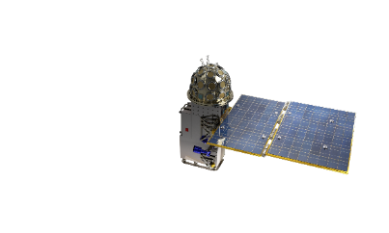
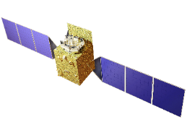
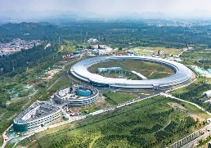
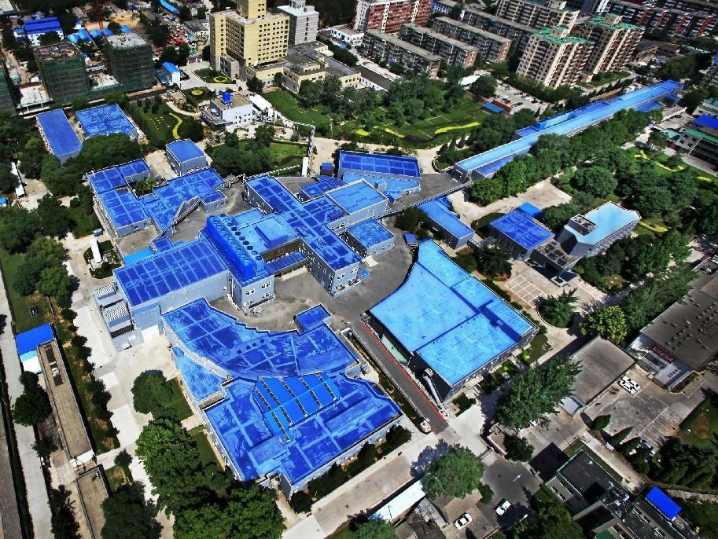
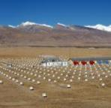
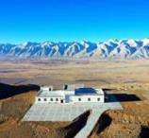
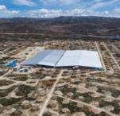
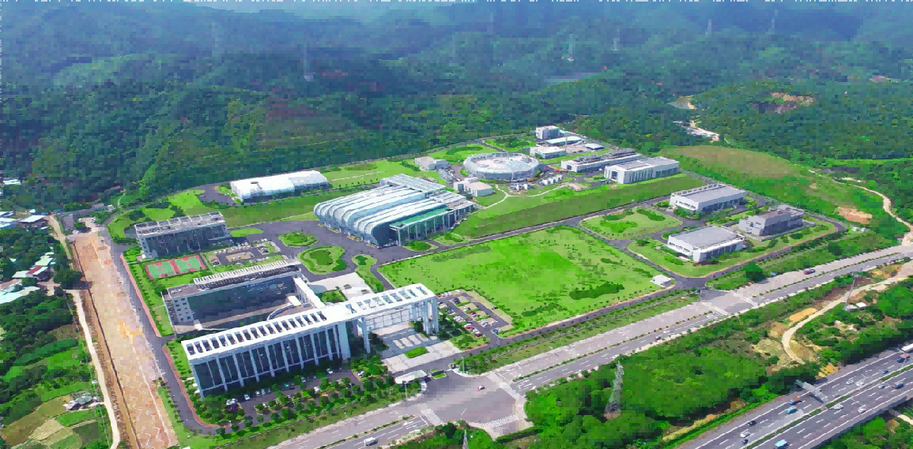
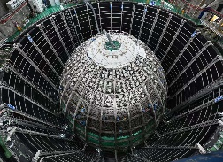
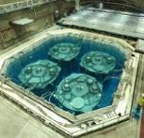
Large Science Facilities
Gravitational wave Electromagnetic Counterpart All-sky Monitor (GECAM)
Insight Hard X-ray Modulation Telescope (HXMT)
Huairou Campus
High Energy Photon Source (HEPS)
IHEP，Beijing Campus
Beijing Electron-Positron Collider (BEPC)
YBJ International Cosmic Ray Observatory (retirement)
Jinan Branch
Ali CMB Polarization Telescope (AliCPT-1)
Large High-Altitude Air Shower Observatory (LHAASO)
Jiangmen Underground Neutrino Observatory (JUNO)
Daya Bay Neutrino Experiment(Daya Bay)
(retirement)
Dongguan Branch
China Spallation Neutron Source (CSNS)

Slide 12


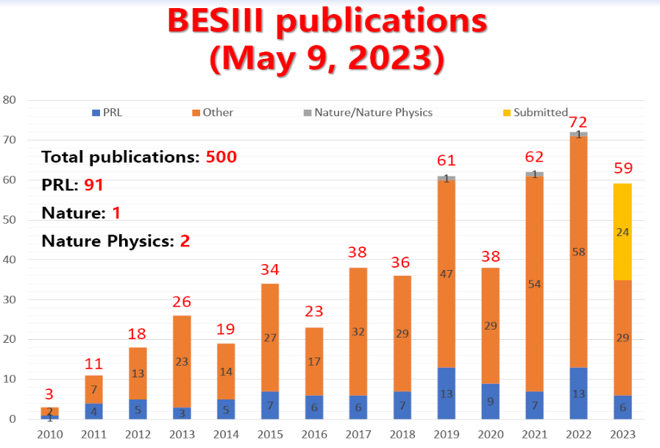
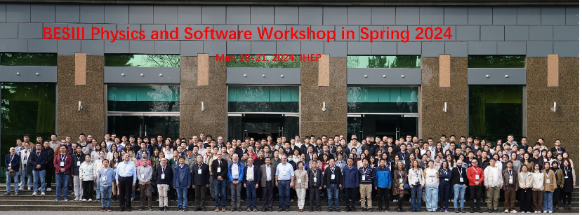
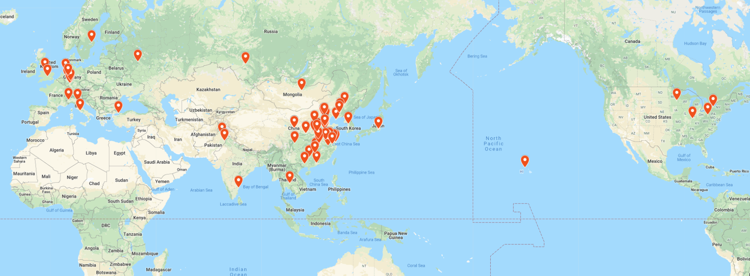
Beijing Electron-Positron Collider II
Beijing Spectrometer (BESIII) Experiment
For hadron physics and τ-charm physics with the highest accuracy
The peak luminosity of the double-ring e⁺e⁻ collider (BEPCII) is 10³³cm⁻²s⁻¹ at center-of-mass energy 3.78 GeV
BESIII International Collaboration
Country/region: 16；University/Institutions: 85; Collaborators: ~600
BESIII International Collaboration

Slide 13

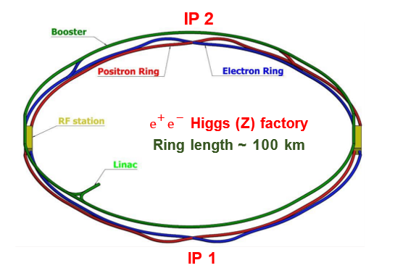
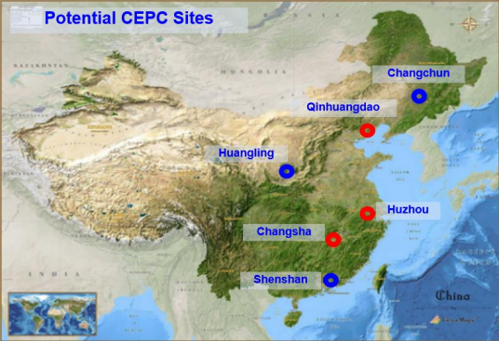
Circular Electron Positron Collider (CEPC)
CEPC is an e⁺e⁻ Higgs factory producing Higgs / W / Z bosons and top quarks, aims at discovering new physics beyond the Standard Model
Proposed in September 2012 right after the Higgs discovery
Upgrade: Super pp Collider (SppC) of S ~ 100 TeV in the future
IP 2
e⁺ e ⁻ Higgs (Z) factory
Ring length ~ 100 km
http://cepc.ihep.ac.cn
3

Slide 14
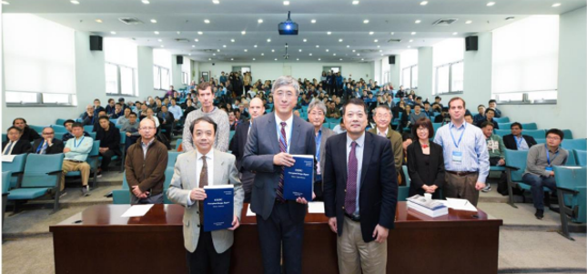
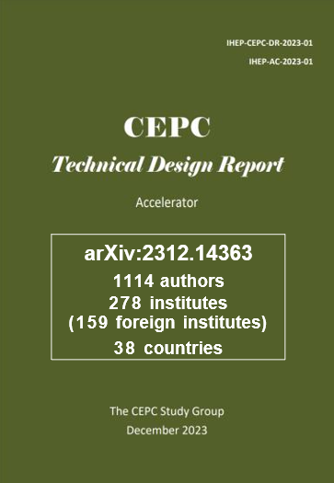
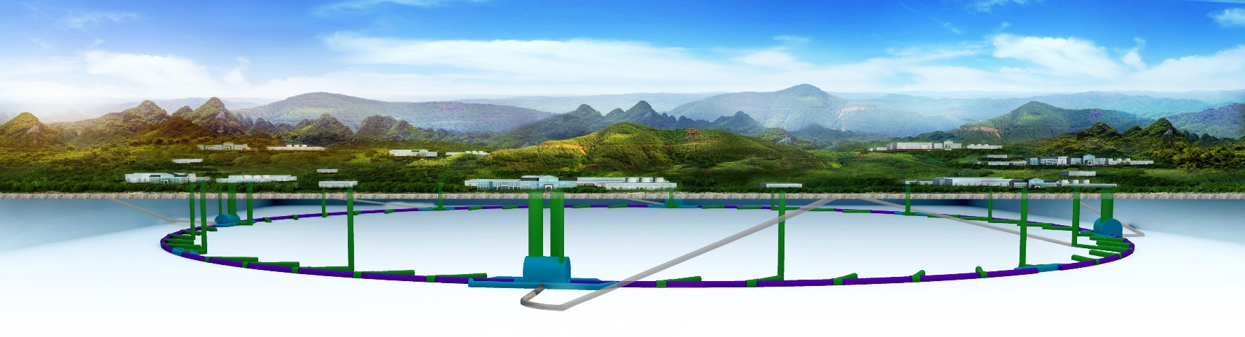
Circular Electron Positron Collider (CEPC)
2018 CEPC CDR released in November
2020: European Strategy for Particle Physics, “An electron-positron Higgs factory is the highest priority next collider.”
2022: ICFA “reconfirmed the international consensus on the importance of a Higgs factory as the highest priority for realizing the scientific goals of particle physics”
2023: US P5 Report stresses “US contribution in a specific higgs factory”
2023: CEPC Accelerator TDR released
http://cepc.ihep.ac.cn
3

Slide 15

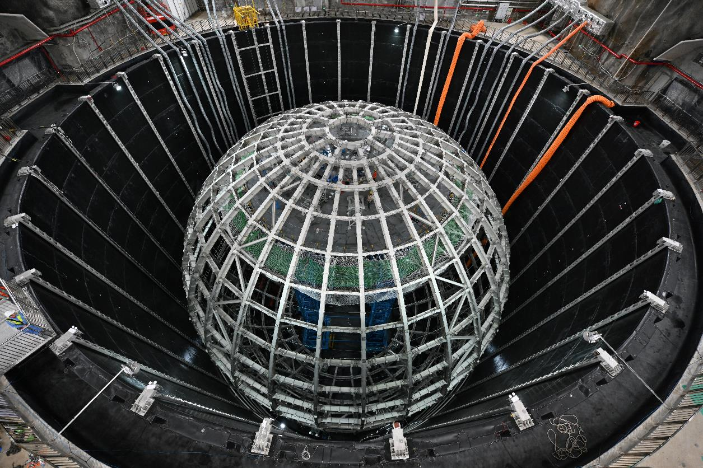
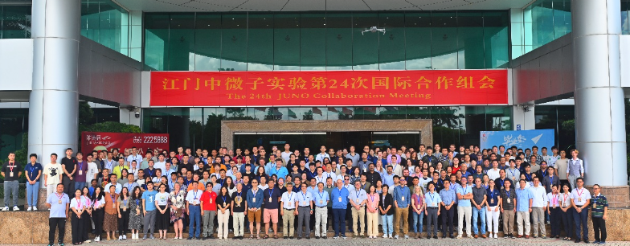
Jiangmen Underground Neutrino Observatory (JUNO)
A 20 kt liquid scintillator detector with unprecedented 3% energy resolution (at 1 MeV) under the 700-meter overburden
Science: To determine neutrino mass hierarchy and precisely measure oscillation parameters, observe supernova neutrinos, solar neutrinos，geoneutrinos，…
Construction will be completed in 2024
JUNO International Collaboration
Country/region: 17；University/Institutions: 75; Collaborators: 754
JUNO Experiment
24th JUNO Intl Collaboration meeting held from Jul. 1- 5, 2024

Slide 16

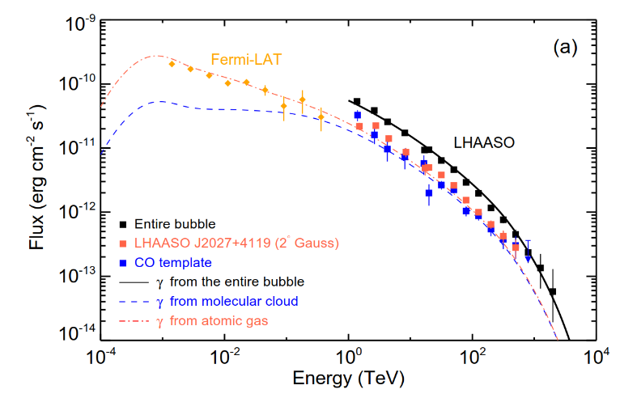
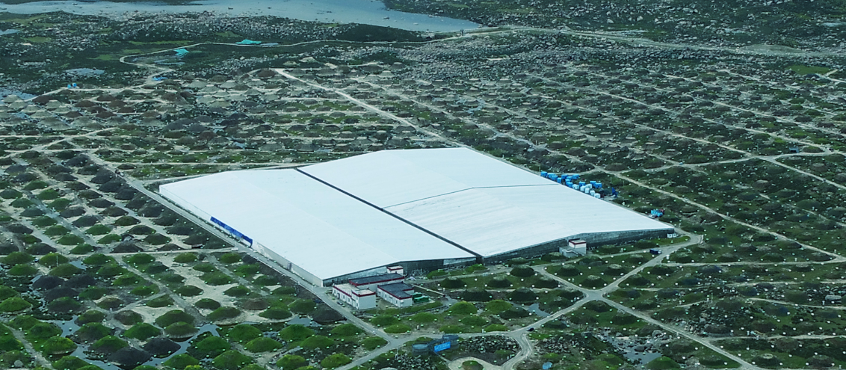
Large High Altitude Air Shower Observatory (LHAASO)
World largest air shower array (with e, m, water Č detectors and Č telescope) for the high energy γ-astronomy and cosmic-ray physics
Construction completed in 2023 and interesting results came out:
  Highest g-rays from the Milky Way： 2.5 PeV
  43 identified γ-ray sources up to ~1 PeV ➔ PeVatrons in the Milky Way
  Energy spectrum of high energy γ-rays from the Crab Nebula as the standard candle
International collaboration: countries/regions: 5, members: ~300

Slide 17
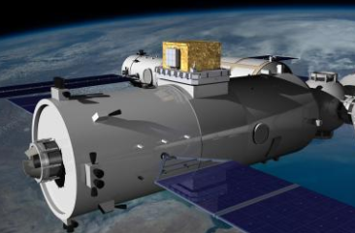
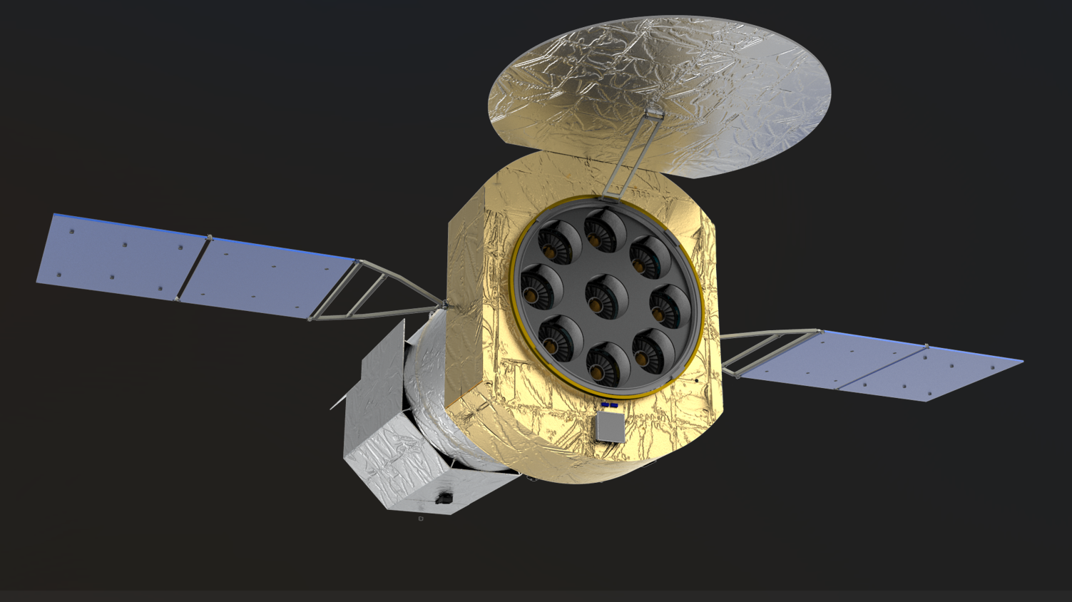
Space Programs
China Space Station: High Energy cosmic-Radiation Detector (HERD)
enhanced X-ray Timing and Polarimetry (eXTP) Observatory
  3D crystal calorimeter for dark matter searches and cosmic-rays
  Acceptance & energy range × 10
  Selected for the Chinese Space Station, to be launched in ~2027
  In collaboration with Italy, Sweden, Switzerland, …
the next generation telescope for“Enhanced X-ray Timing and Polarization Mission”
A leading flagship observatory for black holes, neutron stars and extreme physics, to be launched in ~2027
A large international collaboration with major German participation

Slide 18

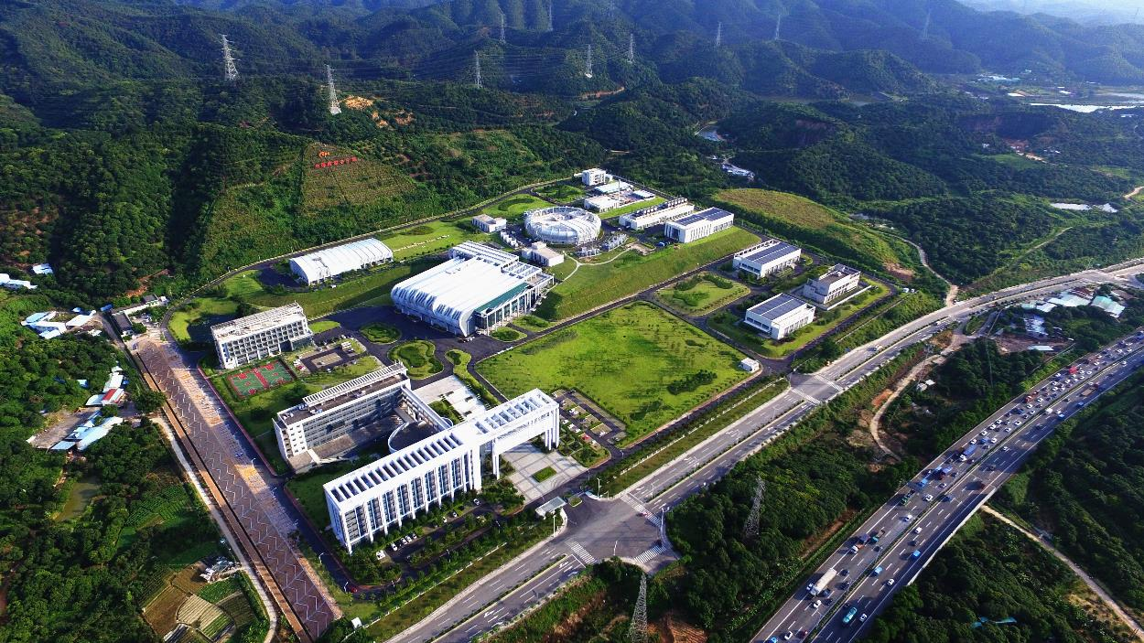
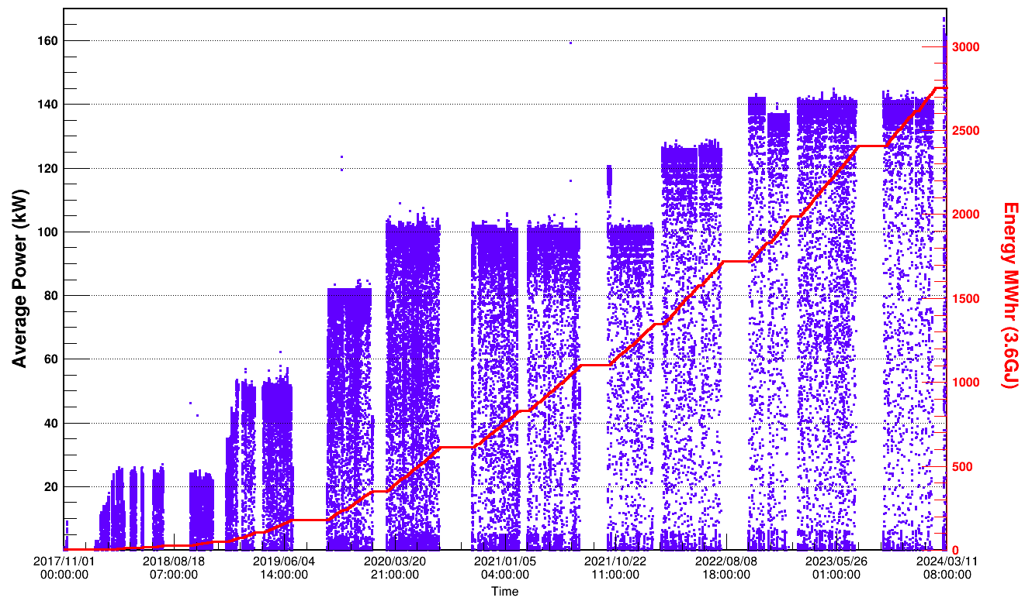
China Spallation Neutron Source (CSNS)
    Located in Dongguan, south of China
    Open to user since 2018 with an availability > 97%
    Power reached 160 kW, 60% higher than design
    11 neutron instruments, 3 of them under commissioning
    CSNS-II
    Beam power upgrade to 500kW
    Add 9 more neutron instruments
    Add a muon station, and a proton test beam station
    Construction started in Jan. 2024
Bird’s View
160kW
125kW
100kW
Beam power evolution

Slide 19
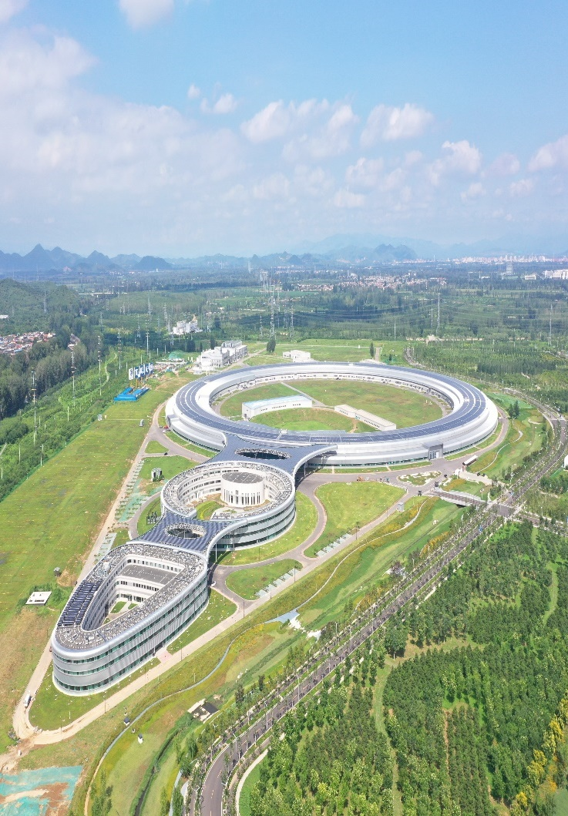

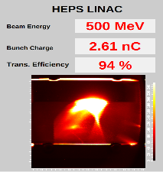
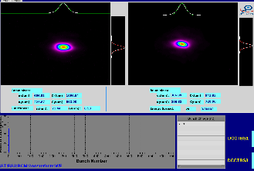
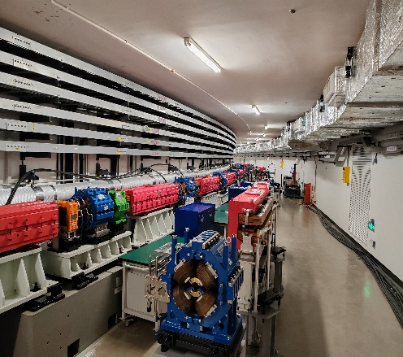



High Energy Photon Source (HEPS)
One of the BRIGHTEST fourth-generation SR facilities
in the world
HEPS will provide high brightness and high coherence photon beam with high energy up to 300 keV in 2025.
The first HIGH-ENERGY synchrotron radiation light source in China
July 2024
CC and UT
All buildings handover for installation.
LINAC
The first electron beam of HEPS was accelerated to 500 MeV with bunch charge >2.5 nC on Mar. 14, 2023.
Booster
The electron beam achieved a bunch charge of more than 5 nC at 6 GeV via the booster on Nov. 17, 2023.
Storage Ring
The electron beam with a current higher than 10mA was successfully stored on Aug. 18, 2024.
Beamline
Installation is underway.
14 user BLs will be installed in phase I and up to 90 BLs can be eventually accommodated.
Utilities installation almost completed.
>1×10²² Brightness
6GeV Beam energy
Construction started on June 29, 2019
LINAC
Booster
Storage Ring
Beamline

Slide 20







Accelerator key technology R&D platform
SRF R&D facility
Magnet R&D
Mechanical & alignment
Klystron Test
Beam test hall
SRF test hall
Vacuum assembly & coating
Magnet R&D
Vacuum R&D
Cryogenic System
  Accelerator key technology R&D platform was established:
  ➢ SRF cavity and module ➢ High efficiency klystron
  ➢ High-precision magnet ➢ Mechanics & alignment
  ➢ Vacuum assembly & coating ➢ Beam test facility
Beam test lab
Alignment
Klystron R&D

Slide 21





Technology transfer: products
Application accelerator
Nuclear medicine and molecular imaging
Precision testing
equipment
Radiation environment monitoring equipment
Silicon detector technology
Boron neutron capture therapy (BNCT)
Magnet-related Equipment
A series of industry irradiation accelerators
A series of superconducting cavities
Dedicated breast PET scanners
Micro SPECT/CT scanner
Micro PET/CT scanner
Multiple models of industrial CT equipment
X-ray three-dimensional micro-CT
High-energy industrial CT
Gamma-ray imaging device
High-speed passive enrichment detection device
Radiation environment monitoring vehicle platforms
Solid-state encoding cameras, channel encoding cameras
Buried gamma neutron detectors
2D X-ray silicon pixel detectors

Slide 22
Roadmap of IHEP
Daya Bay
JUNO
JUNO
Particle Physics
BEPCII/BESIII
CEPC
CEPC
SppC
Particle
Astrophysics
LHAASO
LHAASO
Operation
HXMT
HXMT
Construction
eXTP
eXTP
Future
HERD
HERD
AliCPT-1
AliCPT-1
AliCPT-2
Advanced
Technology
CSNS
CSNS
CSNSII and Future Upgrade
HEPS
HEPS and future beamlines
Future light sources, SAPS, FEL, etc.
2020
2030
2040
2050

Slide 23
Thank you for your attention
Looking forward to more collaborations

