Slide 1


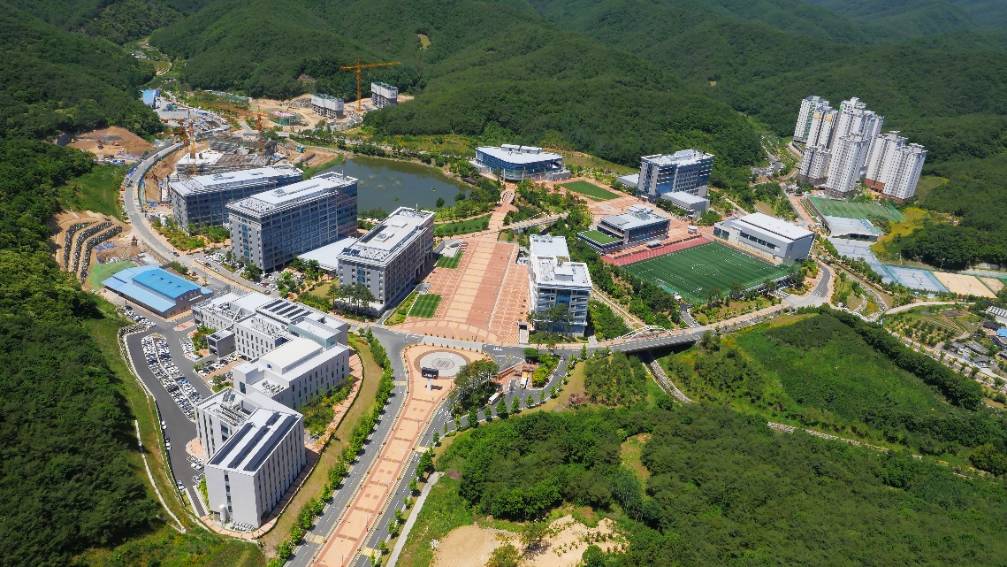

2024/07/11, 가속기여름학교, 고려대학교
Introduction to Synchrotron Small-angle X-ray Scattering
Tae Joo Shin
Graduate School of Semiconductor Materials and Devices Engineering, Ulsan National Institute of Science and Technology (UNIST)
tjshin@unist.ac.kr

Slide 2
Table of Contents
Introduction
SAXS beamline
Basics of Small-angle X-ray scattering
Structural Information obtained by SAXS
Applications
Conclusion

Slide 3
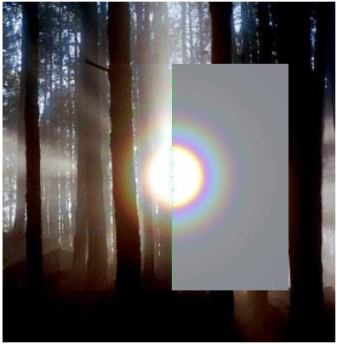
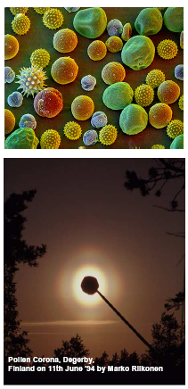
Scattering from Nature - Forest Corona, Pollen Corona
20-30 μm
13.5 μm diameter water droplets.
Photo by Till Credner and Sven Kohle

Slide 4
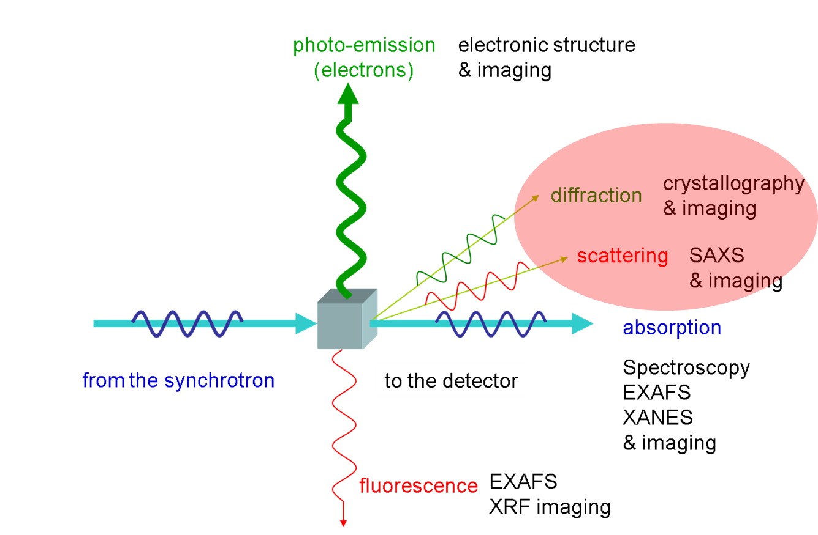
Photon (Synchrotron Radiation) interaction with matter

Slide 5
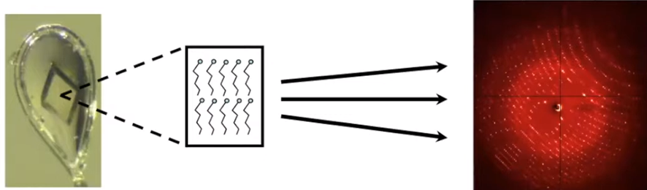
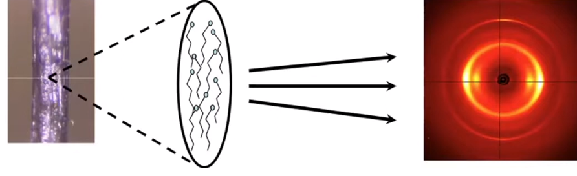
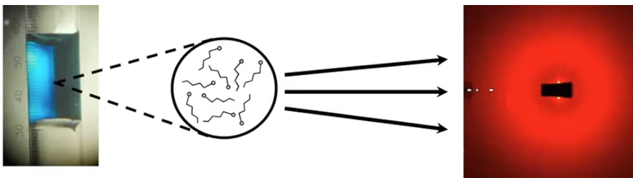
X-ray scattering/diffraction
Crystal
X-ray
Fiber
X-ray
Solution
X-ray

Slide 6
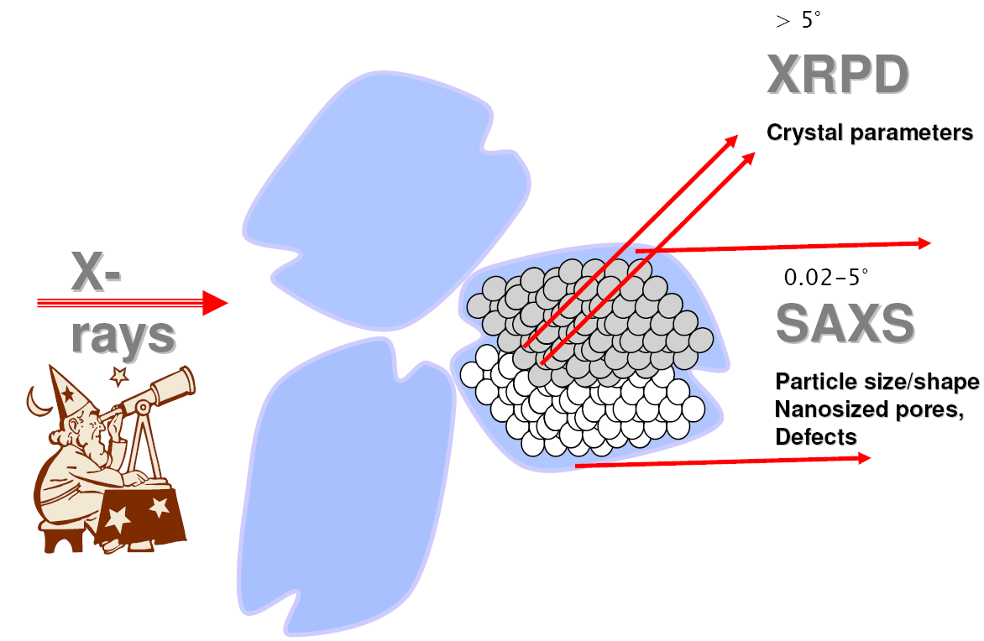
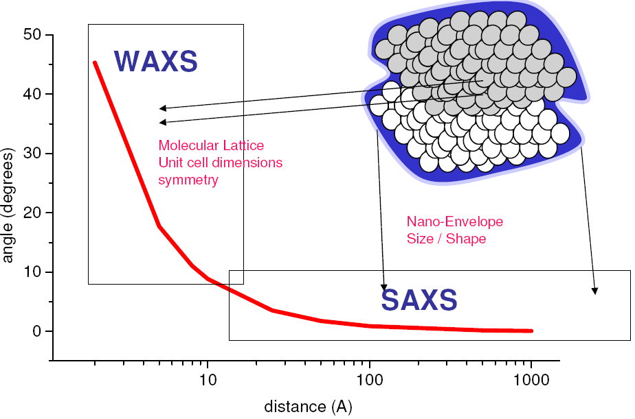
Small-/wide-angle X-ray scattering ?
WAXD
SAXS is the universal method for nanostructure analysis
• Sensitive – low concentration (down to 0.1%)
• Noninvasive – no preparation, staining or drying
• In-situ, real-time capabilities
• Extremely versatile (solids, liquids, gas phase)
→ Structural information from the scattering patterns?
WAXD
Crystalline sample / homogeneous structure --> Small-angle X-ray diffraction (SAXD)
Solution sample / inhomogeneous structure --> Small-angle X-ray Scattering (SAXS)
Notes:
6

Slide 7
Electron Microscopy vs. X-ray Scattering
Electron
Microscopy
Small details are visible
X-ray
Scattering
Small details are NOT visible
Average over large samples are hard to obtain
The results are UNIQUE but NOT representative
Preparation artifacts are inherent
Average over the whole sample is always obtained
The results are REPRESENTATIVE but AMBIGOUS
NO preparation artifacts (in vitro experiments)
→ In order to get the complete picture you need both!

Slide 8
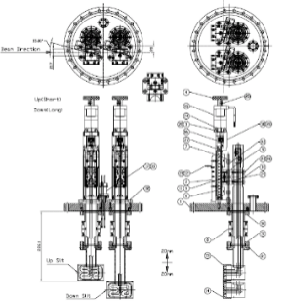
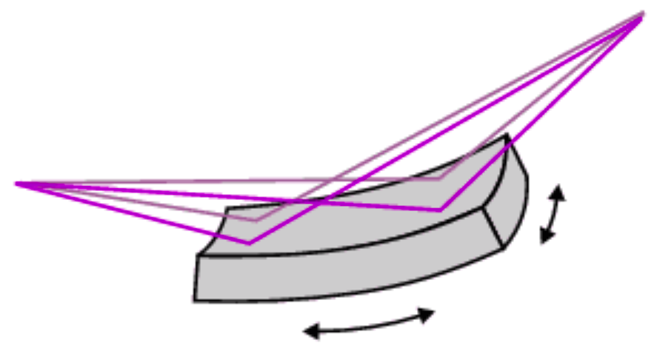

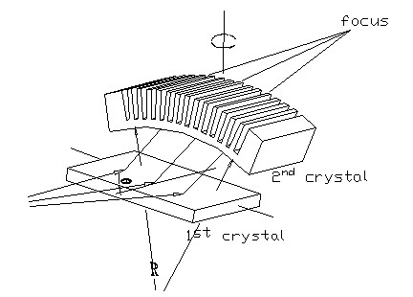

SAXS Beamline : ex) 6D UNIST-PAL Beamline
BM source
0 m
CM
13 m
DCM
19.5 m
FM
24 m
Sample
36 m
Hor. : 2 mrad
Beam size [mm] 26 39
100 μm
$$ψ=\frac{1}{γ}≈\frac{mc^{2}}{E}≈\frac{0.511\left(MeV\right)}{3\left(GeV\right)}≈0.17 (mrad)$$
Ver. : 0.17 mrad
Beam size [mm] 4.42 4.6
100 μm
2:1 focusing
Experimental Hutch
Rh(5nm)/Pt(30nm)
Wall
Optics Hutch
4 mrad (≈0.229º)
Vacuum path
(1)
(2)
(3)
Slit
FM
Slit
Hutch Slit
Sample
DCM
Fixed mask
Photon
shutter
FE slit
Safety shutter
WB slit
Hutch
Shutter
(5)
Aperture pinhole
CCD detector
1,400 mm
CM (L = 1.2 m)
Bending Magnet
4 mrad (≈0.229º)
Rh(5nm)/Pt(30nm)
R = 6.8755 m
B = 1.4557 T
(4)
R(m) ≈ 3.34E(GeV)/B(T)
E_{c}(keV) ≈ 2.218E³(GeV)/R(m) ≈ 8.7 keV
Si(111) DCM
Fixed exit
Sagittal focusing

Slide 9
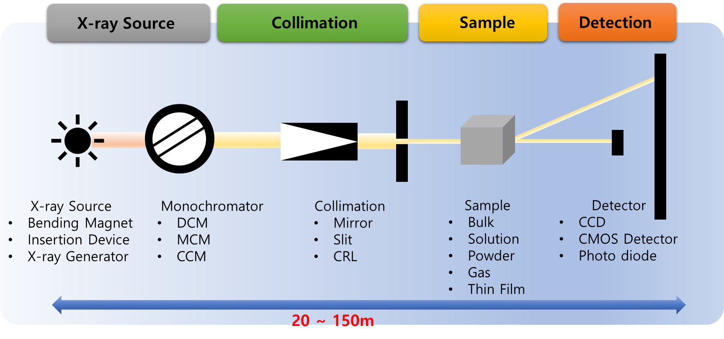
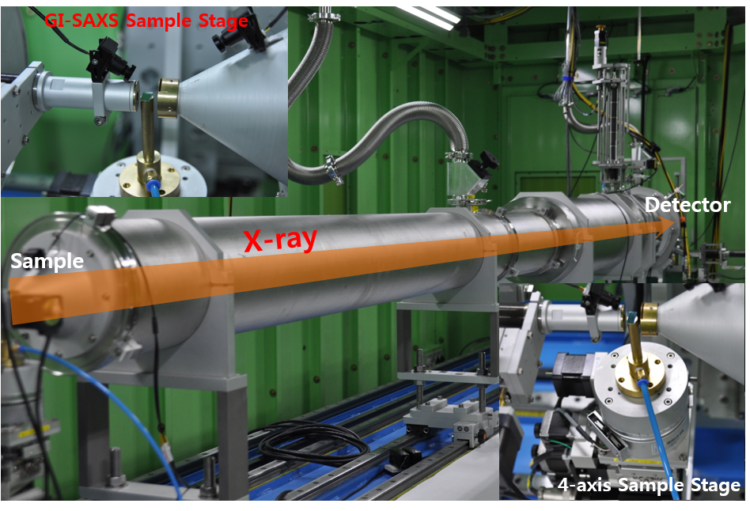
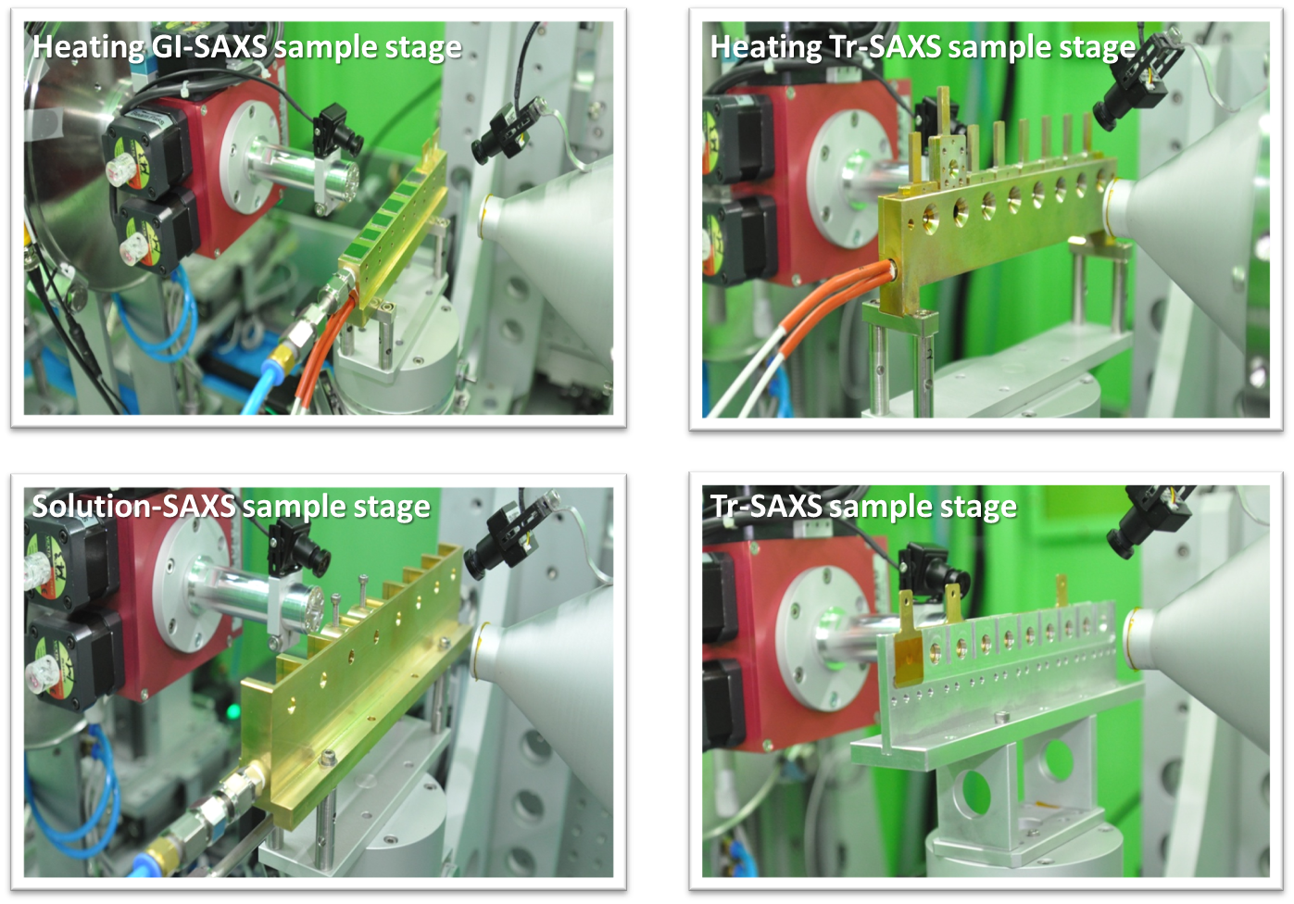
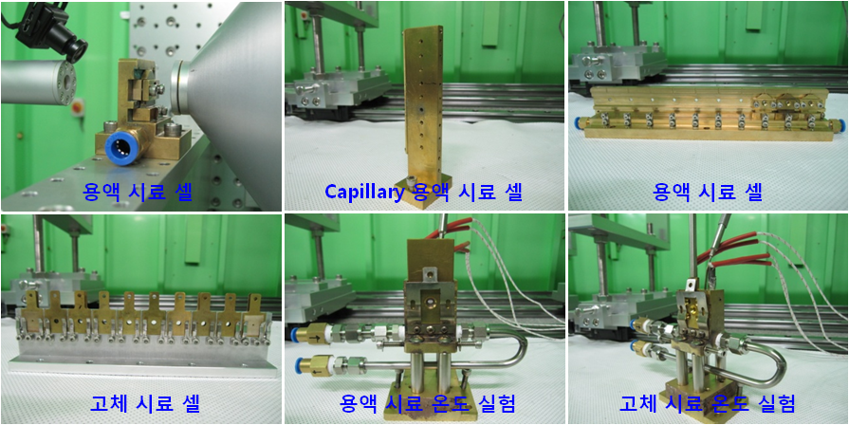
SAXS Beamline : instruments, sample stages
Schematic
Hutch
Sample cells
Sample cells
solution sample cell
capillary sample cell
solution sample cell
solid sample cell
solution sample cell
solid sample cell

Slide 10
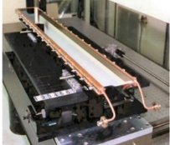
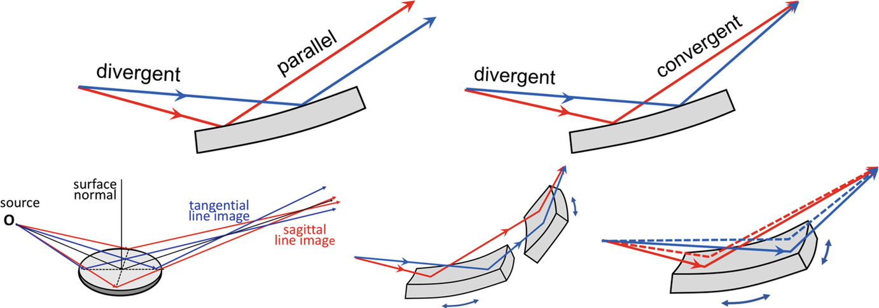
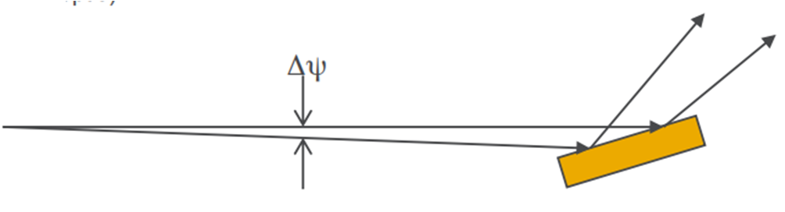
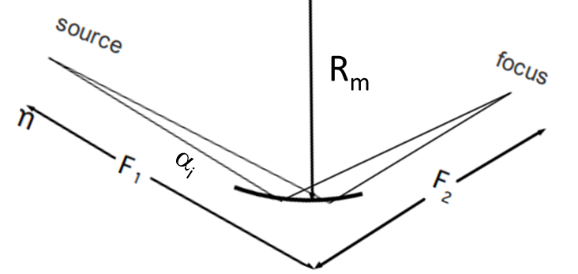
Beamline Optics : Mirror
Collimating flat mirror
Darwin width
ω_{D} = 2r_{e}F(hkl)λ²/πVsin(2θ)
F(hkl) = structure factor
V = volume of unit cell
0.17 mrad
3.0 GeV
Δθ = [Δψ² + ω_{D}²]^{1/2}
170 μrad
L = 1.2 m-long Si crystal with Rh(5 nm)/Pt(30 nm) coating
ex) Si(111) crystal @8 keV --> ω_{D} ≈ 40 μrad
Focusing mirror: Two-dimensional focusing (toroids and ellipsoids)
R_{s}
: sagittal radius
Focal length: f = [R_{m} sin α_{i}]/2
R_{m}
Lens formula: 1/f = 1/F₁ + 1/F₂
R_{s} = R_{m} sin²α_{i}
→ R_{m} = [2/sin α_{i}] [F₁·F₂/(F₁ + F₂)]
Ex) α_{i} = 4 mrad and R_{m} = 8 km
→ R_{s} = 48 mm
Ex) α_{i} = 4 mrad, F₁ = 24 m, F₂ = 12 m, then R_{m} ≈ 8 km

Slide 11
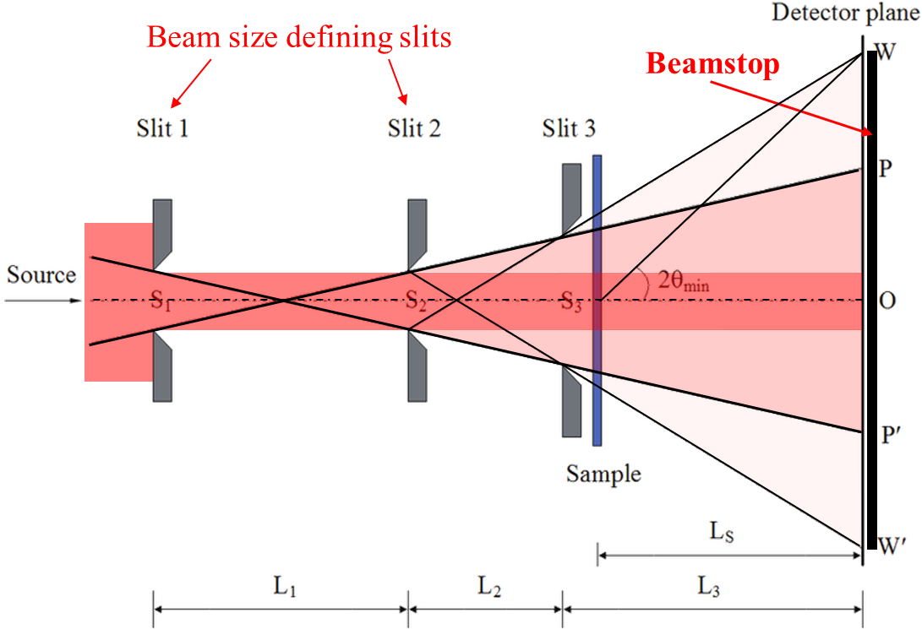





Beamline Components : 3-Slits collimation geometry
3-Slits collimation --> Minimal parasitic scattering
Relation between the apertures and the distances among the three slits
Direct beam size (@detector)
Total beam size including the “diagonal parasitic scattering” contribution (@detector)
Smallest angle free from parasitic scattering
SAXS spatial resolution (maximum dimension resolvable in real space)
Journal of X-Ray Science and Technology 20 (2012) 331–338

Slide 12
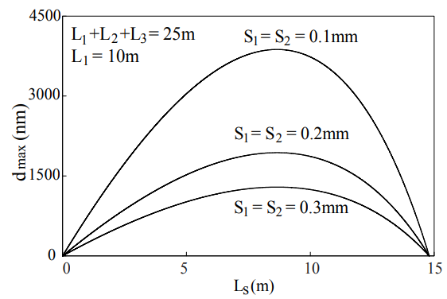
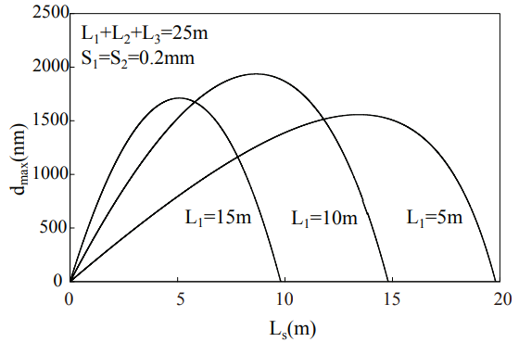
Beamline Components : 3-Slits collimation geometry
3-Slits collimation --> Minimal parasitic scattering
Journal of X-Ray Science and Technology 20 (2012) 331–338

Slide 13
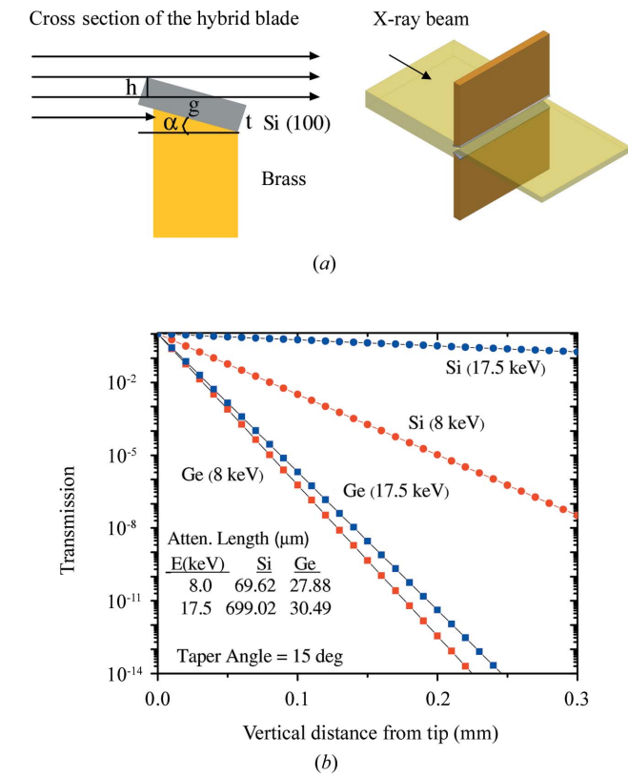
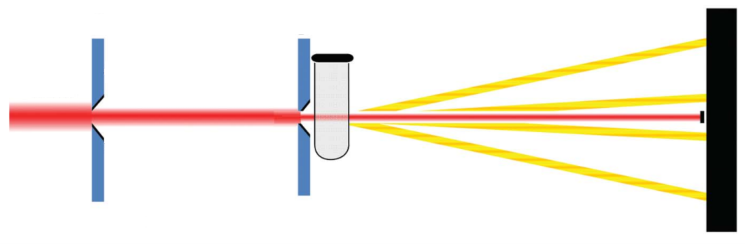
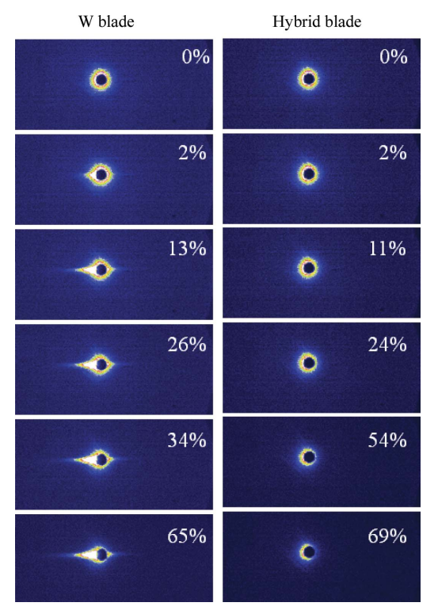
Beamline Components : 2-Slits collimation geometry
2-Slits collimation W/ hybrid blade
J. Appl. Cryst. (2008) 41, 1134–1139

Slide 14
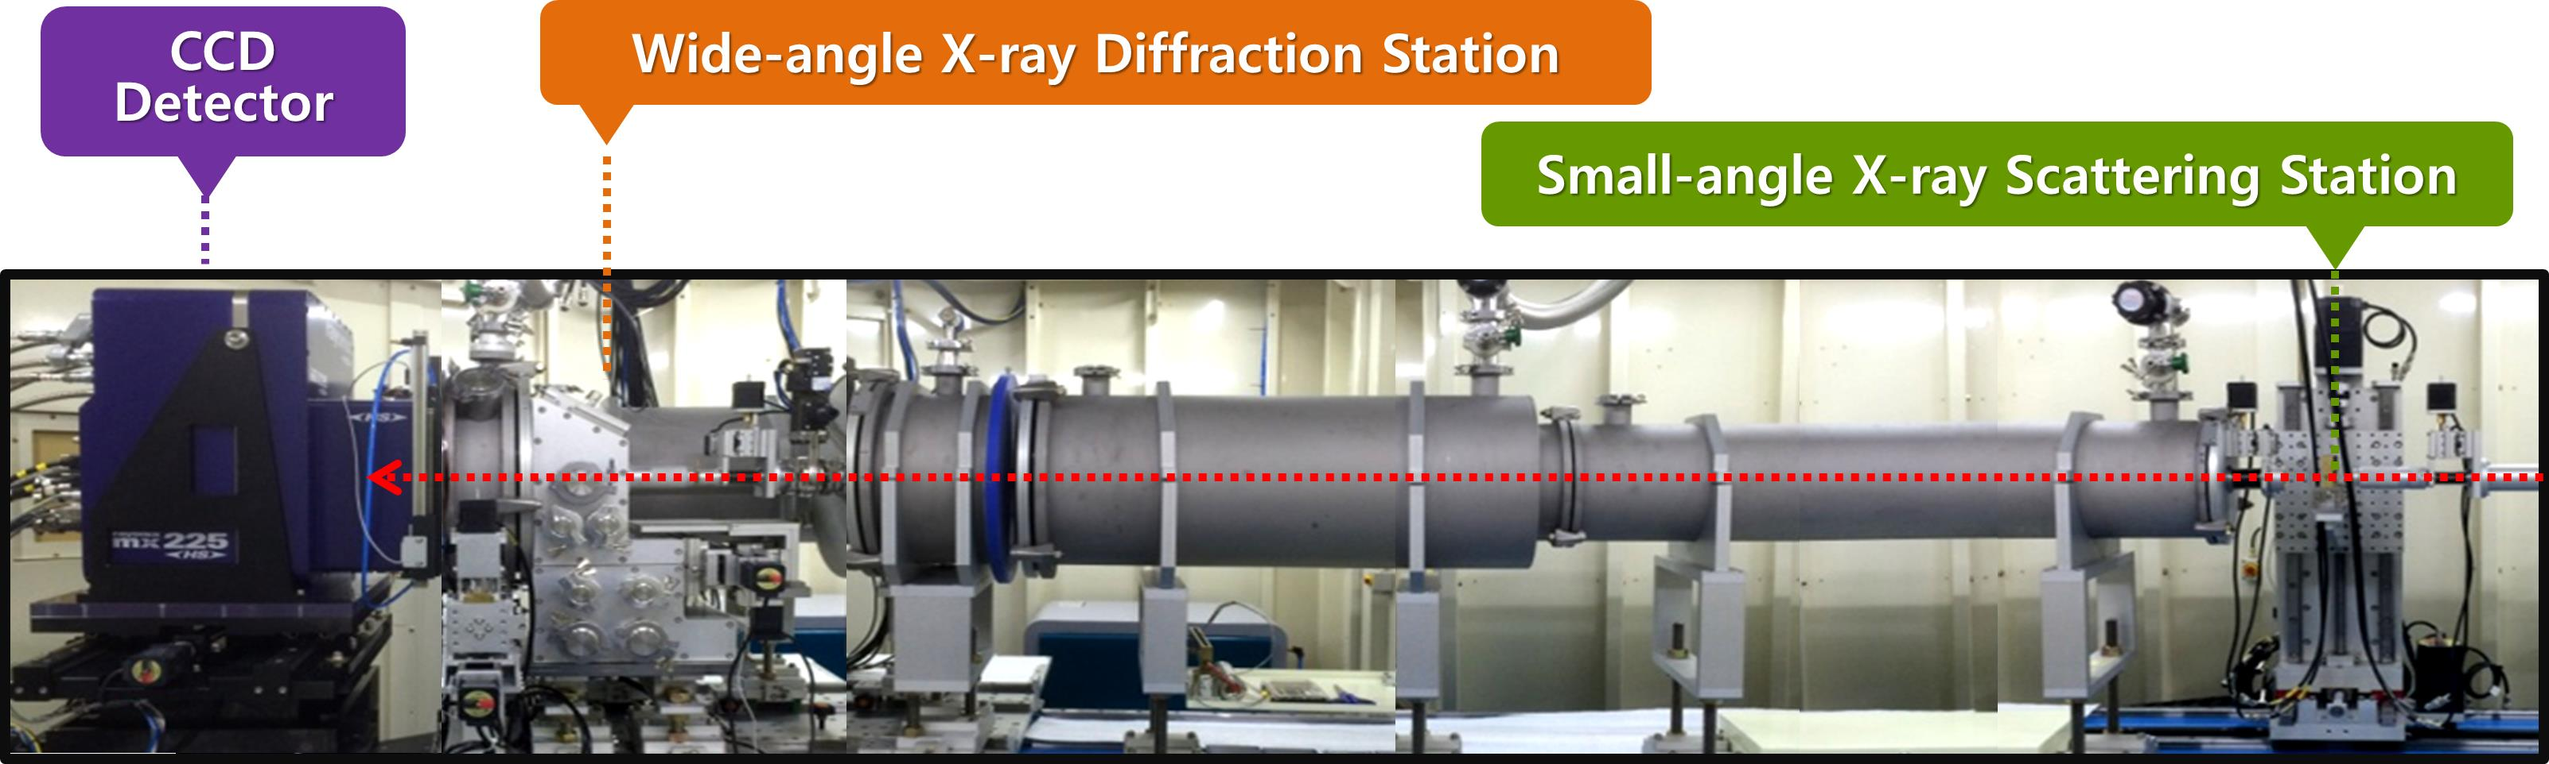
SAXS & WAXD Geometry
X-ray
6D UNIST-PAL beamline
WAXD
(2θ = 0.8º ~ 30º)
nλ = 2d· sinθ
SAXS
2D Detector
X-ray
sample
sample
2θ = 0.02º ~ 4º
> 0.5 m
Beamstop
with a photodiode

Slide 15
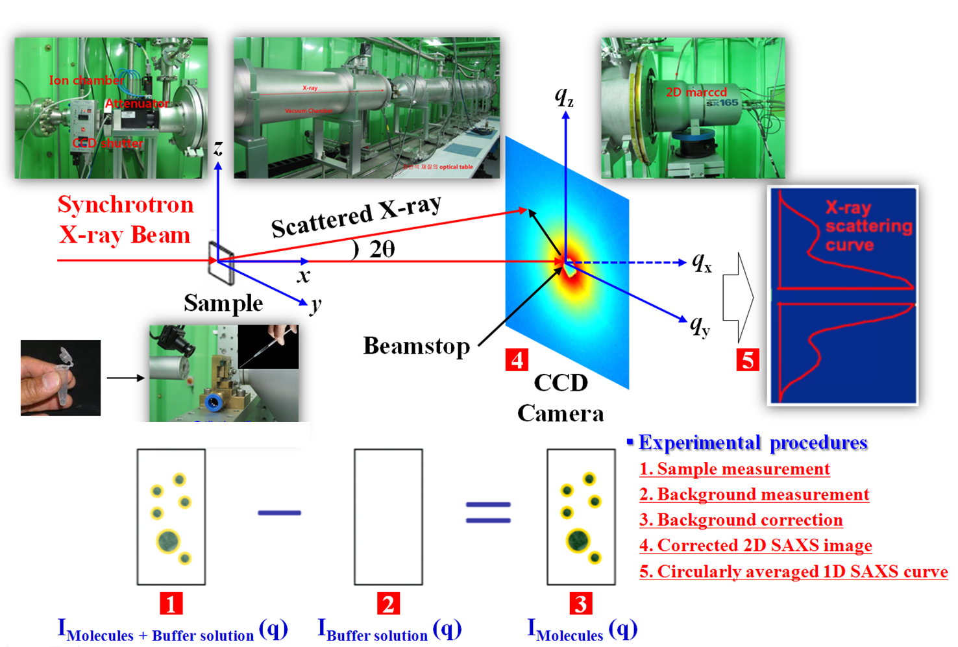
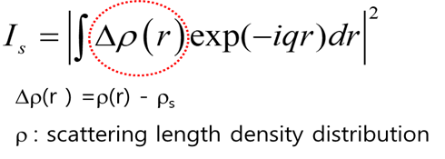
Solution Small-angle X-ray scattering (Sol-SAXS) ?

Slide 16
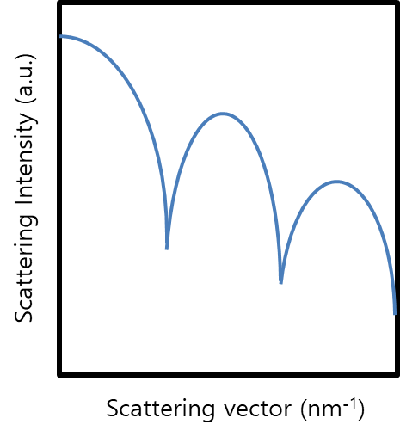
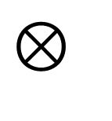

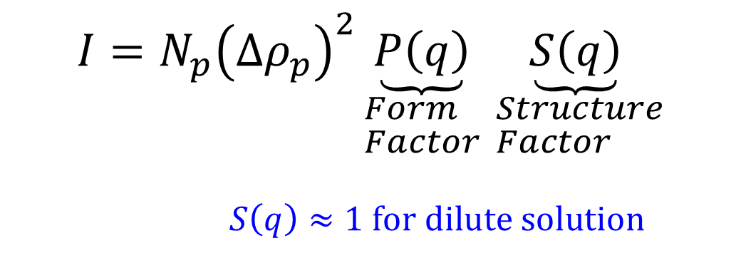
Solution Small-angle X-ray scattering (Sol-SAXS) ?
$$=$$
$$⊗$$
$$I=N_{p}{\left(Δρ_{p}\right)}^{2}\underset{\begin{aligned}&Form \\ &Factor\end{aligned}}{\underbrace{P\left(q\right)}}\underset{\begin{aligned}& Structure \\ & Factor\end{aligned}}{\underbrace{S\left(q\right)}}$$
$$S\left(q\right)≈1 \text{for} \text{dilute} \text{solution}$$

Slide 17
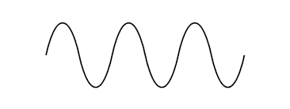



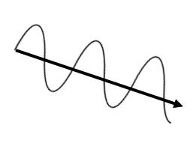



Scattering by X-ray?
Elastic Scattering
λ₁
λ₁
λ₂
-
-
-
-
-
+
-
E = hc/λ₁
λ₁=λ₂
Interference of Waves
Constructive interference
Destructive interference

Slide 18
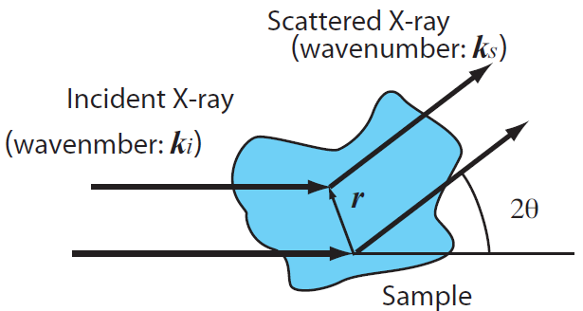
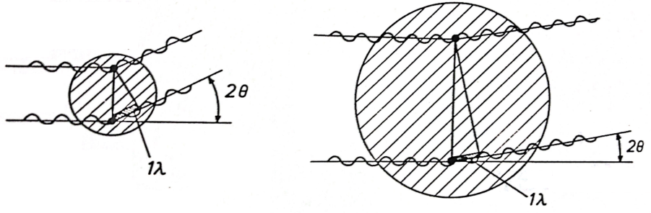
Scattering by X-ray : interference of secondary waves
Small distance between electrons
→ scattering at large angle is intensified
Large distance between electrons
scattering at small angle is intensified

Slide 19
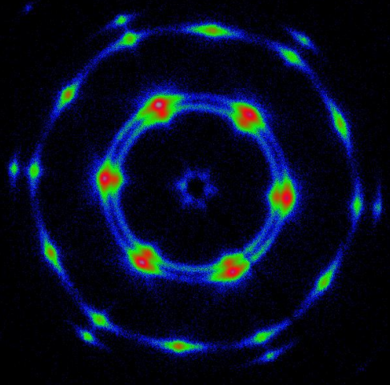
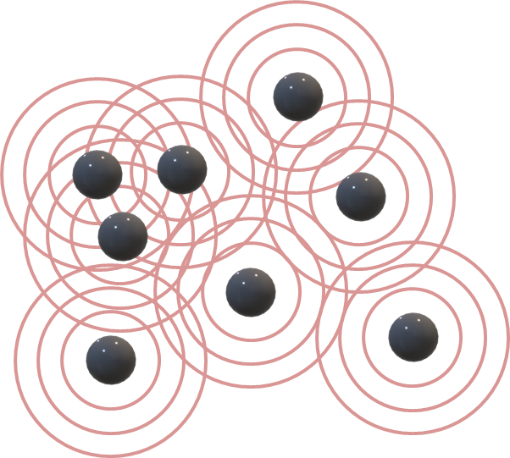




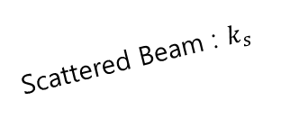



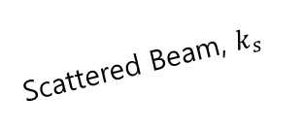
Scattering by X-ray : interference of secondary waves
Interference of Waves
Scattered Beam, $k_{s}$
λ
Incident Beam,
$$k_{i}$$
2θ
Scattering vector
Incident Beam : $\left|k_{i}\right|=\frac{2π}{λ}$
Scattered Beam : $k_{s}$
λ
$$k_{i}$$
q
2θ
$$k_{i}$$
Incident Beam :
- Scattering vector : $q= \frac{4π}{λ}\sin{θ,}$
Domain spacing : $d = \frac{2π}{q}$
- Amplitude of scattered X-ray :
$$A(\vec{q})=\int{Δρ(\vec{r})e^{−i\vec{r}⋅\vec{q}}d\vec{r}}$$
(FT of electron density distribution)

Slide 20
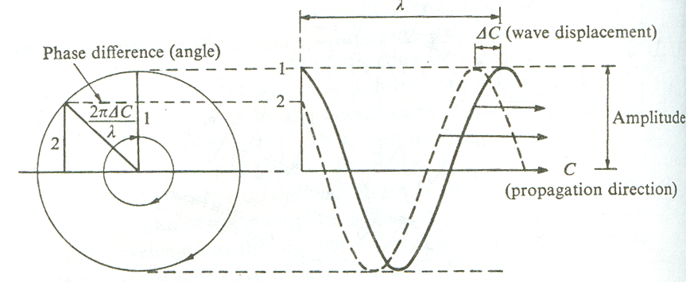

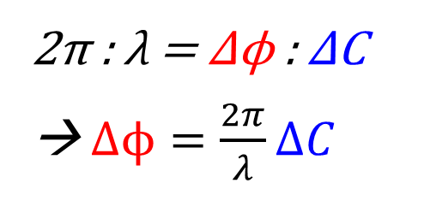
(참고자료) Phase difference (shift), wave displacement
20/57
$$λ$$
2π : λ = Δϕ : ΔC
→ $Δϕ=\frac{2π}{λ}ΔC$

Slide 21


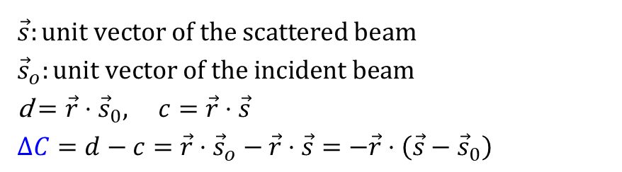


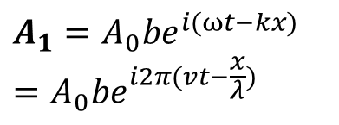


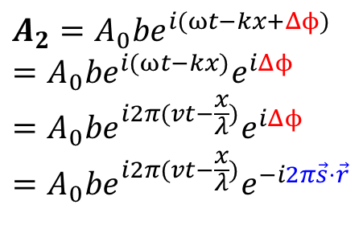

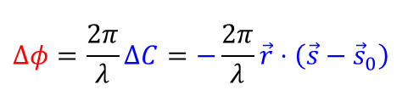


(참고자료) Scattering by X-ray
21/57
$$\vec{s}:\text{unit} \text{vector} \text{of} \text{the} \text{scattered} \text{beam} \\ {\vec{s}}_{o}:\text{unit} \text{vector} \text{of} \text{the} \text{incident} \text{beam}$$
d $=\vec{r}⋅{\vec{s}}_{0}, c=\vec{r}⋅\vec{s}$
$$ΔC=d−c=\vec{r}⋅{\vec{s}}_{o}−\vec{r}⋅\vec{s}=−\vec{r}⋅\left(\vec{s}−{\vec{s}}_{0}\right)$$
$$Δφ=\frac{2π}{λ}ΔC=−\frac{2π}{λ}\vec{r}⋅\left(\vec{s}−{\vec{s}}_{0}\right)$$
$$A_{2}=A_{0}{be}^{i(ωt−kx+Δϕ)}$$
$$=A_{0}{be}^{i(ωt−kx)}e^{iΔϕ}$$
$$=A_{0}be^{i2π(vt−\frac{x}{λ})}e^{iΔϕ}$$
$$=A_{0}be^{i2π(vt−\frac{x}{λ})}e^{−i2π\vec{s}⋅\vec{r}}$$
$$\vec{s}$$
$${\vec{s}}_{0}$$
d
$$A_{1}=A_{0}{be}^{i(ωt−kx)}=A_{0}{be}^{i2π(vt−\frac{x}{λ})}$$
$$\vec{r}$$
$$\vec{s}$$
$$\vec{q}$$
$(k=2π/λ$, ω=2πν)
$$\vec{q}$$
c
$${\vec{s}}_{0}$$
2θ
$${\vec{s}}_{0}$$

Slide 22
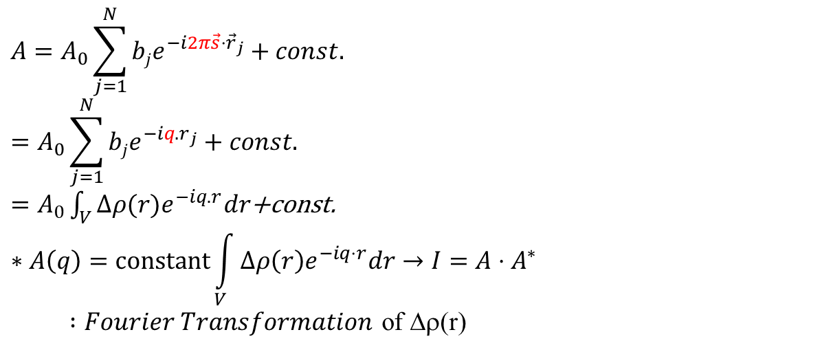
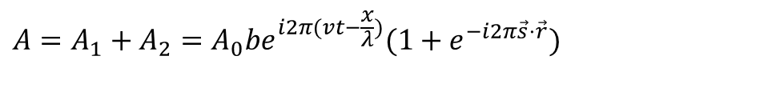

(참고자료) Scattering by X-ray
At the detector,
$$A=A_{1}+A_{2}=A_{0}be^{i2π(vt−\frac{x}{λ})}(1+e^{−i2π\vec{s}⋅\vec{r}})$$
$$A=A_{0}b \left(1+e^{−i2π\vec{s}⋅\vec{r}}\right)$$
For N scatterers,
$$A=A_{0}\sum_{j=1}^{N}{bje^{−i2π\vec{s}⋅{\vec{r}}_{j}}}+const.$$
$$=A_{0}\sum_{j=1}^{N}{bje^{−iq.r_{j}}+const.}$$
$=A_{0}\int_{V}{Δρ(r)e^{−iq.r}dr}$+const.
$$∗A\left(q\right)=\text{constant}\int_{V}{Δρ\left(r\right)e^{−iq⋅r}dr}→I=A⋅A^{∗}$$
$:Fourier Transformation$ of Δρ(r)
Δρ(r): (SLDD, scattering length density distribution)

Slide 23
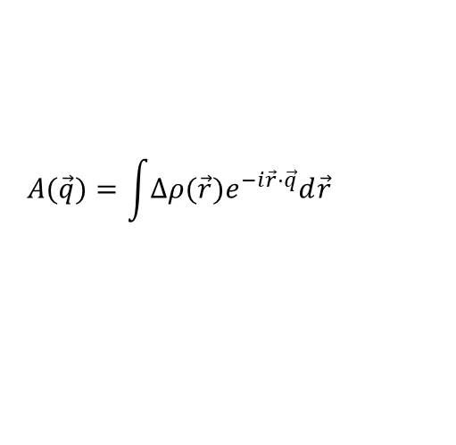
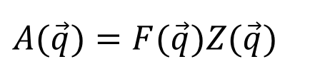






Information from SAXS
23/57
Scattering length density
(electron density)
$$A(\vec{q})=\int{Δρ(\vec{r})e^{−i\vec{r}⋅\vec{q}}d\vec{r}}$$
Scattering amplitude
FT
$$A(\vec{q})=F(\vec{q})Z(\vec{q})$$
$$ρ(\vec{r})$$
IFT
Form factor term
Structure factor term
Autocorrelation
$$Γ_{ρ}(\vec{r}) \\ =V\left\langle ρ(\vec{u})ρ(\vec{u}′)\right\rangle \\ =\int{ρ(\vec{r})ρ(\vec{u}+\vec{r})d\vec{u}}$$
X
Squaring
X
$I(\vec{q})$ $=A(\vec{q})⋅A^{∗}(\vec{q})$
Autocorrelation function
$$I(\vec{q})=\int{Γ_{ρ}(\vec{r})e^{−i\vec{r}⋅\vec{q}}d\vec{r}}$$
FT
$$Γ_{ρ}(\vec{r})$$
$$I(\vec{q})=N_{p}{\left(Δρ_{p}\right)}^{2} P\left(q\right)S(q)$$
IFT
Scattering intensity
Real space
Reciprocal space

Slide 24



Autocorrelation function
24/57
$$I(\vec{q}) \\ =\left\langle {\left|A(\vec{q})\right|}^{2}\right\rangle =A(\vec{q})⋅A^{∗}(\vec{q}) \\ =\left\langle {\left|\int{ρ(\vec{r})e^{i\vec{r}⋅\vec{q}}d\vec{r}}\right|}^{2}\right\rangle =A(\vec{q})⋅A^{∗}(\vec{q}) \\ =\left[\int{ρ(\vec{u})e^{i\vec{u}⋅\vec{q}}d\vec{u}}\right]\left[\int{ρ(\vec{u}′)e^{−i\vec{u}′⋅\vec{q}}d\vec{u}′}\right] \\ =\left[\int{ρ(\vec{u})e^{i\vec{u}⋅\vec{q}}d\vec{u}}\right]\left[\int{ρ(\vec{r}+\vec{u})e^{−i(\vec{r}+\vec{u})⋅\vec{q}}d\vec{r}}\right] \\ =\int{\left[\int{ρ(\vec{u})ρ(\vec{r}+\vec{u})d\vec{u}}\right]e^{−i\vec{r}⋅\vec{q}}d\vec{r}} \\ =\int{Γ_{ρ}(\vec{r})e^{−i\vec{r}⋅\vec{q}}d\vec{r}}$$
$$\vec{u}′=\vec{r}+\vec{u} \\ d\vec{u}′=d\vec{r}$$
autocorrelation function of ρ(r)

Slide 25






Physical meaning of autocorrelation function
25/57
$$Γ_{ρ}(\vec{r}) \\ =V\left\langle ρ(\vec{u})ρ(\vec{u}′)\right\rangle \\ =\int{ρ(\vec{u})ρ(\vec{u}+\vec{r})d\vec{u}}$$
$$\vec{r}$$
→ Correlation between the electron density distributions at two given positions.
$$\vec{u}$$
$${\vec{u}}^{′}=\vec{u}+\vec{r}$$
$$O$$
Γ_{ρ}(r) is related to the average of ρ(u)ρ(u’),
$$\left\langle ρ(\vec{u})ρ(\vec{u}′)\right\rangle =\frac{\int{ρ(\vec{u})ρ(\vec{u}+\vec{r})}}{\int{d\vec{u}}}=\frac{Γ_{ρ}(\vec{r})}{V}$$
→ Γ_{ρ}(r) specifies how the densities ρ(u) and ρ(u’) in neighboring regions separated by r are correlated to each other on the average.

Slide 26



Normalized Autocorrelation function
26/57
$$Γ_{ρ}(\vec{r}) \\ =V\left\langle ρ(\vec{u})ρ(\vec{u}′)\right\rangle \\ =\int{ρ(\vec{r})ρ(\vec{u}+\vec{r})d\vec{u}} \\ =\int{\left[η(\vec{u})+\left\langle ρ\right\rangle \right]\left[η(\vec{u}+\vec{r})+\left\langle ρ\right\rangle \right]d\vec{u}} \\ =\int{η(\vec{u})η(\vec{u}+\vec{r})d\vec{u}}+{\left\langle ρ\right\rangle }^{2}\int{d\vec{u}}+\left\langle ρ\right\rangle \int{η(\vec{u})d\vec{u}}+\left\langle ρ\right\rangle \int{η(\vec{u}+\vec{r})d\vec{u}} \\ ≈\int{η(\vec{u})η(\vec{u}+\vec{r})d\vec{u}}+{\left\langle ρ\right\rangle }^{2}V \\ ≈Γ_{η}(\vec{r})+{\left\langle ρ\right\rangle }^{2}V$$
$η(\vec{u})=ρ(\vec{u})−\left\langle ρ\right\rangle$
η($\vec{u}$): relative electron density
=0 (by the definition of η(r)
Meaningful only r is of the same order of magnitude as the sample dimension; macroscopic dimension
$$⇒Γ_{ρ}(\vec{r})≈Γ_{η}(\vec{r})+{\left\langle ρ\right\rangle }^{2}V \\ I(\vec{q})=\int{Γ_{η}(\vec{r})e^{−i\vec{q}\vec{r}}d\vec{r}+{\left\langle ρ\right\rangle }^{2}Vδ(\vec{q})}$$
Null scattering or scattering at q=0
Experimentally unobservable

Slide 27


Autocorrelation function
27/57
1.
$$I(\vec{q})=\int{Γ_{ρ}(\vec{r})e^{−i\vec{q}\vec{r}}d\vec{r}}\begin{matrix} & vs. & \end{matrix}I(\vec{q})=\int{Γ_{η}(\vec{r})e^{−i\vec{q}\vec{r}}d\vec{r}}$$
$$Γ_{ρ}(\vec{r}→∞)=\left\langle ρ(\vec{u})\right\rangle \left\langle ρ(\vec{u}′)\right\rangle V=\left\langle ρ\right\rangle V≠0 \\ Γ_{η}(\vec{r}→∞)=\left\langle η\right\rangle V=0$$
2. Autocorrelation function approach
What determines the strength and pattern of scattering from a sample is not the absolute value of the scattering length density but rather the fluctuations or the heterogeneities in the scattering length density present in the sample. The absolute value of the scattering length density governs the intensity of the null scattering, which is of course unmeasurable and therefore has no practical meaning. If we are to increase the scattered intensity from a sample for case of measurement, we have to increase the contrast in the scattering length density among different molecules, species, or regions in the sample.
*Babinet’s Reciprocity Principle: All produce identical I_{obs}(q)

Slide 28

Correlation functions
28/57
Totally disordered system
Amorphous system
Monoatomic liquid or paracrystalline state
Close-packed crystal

Slide 29




𝜌(𝑟) & $Γ_{ρ}$(𝑟) of lamellar structure
Ideal ordering
Long period change
Crystal thickness change

Slide 30


Pair distance distribution function (PDDF)
30/57
$$I(q)=4π\int_{0}^{∞}{p\left(r\right)\frac{\sin{q}r}{qr}dr}→p\left(r\right)=\frac{1}{2π^{2}}\int_{0}^{∞}{I\left(q\right)⋅qr⋅\sin{q}r dq} \\ p\left(r\right)=r^{2}γ\left(r\right)≡r^{2}Δ{\tilde{ρ}}^{2}\left(r\right) \\ =r^{2}\underset{\begin{aligned}\text{self}\text{−}\text{convolution} \text{of} \\ \text{density} \text{distribution} \text{function}\end{aligned}}{\underbrace{\int_{V}{Δρ\left(r_{1}\right)Δρ\left(r_{1}−r\right)dr_{1}}}}$$
$\text{Pair} \text{distance} \text{distribution} \text{function} (\text{PDDF}):$
$\text{P}\text{robability} \text{finding} \text{the} \text{scattering} \text{elements} \text{separated} \text{by} \text{r}$

Slide 31



Scattering Intensity & Pair distance distribution function
31/57
Form factor
PDDF
Core-shell structure
Particle’s SHAPE
Distribution of distances of atoms from centroid
1D: only distance, not direction
20:1 = q_{min} : q_{max} → usually OK
p(r) → alternative measure of R_{g} and also longest cord

Slide 32



Scattering Intensity & Pair distance distribution function
32/57
Scattering Intensity (Form factor)
Pair distance distribution function
Particles

Slide 33


Invariant
33/57
The invariant Q is defined as the quantity obtained when I(s) is integrated with respect to s throughout the reciprocal space.
$$Q=\int{I(\vec{s})d\vec{s}}=\frac{1}{(2π)^{3}}\int{I(\vec{q})d\vec{q}}$$
An isotropic material for which I(s) depends only on the magnitude of s.
$$Q=4π\int{s^{2}I(\vec{s})d\vec{s}}=\frac{1}{2π^{2}}\int{I(\vec{q})d\vec{q}}$$
The invariant Q can be regarded as representing the overall scattering powder of the sample that takes into account the intensity of scattering that is expected from it under all possible scattering geometry.
$$Q=\int{Γ_{ρ}(r)\left[\int{e^{−2πsr}ds}\right]dr=\int{Γ_{ρ}(r)δ(r)dr=Γ_{ρ}(0)}}=\left\langle ρ^{2}\right\rangle V$$
Analyze the size distribution of the sample and the interactions between particles.

Slide 34








Fourier Transform (FT)
34/57
Fourier transform
Real
FT
Imaginary
Real
FT
Imaginary
$$A(\vec{q})=\int{ρ(\vec{r})e^{−i\vec{r}⋅\vec{q}}d\vec{r}}$$
FT
FT
ρ(r): scattering length density distribution
$$I=N_{p}{\left(Δρ_{p}\right)}^{2} \underset{\begin{aligned}&Form \\ &Factor\end{aligned}}{\underbrace{P\left(q\right)}}\underset{\begin{aligned}&Structure \\ &Factor\end{aligned}}{\underbrace{S\left(q\right)}}$$
$$S\left(q\right)≈1 \text{for} \text{dilute} \text{solution}$$
size
size, orientation
FT
FT
elongation
shape
FT
FT
facet
orientation
FT
FT
distribution
Courtesy of Byeongdu Lee, APS, ANL (USA)

Slide 35



Reciprocal lattice construction
35/57
Real lattice (crystal planes)
Reciprocal lattice (diffraction spots)
$$G∗=ha^{∗}+kb^{∗}+lc^{∗}$$
y
b*
030
020
b*
d₀₁₀
010
b
a*
a*
a
200
100
000
d₁₀₀
x
Direction of reciprocal lattice
- a* ⊥ (100) plane, b,c-plane of the real lattice
- b* ⊥ (010) plane, a,c-plane of the real lattice
Length of reciprocal lattice
- a* : 1/d₁₀₀
- b* : 1/d₀₁₀
$$\vec{R}=h\vec{a}+k\vec{b}+l\vec{c}$$

Slide 36


Information from SAXS
36/57
1. limit q → 0: Electron density fluctuations
2. Guinier range (0.1<q·R_{g}<1.3)
: particle size
3. Particle shape, large scale structures
4. Porod range : Particle Surface/volume
5. Intermolecular interaction

Slide 37



Sphere sample: Scattering intensity from Form factor
37/57

Slide 38



Spherical Shell sample
38/57

Slide 39



Radius of gyration, Size distribution
39/57
Guinier plot: log (I(q)) vs q2
Size distribution
Gaussian distribution
Distribution ⇧ → fringes missing
O. Glatter & O. Kratky ed., “Small Angle X-ray Scattering”, Academic Press (1982).

Slide 40
Size: Radius of gyration?
40/57
Radius of gyration: R_{g}
R_{g}² is the average squared distance of the scatterers from the centre of the object
2
1
3
1
1
2
Position vector from centre of mass
Ex)
R_{g}² =(1²+ 1²+ 1²+ 2²+ 2²+ 3² )/6=20/6
R_{g}=√3.333 = 1.82
Scattering length density

Slide 41



How to find out R_{g} : Guinier Law
41/57
For q∙R_{g} < 1.3 (Typically)
$$I=I_{0}\exp{(}−\frac{1}{3}q^{2}{R_{g}}^{2}) →\ln{I}=\ln{I_{0}}−\frac{1}{3}q^{2}{R_{g}}^{2}$$
Guinier R_{g} → 41.8 Å
Plot lnI vs q²
→ Straight line, slope –${R_{g}}^{2}$/3
→ True for all shapes (but works best for spheres)
in the range
of q∙R_{g} < 1.3
R_{g} for different objects
Solid sphere radius R: R_{g} = √(3/5) R
Thin rod length L: R_{g} = √(1/12) L
Thin disk radius R: R_{g} = √(1/2) R

Slide 42




Porod’s law
42/57
For a sharp interface, the scattered intensity decreases as q-4.
Combination of Porod’s law & Invariant Q
→ important for the characterization of porous materials!

Slide 43







Dense System
43/57
r_{ij} ≈ λ
→ interparticle interferences are not negligible
r₁₂
$$⊗$$
$$=$$
λ
$$=$$
$$S\left(q\right)$$
$$X$$
P$\left(q\right)$
I$\left(q\right)$
Structure factor
Form factor
Intensity

Slide 44

Dense system: Form factors & Structure Factors
44/57

Slide 45
SAXS more…
45/57
SAXS
Combined measurements with DSC, viscoelasticity, wide q-range
- Hierarchical structure
- Anisotropic structure
Time-resolved SAXS
- Structure evolution, degration
XPCS
-dynamics
- Structure fluctuation
GI-SAXS
- Thin film, orientation, interface, surface
Microbeam SAXS
- Inhomogeneity of nano-structure
- Small area

Slide 46






Applications
46/57
Colloidal System
Biomolecules
Block copolymer
Polymer Micelle
Polymer Membrane
Conjugated Polymer
Hydrogel

Slide 47

1. Block Copolymers : Nanosructure & Phase Behavior
47/57
Nano structure | Peak Ratio
Lamellae | 1:2:3:4
Sphere (fcc) | √3:√4:√8:√11:√12 etc.
Sphere (bcc) | √2:√4:√6:√8:√10 etc.
Gyroid | √6:√8:√14:√16:√20 etc.
Double diamond | √2:√3:√4:√6:√8 etc.
Hexagonal | 1:√3:√4:√7:√12 etc.
Peak | Position | Ratio
1st | 0.24 nm⁻¹ | 1
2nd | 0.48 nm⁻¹ | 2
3rd | 0.72 nm⁻¹ | 3
4th | 0.96 nm⁻¹ | 4
Gyroid
Lamellae
Lamellae
Sphere (fcc)

Slide 48


2. Micro-beam SAXS
48/57
Beam size
- Current : 60 (V) X 450 (H) μm²
- Year 2014 : 20 (V) X 150 (H) μm²
- Future : 8 (V) X 20 (H) μm²
* Low-voltage Actuator

Slide 49




3. Colloid study by Rheo-SAXS
49/57
Shear Alignment
Radial direction
Tangential direction
Shear Aligning
Shear rate (1/sec)
Shear rate (1/sec)

Slide 50





4. Nanostructure during battery cycling: Li-ion Battery (in-operando)
50/57
Li-ion Battery In-operando SAXS
meso-TiO₂ electrode
meso-Co₃O₄ electrode
meso-SnO₂ electrode
→ LiSnO₂

Slide 51


5. Orientation evolution by Tensile Experiment of PCL
51/57
in-situ Tensile Experiment (Tr-mode)
Linkam Tensile stress testing system
In-situ SAXS & WAXD patterns of PCL

Slide 52

6. Micro-fiber Structure Analysis (1)
52/57
PEDOT-PSS Single Fiber (Dia. 30 μm)

Slide 53

6. Micro-fiber Structure Analysis (2)
53/57
PEDOT-PSS Single Fiber (Dia. 30 μm)

Slide 54

Data analysis : Model Fitting
54/57
Data analysis software ATSAS 3.2.1
https://www.embl-hamburg.de/biosaxs/software.html

Slide 55


Data analysis : Model Fitting
55/57
https://www.nist.gov/ncnr/data-reduction-analysis/sans-software
https://usaxs.xray.aps.anl.gov/software/irena

Slide 56

Conclusion
56/57
1. Synchrotron SAXS Beamlines → Various applications
2. SAXS → Structure-Property Relationship → New Material Design & Synthesis
3. in-situ Experiments → Many issues, Operando, Understanding & Process Optimization
Future works : More in-situ experiments, issue solving, combined techniques, automatic analysis software…
Electromagnetic radiation (synchrotron radiation) is given off when very high energy charged particles are accelerated.
e-
Synchrotron radiation
Bending Magnet
Synchrotron radiation

Slide 57

57/57
PLS-II
PAL-XFEL
Thank You
for your Attention!!!
Tae Joo Shin
tjshin@unist.ac.kr

